Slide 1
Telenor use case: “Unsupervised Anomaly Detection for Telenor Network Data”
Hackathon 2021: 12-14 March
Sara Malacarne - Telenor Research

Slide 2

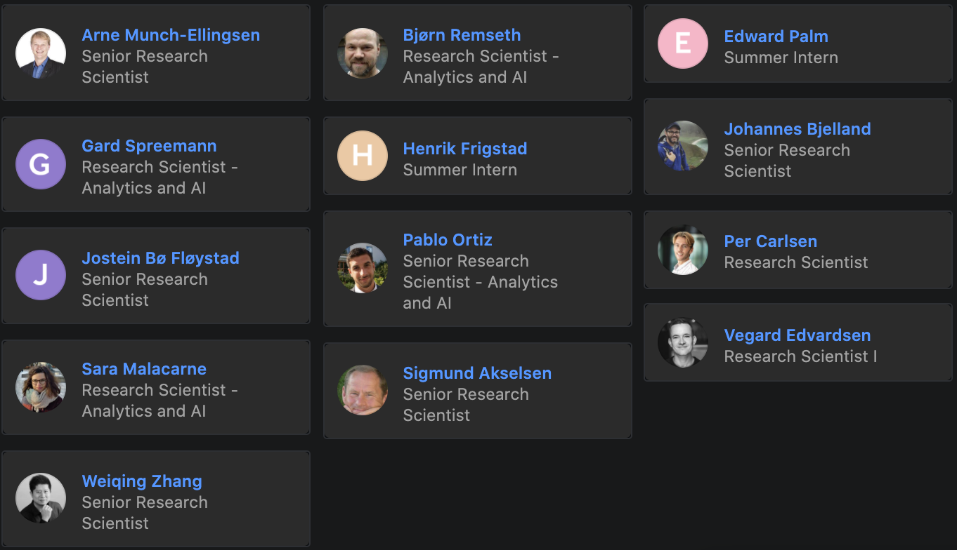
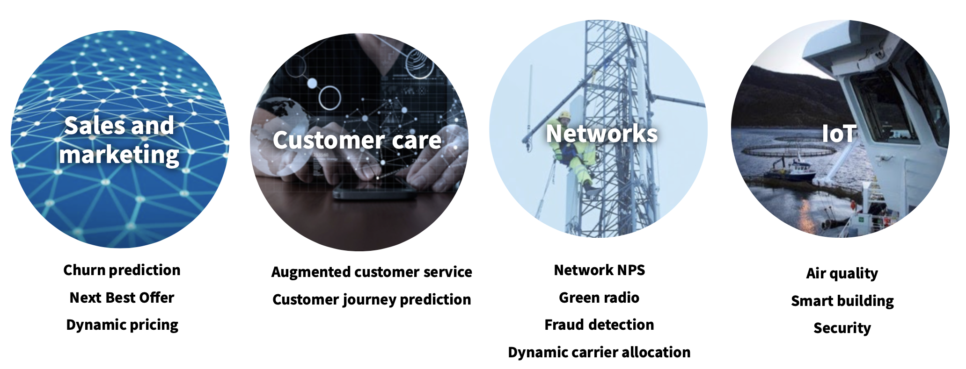
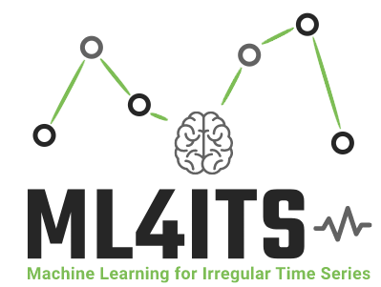
Telenor Research
Analytics and AI team
Machine Learning for Irregular Time Series
Notes:
Time series are everywhere

Slide 3
Unsupervised Anomaly Detection for the RAN dataset
What is the RAN?
The Radio Access Network (RAN) is the part of a telecom system that connects individual devices (phones, computers, ect) to the Core Network.
The Core Network is the central element of the telecom system which provides services to customers connected to the network, such as routing of calls, downloading/uploading data and many more.
Different types of RAN:
GRAN/GERAN or GSM RAN (2G)
UTRAN, or UMTS RAN (3G)
E-UTRAN, or LTE RAN (4G)
Notes:
Two use cases that we bring into ML4ITS in Network proposed by Telenor Denmark who will share data with us.
The first pair of use cases fall under the network proactive maintenance and zero touch operation category and concern the detection of anomalies and failures in the NW.
Anomalies mean incidents. We deal here with multivariate time series so what is considered anomalous is not so straight forward to detect. Furthermore, baseline models exist, which can capture the obvious anomalies but state of the art models are needed to advance in the detection. (for example GANs or other)
Also an understanding of why the incidents occur, in terms of network features fed into the model is of vital/very high importance in order to intervene. This connects well to the UNCERTAINTY topic of the project
And again, if anomalies are detected, find a way to “grade them” in terms if features they depend on so one can prioritise certain alarms more than others (i.e. give a plan of action - again uncertainty studies)
Failure prediction is another use case for which anomalous/concerning performance TRENDS have to be identified.
As before, this has to be understood in terms of the features fed into the models to trigger action so that customers are not impacted. Moreover, if the failures are due to high traffic, highlight the areas where some upgrades should be needed, also in a proactive way, by capacity forecasting.
The exact position of the network cells is given so we not only have thousands of multivariate time series at our disposal, but also the topological information ( interesting from graph perspective)

Slide 4
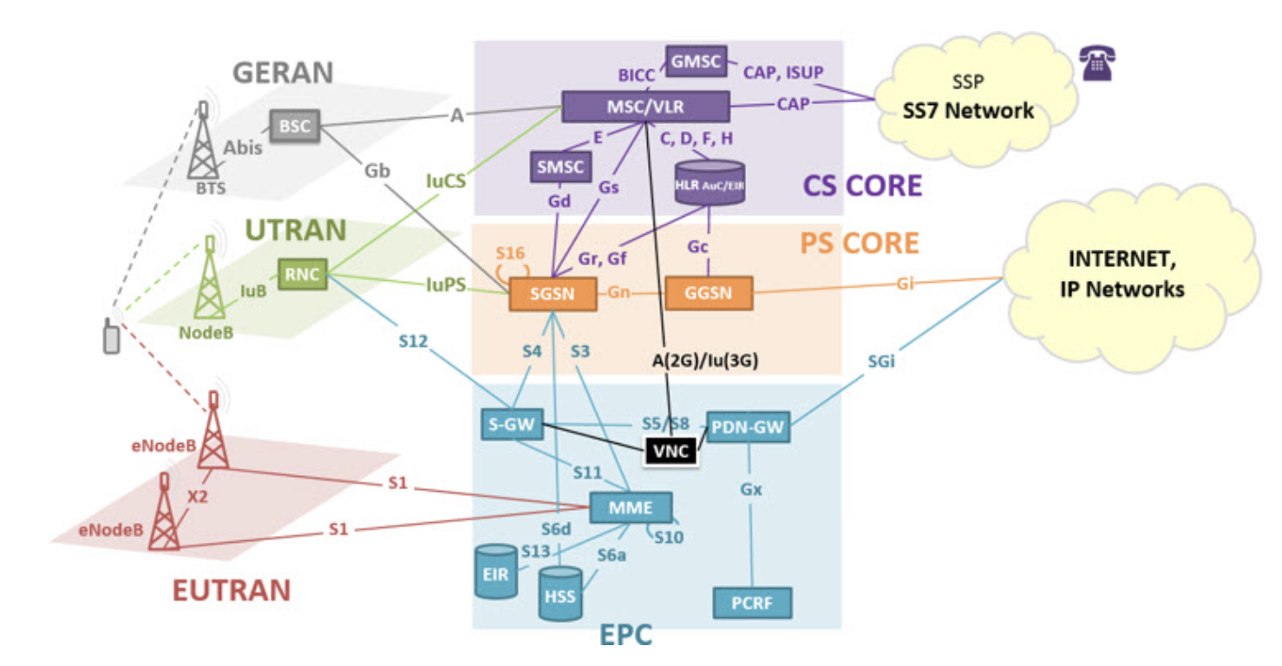
- 2G
- 3G
- 4G
Radio Access Network
Core Network
Network
Telecommunication System
Notes:
Two use cases that we bring into ML4ITS in Network proposed by Telenor Denmark who will share data with us.
The first pair of use cases fall under the network proactive maintenance and zero touch operation category and concern the detection of anomalies and failures in the NW.
Anomalies mean incidents. We deal here with multivariate time series so what is considered anomalous is not so straight forward to detect. Furthermore, baseline models exist, which can capture the obvious anomalies but state of the art models are needed to advance in the detection. (for example GANs or other)
Also an understanding of why the incidents occur, in terms of network features fed into the model is of vital/very high importance in order to intervene. This connects well to the UNCERTAINTY topic of the project
And again, if anomalies are detected, find a way to “grade them” in terms if features they depend on so one can prioritise certain alarms more than others (i.e. give a plan of action - again uncertainty studies)
Failure prediction is another use case for which anomalous/concerning performance TRENDS have to be identified.
As before, this has to be understood in terms of the features fed into the models to trigger action so that customers are not impacted. Moreover, if the failures are due to high traffic, highlight the areas where some upgrades should be needed, also in a proactive way, by capacity forecasting.
The exact position of the network cells is given so we not only have thousands of multivariate time series at our disposal, but also the topological information ( interesting from graph perspective)

Slide 5
Structure of the Base Stations
Base stations or sites
Sectors
Cells grouped in capacity layer and coverage layer
2600 MHz
Capacity layer
1800 MHz
Frequencies | Technology | Layer
2600MHz | 4G | capacity
2100MHz | 4G-3G | capacity
1800MHz | 4G-2G | capacity/coverage
900MHz | 4G-3G-2G | coverage
800MHz | 4G | coverage
Coverage layer
800 MHz
Sector
LTE site

Slide 6
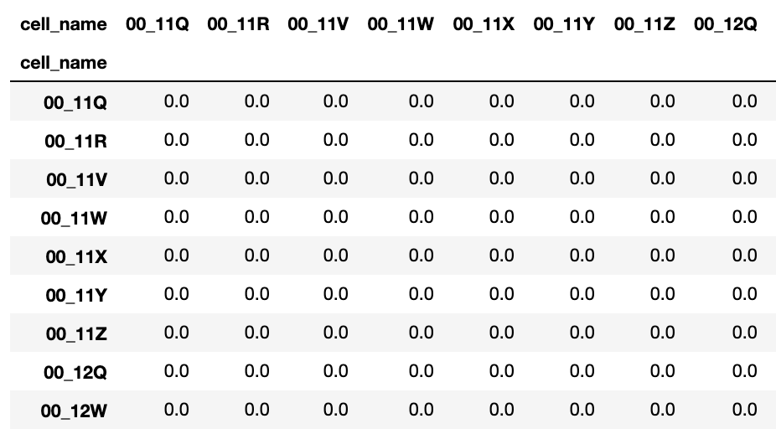
Datasets provided:
RAN dataset counters
Availability/Unavailability of the cell (planned or unplanned)
Bandwidth
Voice related counters(drop rate, setup failure rate, number of voice attempts)
Data related counters(drop rate, setup failure rate, number of data attempts)
Throughput rate (estimate of the resource allocated x user)
Handover failure rate
Relative distance matrix
Notes:
Bandwidth describes the maximum data transfer rate of a network or Internet connection.

Slide 7
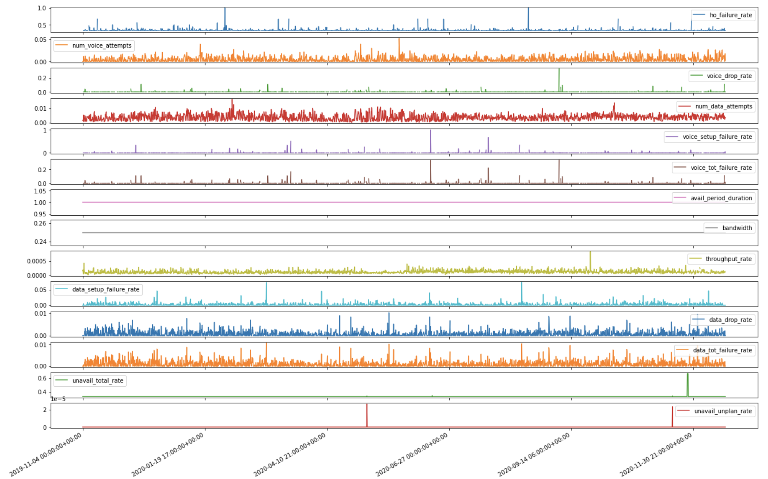

Slide 8
Main Task
Automatic Detection and Visualization of anomalies in the data (i.e. spikes, sudden drops, trend anomalies)
Keep in mind:
Correlations between features are important! (e.g. a peak in the number of data/voice attempts might be an indication of a misconfiguration of parameters in the network BUT if it also correlates with the other counters it might only mean that there is a sudden increase in the traffic)
The topological information of the position of the sites can be useful in filtering out the “false” anomalies.
Not all anomalies are business concerning (e.g. a peak in the throughput rate is an anomaly but positive for the Operator)
Some anomalies could be connected to missing data, important to filter these out.

Slide 9
Main Task - Evaluation Criteria
Presentation/visualization of the anomalies time series (quality)
Creativity/quality of the proposed solution
Use of contextual data (i.e., topology, correlation between time series and locations)
Model performance (you will be given a list of true anomalies)

Slide 10






ML4ITS - Machine Learning for Irregular Time Series
Industrial time-series are much more challenging
varying sampling frequencies;
high level of noise that do not follow standard statistical distributions;
heterogeneity;
lack of gold-standard labelling for classification tasks.
ML4ITS will develop new AI and Deep Learning-based technologies for such irregular time-series, that will significantly advance the state of the art within transfer learning, unsupervised learning, and data augmentation
http:\\ml4its.github.io
Notes:
ML4ITS will provide data analysis solutions for time-series collected during real-life industrial operations. Industrial time-series are much more challenging than the thoroughly cleaned and curated time-series used as benchmarks by the ML community, presenting properties such as size (having only short series makes the learning of the dynamics difficult); varying sampling frequencies; high level of noise that do not follow standard statistical distributions; heterogeneity; lack of gold-standard labelling for classification tasks. ML4ITS will develop new AI and Deep Learning-based technologies for such irregular time-series, that will significantly advance the state of the art within transfer learning, unsupervised learning, and data augmentation.
Among those cases we have time series classification, forecasting and anomaly detection

Slide 11
ML4ITS - Machine Learning for Irregular Time Series
Looking for Master Students (2021/2022)!
Motivation: There are two main types of anomalies that are desirable to detect: 1) point anomalies and 2) trend anomalies. The latter, corresponding to failures in the Network, are especially hard to recognise, as they do not differ much from the “normal” situation A possibility is to leverage on the correlations between the time series components and also use the topological information on the location of the base stations, in order to discover them.
Task: In this thesis, the student(s) will explore the capabilities of Deep models such as Graph Neural Networks (GNNs) and/or Generative Adversarial Networks (GANs) for the task of anomaly detection. In particular the student(s) will:
Explore the state of the art in use of Deep Learning for Anomaly Detection for both the univariate and the multivariate case
Implement a set of strong baselines
Propose one++ GNN/GAN based solution for Anomaly Detection on Telco data, leveraging on the correlations between the multivariate time series components and spatial correlations between the neighbouring base stations.
Main Supervisor: Massimiliano Ruocco (NTNU/Sintef Digital) [massimiliano.ruocco@ntnu.no]
Co-Supervisor: Sara Malacarne (Telenor Research) [sara.malacarne@telenor.com]

