Slide 1
Model Transformation
Patrick Stünkel – 03/02/21

Slide 2
Agenda
Motivation: Why do we need model transformation in MDE?
Classification of Model Transformations
Model-to-Text
Model-to-Model
Standards and tools
Bidirectionalization
Exercises

Slide 3
https://github.com/webminz/mt-lecture

Slide 4
Remember: Software Development Process
Analysis
Design
Implementation
Test
Deployment
Operation
Abstraction

Slide 5
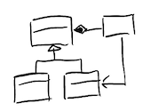
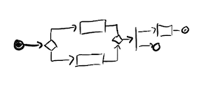
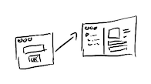
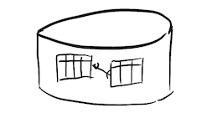
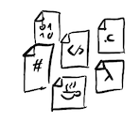

Entities & Concepts
Process Descriptions
Mockups
Abstraction
?
Database
Code
User Interfaces

Slide 6
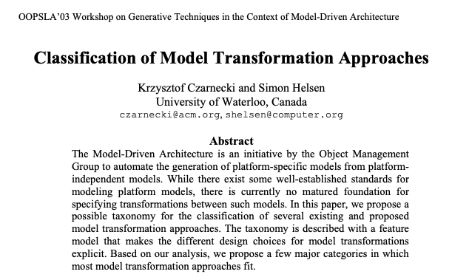
Model Transformation to the Rescue!
[Czarnecki & Helsen, 2003]

Slide 7
Model Transformation (MT) - Taxonomy
model-to-model
homogeneous
vs.
type
format
vs.
model-to-text
heterogeneous
MT
in-place
imperative
vs.
scope
definition
vs.
out-place
declarative
Def: “A program that takes one or more models as input and produces one or more models as output” [Brambilla et. al.]

Slide 8
Examples
Generate SQL DDL (CREATE TABLE) statements from annotated Java Classes (model-to-text, out-place, heterogenous)
Translate a UML-Activity Diagram into a BPMN diagram (model-to-model, out-place, heterogeneous)
Rename all occurences of an element in a Simulink diagram (model-to-model, in-place, homogeneous)
More survey papers:
“A Taxonomy of Model Transformation” [Mens & van Gorp, 2006]
“Survey and classification of model transformation tools” [Kahani et. al.,2018]

Slide 9
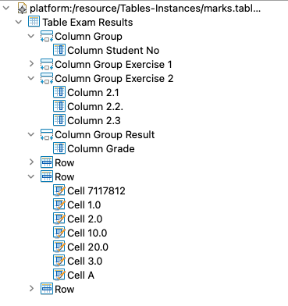
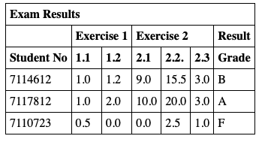
Getting Started: Model-to-Text
Checkout: https://github.com/webminz/mt-lecture
Open metamodels-ws as a workspace in a recent Eclipse (>= 2020-06) with Epsilon(https://www.eclipse.org/epsilon/) installed
From within, launch runtime-eclipse and use model-ws as workspace

Slide 10

Discussion: MT-tool vs. Direct Coding
Of course you can always program it in {your favourite PL here}
...But then you must also implement...
...A Parser infrastructure for your model format
...A code-generationg/templating engine
...And the logic of the transformation itself
Or you use existing tools!
E.g.: Epsilon, in particular:
EOL: Epsilon Object Language
EGL: Epislon Generation Language
ETL: Epsilon Transformation Language
There are also other tools (more on that in the end)

Slide 11
EOL
Foundation for everything you do in Epsilon
imperative Programming Language
mix of JavaScript and OCL
Builtin primitives for working with models
for (c in Column.all) {
c.name.println();
}
var n : new Column();
n.name = “New Column”;
n.table = Table.all().first();
var cells = Row.all().collect(r|
r.cells.select(c|c.column = n));

Slide 12
EGL
Writing
String result = “<!DOCTYPE html>\n”;
result += “<html>\n”;
result += “<head>\n”;
...
quickly becomes really cumbersome!
Thus => Templates
Other Examples: Apache Velocity, Java Server Pages (JSP), C# Active Server Pages (ASP)...

Slide 13

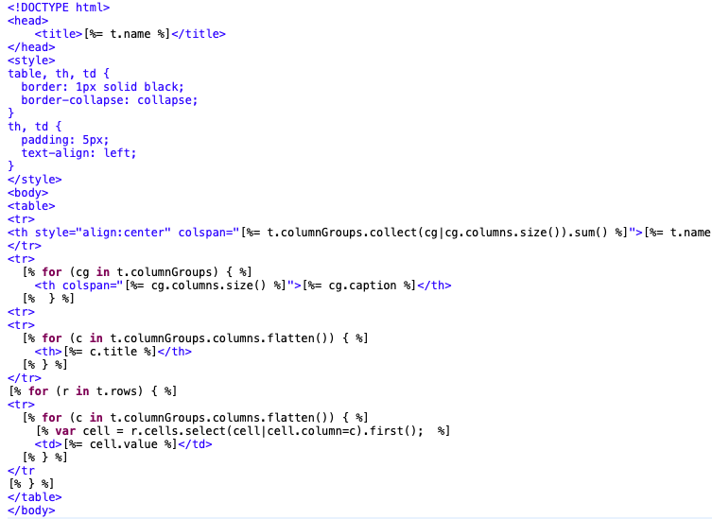
EOL expressions [%= ... %]
EGX rule
calls
Control Structures (for,var...)
EGL template

Slide 14
Incrementality
Model v.1.0
gen
Code v.1.0
manual changes
manual changes
Model v.2.0
gen
Code v.1.1
overwrite!
Protected Regions (out.startPreserve()/out.stopPreserve()) or
Keep generated and hand written stuff separated or
Extend your metamodel or
Implement automated merging of generated and hand written code

Slide 15
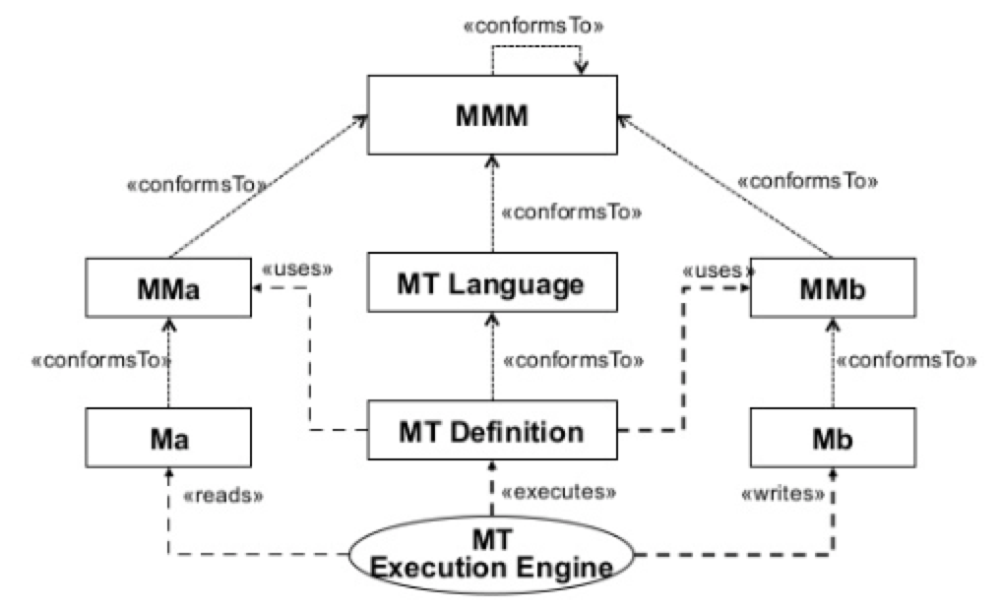
Next up: Model-to-Model Transformation

Slide 16
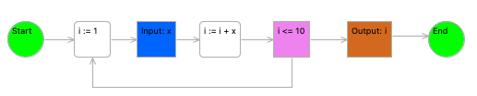
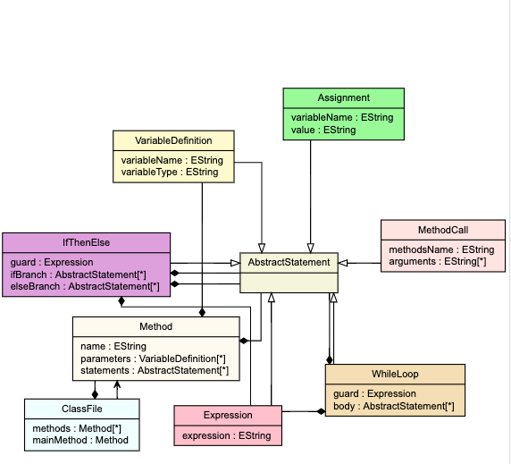
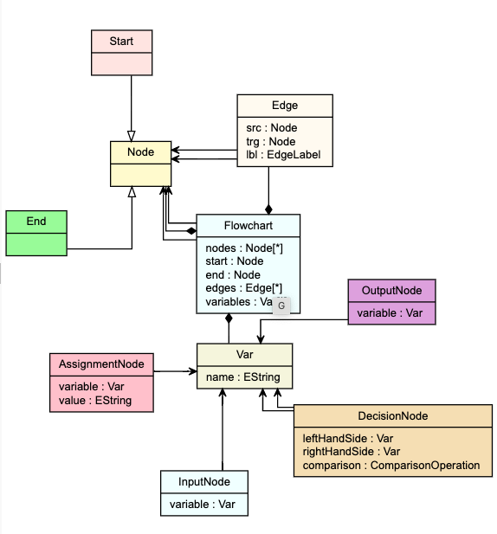
Motivation: Flow Chart to Java
public class MyFlow {
public static void main(String[] args) {
int i = i;
do {
int x;
x = readln()
i = i +x;
} while (i <= 10)
println(i);
}
}
EGL
Template
Graphical
Editor
?!

Slide 17
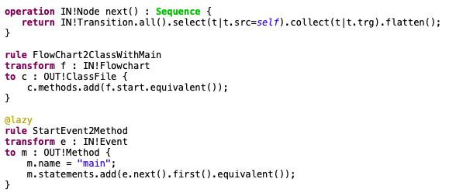
ETL
hybrid transformation language = mix of imperative and declarative
reuse existing EOL expressions or define your own
rules
matching pattern
creation pattern
equivalent
lazy rule
imperative EOL statement block

Slide 18
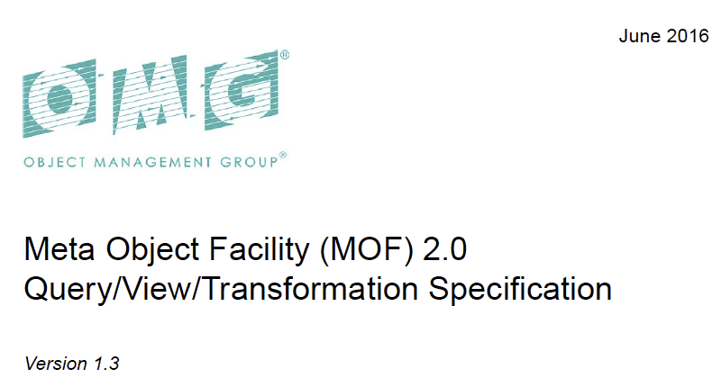
QVT: The flawed standard
Envisaged 2002 for MDA, first version 2005, most recent version 2016
Standard for the definition of Queries, Views and Transformation on models
Comprises sub-specifications: QVT-operational (imperative) and QVT-relational (declarative)
Lacks (especially QVT-r) precise execution semantics
Hence: Still no default implementation!
“Bidirectional model transformations in QVT: semantic issues and open questions” [Stevens, 2010]

Slide 19
Tools
Epsilon
Xtend (imperative,Xtext ecosystem): https://www.eclipse.org/xtend/
ATL (hybrid, ATL/Obeo/Acceleo ecosystem): https://www.eclipse.org/atl/
Henshin (declarative, graph based): https://www.eclipse.org/henshin/
Viatra (hybrid, reactive): https://www.eclipse.org/viatra/
eMoflon (declarative, (triple) graph based): https://emoflon.org/
.NET Modeling Framework (hybrid, for .NET): https://archive.codeplex.com/?p=nmf

Slide 20
Further Challenges: Bidirectionalization
How do we trace transformations over time?
Can we sometimes invert the transformation direction?
“equivalent()”
MM_A
A2B Def
MM_B
M_a
a2b trace
M_b
Source
gen
Target
???

Slide 21
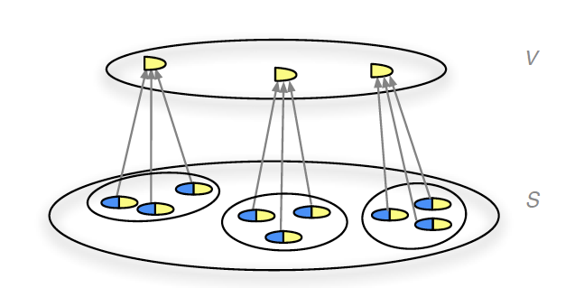
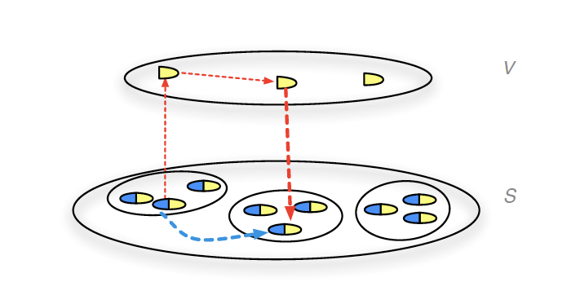
Bidirectional Transformations (BX)
Asymetric Lenses
Want to learn more?
“Introduction to Bidirectional Transformations” [Abou-Saleh et. al., 2010]
ask me past@hvl.no ;-P
GET
PUT

Slide 22
Exercises
https://github.com/webminz/mt-lecture/exercises/exercise.pdf

