Slide 1
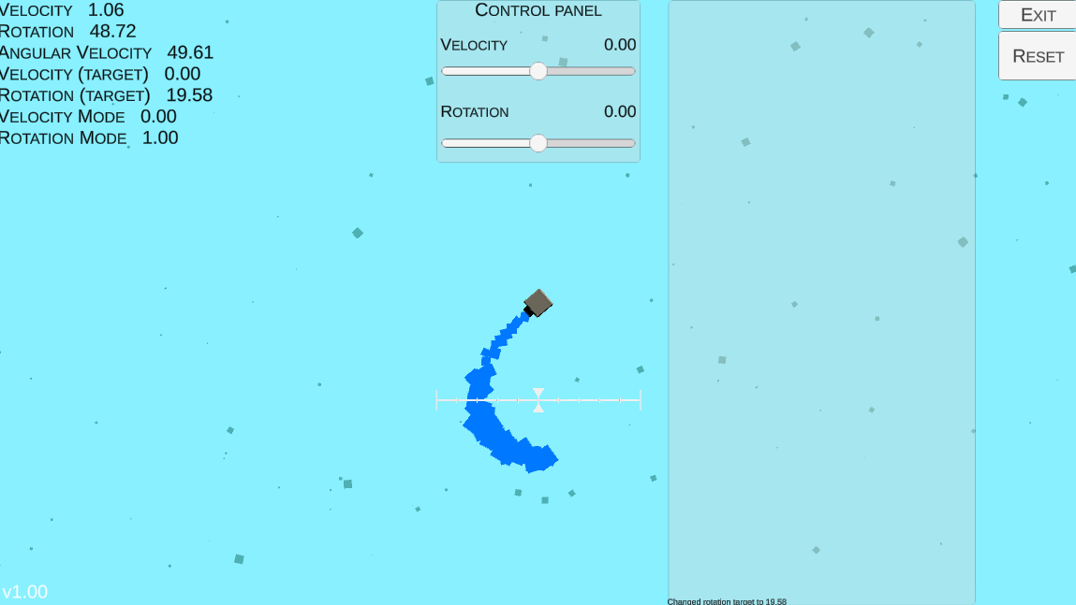
Dummy environment

Slide 2
Dummy environment
State (7) raw
velocity
rotation
angular velocity
velocity target
rotation target
velocity mode
rotation mode
Action (m=1)
Continuous rotational torque
DEMO (manual control)
State (n=2) preprocessed
delta rotation
angular velocity

Slide 3
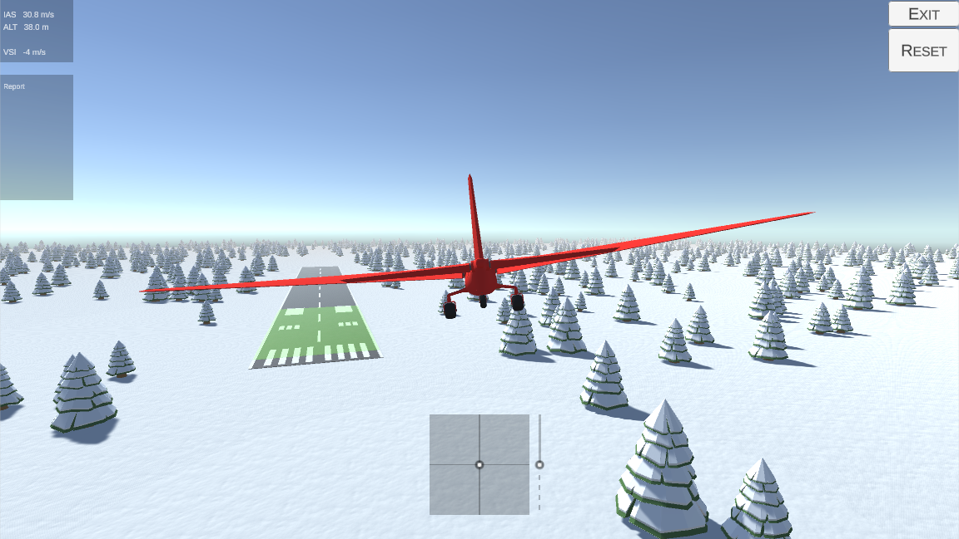
Flight environment - design

Slide 4
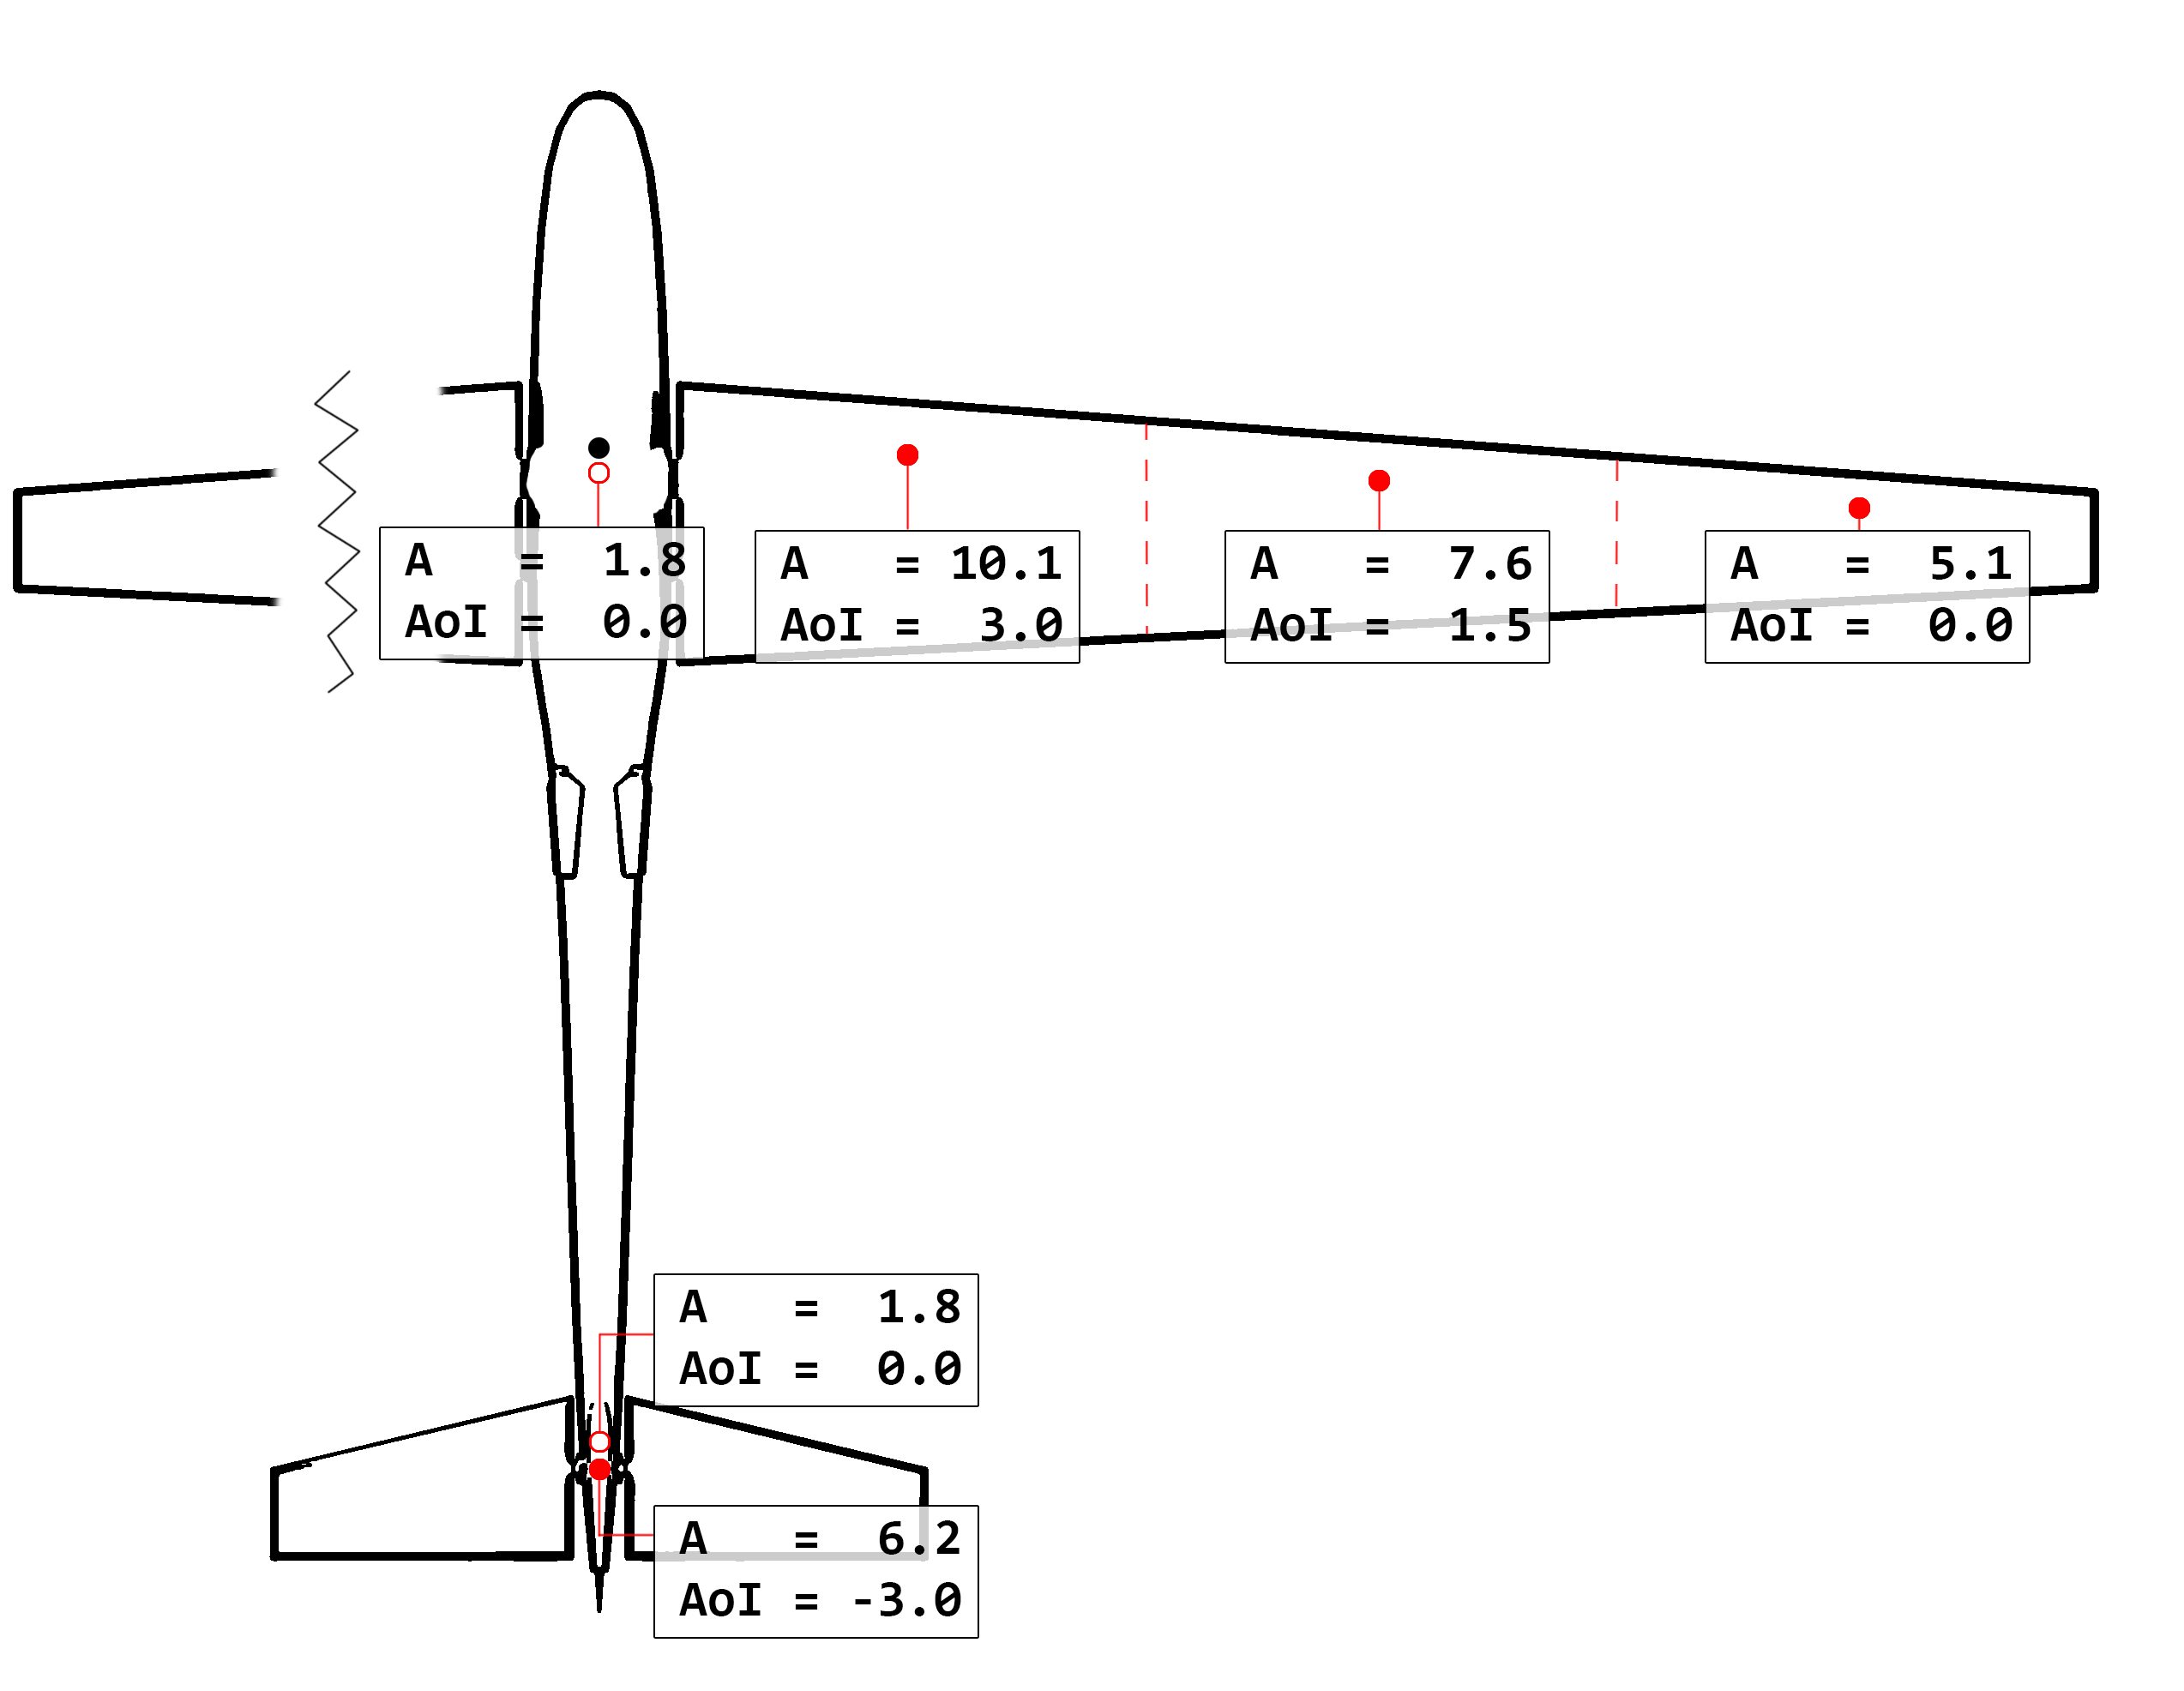
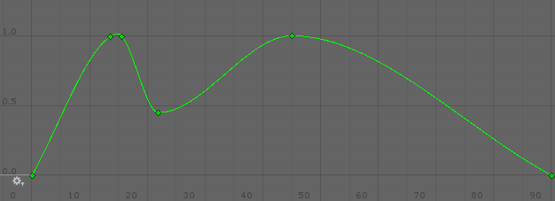
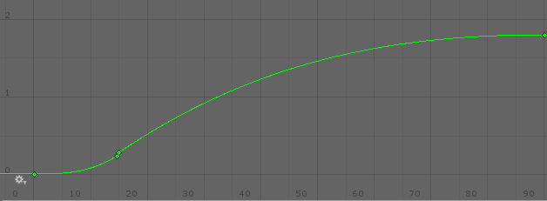
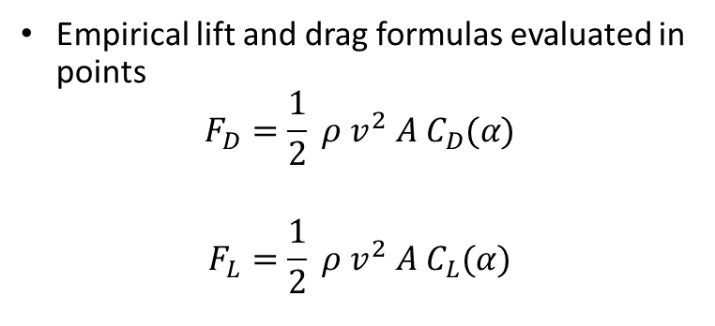
Flight environment – wing calculations
Empirical lift and drag formulas evaluated in points
$$F_{D}=\frac{1}{2} ρ v^{2} A C_{D}(α)$$
$$F_{L}=\frac{1}{2} ρ v^{2} A C_{L}(α)$$

Slide 5
Flight environment - demo
DEMO

Slide 6
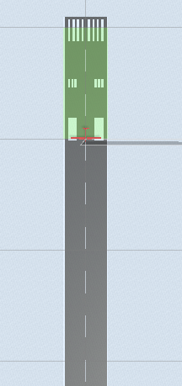
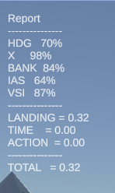
Flight environment – reward function
Touch-down score criteria
IAS (speed)
VSI (vertical speed)
X (center-line deviation)
HDG (heading deviation)
Bank

