Slide 1

Analyse von neuronal networks und climate change temperature data
Gruppe:
Torge Schwark
Joschua Quotschalla

Slide 2
Übersicht
Data-Loader Pipelinne
Visualisierungen
Performance Architekturen
Daten Normalisierung
Varianz Input-Sequenz
Fazit

Slide 3
Data-Loader Pipeline Original
def data_generator( batch_size, is_train, augmenation):
path = DATA_PATH_PROCESSED
all_files = sorted(glob.glob(path + '*.txt'))
while True:
inputs, labels = select_data(batch_size, all_files, is_train, augmenation)
#Data Augmentation
mu = 0
sigma = 0.0
rnd = np.random.normal(mu, sigma, size=inputs.shape)
inputs += rnd
yield inputs, labels
def parse_file(file_name):
file = open(file_name,"r")
lines = file.readlines()
samples = []
count = 0
for line in lines:
x, y = line.strip().split(' ')
samples.append((float(y),))
return samples

Slide 4
Data-Loader Pipeline Optimized (?)
def fast_select_data(data, ind_dict, batch_size, is_train):
selected_inputs = []
selected_labels = []
num = 0
while num < batch_size:
if is_train:
indx_file = random.randint(int((len(data)-1)*VALIDATION_PERCENTAGE),len(data)-2)
else:
indx_file = random.randint(0,int((len(data)-1)*VALIDATION_PERCENTAGE)-1)
if len(ind_dict[indx_file]) != 0:
indx_seq = random.randint(0,len(ind_dict[indx_file])-2)
sub_seq_input = data[indx_file][(ind_dict[indx_file][indx_seq]-SEQ_LEN_FUTURE-SEQ_LEN_PAST+1):(ind_dict[indx_file][indx_seq]-SEQ_LEN_FUTURE+1)]
sub_seq_label = data[indx_file][ind_dict[indx_file][indx_seq]-SEQ_LEN_FUTURE+1:ind_dict[indx_file][indx_seq]+1]
selected_inputs.append(sub_seq_input)
selected_labels.append(sub_seq_label)
num += 1

Slide 5
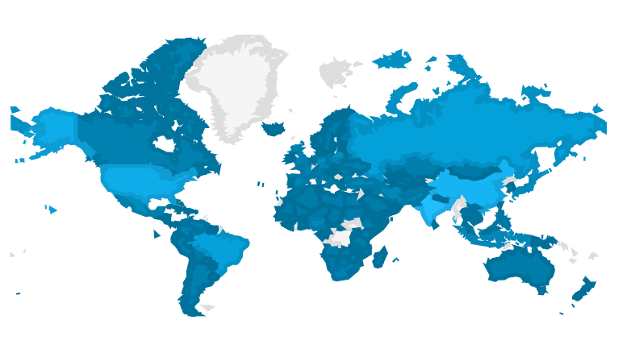
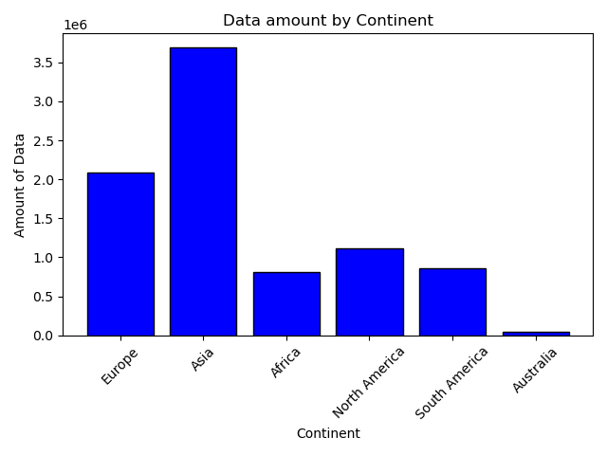
Visualisierungen Histogramm

Slide 6
Performance Architekturen
MLP
CNN (1D)
RNN
LSTM
Transformer

Slide 7
Performance Architekturen MLP
def setup_model_mlp():
input = tf.keras.layers.Input(shape=(SEQ_LEN_PAST, NUM_INPUT_PARAMETERS), name='input')
dp = 0.0
x = tf.keras.layers.Flatten()(input)
x = tf.keras.layers.Dense(1024, activation='relu')(x)
x = tf.keras.layers.Dropout(dp)(x)
x = tf.keras.layers.Dense(1024, activation='relu')(x)
x = tf.keras.layers.Dropout(dp)(x)
x = tf.keras.layers.Dense(1024, activation='relu')(x)
x = tf.keras.layers.Dropout(dp)(x)
x = tf.keras.layers.Dense(2000, activation='relu')(x)
x = tf.keras.layers.Dropout(dp)(x)
x = tf.keras.layers.Dense(2000, activation='relu')(x)
x = tf.keras.layers.Dropout(dp)(x)
x = tf.keras.layers.Dense(2000, activation='relu')(x)
x = tf.keras.layers.Dropout(dp)(x)
x = tf.keras.layers.Dense(2000, activation='relu')(x)
x = tf.keras.layers.Dropout(dp)(x)
x = tf.keras.layers.Dense(2000, activation='relu')(x)
x = tf.keras.layers.Dropout(dp)(x)
x = tf.keras.layers.Dense(2000, activation='relu')(x)
x = tf.keras.layers.Dropout(dp)(x)
x = tf.keras.layers.Dense(528, activation='relu')(x)
x = tf.keras.layers.Dropout(dp)(x)
x = tf.keras.layers.Dense(SEQ_LEN_FUTURE * NUM_OUTPUT_PARAMETERS, activation='linear')(x)
x = tf.keras.layers.Reshape((SEQ_LEN_FUTURE, NUM_OUTPUT_PARAMETERS))(x)
model = tf.keras.models.Model(input, x)
return model

Slide 8
Performance Architekturen MLP
TODO: Performance Plot

Slide 9
Performance Architekturen CNN (1D)
def setup_model_conv_1d(architecture, normalized = False):
input = tf.keras.layers.Input(shape=(SEQ_LEN_PAST, NUM_INPUT_PARAMETERS), name='input')
filters_list = architecture[0]
kernel_sizes = architecture[1]
if (len(filters_list) == len(kernel_sizes)): # if dropout -> list is not empty
x = tf.keras.layers.Conv1D(filters=filters_list[0], kernel_size=kernel_sizes[0], activation='relu', padding='valid')(input)
for i in range(1, len(filters_list)):
if normalized: x = tf.keras.layers.LayerNormalization()(x)
x = tf.keras.layers.Conv1D(filters=filters_list[i], kernel_size=kernel_sizes[i], activation='relu', padding='valid')(x)
else:
x = tf.keras.layers.Conv1D(filters=filters_list[0], kernel_size=5, activation='relu', padding='valid')(input)
for i in range(1, len(filters_list)):
if normalized: x = tf.keras.layers.LayerNormalization()(x)
x = tf.keras.layers.Conv1D(filters=filters_list[i], kernel_size=5, activation='relu', padding='valid')(input)
x = tf.keras.layers.Flatten()(x)
# Dense Layers
x = tf.keras.layers.Dense(400, activation='relu')(x)
x = tf.keras.layers.Dense(300, activation='relu')(x)
x = tf.keras.layers.Dense(200, activation='relu')(x)
x = tf.keras.layers.Dense(100, activation='relu')(x)
# Output Layer
x = tf.keras.layers.Dense(SEQ_LEN_FUTURE * NUM_OUTPUT_PARAMETERS, activation='linear')(x)
x = tf.keras.layers.Reshape((SEQ_LEN_FUTURE, NUM_OUTPUT_PARAMETERS))(x)
model = tf.keras.models.Model(input, x)
return model
def setup_model_mlp():
input = tf.keras.layers.Input(shape=(SEQ_LEN_PAST, NUM_INPUT_PARAMETERS), name='input')
dp = 0.0
x = tf.keras.layers.Flatten()(input)
x = tf.keras.layers.Dense(1024, activation='relu')(x)
x = tf.keras.layers.Dropout(dp)(x)
x = tf.keras.layers.Dense(1024, activation='relu')(x)
x = tf.keras.layers.Dropout(dp)(x)
x = tf.keras.layers.Dense(1024, activation='relu')(x)
x = tf.keras.layers.Dropout(dp)(x)
x = tf.keras.layers.Dense(2000, activation='relu')(x)
x = tf.keras.layers.Dropout(dp)(x)
x = tf.keras.layers.Dense(2000, activation='relu')(x)
x = tf.keras.layers.Dropout(dp)(x)
x = tf.keras.layers.Dense(2000, activation='relu')(x)
x = tf.keras.layers.Dropout(dp)(x)
x = tf.keras.layers.Dense(2000, activation='relu')(x)
x = tf.keras.layers.Dropout(dp)(x)
x = tf.keras.layers.Dense(2000, activation='relu')(x)
x = tf.keras.layers.Dropout(dp)(x)
x = tf.keras.layers.Dense(2000, activation='relu')(x)
x = tf.keras.layers.Dropout(dp)(x)
x = tf.keras.layers.Dense(528, activation='relu')(x)
x = tf.keras.layers.Dropout(dp)(x)
x = tf.keras.layers.Dense(SEQ_LEN_FUTURE * NUM_OUTPUT_PARAMETERS, activation='linear')(x)
x = tf.keras.layers.Reshape((SEQ_LEN_FUTURE, NUM_OUTPUT_PARAMETERS))(x)
model = tf.keras.models.Model(input, x)
return model

Slide 10
Performance Architekturen CNN
x = tf.keras.layers.Dropout(dp)(x)
x = tf.keras.layers.GlobalAveragePooling1D()(x) # for each peature map, do global avg pooling resulting in 1 value
x = tf.keras.layers.Flatten()(x)
TODO: Performance Plot (GlobalAveragePooling vs Flatten?)

Slide 11
Performance Architekturen CNN
TODO: Performance Plot (GlobalAveragePooling vs Flatten?)

Slide 12
Performance Architekturen RNN
TODO:

Slide 13
Performance Architekturen RNN
TODO: Performance Plot

Slide 14
Performance Architekturen LSTM
TODO:

Slide 15
Performance Architekturen LSTM
TODO: Performance Plot

Slide 16
Performance Architekturen Transformer
def loop_setup_transformer():
Pass..
def transformer_encoder(inputs, dropout=0.25, head_size=256, num_heads=32, ff_dim=4):
# Normalization and Attention
x = tf.keras.layers.LayerNormalization(epsilon=1e-6)(inputs)
x = tf.keras.layers.MultiHeadAttention(key_dim=head_size, num_heads=num_heads, dropout=dropout)(x, x)
x = tf.keras.layers.Dropout(dropout)(x)
res = x + inputs
# Feed Forward Part
x = tf.keras.layers.LayerNormalization(epsilon=1e-6)(res)
x = tf.keras.layers.Conv1D(filters=ff_dim, kernel_size=1, activation="relu")(x)
x = tf.keras.layers.Dropout(dropout)(x)
x = tf.keras.layers.Conv1D(filters=inputs.shape[-1], kernel_size=1)(x)
return x + res

Slide 17
Performance Architekturen Transformer
TODO: Performance Plot

Slide 18
Data Normalisierung
TODO:

Slide 19

Varianz Input-Sequenz
MLP
CONV
8
16
32
LSTM
Transformer
64

Slide 20
Varianz Input-Sequenz
MLP
CONV
8
16
32
LSTM
Transformer
64

Slide 21
Varianz Input-Sequenz
MLP
CONV
8
16
32
LSTM
Transformer
64

Slide 22
Varianz Input-Sequenz
MLP
CONV
8
16
32
LSTM
Transformer
64

Slide 23
Fazit

