Slide 1
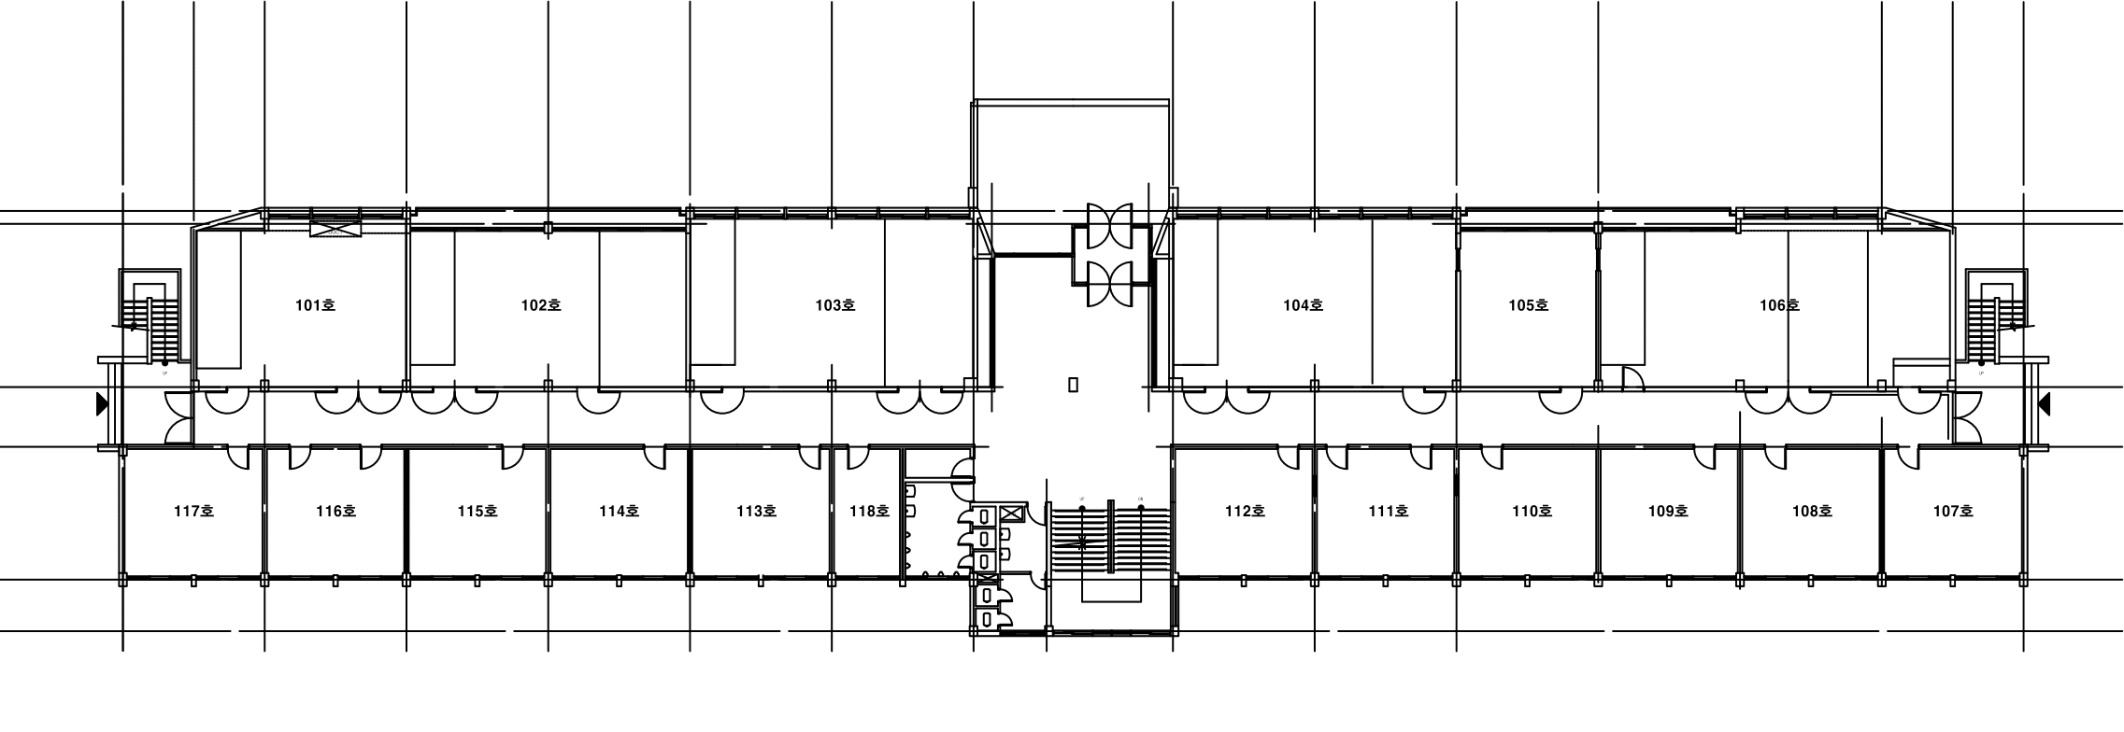

Slide 2
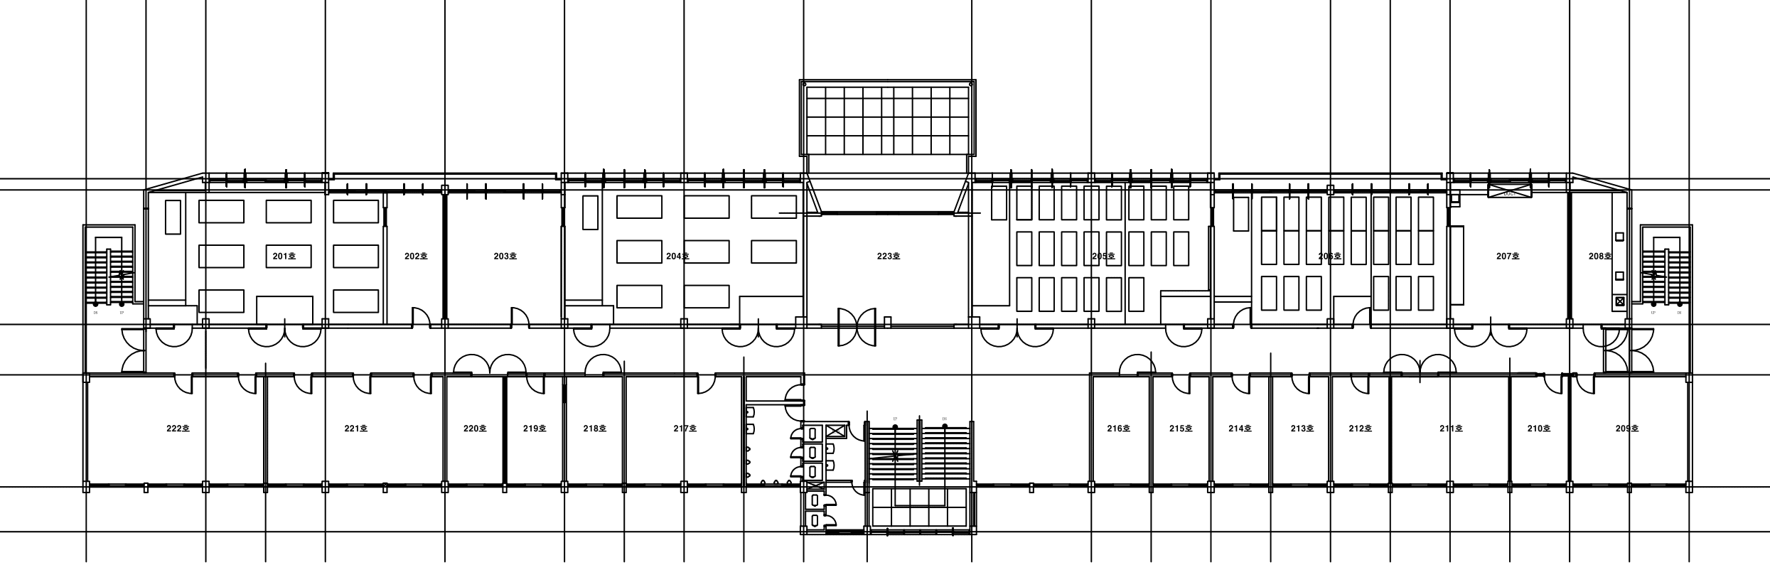

Slide 3
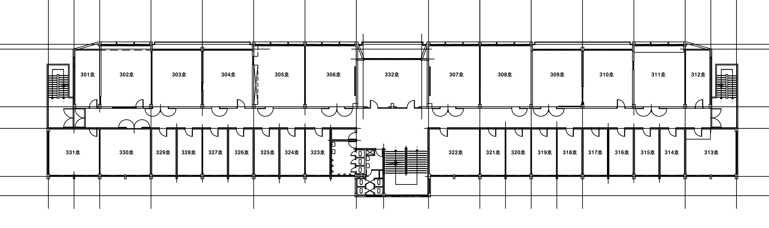

Slide 4
1450, 587
1250, 596
219, 746
2390, 746
1463, 746
1225, 746
1225, 821
1463, 821
219, 821
1221, 884
1317, 892
2390, 813

