Slide 1
Into to Flexboxes
Week 31 Day 2

Slide 2
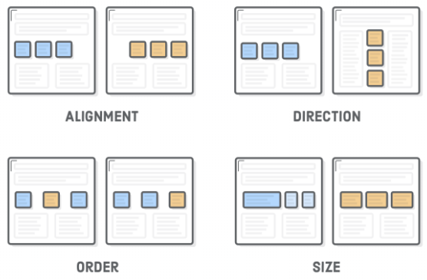
Flexbox
The “Flexible Box” or “Flexbox” layout mode offers an alternative to Floats for defining the overall appearance of a web page.
Whereas floats only let us horizontally position our boxes, flexbox gives us complete control over the alignment, direction, order, and size of our boxes.

Slide 3
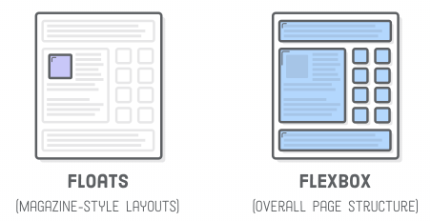
Floats vs Flexbox
Its recommended to use flexbox to lay out your web pages as much as possible, reserving floats for when you need text to flow around a box (i.e., a magazine-style layout) or when you need to support legacy web browsers.

Slide 4
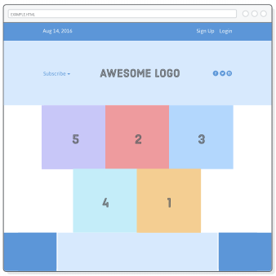
Setup
Download the Flexbox_W26_D1.zip file from canvas.
Open the HTML and CSS files in “Atom”
We will be creating the HTML page on the right.
Notes:
Have students download the ”flexbox-images” file from canvas.

Slide 5
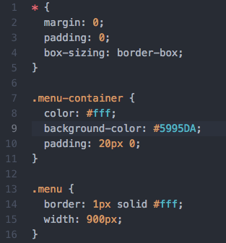
Before we start
Add the CSS syntax on the right into the flexbox.css file
Notes:
Have students download the ”flexbox-images” file from canvas.

Slide 6
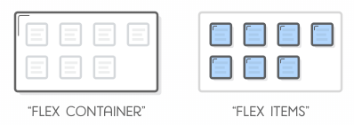
FLEXBOX OVERVIEW
Flexbox uses two types of boxes that we’ve never seen before: “flex containers” and “flex items”. The job of a flex container is to group a bunch of flex items together and define how they’re positioned.
Every HTML element that’s a direct child of a flex container is an “item”.
Flex items can be manipulated individually, but for the most part, it’s up to the container to determine their layout.
The main purpose of flex items are to let their container know how many things it needs to position.

Slide 7
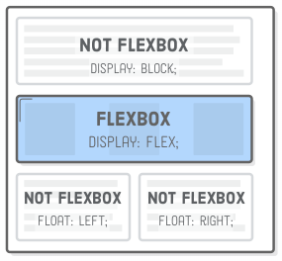
FLEX CONTAINERS
The first step in using flexbox is to turn one of our HTML elements into a flex container.
We do this with the display property
By giving it a value of flex, we’re telling the browser that everything in the box should be rendered with flexbox instead of the default box model.
Add display:flex; to the .menu-container class.
This enables the flexbox layout mode—without it, the browser would ignore all the flexbox properties that we’re about to introduce.
Now we must tell the container how to display the items…..

Slide 8
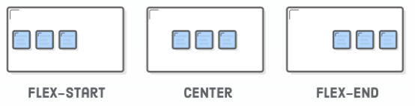
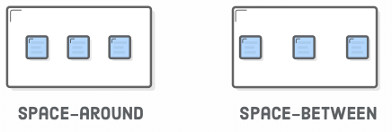
Aligning a Flex Item
The justify-content property defines the horizontal alignment of its items. Add justify-content: center; to the .menu-container class.
Other values for justify-content are shown below:
Center
Flex-start
Flex-end
Space-around
Space-between
Add display:flex; and
justify-content: space-around;
to the .menu class

Slide 9
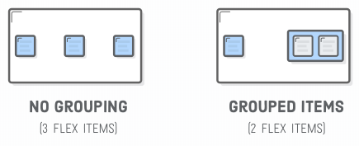
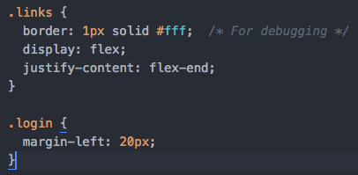

Grouping FLEX items
Flex containers only know how to position elements that are one level deep (i.e., their child elements). They don’t care one bit about what’s inside their flex items.
Wrapping a bunch of items in an extra <div>results in a totally different web page.
Lets say you want both the Sign Up and Login links to be on the right side of the page.
We would put them into their own <div class=“links”>
add the following CSS.
Notes:
We won’t need those white borders anymore, so you can go ahead and delete them if you like.

Slide 10
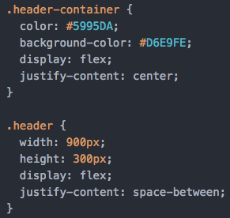
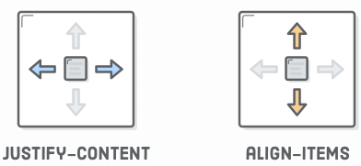
cross-axis (vertical) alignment
So far, we’ve been manipulating horizontal alignment, but flex containers can also define the vertical alignment of their items.
This is something that’s simply not possible with floats.
Add the CSS syntax on the right to flexbox.css

Slide 11
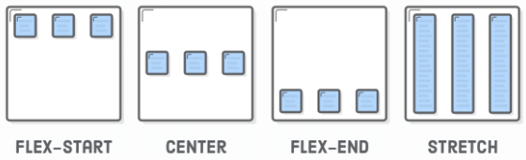
Cross-Axis (Vertical) Alignment
Vertical alignment is defined by adding an align-items property to a flex container.
The available options for align-items:
center
flex-start (top)
flex-end (bottom)
Stretch (Same height as container)
baseline
Add align-items: center; to the .header class
Notes:
The box for each item extends the full height of the flex container, regardless of how much content it contains. A common use case for this behavior is creating equal-height columns with a variable amount of content in each one—something very difficult to do with floats.
To show Stretch and Baseline….. Add this to the css file .social,
.logo, .subscribe {
border: 1px solid #5995DA;
}

Slide 12
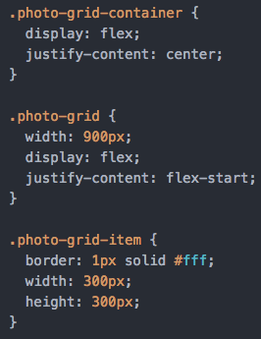
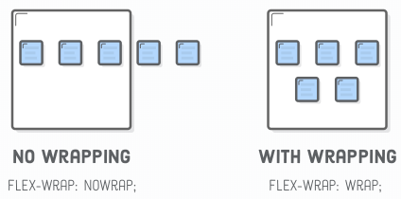
Wrapping flex items
Flexbox can it render items as a grid and it can change their alignment, direction, order, and size, too.
To create a grid, we need the flex-wrap property.
Add the syntax on the right to the CSS file

Slide 13
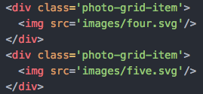
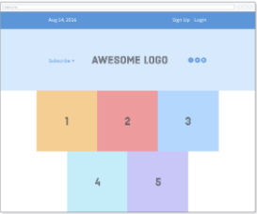
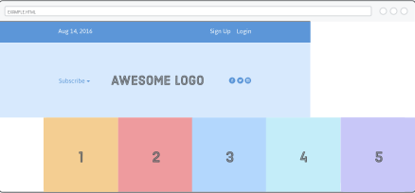
Wrapping Flex Items
Insert an extra two photos into the .photo-grid:
By default, they flow the edge of the page
Adding flex-wrap: wrap; forces items that don’t fit to get bumped down to the next row (Refresh the webpage)
The second row is currently left-aligned.
Adding justify-content: center;
Will center all the images.
Notes:
The last line is currently left-aligned. Try centering it by updating our .photo-grid rule, like so: justify-content: center;

Slide 14
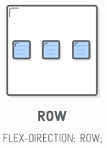
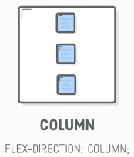
Flex container direction
Direction refers to whether a container renders its items horizontally or vertically.
So far, all the containers we’ve seen use the default horizontal direction, which means items are drawn one after another in the same row before popping down to the next column when they run out of space
Flexbox is its ability to transform rows into columns using only a single line of CSS.
Add flex-direction: column; to .photo-grid class.
This changes the direction of the container from the default row value
Instead of a grid, our page now has a single vertical column

Slide 15
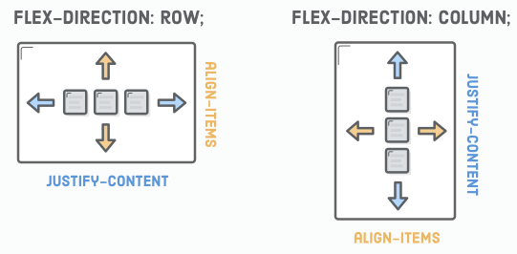
Flex Alignment
Notice that the column is hugging the left side of its flex container despite our justify-content: center; declaration.
When you rotate the direction of a container, you also rotate the direction of the justify-content property.
It now refers to the container’s vertical alignment—not its horizontal alignment.
To horizontally center our column, we use the align-items: center; property on our .photo-grid
Notes:
To horizontally center our column, we need to define an align-itemsproperty on our .photo-grid:

Slide 16
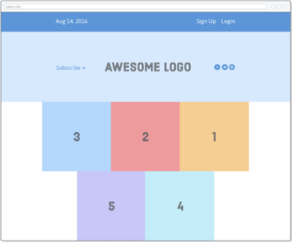
Flex item order
The flex-direction property also offers you control over the order in which items appear via the row-reverse and column-reverse properties
Add flex-direction: row-reverse; and align-items:center; to the .photo-grid class
Both rows are now rendered right-to-left instead of left-to-right

Slide 17
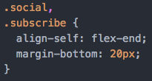
Flex item alignment
What if we want that Subscribe link and those social icons to go at the bottom of the header instead of the center? Align them individually!
This is where the align-self property comes in. Adding this to a flex item overrides the align-items value from its container: Add the following to the CSS file.
The available options for align-self:
center
flex-start (top)
flex-end (bottom)
Stretch (Same height as container)
baseline

Slide 18
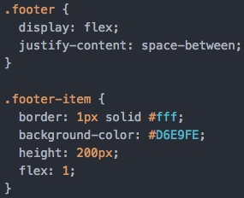
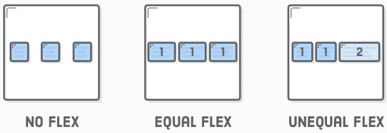
Flexible items
Flex items are flexible: they can shrink and stretch to match the width of their containers
The flex property defines the width of individual items in a flex container
For example, an item with a flex value of 2 will grow twice as fast as items with the default value of 1.
Add the following code to the CSS file

Slide 19
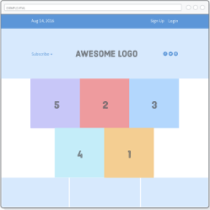

Flexible items
That flex: 1; line tells the items to stretch to match the width of .footer
Since they all have the same weight, they’ll stretch equally
Increasing the weight of one of the items makes it grow faster than the others.
For example, we can make the second item grow twice as fast as the other two with the following rule:

Slide 20

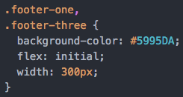
Static Item Widths
We can even mix-and-match flexible boxes with fixed-width ones. flex: initial falls back to the item’s explicit width property.
We’re going to make our footer behave like the above diagram. The center item is flexible, but the ones on either side are always the same size.
All we need to do is add the following rule to our stylesheet:
When you resize the browser window, you’ll see that only the middle box in the footer gets resized.

Slide 21
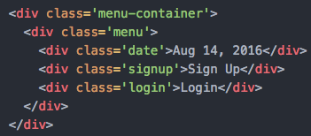

Flex-Items and Auto Margins
Auto-margins in flexbox are special.
They can be used as an alternative to an extra <div> when trying to align a group of items to the left/right of a container.
Let’s change our items in .menu so that it matches the following below:
Reloading the page should make the items spread out equally through our menu.
We can replicate the desired layout by sticking an auto-margin between the items we want to separate, like so:
Auto-margins eat up all the extra space in a flex container, so instead of distributing items equally, this moves the .signup and any following items (.login) to the right side of the container.
Notes:
Auto-margins eat up all the extra space in a flex container, so instead of distributing items equally, this moves the .signup and any following items (.login) to the right side of the container.

Slide 22
Summary
Use display: flex; to create a flex container.
Use justify-content to define the horizontal alignment of items.
Use align-items to define the vertical alignment of items.
Use flex-direction if you need columns instead of rows.
Use the row-reverse or column-reverse values to flip item order.
Use order to customize the order of individual elements.
Use align-self to vertically align individual items.
Use flex to create flexible boxes that can stretch and shrink.

