Slide 1
Analysis of Rice Production in Sri Lanka
Data Science – Team 08 (Data Hungers)
S. Abilash 199303L
D. T. I. Wirasingha199374D
S. P. P. Aravinda 178082E
M. M. G. U. M. Thialakasiri 199369R

Slide 2
Yala & Maha – Major Seasons
Maha season (wet)
Starts in October-November and the harvesting happens on February-March
Average 560,000 ha of lands are cultivated
70% of the yearly rice production
Yala season (dry)
Starts in April-May and the harvesting happens on August-September
Average 310,000 ha of lands are cultivated
30% of the yearly rice production

Slide 3
Major Effects
Problem Statement
Identify whether the Mahaweli Project has positive impact on rice production
Effects from rice production and import
Analysis Data
Sri Lankan government ’opendata’ portal
Datasets of ’Paddy Production In Yala Season 1952 - 2012’
Datasets of ‘Paddy Production In Maha Season 1952 - 2012’
Datasets of ’Paddy Production In 1952 - 2012’
Datasets of ’Paddy Production In 2013 - 2018’

Slide 4
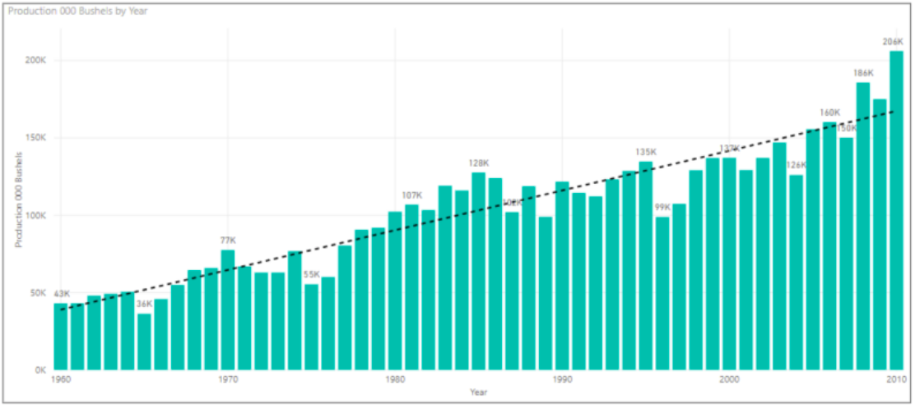
Effect of Mahaweli Project
Before completion of the first stage (1952-1976)
Second stage of the project was initiated in 1977 and completed in 1995

Slide 5
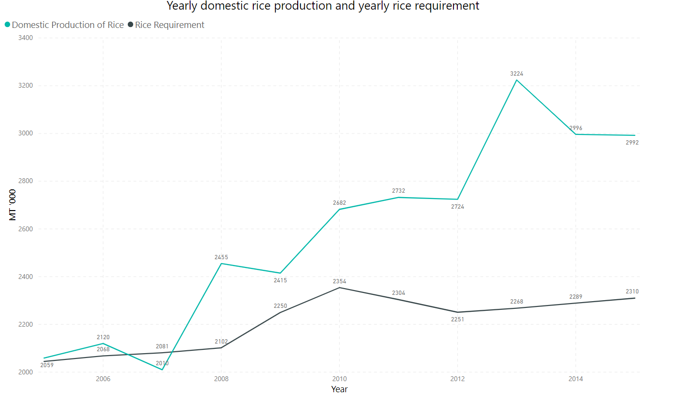
Production Vs Consumption

Slide 6
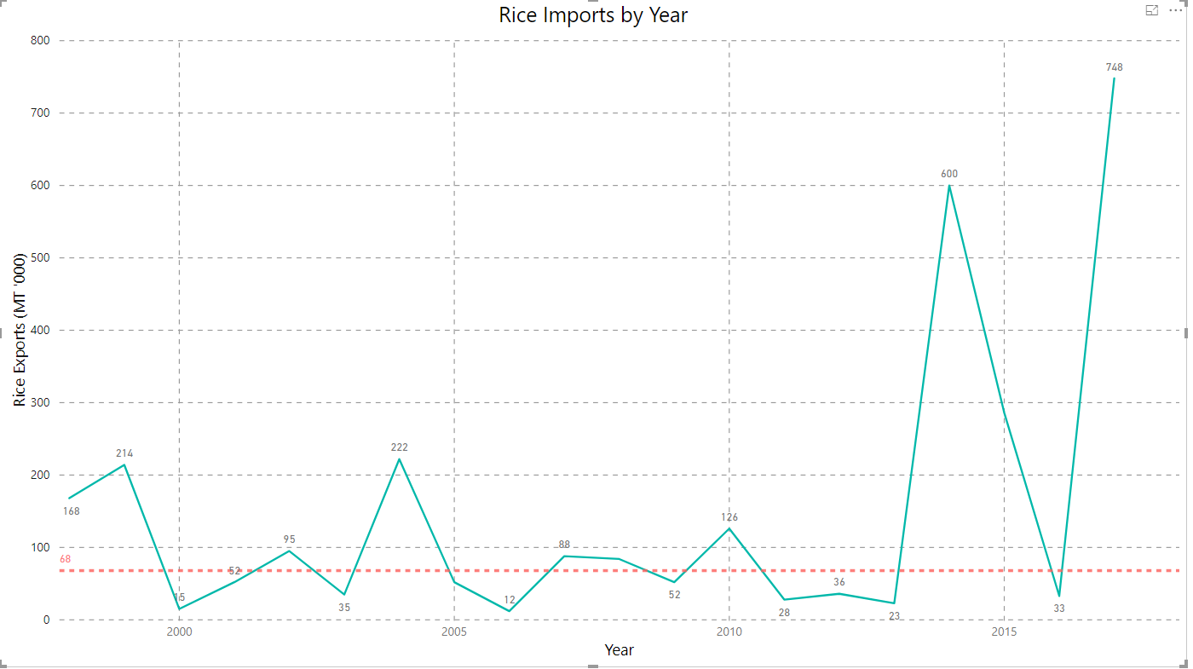
Why Rice Import Increasing ??
Rice Import (MT)

Slide 7
High demand for Basmati…
With a good aroma and taste Basmati has become one of the favorite rice variant around the world
Basmati varieties require prolonged sunshine, high humidity and assured water supply
Heavy neutral soils like clay loamy, pH range for the soil for better yield is 5.0 to 8.5

Slide 8
Solutions to limit import
Introduce fragrant gene of Basmati into local Sri Lankan rice
Other variants like brown rice can be proposed for lower GI and higher fiber content consumption

Slide 9
Q & A

Slide 10
Thank You

