Slide 1

Session Banner - Skills for AI Agents a confronto: Cowork e Copilot Studio
Notes:
This is the opening banner slide for 'Skills for AI Agents a confronto: Cowork e Copilot Studio'. The session is presented by: Federico Porceddu, Marco Caruso. This slide sets the visual theme for the presentation.

Slide 2
Skills for AI Agents a confronto: Cowork e Copilot Studio
Notes:
Main title slide displaying 'Skills for AI Agents a confronto: Cowork e Copilot Studio'. Presented by: Federico Porceddu, Marco Caruso. Use this slide to introduce the session topic.

Slide 3
Event Sponsors
Notes:
Sponsor acknowledgment slide. Take a moment to thank the event sponsors and explain their support for the conference.

Slide 4
Skills for AI Agents a confronto: Cowork e Copilot Studio
Le Skills stanno diventando un building block fondamentale per creare agenti AI più capaci, modulari e riutilizzabili.
In questa sessione esploreremo due approcci alle Skills: dal mondo dei Cowork a Microsoft Copilot Studio. Vedremo come progettare e utilizzare Skills per estendere le capacità degli agenti, orchestrare attività e integrare persone, agenti e sistemi aziendali.
Attraverso casi d’uso ed esempi pratici, confronteremo i due approcci e scopriremo quando e come utilizzare le Skills per portare l’AI agentica a un livello superiore.
Federico Porceddu; Marco Caruso
Notes:
Detailed session information for 'Skills for AI Agents a confronto: Cowork e Copilot Studio'. Session description: Le Skills stanno diventando un building block fondamentale per creare agenti AI più capaci, modulari e riutilizzabili._x000D_
_x000D_
In questa sessione esploreremo due approcci alle Skills: dal mondo dei Cowork .... Review the session objectives and speaker credentials.

Slide 5
Skills for AI Agents a confronto: Cowork e Copilot Studio

Slide 6
Demo: Skills for AI Agents a confronto: Cowork e Copilot Studio
Notes:
Demo section for 'Skills for AI Agents a confronto: Cowork e Copilot Studio'. This slide is for live demonstrations. Ensure all demo materials are prepared and tested.

Slide 7
Questions & Discussion
Notes:
Q&A slide for 'Skills for AI Agents a confronto: Cowork e Copilot Studio'. This is time for audience questions and discussion. Prepare to address common questions about the topic and invite participation.

Slide 8
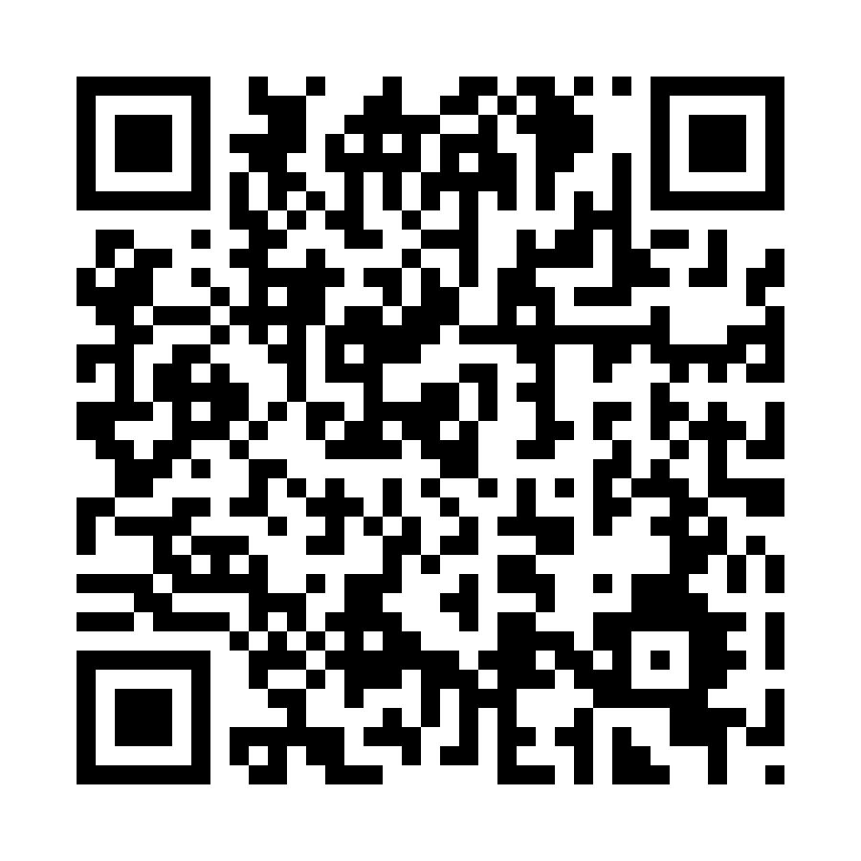
Please Vote for This Session
Vote for Session - Skills for AI Agents a confronto: Cowork e Copilot Studio
https://vote.dotnetdev.it/vote/l44tzzta/1323869
Notes:
Voting slide for 'Skills for AI Agents a confronto: Cowork e Copilot Studio'. Ask audience to scan the QR code or visit https://vote.dotnetdev.it/vote/l44tzzta/1323869 to vote. Emphasize the importance of feedback.

