Slide 1
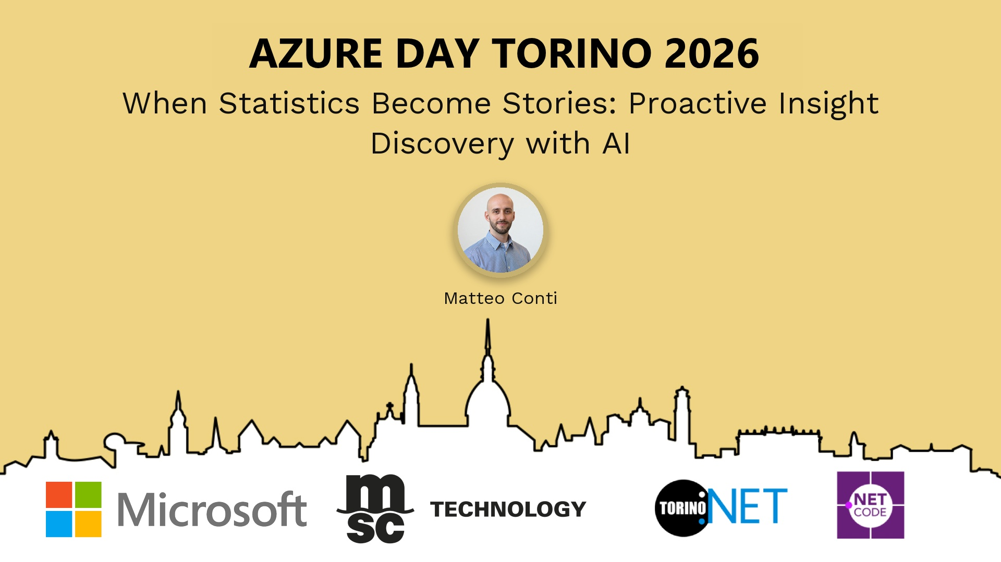
Session Banner - When Statistics Become Stories: Proactive Insight Discovery with AI
Notes:
This is the opening banner slide for 'When Statistics Become Stories: Proactive Insight Discovery with AI'. The session is presented by: Matteo Conti. This slide sets the visual theme for the presentation.

Slide 2
When Statistics Become Stories: Proactive Insight Discovery with AI
Notes:
Main title slide displaying 'When Statistics Become Stories: Proactive Insight Discovery with AI'. Presented by: Matteo Conti. Use this slide to introduce the session topic.

Slide 3
Event Sponsors
Notes:
Sponsor acknowledgment slide. Take a moment to thank the event sponsors and explain their support for the conference.

Slide 4
When Statistics Become Stories: Proactive Insight Discovery with AI
L’interazione in linguaggio naturale ci permette ormai di interrogare basi dati complesse in modo semplice e immediato. Ma i dati possono offrire molto di più delle risposte alle domande che sappiamo già formulare: l’AI può esplorarli in modo proattivo, mettere in relazione informazioni distribuite nel tempo e far emergere pattern e insight difficilmente riconoscibili dall’occhio umano.
È questa l’idea alla base di un progetto reale sviluppato per una realtà di primo piano dello sport professionistico italiano, costruito su decenni di statistiche, risultati, box score e dati play-by-play. ...
Matteo Conti
Notes:
Detailed session information for 'When Statistics Become Stories: Proactive Insight Discovery with AI'. Session description: L’interazione in linguaggio naturale ci permette ormai di interrogare basi dati complesse in modo semplice e immediato. Ma i dati possono offrire molto di più delle risposte alle domande che sappiamo .... Review the session objectives and speaker credentials.

Slide 5
When Statistics Become Stories: Proactive Insight Discovery with AI

Slide 6
Demo: When Statistics Become Stories: Proactive Insight Discovery with AI
Notes:
Demo section for 'When Statistics Become Stories: Proactive Insight Discovery with AI'. This slide is for live demonstrations. Ensure all demo materials are prepared and tested.

Slide 7
Questions & Discussion
Notes:
Q&A slide for 'When Statistics Become Stories: Proactive Insight Discovery with AI'. This is time for audience questions and discussion. Prepare to address common questions about the topic and invite participation.

Slide 8
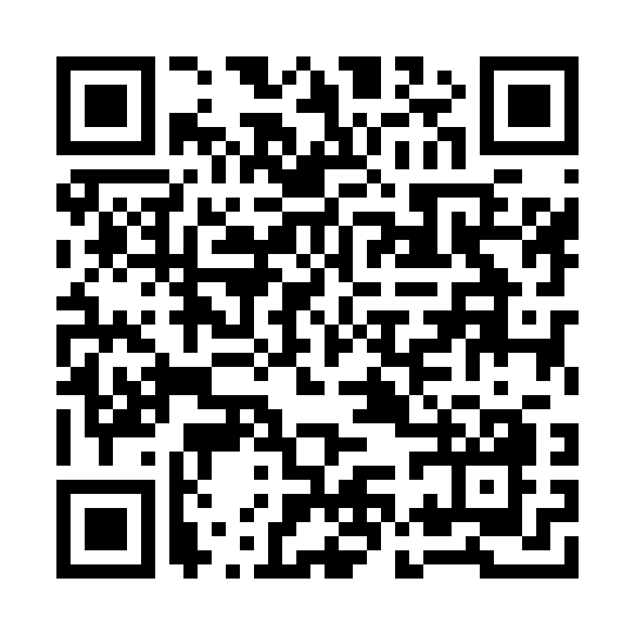
Please Vote for This Session
Vote for Session - When Statistics Become Stories: Proactive Insight Discovery with AI
https://vote.dotnetdev.it/vote/l44tzzta/1326864
Notes:
Voting slide for 'When Statistics Become Stories: Proactive Insight Discovery with AI'. Ask audience to scan the QR code or visit https://vote.dotnetdev.it/vote/l44tzzta/1326864 to vote. Emphasize the importance of feedback.

