Slide 1
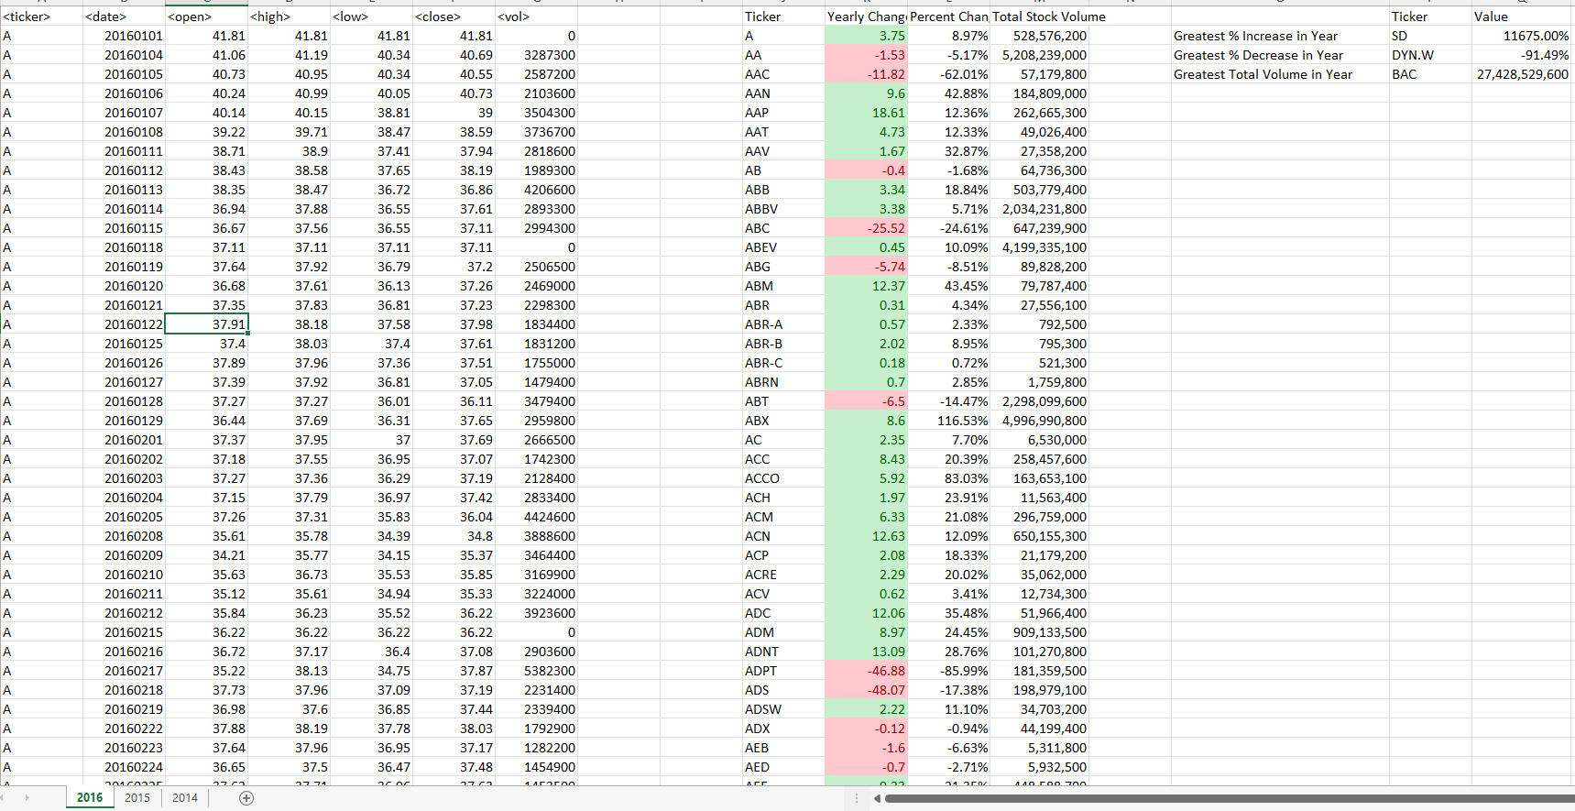
This shows the results from executing the code on the 2016 worksheet. It includes calculations for the greatest in the year 2016.

Slide 2
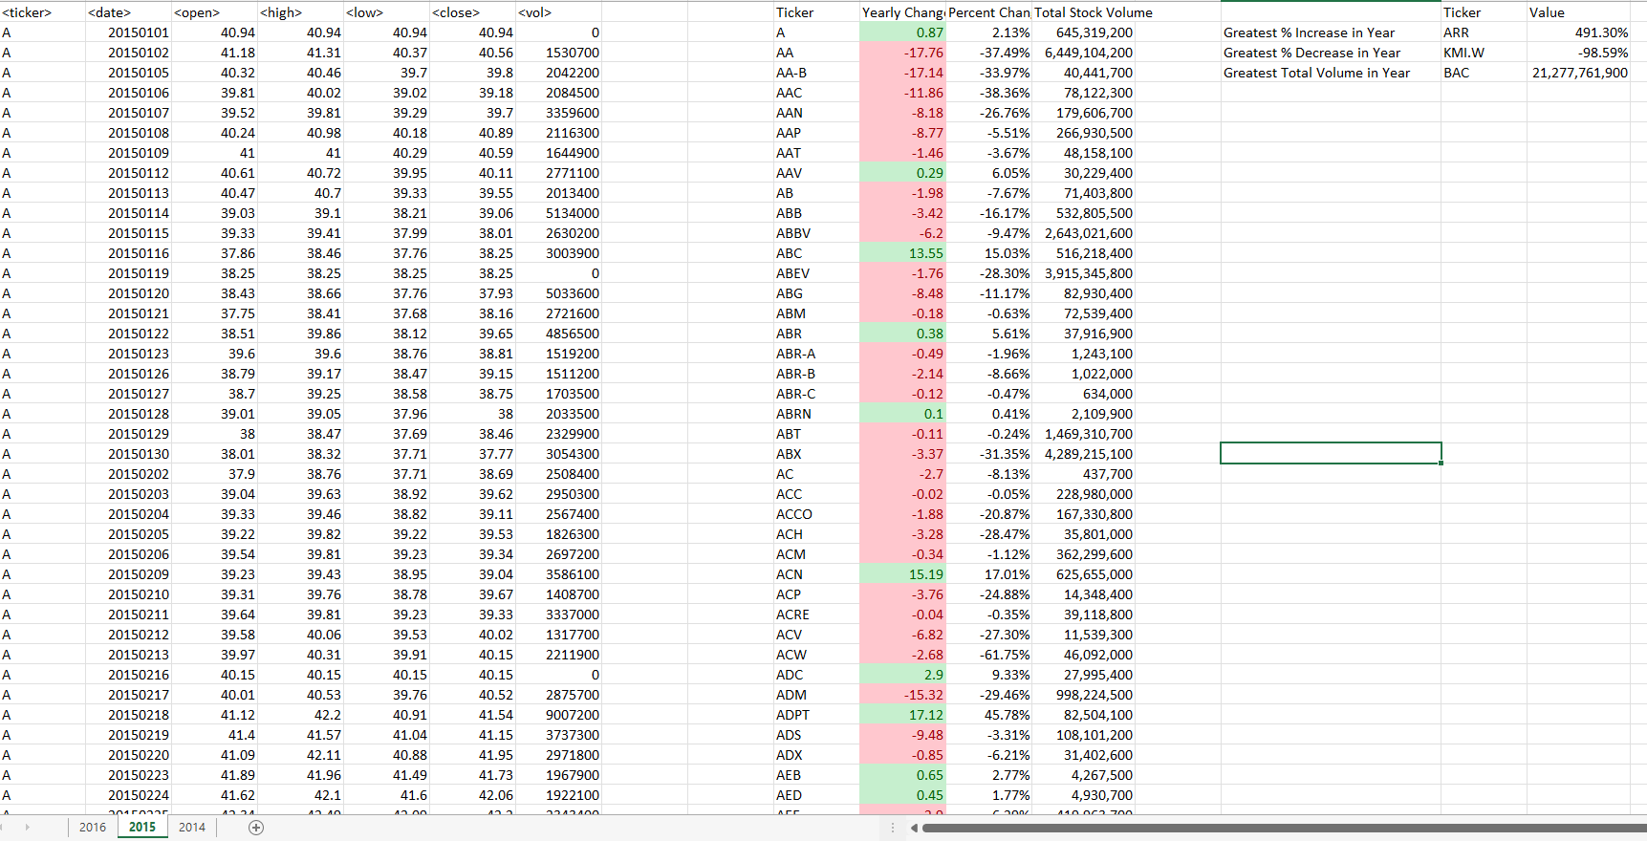
This shows the results from executing the code on the 2015 worksheet. It includes calculations for the greatest in the year 2015.

Slide 3
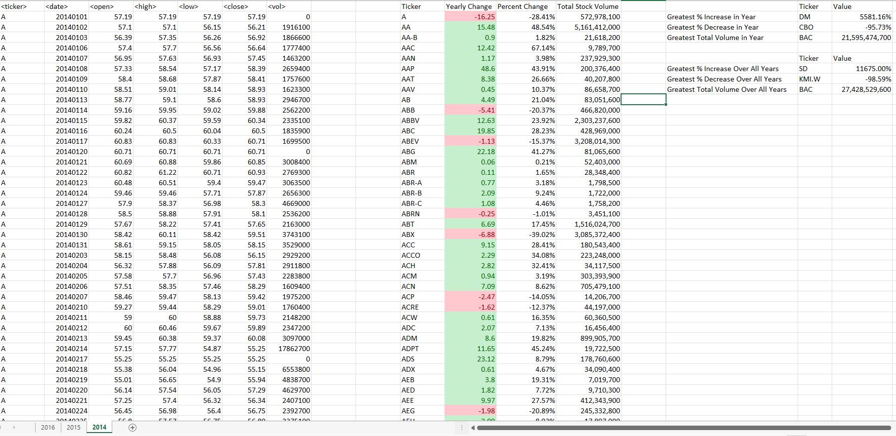
This shows the results from executing the code on the 2014 worksheet. It includes calculations for the greatest in the year 2014, and the greatest across all years for all spreadsheet as well.

