Slide 1
Inverted Index and Advanced Operators for Information Retrieval
By Victor and Akam

Slide 2
OUR CHOSEN TOPIC
Implementing the ANDNOT operator over posting lists.
We will present the ANDNOT method, the logic and algorithm behind it and explain its purpose.

Slide 3


Documents

Slide 4
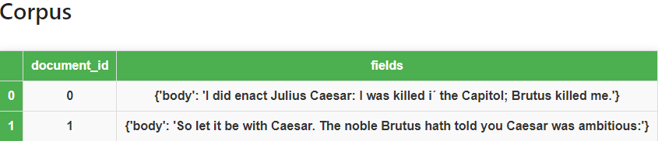
Corpus: list of documents with ids and body fields

Slide 5
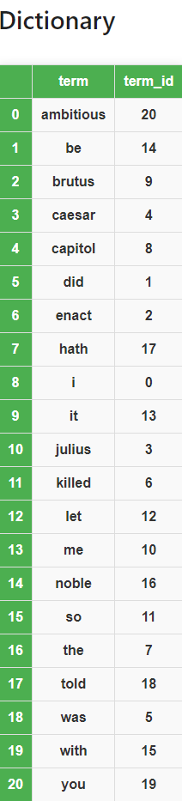
processing pipeline – Tokenization, normalization, MAPPING TERMS TO an incremental id and SORTING OF THE TERMS

Slide 6
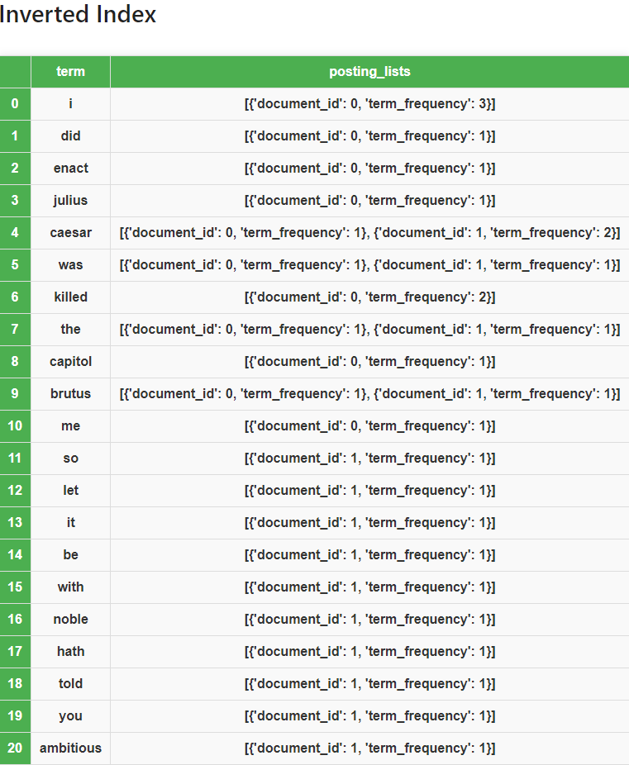
INVERTED INDEX - MAPPING TERMS TO POSTINGS LISTS

Slide 7
Boolean retrieval operations: Different Operations on posting lists:
Conjunctive AND operation
Finding documents that contain both term A and term B and retaining only the common document_ids between the two posting lists, e.q: posting list for term A is [1,3,5,6] and posting list for term B is [2,3,4,6], the AND operation results in [3,6]
Disjunctive OR operation
Finding documents that contain either term A or term B and including all unique document_ids from the two posting lists, e.q: posting list for term A is [1,3,5,7] and posting list for term B is [3,5,7,9], the OR operation results in [1,3,5,7,9]

Slide 8
presenting andnot operator between two posting lists
Finding documents that contain
term A but not term B
Notes:
I will now present how a ANDNOT operator between two posting lists works.
Doing a ANDNOT operation between two posting lists means, finding documents that contain term A but not term B.

Slide 9
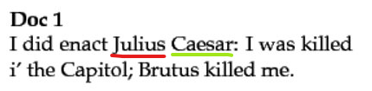
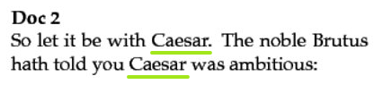
Andnot operator - Let's find the document containing the term CAESAR but not julius
Notes:
I will now show you, the result of doing such an operation on two posting lists.
Here we have two documents. Document 1, with the id 0 which contains the term Julius and Caesar.
Document 2, with the id 1 which contains the term Caesar but not Julius.
When doing a ANDNOT operation where we are interested in Caesar but not Julius, we have to check the posting lists for both terms.
In this case we retrieve the posting lists with the help of an Inverted Index.
We can see that document id 0 is present in both of the posting lists Julius and Caesar.
This means that the document with the id 0 contains both of these terms which results in this document not being returned while the document with the id 1 will be.

Slide 10
Implementing THE ANDNOT OPERATOR OVER POSTING LISTS - Let's find the document containing the term CAESAR but not julius
Implementation:
We have two pointers from two posting lists, each pointing to the first element of each list
If the second pointer is None, we yield the element of the first pointer and move the pointer for the first list one step forward.
If the document id of the first pointer element is smaller than the document id of the second pointer element, we yield the element of the first pointer and move the pointer for the first list one step forward.
If the document ids of both pointer elements are equal, we move the pointer of the first list one step forward.
If the document id of the first pointer element is greater than the document id of the second pointer element, we move the pointer for the second list one step forward.
This flow is done executing when we have gone through and compared both lists yielding the relevant elements in the process.
Notes:
So the way the implementation works, is that we have two pointers both pointing to the first element of each list.
If the pointer for the first list is not pointing to an element then we return nothing.
So as long as the pointer for the first list is pointing to an element we follow a particular flow in order, where if one of these statements are true we start the flow again from the top:
If the second pointer is None, we yield the element of the first pointer and move the pointer for the first list one step forward.
If the document id of the first pointer element is smaller than the document id of the second pointer element,
we yield the element of the first pointer and move the pointer for the first list one step forward.
3. If the document ids of both pointer elements are equal,
we move the pointer of the first list one step forward.
4. If the document id of the first pointer element is greater than the document id of the second pointer element,
we move the pointer for the second list one step forward.
This flow is done executing when we have gone through and compared both lists yielding the relevant elements in the process.

Slide 11
Demonstration of the andnot operation

Slide 12
SUMMARY
This ANDNOT operation is valuable in refining search results and providing more specific and relevant information to the user in information retrieval systems.

Slide 13
THANK YOU

