Slide 1
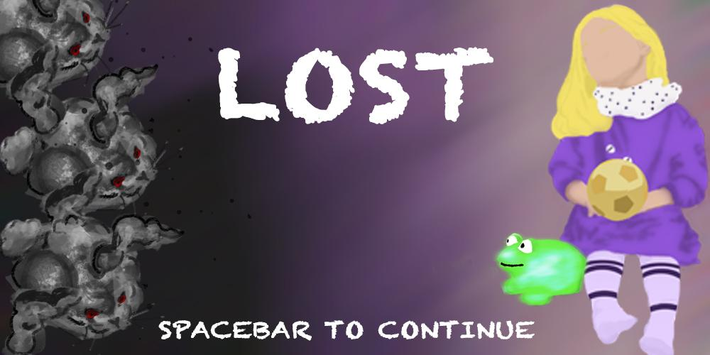
Brought to you by: Emi, Deblin, Trevor, Khadeidre, Zhitao, and Clay

Slide 2
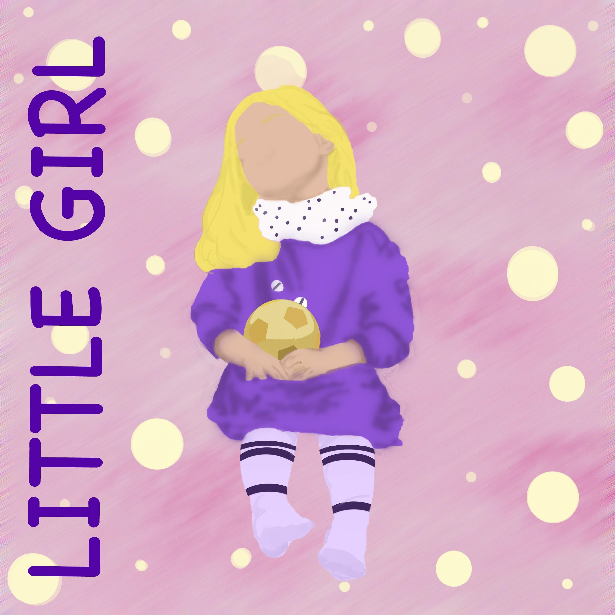
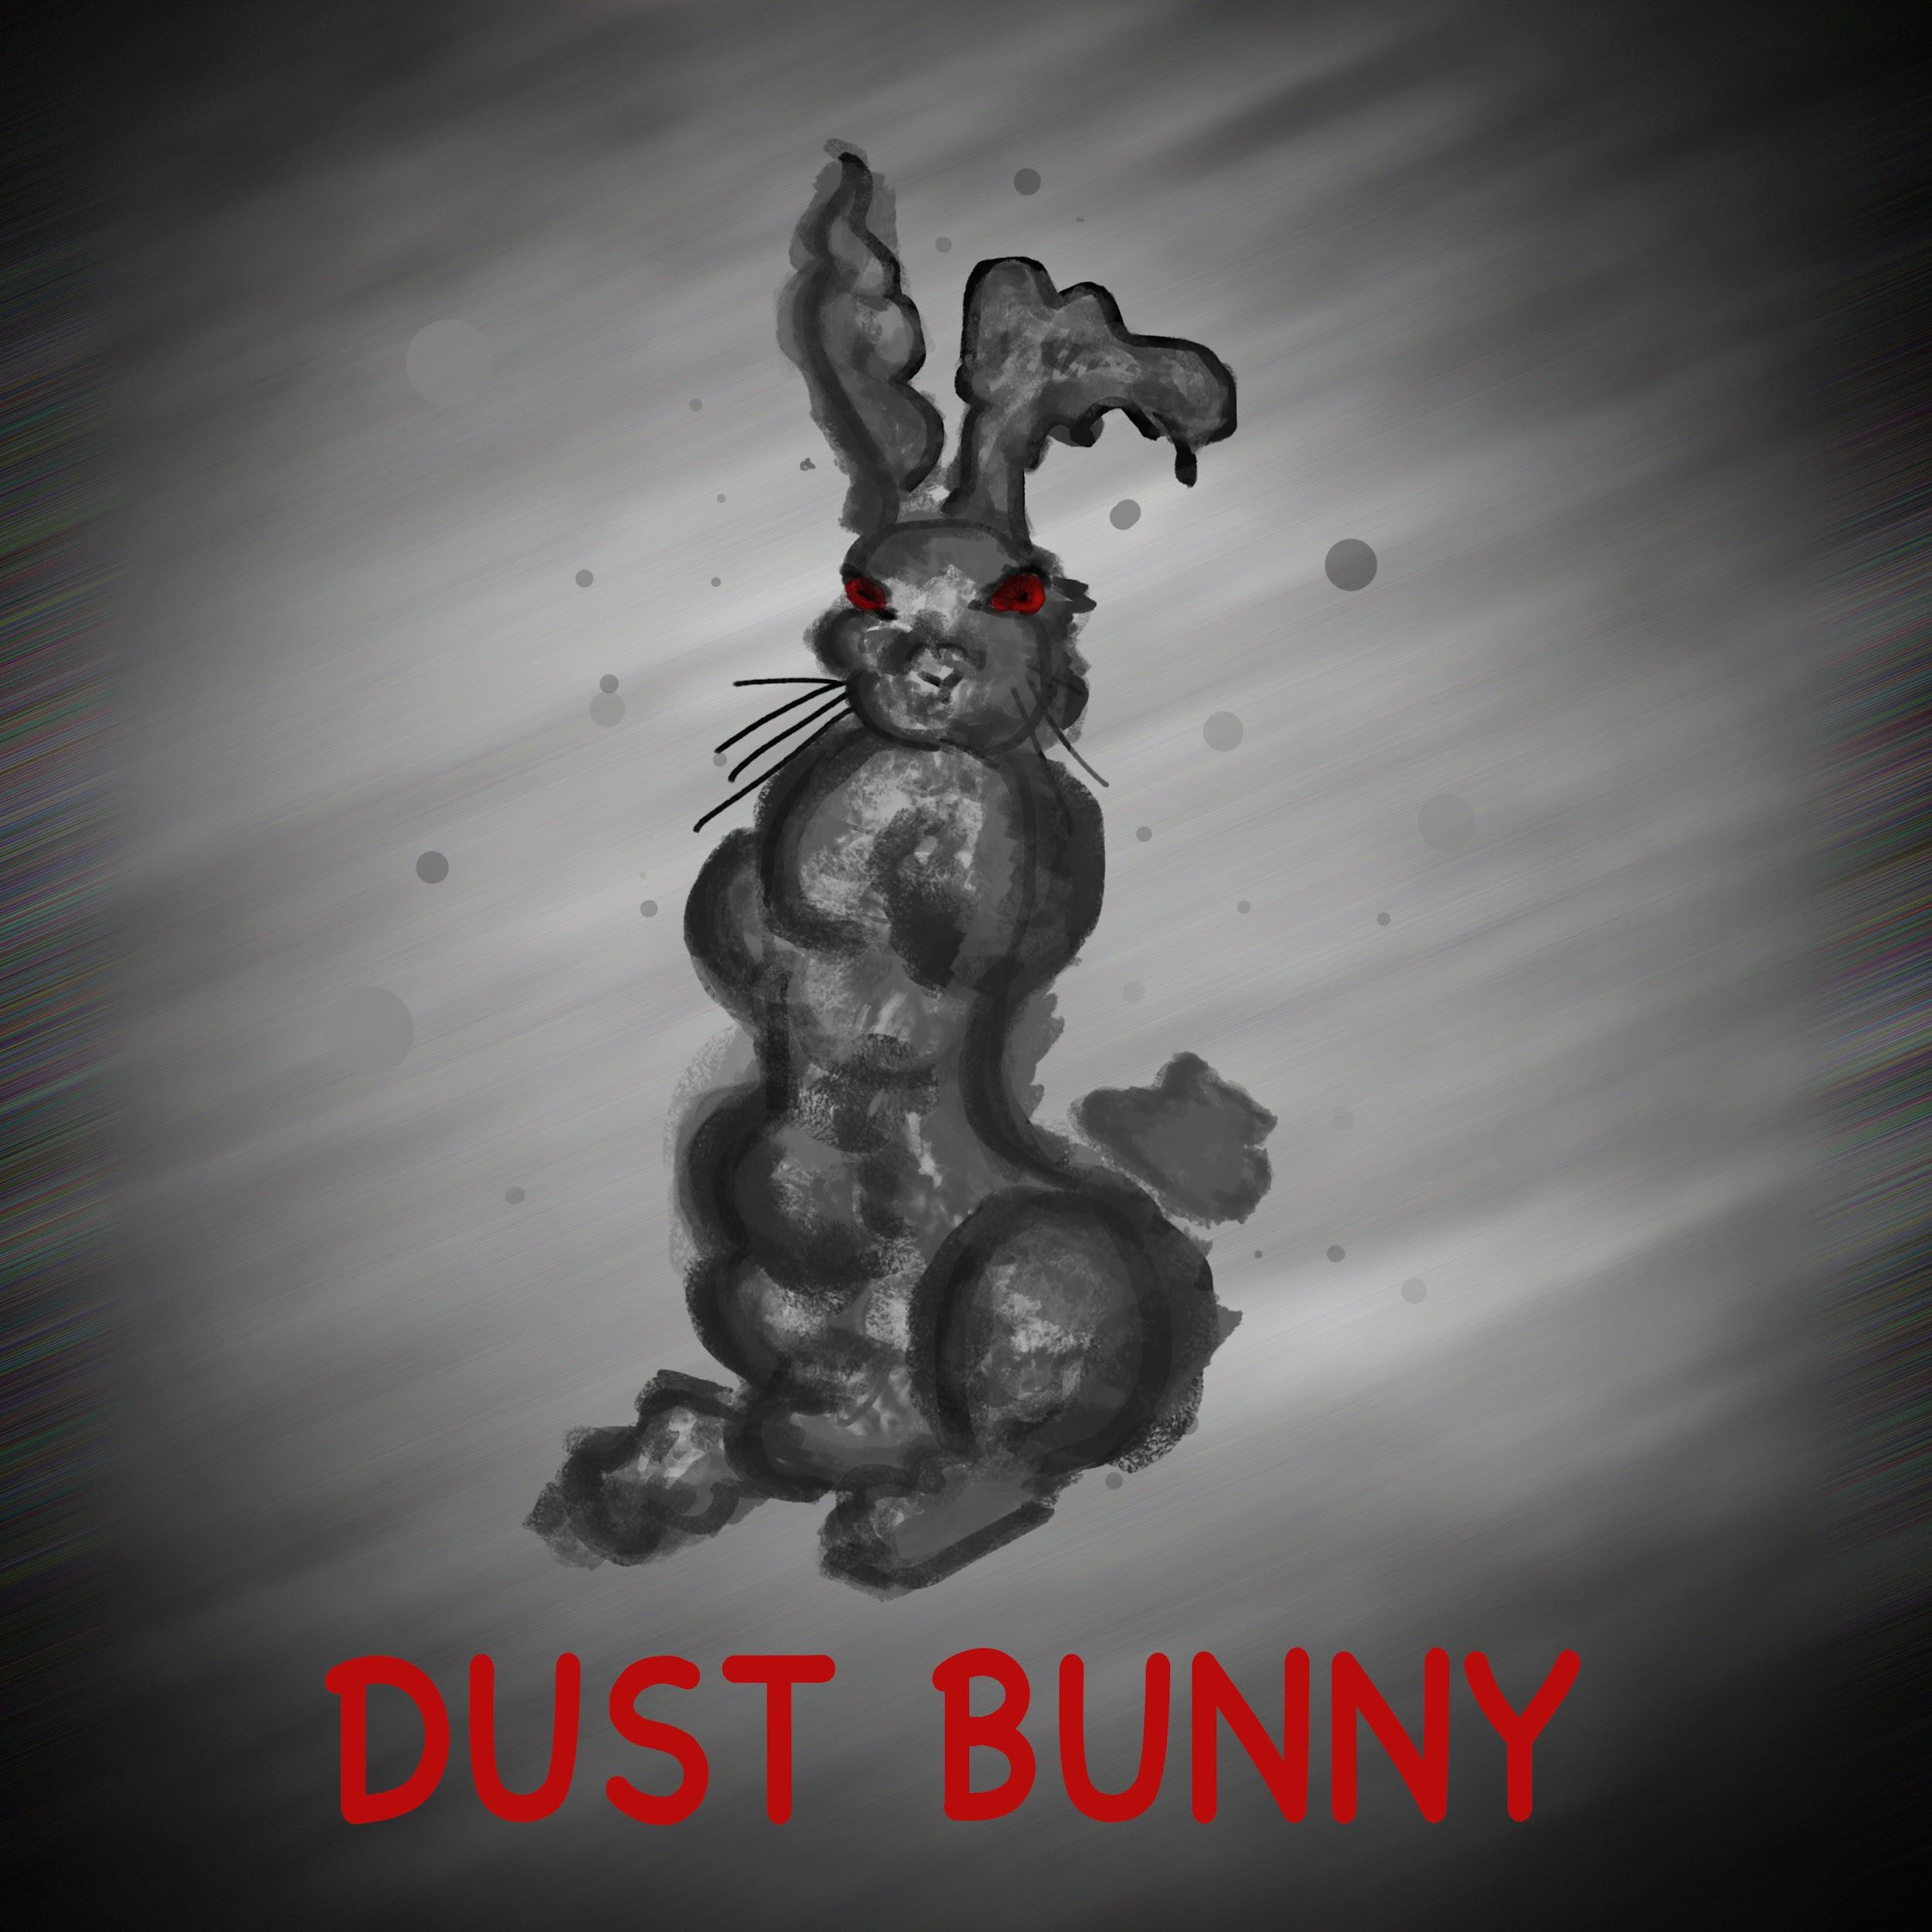
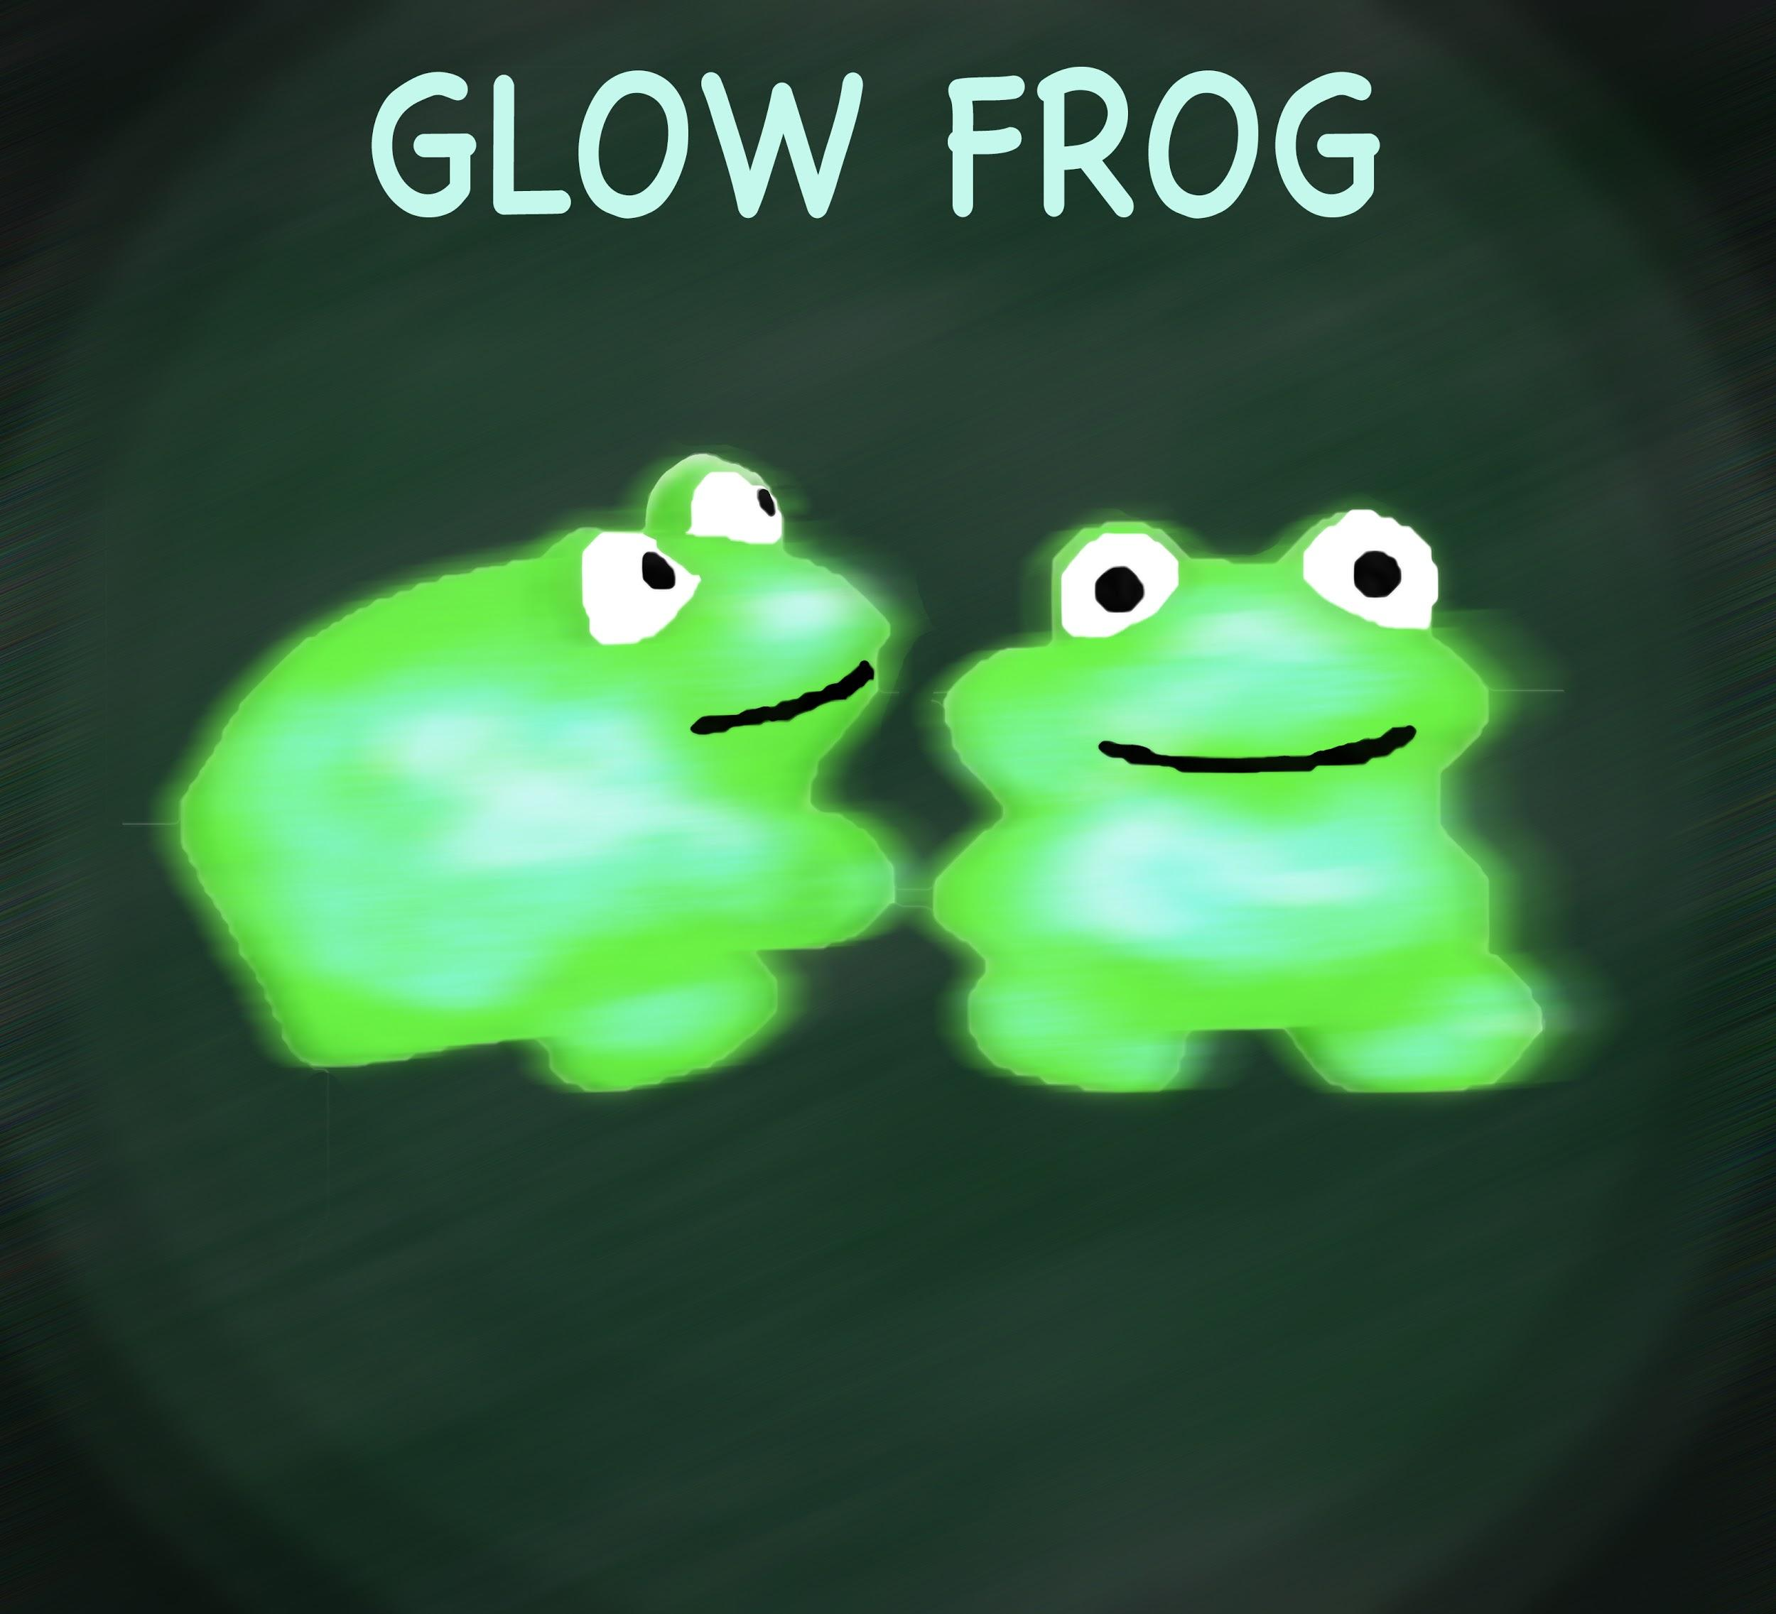
Context

Slide 3
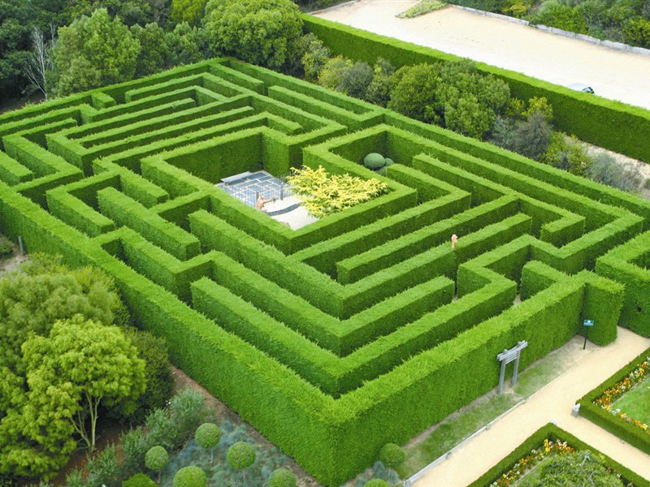
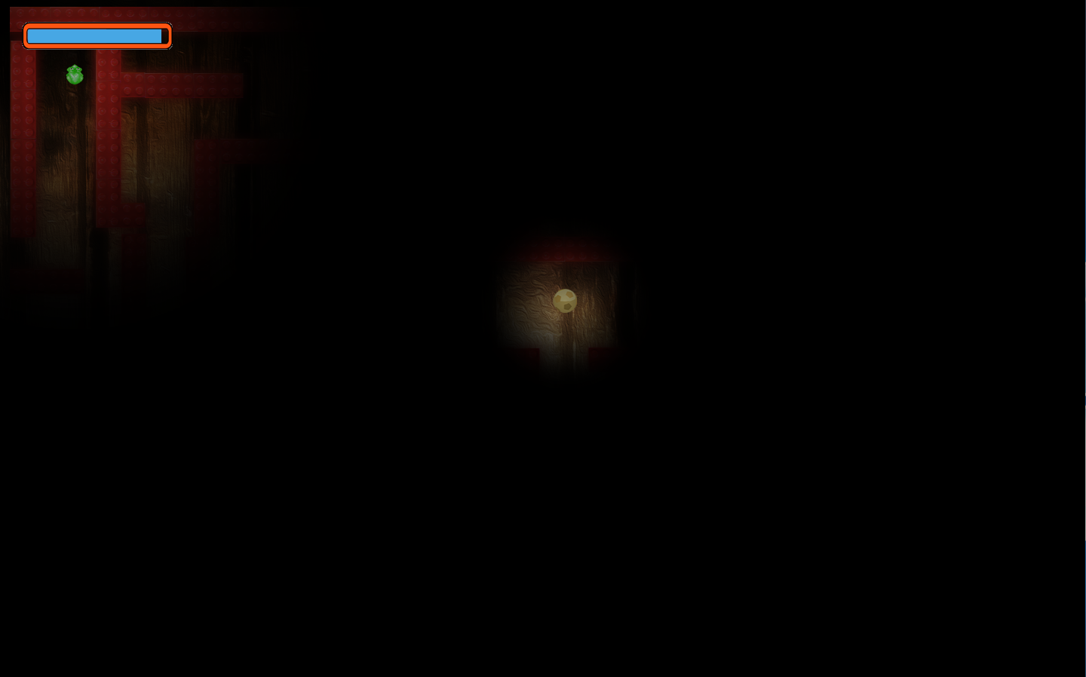
So what is “Lost”?
A maze game inspired by children’s fear of losing their toys and being lost in the dark. Fog of war. Time and darkness are against you.

Slide 4


Audience

Slide 5
Past Level 1...
Environmental hazards
Enemies
New Maps
Multiple toys to collect

Slide 6
Let’s Play!!!

