Slide 1
Preliminary Design Review
Tormod Stokka – Daniel Sortland – Henrik Eikefet

Slide 2
Requirements
Robot arm requirements: a. Robot arm capable of picking toys from the floor b. Minimum floor area covered with mobile robot base stopped: 0,5 m2 c. Capable of lifting: i. End-effector camera: 100g ii. Gripper: 200g iii. Payload (picked object): Max. 500g d. Desirable: reaching up to 50cm underneath 10 cm high furniture
Mobile base requirements: a. Capable of covering a 100 sq. m area in 10 minutes b. Have a turn radius less than 0.25 m
Notes:
Henrik

Slide 3
Navigation
Rapidly-Exploring Random Tree (RRT)
Suited for Differentially-Steered Vehicle (Mobile platform)
Can handle many obstacles
Less computational cost then PRM
Notes:
Daniel

Slide 4
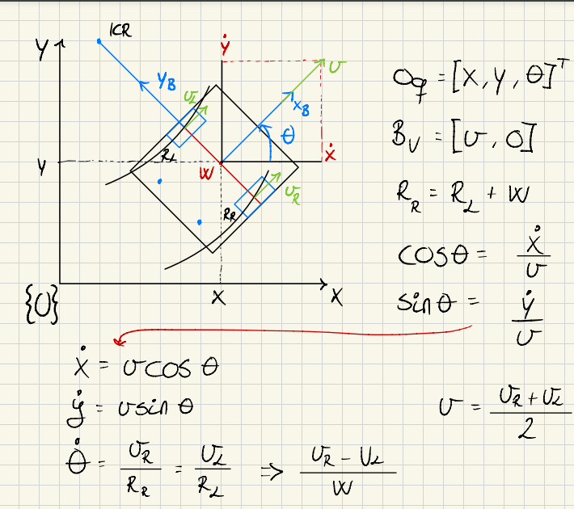
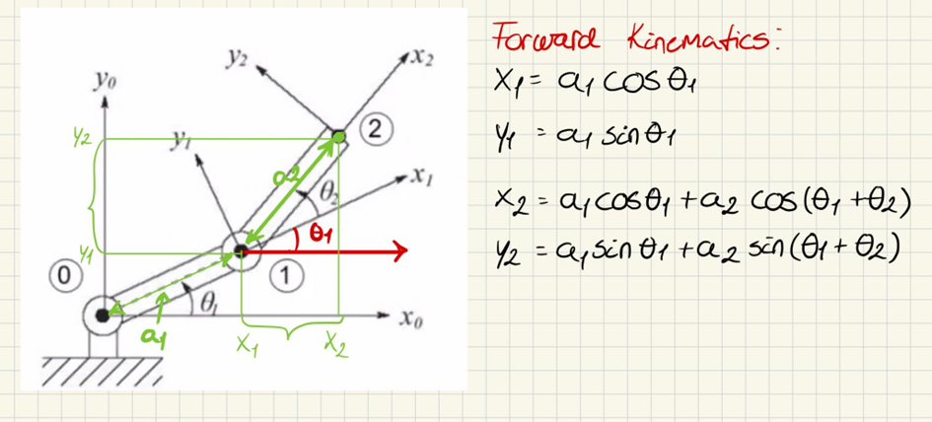
Kinematic Model – Mobile vehicle
Notes:
Henrik

Slide 5
Control
PI-Regulator – The best choice
PID – Harder to tune
Notes:
Daniel

Slide 6
Localization
Map based
3D Camera – Object detection - Mapping
LIDAR - High resolution distance measurement
Wheel encoders – Rotation of wheels
Kalman filter
Notes:
Henrik

Slide 7
plan for the coming weeks
Simulations – ROS?
Further planning

