Slide 1


| Tech Management, SRI-B
CLAWS
CLASH OF THE
RVCE
LOBSTERCLAW
Cooking app that doesn’t just inspire you it shops for you
Ajay Girish
Rishon Thomas Joby

Slide 2
Idea
Problem Statement
Why this theme (On-device) Cooking decisions happen on your phone, in the moment — not at a desk. On-device AI means personalized help exactly where and when you need it, with zero friction.
The problem & who faces it A young working professional, cooking most nights after a long day, opens three different apps — one to find a recipe, two more to compare grocery prices across Blinkit, Zepto, and Instamart — and still ends up ordering out because the process is exhausting. Millions of young Indians face the same daily decision paralysis: what do I cook, and where do I buy it without overpaying?
Why it matters
India's quick-commerce market crossed ₹10,000 Cr in 2024 — the buying habit is already there
The average urban Indian checks 3+ apps before deciding what to cook and where to buy
Without a unified tool, most end up defaulting to one app out of habit — often overpaying when a cheaper option was one tap away
No existing app connects recipe discovery to live grocery price comparison in one flow, pushing people back to ordering out on Swiggy instead of cooking
This is a daily decision for 50M+ urban Indians — not a niche problem, a daily utility gap

Slide 3
Idea
Current Solution & Gaps
Existing Solutions
Recipe apps (Hebbar's Kitchen, Tasty, YouTube) — give recipes but stop there, no grocery connection
Grocery apps (Blinkit, Zepto, Instamart) — sell ingredients but have no recipe context
AI assistants (ChatGPT, Gemini) — suggest recipes but have no real-time Indian grocery price data
What's missing / broken
You still need 3–4 apps to go from "what do I cook" to "where do I buy it" — nothing connects the two
Grocery apps have zero awareness of what you're trying to cook, so you're manually searching each ingredient one by one
AI tools give generic recipes with no price sensitivity — they don't know that toor dal is ₹23 cheaper on Zepto today
The friction pushes people back to ordering out on Swiggy, which costs 3–4x more than cooking at home
Opportunity
One app that takes a working professional from "what should I cook tonight?" to a full ingredient price comparison across all three stores — in under 30 seconds, on the phone already in their hand.

Slide 4
Idea
Our Solution
What we built
LobsterClaw — a Kotlin Android app that generates personalised Indian recipes based on your mood and taste profile, then fetches live grocery prices across Blinkit, Zepto, and Instamart so you always know where to buy cheapest.
Core idea
Two AI layers working together. OpenRouter handles recipe generation — fast, smart, personalised to your cuisine preferences, spice level, and household size. OpenClaw, a self-hosted AI agent, handles live price fetching by searching all three stores in real time through SearXNG, a self-hosted search engine. No paid scraping APIs, no third-party price databases — just live results every time.
Key features
Mood-based recipe feed — Quick Cook, Weekend Mode, Budget Friendly, Healthy
Live price comparison across Blinkit, Zepto, and Instamart with the best deal highlighted
Customise any recipe on the fly — tap a tag like "vegan" or "low-carb" and the recipe adapts
Save recipes offline, and an AI chat tab for any cooking question

Slide 5
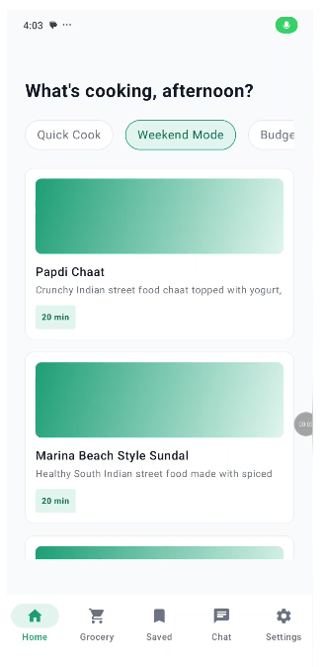
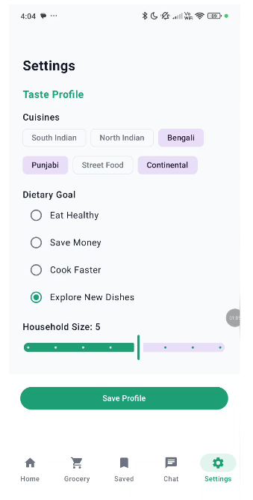
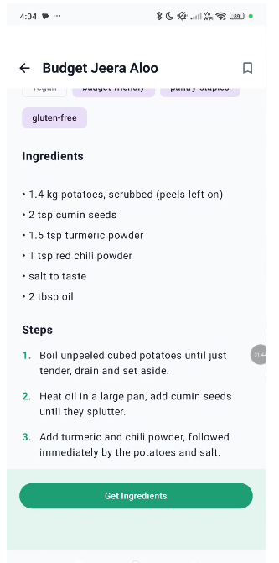
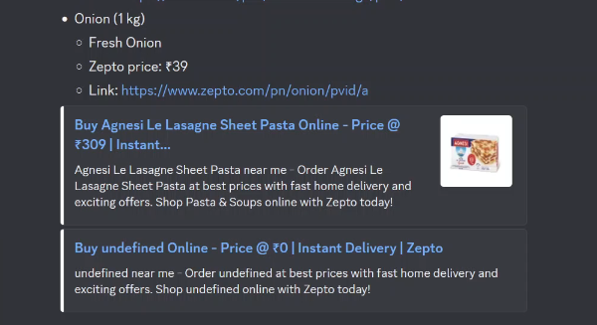
Idea
Demo/Product Walkthrough
Recipe Suggestions
Taste and Dietary Personalization
Fetching of Recipe
Fetching of ingredients from quick commerce sites at best possible price

Slide 6
Idea
Tech & Architecture
Tech Stack
Kotlin + Jetpack Compose + Material 3 (UI)
Room for offline saved recipes, SharedPreferences for user taste profile
OkHttp + Gson for all networking
AI Usage
OpenRouter — recipe generation, recipe customisation, and AI chat (streaming responses)
OpenClaw (self-hosted gateway, port 18789) — runs the grocery price agent using a custom skill
SearXNG (self-hosted, port 8888) — live web search that powers the OpenClaw agent across Blinkit, Zepto, and Instamart
System Flow
User selects a recipe and taps "Get Ingredients"
App sends each ingredient to the OpenClaw gateway running on the local machine
OpenClaw picks up the grocery skill and runs it against SearXNG
SearXNG searches Blinkit, Zepto, and Instamart in real time
Results are parsed, validated, and the cheapest option is flagged
App displays the live price comparison per ingredient

Slide 7
Idea
Impact & Use cases
Real-life scenarios
A working professional gets home at 8pm with no idea what to cook — selects "Quick Cook", gets 3 sub-30-minute Indian recipes with full steps, buys all ingredients from the cheapest store without opening a second app
A student on a tight budget selects "Budget Friendly", sees recipes under ₹150 per serving, and the price comparison confirms which store saves them the most that day
Someone on a health goal picks "Healthy", gets high-protein meals with full macros displayed, and shops for ingredients without overpaying out of app habit
A family cooking for the weekend selects "Weekend Mode", gets an elaborate slow-cooked recipe, pushes the full ingredient list to grocery in one tap instead of manually searching each item across three apps
Scale potential
Cooking is a daily decision for 50M+ urban Indians — this isn't a niche use case, it's a daily utility
Every percentage point shift from ordering out to cooking at home is a massive behavioural unlock — LobsterClaw sits right at that tipping point
The self-hosted AI stack means the cost per user doesn't scale with usage — making it viable to grow without burning on API costs

Slide 8
Idea
Differentiation
Why LobsterClaw stands out
Every existing app solves half the problem — recipe apps stop at inspiration, grocery apps stop at the cart. LobsterClaw is the only app that connects the two in a single flow, on the device already in your hand.
MOAT 1 — Self-hosted AI pipeline OpenClaw + SearXNG means the entire price intelligence layer is owned, not rented. No paid scraping APIs, no third-party price feeds, no rate limits. Competitors would need to build or license the same infrastructure to replicate it — and most won't bother because it looks like infra work, not product work.
MOAT 2 — Taste profile personalisation The onboarding isn't a filter — it's the prompt. Every recipe generated is shaped by the user's cuisine preferences, dietary goal, spice level, and household size from day one. The longer someone uses LobsterClaw, the more dialled in it gets. Switching to another app means starting from zero.

Slide 9
Idea
Demo Link
https://github.com/Tornado025/LobsterClawe

