Slide 1
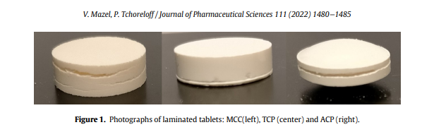
Types of lamination
1. Air entrapment
2. Die wall edge
3. High tensile stress at the center
Worse on tablets with high initial thickness because of high initial air content (Our 1D model can capture it)
Worse for ductile materials, i.e., materials that can be compressed very close to their true density
Happens during ejection
It occurs on the face that eject the last
when the tablet goes out of the die, due to the elastic recovery and to the residual die wall pressure, shear stresses develop at the edge of the die (next slide)
Only happens for biconvex tablets
Happens during decompression
Worse on tablets with low thickness
A plot of tensile strength vs residual stress is helpful to map out the failures due to either of these mechanisms

Slide 2
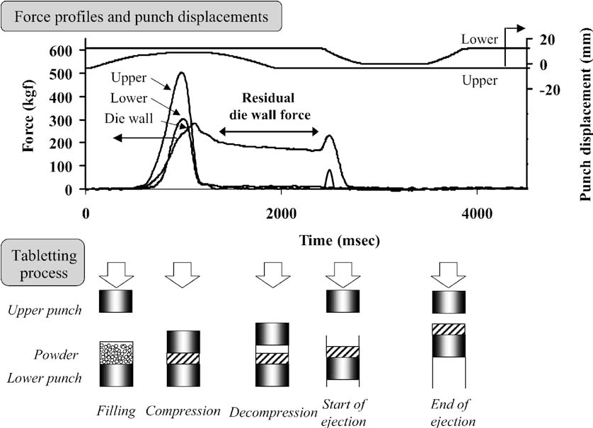
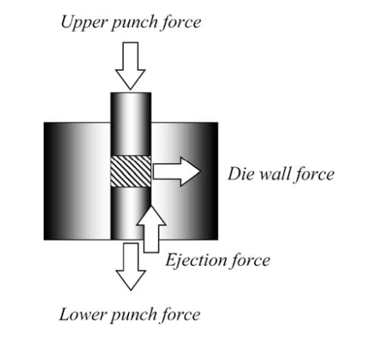
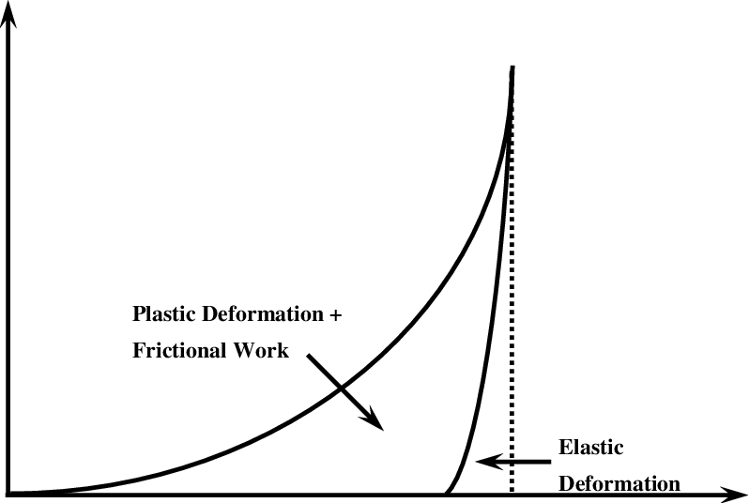
Compression stress
Takeuchi, Hirofumi, et al. "Die wall pressure measurement for evaluation of compaction property of pharmaceutical materials." International journal of pharmaceutics 274.1-2 (2004): 131-138.
Displacement

Slide 3
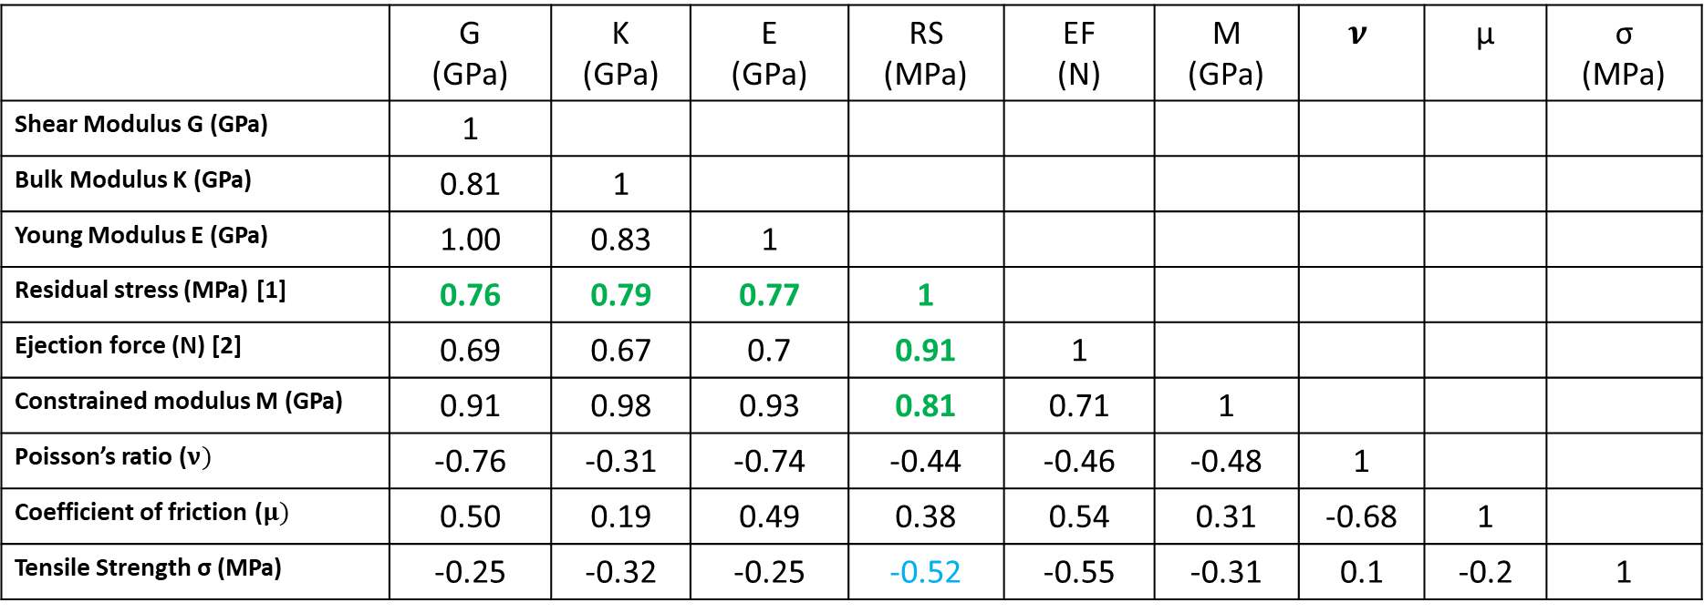
Is there any correlation between residual stress and material elasticity?
Correlation coefficient matrix
 | G (GPa) | K (GPa) | E (GPa) | RS (MPa) | EF (N) | M (GPa) | $$ν$$ | μ | σ (MPa)
Shear Modulus G (GPa) | 1
Bulk Modulus K (GPa) | 0.81 | 1
Young Modulus E (GPa) | 1.00 | 0.83 | 1
Residual stress (MPa) [1] | 0.76 | 0.79 | 0.77 | 1
Ejection force (N) [2] | 0.69 | 0.67 | 0.7 | 0.91 | 1
Constrained modulus M (GPa) | 0.91 | 0.98 | 0.93 | 0.81 | 0.71 | 1
Poisson’s ratio ($ν)$ | -0.76 | -0.31 | -0.74 | -0.44 | -0.46 | -0.48 | 1
Coefficient of friction ($μ)$ | 0.50 | 0.19 | 0.49 | 0.38 | 0.54 | 0.31 | -0.68 | 1
Tensile Strength σ (MPa) | -0.25 | -0.32 | -0.25 | -0.52 | -0.55 | -0.31 | 0.1 | -0.2 | 1
All elastic constants are correlated for a compact in a die.
Residual radial stress correlates with all moduli and ejection force.
Residual stress and tensile strength are not highly correlated.
Tensile strength does not correlate with any common moduli.
[1] see previous slide
[2] see previous slide

