Slide 1
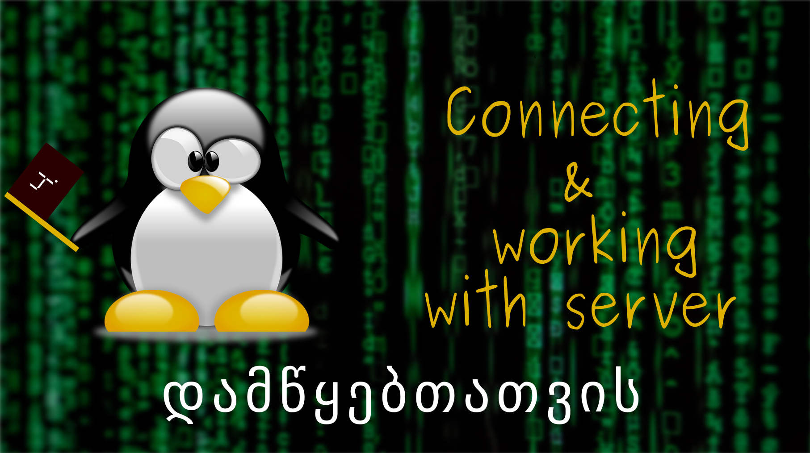
5/3/2120

Slide 2










Q1. Which one is a cloud provider?
ALL!

Slide 3

Q2.
  What is a server, software or hardware?

Slide 4
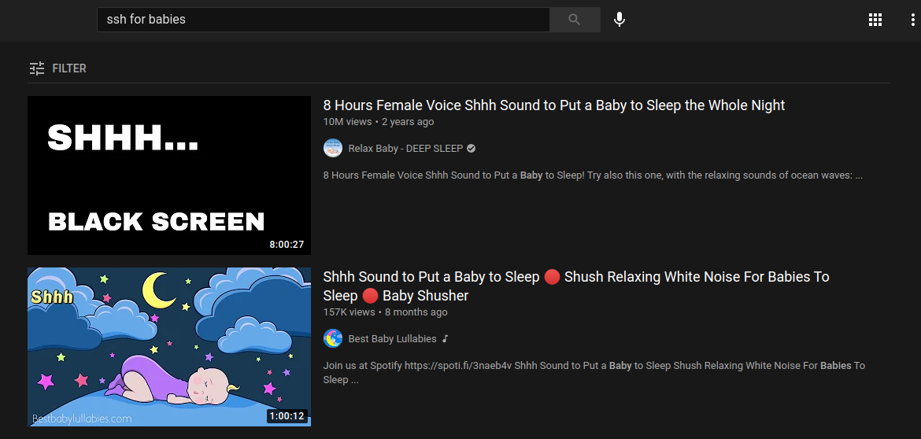
What is SSH?
Secure Shell
Gives access to a remote computer
Can be used with or without typing password every time

Slide 5

Using ssh
But wait, I do not have a server …
And I have Windows 😭
With password only (less secure)
With ssh keys (more secure)
ssh config file

Slide 6

Using scp
allows to copy files between computers/servers
SCP Syntax
Can be replaced with filezilla
not the best way to copy/transfer code files (use github)

