Slide 1

1/12/2120

Slide 2


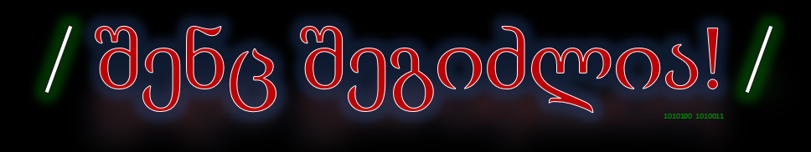
which terms are used in some CLI text/code editors?
Destroy?
copy
kill
yank
destroy

Slide 3
Install Nano & Vim
sudo apt install nano
sudo apt install vim

Slide 4
Nano vs Vim
Nano: Simple, good option for beginners
Vim: Much more complex, but very powerful

Slide 5

Basic operations
Open/Close editor/file(+already opened & no permissions cases)
Editing files, basic navigation and :
    text selection
    copy / paste (+from outside)
    undo / redo
    search
Save File

Slide 6
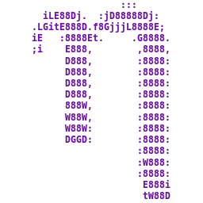
Nano editor

Slide 7

Vim Editor
Vim has modes
yy, G, gg, dd, shift a/i, 5j, ci{, 3p...

