Slide 1

1/4/2120

Slide 2
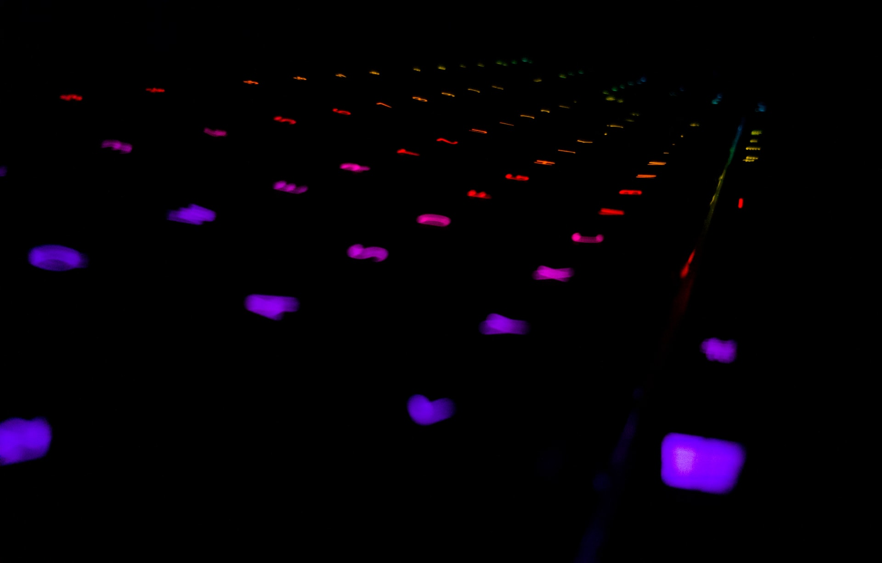
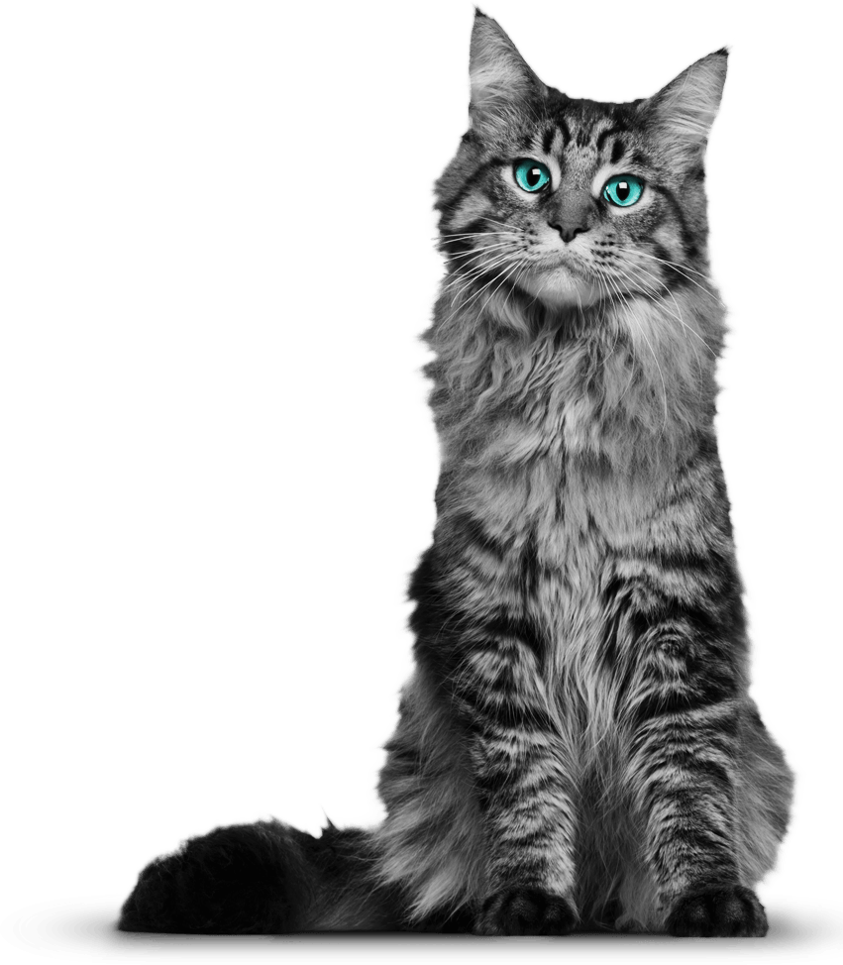

which one is not true?
command cal 2021 - displays 2021 year calendar with current date highlighted
command datetime - shows date, time and timezone on a computer
you can install and run aquarium in terminal
there is a concept of soft and hard links in shell

Slide 3
Good to know
type & other builtin commands
Ctrl + C / Z
how to use . and .. when navigating
spaces in filenames

Slide 4
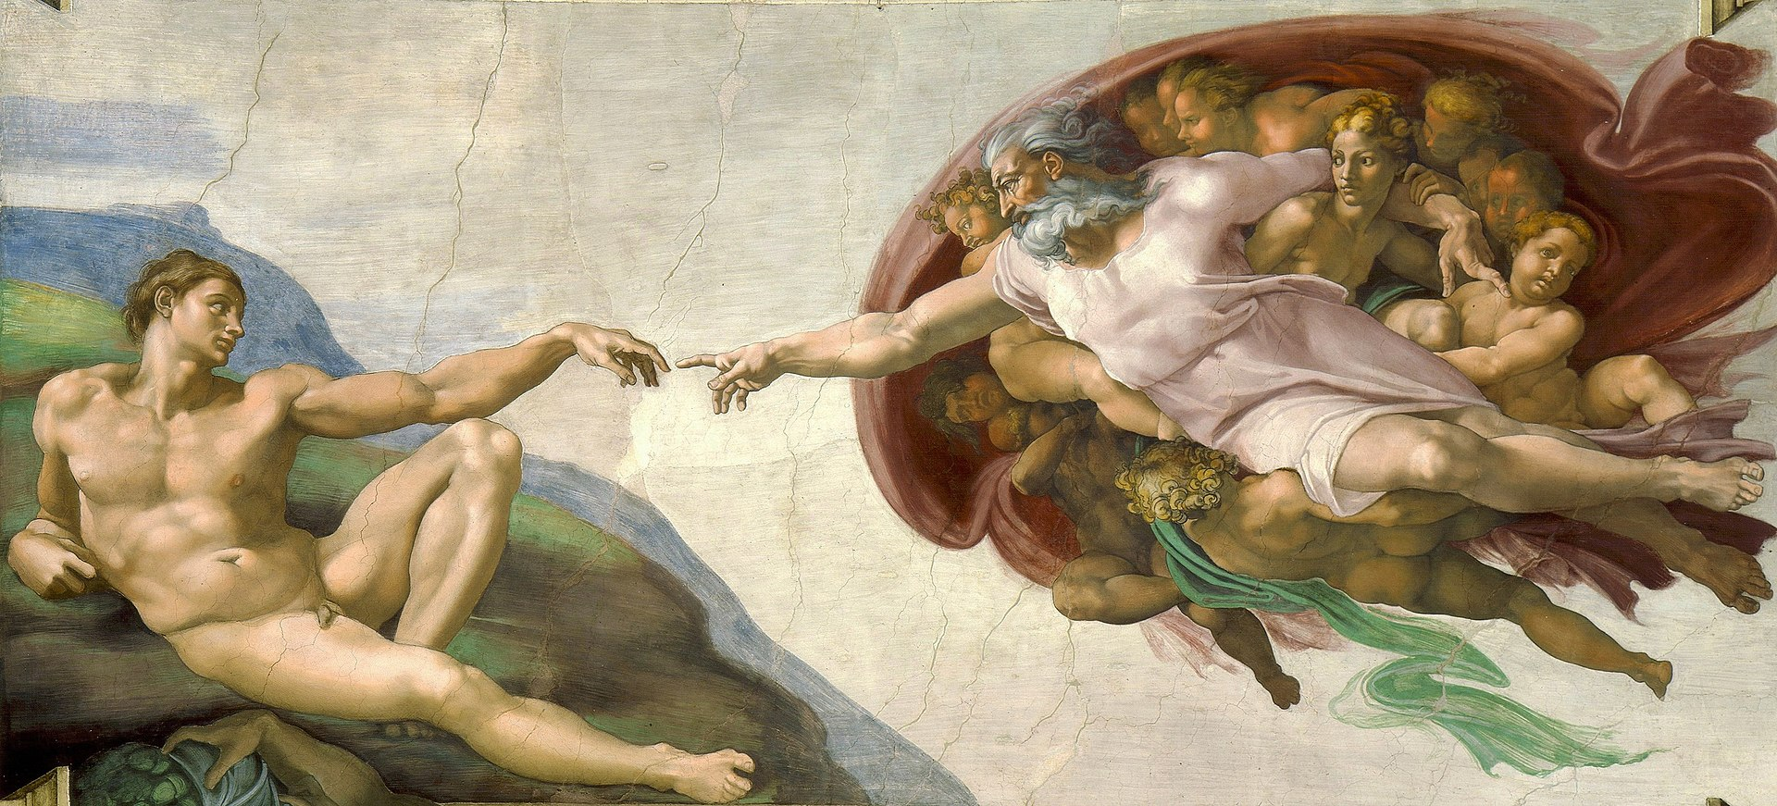
1. Create
mkdir (-p)
touch (or > filename 😎)

Slide 5
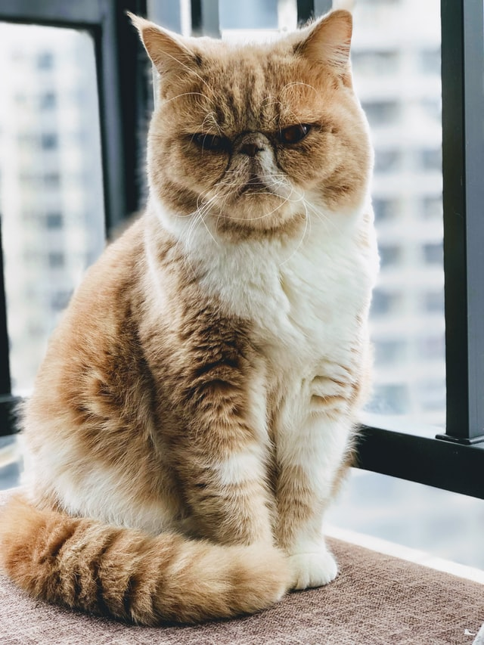
2. View
ls, cd, pwd, tree
cat, head / tail, more / less

Slide 6
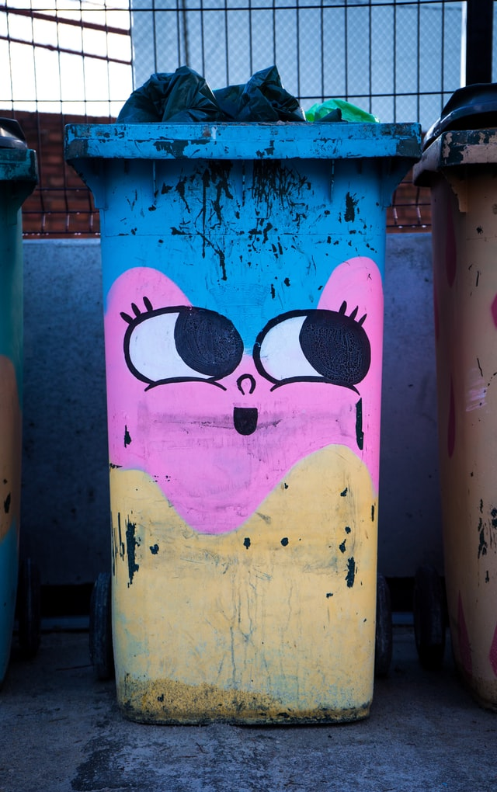
3. Delete
rmdir
rm (-d, -f, -r, -i …)

Slide 7
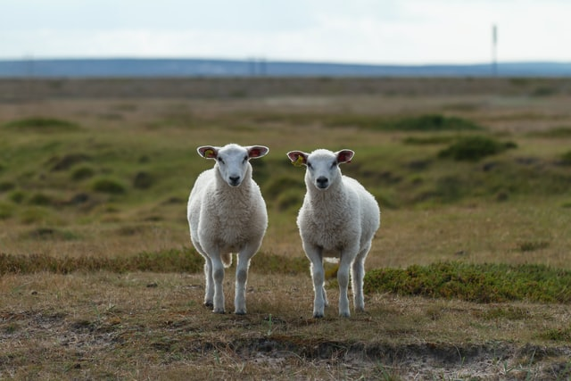
4. Copy
cp (-r/R, -i, -v…)
be careful with /-s after folder names

Slide 8

5. Rename / Move
mv (-r, -i, -v...)

Slide 9
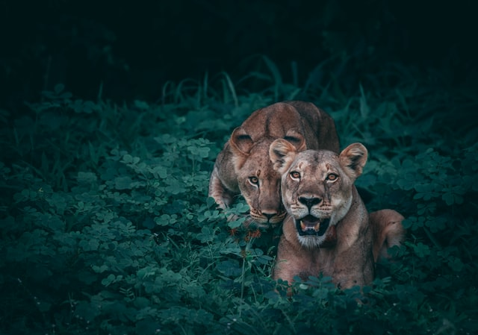
What are wildcards? (bonus)
* - matches everything
? - matches one character

Slide 10

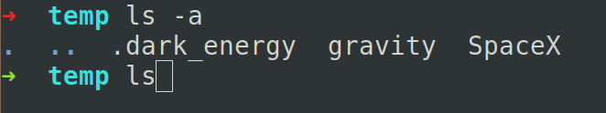
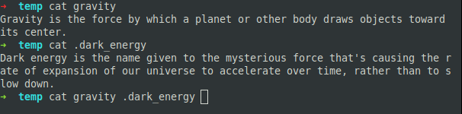
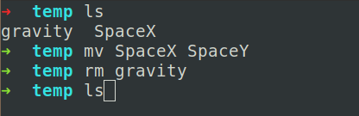
Quiz Time(1)
What will happen:
1.
2.
3.
4.

Slide 11
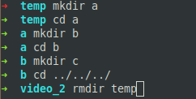
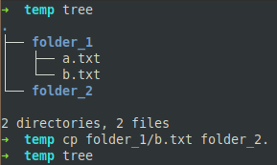
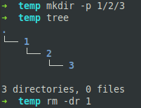

Quiz Time(2)
What will happen:
5.
6.
7.
8.

Slide 12
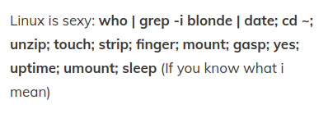
Practice
1. Which 1 letter is a shell command?
2. install aquarium in terminal
3. good article (18+) -
https://www.tecmint.com/20-funny-commands-of-linux-or-linux-is-fun-in-terminal/

