Slide 1

12/28/2020

Slide 2
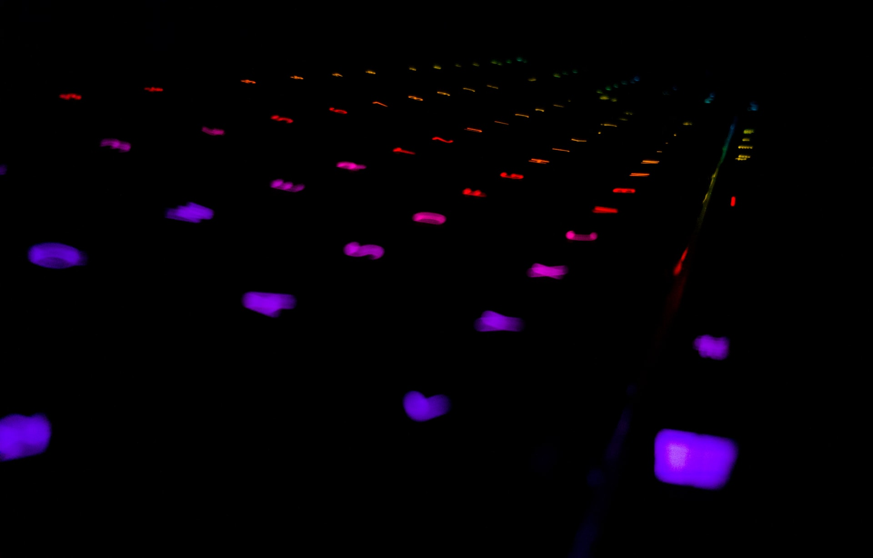


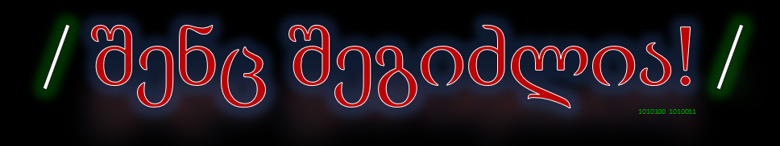
Which one is not a shell?
Sh
Zsh
Bsh
Dash
Bash
Fish
bsh

Slide 3

Hello bash!
Opening terminal (is it Bash/Sh/Dash ?)
Copy/Paste (Ctrl + C ?), Text Selection
Tab autocomplete
History

Slide 4

Other cool info
installing programs
what are flags? (-y, +y/n cases + q to quit)
Who is sudo?
Home folder ( /home/your_username )

Slide 5

Basic navigation commands
prompt and ~ (tilde symbol) in path
cd, lcd, ls, pwd - which one is not?
“ მოძრაობა და მხოლოდ მოძრაობა არის, ჩემო თერგო, ქვეყნის ღონისა და სიცოცხლის მიმცემი ”

Slide 6

Quiz Time
1. Default home folder for user programmer will be…
2. How can I install program tree with shell?
3. Name at least 3 different shells

Slide 7
Practice
1. Does Bash mean anything?
2. how can we get help about program/command in shell?
3. Find out how you can start 3 different programs using only terminal

