Slide 1

12/19/2020

Slide 2



After this course you will
Know Basic Linux commands
Be able to work with remote servers
Be able to make others think you can hack the WiFi/Facebook/Instagram e.t.c

Slide 3
Q/A
I do not plan to work as a software developer
What should I know?
How should I install Linux? Which one?
Minimum hardware requirements
:~$ whoami & რატომ ვწერ ინგლისურად?

Slide 4
Why Linux?
Free and Open source
More Secure
More stable
More Customization*

Slide 5



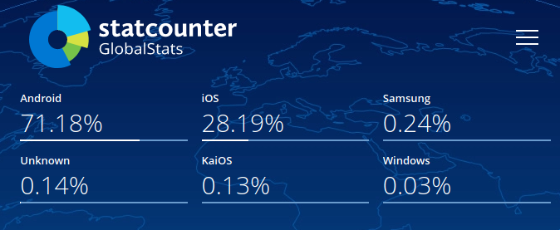

Do you use Linux?
* It is more popular than you may think

Slide 6
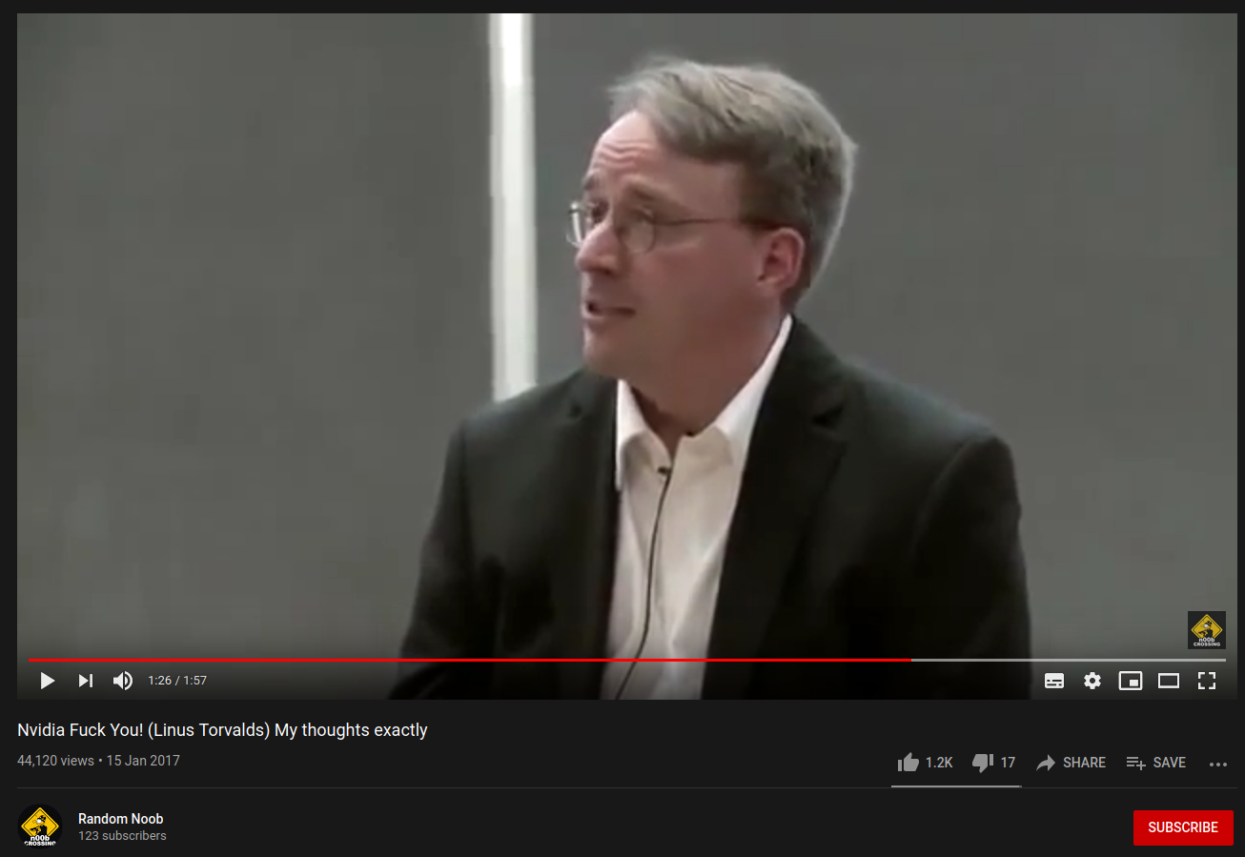
Who is he?

Slide 7

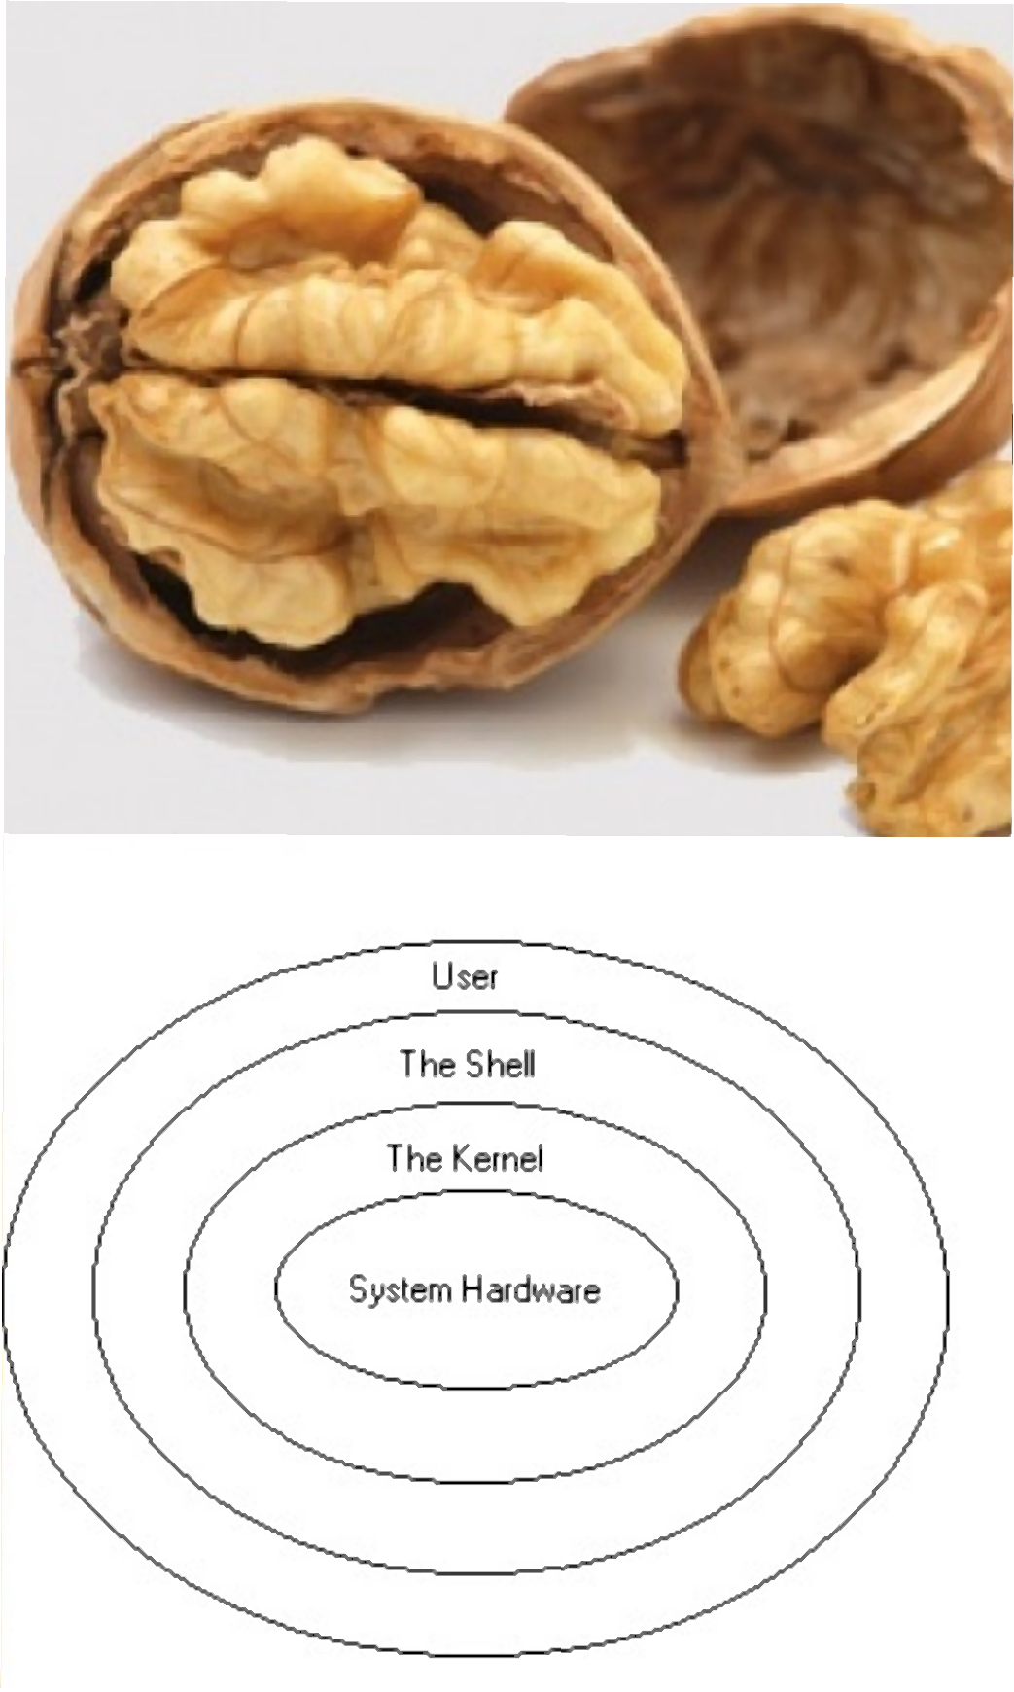
Useful to know
GNU / Linux ?
Linux / Unix ?
Terminal/Shell/Console/TTY
GUI & CLI
What is a linux distro/distribution?
Foss

Slide 8

Quiz Time
GUI / CLI stands for ...
Who created the first Linux kernel?

Slide 9
Practice
Install Linux on your computer
What is this audio about(listen)

