Slide 1


Wave-Based Resource Management
for Circuit Cutting in HPC–Quantum Convergence
ACM ICS 2026
Ricard S. Raigada-García¹ Josep Jorba¹ Sergio Iserte²
¹Universitat Oberta de Catalunya ²Barcelona Supercomputing Center
June 2026

Slide 2



The Problem
Circuit-cut fragments lack first-class scheduling
Existing frameworks
What HPC centres need
Cut circuits into fragments ✓ Execute them as a monolithic block QPU failure ⇒ entire job fails
No per-fragment retry or failover Cutting logic coupled to backend
Per-fragment routing: HPC · QPU · cloud Retry + failover without pipeline restart Cutting and scheduling evolve independently
Mature Slurm policies applied to quantum jobs
The gap: k=4 gate cuts produce 2 592 fragments. Existing frameworks schedule them as one atomic unit. DQR treats each fragment as a first-class schedulable unit.
R. S. Raigada-García – DQR: Wave-Based Dispatch for Circuit Cutting – ACM ICS 2026
2 / 5

Slide 3
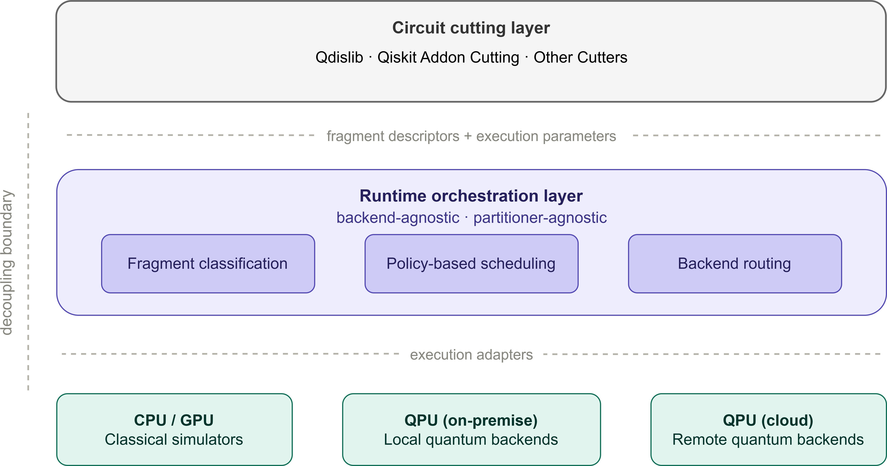
DQR: Dynamic Queue Router
Three contributions bridging HPC and quantum
Three Contributions
Fragment Abstraction
Backend-agnostic descriptor tuple. Scheduler never parses quantum cir-cuit code.
Wave-Based Dispatch
Non-blocking pipeline concurrency. Per-fragment retry & QPU→CPU failover.
Production Implementation
CESflA Qmio + IBM Torino (133 q cloud). Qdislib Qulacs QCore.
R. S. Raigada-García – DQR: Wave-Based Dispatch for Circuit Cutting – ACM ICS 2026
3 / 5
Runtime orchestration layer: fragment descriptors flow from the circuit cutting

Slide 4
Results on CESGA Qmio
32-qubit HEA · 2 real QPU backends · k=2 and k=4 cuts
1.11×
makespan vs CPU baseline
(L=1, Policy A)
5 %
DQR coordination overhead
(L=2, 2 592 fragments)
0
pipeline restarts
during QPU failover
Without DQR
With DQR
Qmio rejects 2 fragments (unsupported control-flow).
QPU incompatibility ⇒ entire job fails.
Manual re-submission required.
Qmio rejects 2 fragments → max retries exceeded
→ DQR re-labels QC→HPC
→ CPU simulation: SUCCESS
→ all 72 fragments complete, 0 restarts, no intervention
L=2 (2 592 frags): 55% of DQR-time = IBM Cloud round-trip latency; 40% = HPC critical path running in parallel; 5% = fixed coordination residual.
R. S. Raigada-García – DQR: Wave-Based Dispatch for Circuit Cutting – ACM ICS 2026
4 / 5

Slide 5


Thank You
rraigadag@uoc.edu
Universitat Oberta de Catalunya
Wave-Based Resource Management for Circuit Cutting in HPC–Quantum Convergence
Raigada-García; Josep Jorba; Sergio Iserte UOC BSC CESGA — 2026

