Slide 1

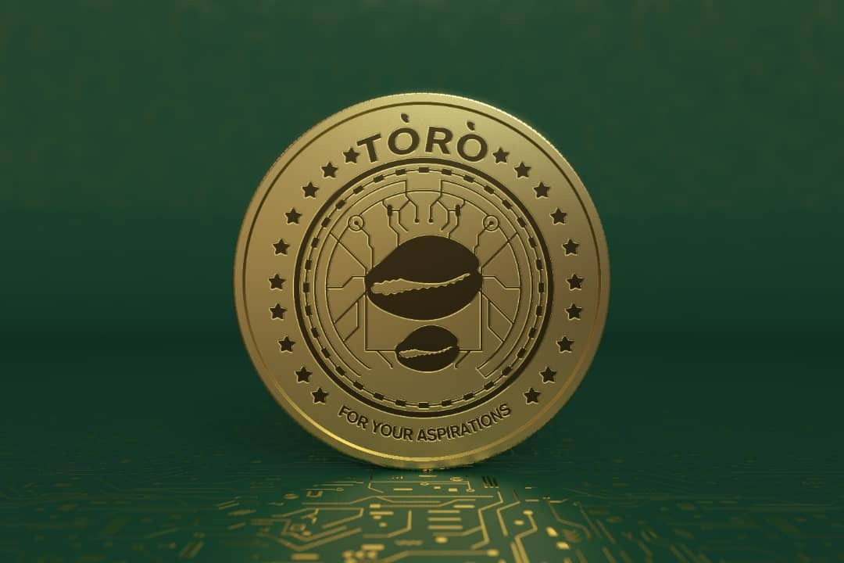
Tórónet Platform, Ecosystem & Distributed Autonomous Organization (DAO)
Financial Inclusion & well-being through technology
We are building the ecosystem that helps make aspirational products and opportunities, more accessible for millions of people
Notes:
1. Table of contents
2. Introduction
3. Our company
4. Our team
5. Problem
6. Them vs. us
7. Solution
8. SWOT analysis
9. Product overview
10. Our plans
11. Product demo
12. Traction
13. Case study
14. Reviews
15. Awards
16. Market size
17. Target
18. Competitors
19. Business model
20. Timing
21. Predicted growth
22. Investment

Slide 2
Contents
Here’s what you’ll find in this presentation:
Introduction
Gaps in Current Financial System
Addressing the Gap with Tórónet
About Tórónet
The Platform
Tórónet Association
The DAO
Tórónet Technologies
Projects on the Platform
Meet the Team
Road Map
Rollout Plan

Slide 3
Sections
01
02
03
04
Section A
Section B
Gaps in current Solutions
Addressing the Gap with Tórónet
Section C
Section D
About the Platform, Association, DAO, Technologies, and Projects
The Team, Next Steps,Rollout Plans, and Projections

Slide 4
01
Section A
Gaps in current Solutions

Slide 5
Introduction
Millions of people across the world are unable to meet their “aspirations for Shelter, Food, Energy, Credit, Smart-phones ( the 21st century gateway into dignified work) , clean environment & equity a reality.
Tórónet is a platform & inclusive ecosystem that helps make aspirational products and opportunities, more accessible for millions of people in rural, unbanked, and underbanked communities so that growth and development is a reality not a dream for the population in focus.

Slide 6
Gaps in Current Systems and Solutions
The communities in focus are mostly rural, unbanked and underbanked
Traditional financial systems have not addressed the needs of these communities
Emerging financial technologies have not addressed this gap either but have features that provide some promise.

Slide 7
Gaps in Current Systems and Solutions
Gaps in Traditional Financial Systems
Traditional finance has not addressed the needs of this communities in nearly a century
Requires significant infrastructure in form of branches and ATMs that would not be cost-effective to deploy as extensively in rural communities
Requires trust structures that has failed these communities
Structurally unable to build a credit scoring and history system for these communities
Has resulted in loan rates at 30% and greater
High default rates
Poor grants utilization and delivery success rates
The finance rates and systems leave these communities falling further behind.

Slide 8
Gaps in Current Systems and Solutions
Potential in Emerging and Decentralized Financial Systems
Emerging technology in finance has not penetrated these communities in recent years either:
Digital assets have a penetration advantage since the needed infrastructure and devices can simply be mobile phones
Requires less costly infrastructure
Could potentially deliver lower costs per transaction
Inherent trust structures based on smart contracts can be deployed to address some of the trust gaps, reduce potential default and fraud rates in finance and grants administration.

Slide 9
Gaps in Current Systems and Solutions
Gaps in Emerging and Decentralized Financial Systems
Emerging decentralized financial technologies have not penetrated these communities in the years since their introduction:
Current implementations have not been built right to be usable in these communities
Transaction costs are too high (Bitcoin transaction now at about USD 30/transaction, Ethereum USD 20/transaction
Average transactions are about USD 2 in these communities
Speed of transaction does not permit in person transactions at markets and stores.
The entire concept of lose your primary keys – lose your assets will never find mass adoption in these communities

Slide 10
“The Internet of Money should not cost 5 cents per transaction.”
—Vitalik Buterin, 2016

Slide 11
Gaps in Current Systems and Solutions
Emerging decentralized financial technologies have not penetrated these communities in the years since their introduction:
Excessive hacks and security breaches targeting end users, fraudulent projects, rug pulls, Ponzi-like deflationary token schemes relying on new users but with no real use case, all combine to ensure these communities have not adopted nor will rely on these platforms as their main financial ecosystem.
Trust is crucially more important in these communities, where protection by a central regulator tends to be weaker
Gaps in Emerging and Decentralized Financial Systems (cont’d)

Slide 12
Gaps in Current Systems and Solutions
Gaps in Emerging and Decentralized Financial Systems (cont’d)
Emerging decentralized financial technologies have not penetrated these communities in the years since their introduction:
Having some semblance of technology and user support is going to be pivotal to these communities
Ability to move their assets freely between platforms and to traditional financial systems will also be key
Emerging decentralized technologies and solutions may be new, but the reason for low adoption is because they are currently not built correctly for these communities

Slide 13
02
Section B
How Tórónet Addresses the Gaps in current Solutions

Slide 14
How Tórónet Addresses the Gaps (contd)
Tórónet Tokens are Intrinsically Cross Chain
Tórónet founders are early proponents of separating assets from chains, in the same manner as fiat assets can move across different platforms in traditional finance.
At Tórónet we believe blockchain tokens should result in more financial freedom for users, including the freedom to move their assets freely to other blockchains or even to fiat as they need.
The project will focus on making Tórónet tokens interoperable with as many leading blockchains as possible as well as on and off ramp to fiat gateways.
Tórónet developers have published several articles on delivering cross-chain assets: https://cointelegraph.com/news/blockchains-need-to-move-toward-standards-for-interoperable-asset-transfers

Slide 15
How Tórónet Addresses the Gaps (contd)
Focus on security
Trust is one of the barriers to adoption of blockchains in many unbanked and underbanked communities
Testimonies of investment in assets that resulted in rug pulls, hacks, deflationary ponzi-like schemes that see some tokens drop in value by up to 80% within weeks abound, and cause wariness among many in the communities of focus
We believe assets should be grounded in sound financial basis, and projects that are accepted by the community will typically be based on such assets.

Slide 16
Focussing on real problems facing real people that financial inclusion through technology can solve
01
02
03
Ubuntu Economy
Digital Economic Inclusion via smart phones
Shelter Economy Inclusion via affordable homes
05
06
7
04
Financial Inclusion economy
Affordable Food Economy
Energy Economy
Environment Economy

Slide 17
Tórónet Projects
Examples of projects sought by the community
Decentralized Financing
Community Projects
Social Impact Projects
Agricultural financing, sustainable energy, environmental impact projects utilizing smart contracts to facilitate trust
Cooperatives, Credit unions, Community organizations that seek to solve market linkage and payment inefficiency problems.
Financing of real-life projects that spurs growth in communities
Smart phones
Homes and mortgages
Vehicles and Transportation

Slide 18
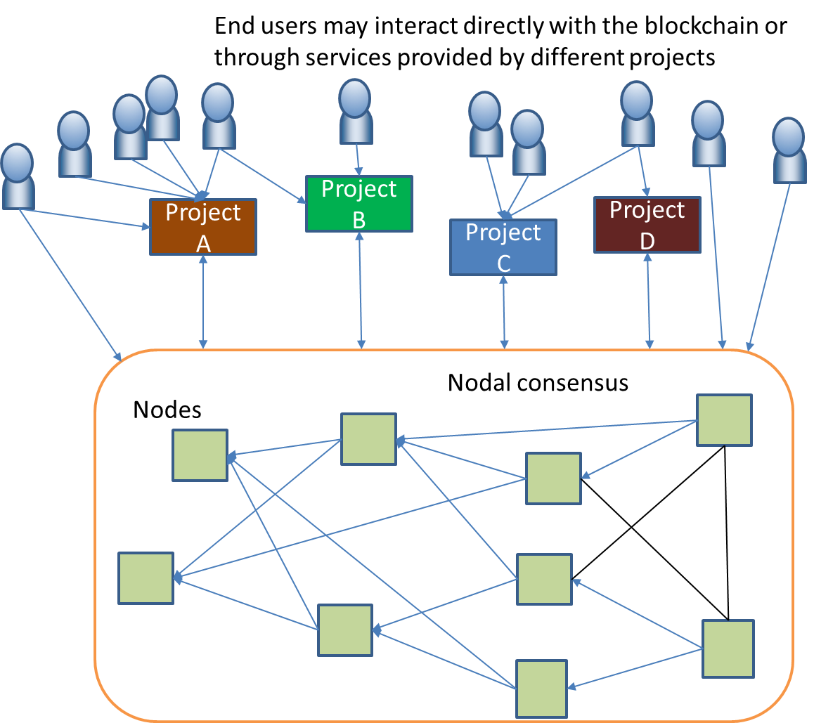
How Tórónet Addresses the Gaps (contd)
Tórónet architecture is decentralized but allows projects on the platform to operate independently with decentralized or centralized architecture to fit the needs of their users and conform to regulations in their jurisdictions
Projects can require KYC and AML from their users to fit their use case.
The blockchain has in-built features to enable users indicate they allow KYC on their blockchain addresses
Users can maintain multiple addresses for different services, and choose to enable KYC on their addresses based on their needs
Users can recover assets in KYC’d accounts, or through a petition to the DAO using the same consensus model of the entire network.
Besides KYC for their own users, projects are more tightly connected to their communities, and will typically offer technical support to their users

Slide 19
How Tórónet Addresses the Gaps (contd)
Trust is a key element within communities valuable to Tórónet
Projects also need to be accepted by the community based on the consensus decision via the Tórónet DAO.
Projects that create tokens out of nothing are unlikely to have a platform based on community consensus via the DAO.
The types of projects that the network seeks includes community development tokens of rural and agricultural cooperatives and organizations.
Projects geared towards microloans for those out of reach of typical traditional loans, sustainability projects, natural resource mining transparency and recording, and projects enabling agricultural loans, grants, supply chain, storage, and produce delivery.

Slide 20
How Tórónet Addresses the Gaps (contd)
Focus on security
Vaults and tokens are developed to the utmost state of the art to ensure rug pulls and many of the careless incidents that result in hacks are prevented:
Founders and operators of the blockchain have full technical knowledge of the technology and do not repose keys to vaults with developers
Owner access to contracts are not exposed to external calls
All transactions are monitored daily and all contracts have pause functions to enable tight control in very timely manner
Transactions between reserves have multi-sig functionality as well as time lapses built-in.
All vulnerabilities and reports are monitored daily by a technical team that includes some of the most experienced security experts in the blockchain field
See for instance: https://github.com/Toronet/SmartContracts/blob/main/eth_bridge/eth_bridge.sol

Slide 21
How Tórónet Addresses the Gaps (contd)
By utilizing a modified proof of stake and proof of authority consensus model
All nodes stake resources so they can be trusted to write blocks of transactions
Block mining does not need to be slowed down or have nodes perform costly math transactions.
Node stake provides a “bond” for the blocks they are writing. If malicious transactions are written by any node, the node stake automatically is used to offset the transaction
The total value of transactions that nodes can commit per week is limited to the amount staked.

Slide 22
How Tórónet Addresses the Gaps (contd)
By utilizing a modified proof of stake and proof of authority consensus model
Nodes are decentralized and independent of each other, but need to be voted in by the entire community via a DAO
This provides an additional level of security as nodes are also vetted by the community via their votes.

Slide 23
Tórónet Features - Summary
Costs
Speed
Capacity
Low cost transactions Less than 5c/transaction
Transactions committed in average of 2 seconds
Can handle over 30,000 transactions/seconds

Slide 24
03
Section C
About the Platform, Association, DAO, Technologies, and Projects

Slide 25
The Tórónet Network
01
03
Tórónet Association
Tórónet Technologies
02
04
Tórónet DAO
Tórónet Nodes and Projects

Slide 26
Tórónet Association
Registered as an Association in Swiss canton of Geneva Swiss Central Business Name Index https://www.zefix.ch/en/search/entity/list/firm/1519673
Non-profit Association
Organizes and prepares submissions for DAO votes
Receives submissions for network node membership
Receives 20% of all gains from the network for funding of developmental projects in communities of focus to the network

Slide 27
Tórónet DAO
The DAO enables the community to participate in running the organization
DAO decisions are determined via votes based on governance tokens.
Includes votes on admission of nodes and projects
Fees and rate margins
The governance tokens are called ToroG
Some of the DAO proposals that update smart contract properties such as fees and rates are written into DAO smart contracts so that the results are also automatically implemented by the smart contract.

Slide 28
Tórónet DAO
The DAO enables the community to participate in running the organization (cont’d)
There are only 35 million ToroGs, minted with the genesis block
ToroGs are needed to deploy smart contracts
ToroGs are also distributed to members of the network as follows :
Acknowledging the past :
- Vission bearers – {10%)
TòròNet development sponsors {20%}
TòròNet Team comprising {20%}
Incentivising the future :
TòròNet Network members , the nodes {15%)
TòròNet Association/reserves {10%)
TòròNet Community – {25%}
ToroGs are reserved and not released to any external exchange for at least one year from their release.

Slide 29
Tórónet Technologies
The technology and all development of the program was funded by Vorien Corelli, and TutorCentral over a span of five years.
Coding and development was done by TutorCentral.
A special vehicle – Tórónet Technologies - is created to hold the development assets and initial investment in creating the network.
The codes will be released incrementally as open source over the next five years allowing the network the space to grow and protect its intellectual property.
The open source github is at: https://github.com/Toronet
Some of the codes are already available on the hub.
Tórónet developer will be responsible for deciding and financing changes to the code long term.

Slide 30
04
Section D
The Team, Next Steps,Rollout Plans, and Projections

Slide 31
Tórónet Multi-Disciplinary Team
Tórónet consists of top technology experts, programmers, researchers, and professors with user applications in some of the top companies in the world, and peer-reviewed publications in blockchain technology and other leading-edge technology.
The team includes technology experts with expertise in not just blockchain but also published research in other relevant technology including machine learning and financial tools, and business processes.
What also differentiates Tórónet team from other blockchain focused teams is an equal focus on process and operations. This is particularly important for projects that are likely to gain adoption in under banked communities where regulatory protections are usually weaker and trust and process are key determinants for success
The team includes some of the most accomplished process experts in delivering solutions within rural communities, as well as former process and technology consultants focusing on the same communities.

Slide 32
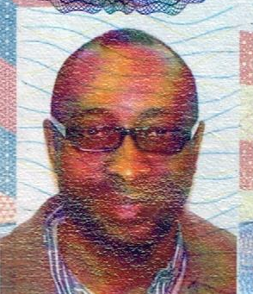

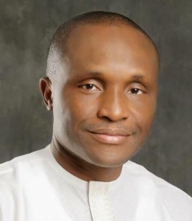





Tórónet Team
Dr. Ken Alabi
Bolaji Akinboro
Expert in payment systems with over 7 years experience at major payments organizations. Former process and technology consultant at Accenture. Accomplished researcher with over 30 publications in technolgy journals and conferences. Has developed solutions that are currently in use in several major defense and aerospace companies in the US. Leading proponent of interoperable blockchains with several blockchain publications and peer reviewed articles. https://www.linkedin.com/in/kenalabi/
Chairman and founder of Vorian Corelli, an Agritech matching company that has now delivered equivalent of 200m meals within the past year. He also co-founded Cellulant , a pan-african fintech & executed the largest subsidy program in Africa for the Nigerian government . He launched and led Procter and Gamble ops in Ghana Has operational tenure in several countries: Ghana, Kenya, Malawi, Nigeria, and Tanzania. He is One of the leading process, operations and supply chain experts in the African subcontinent. https://www.linkedin.com/in/bolaji-akinboro
Dr. Ndidi Nnoli- Edozien
Dr. Wenhai Li
Arkan Akin
Blockchain expert, professor, and researcher with several year’s experience implementing technology solutions. Has developed solutions that are currently in use in several major defense and aerospace companies in the US. https://www.farmingdale.edu/faculty/?fid=80516
Digital asset specialist providing communications and custodial services. Avid publisher and proponent of blockhain for social change. https://www.linkedin.com/in/akinarkan/
Expert in ESG, climate, and sustainability. Member of the Club of Rome. Has led many grant and development inittiatives with experience spanning Europe and Africa. https://www.linkedin.com/in/dr-ndidi-nnoli-edozien

Slide 33
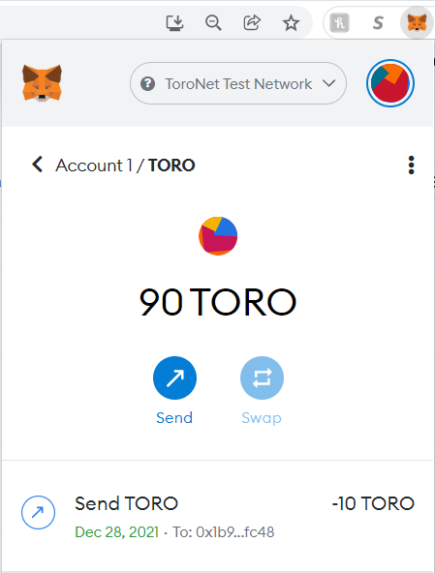
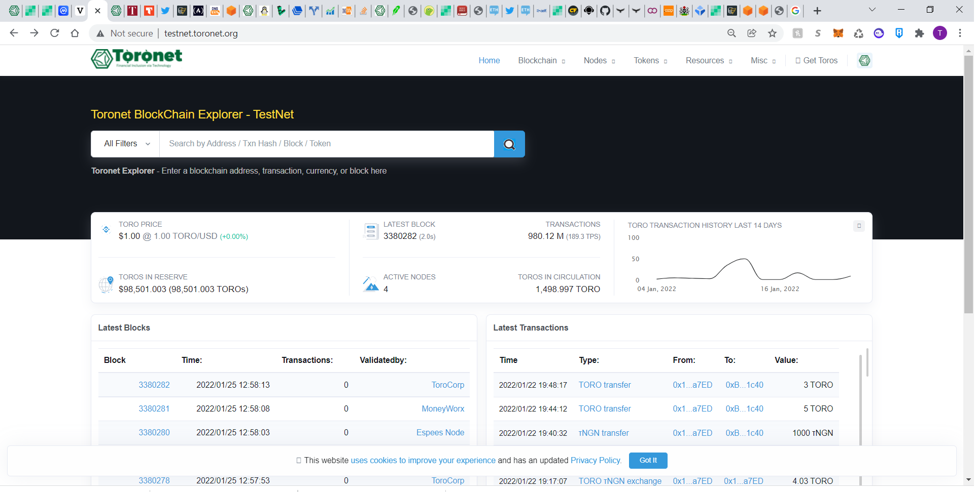
Current Sites and Applications
Current Project Sites, Applications, and Resources:
Testnet
Testnet Explorer
Testnet Walled
Mainnet
Mainnet Explorer
Mainnet Wallet
Standard ERC20 Wallets
Metamask
Brave Browser Wallet
Community sites
Medium Page
Github
Twitter, Discord, Youtube, Facebook

Slide 34
Current Projects on Tórónet and Status
Project | Description | Status
Espees | Token for a community with over 5 million members and chapter in several countries | Live
Aspiro | Decentralized financing of developmental aspirations in several African countries | In Development
EMI | Decentralized finance allowing members to stake to provide financing for verified and secured assets (smart phones) in under banked communities | In Development
Assetteria | Decentralized market place bringing together small investors with micro-financing needs in several Latin American markets | Currently in talks to join

Slide 35
Roadmap
Release
Expand
2021
Go live and open up the network. Launch the with the community
2023
Expand to multiple communities and continents enhancing financial inclusion in under represented communities.
Grow
Develop
Develop the technology. Start and test the concept. Launch mainnet
2022
Expand the projects on the network. Provide development assistance to community and agric initiatives
2024

Slide 36
Release Plan
Prepare the rollout plan (completed)
Prepare media plan (completed)
Prepare rollout financing plan (completed)
Prepare the release team (hiring in progress)
Prepare press releases (completed)
Execute the press release, media and social media plan
Execute the community governance token release plan
Complete a token exchange of 1m of the DAO governance tokens

Slide 37
Funding with Governance Tokens
For the first five years and up till Mainnet launch Tórónet has been self funded by the team (Vorian Correlli and Tutor Central)
The team was seeking to prove the project and ensure fidelity to its original vision rather than become a vehicle controlled by venture funds
Subsequent to go-live, funding will be required to ensure an effective release and rollout, as well as establishment of the Association’s mandate before fees on the network would be sufficient to sustain the Association’s operations
The team is seeking to exchange 1m of the DAO’s governance tokens at 50USD per token

Slide 38
Funding with Governance Tokens (cont’d)
The team is seeking to exchange 1m of the DAO’s governance tokens at 50 USD per token
Release is on a first taker basis until the allocation is completely acquired
Enables investors that acquire the tokens to participate in governance decision similar to how venture funds influence their companies, to the extent of their stake or percentage of governance tokens held
Benefit from potential increase in the value of the network, demand for tokens from the utility of the tokens for executing smart contracts and starting projects, as well as the demand by projects and nodes to increase their share of stake in the network
Reserving only portions of the governance tokens for exchange, retains focus and control within the community, and will likely ensure success while still providing value to early adopters, investors, the development and founding team, and the entire community
The valuation of the governance tokens compares favorably with other similar projects (next slide.)

Slide 39
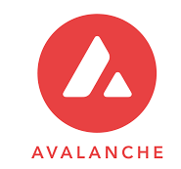
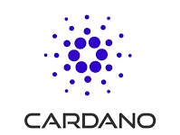
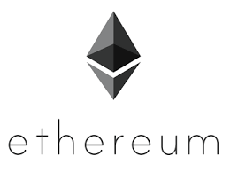
Token Valuation Compared to Other Projects
15b
34b
285b
1.65b
Avalanche
ADA
Ethereum
Tórónet
Has fully functioning mainnet and smart contract platform
Fast and low-cost transactions.
Strong technical team focusing on blockchain technology
Platform to several projects that are likely to inhibit adoption in underbanked communities
Supply uncapped, mints rewards to miners
Has fully functioning mainnet. Smart contract platform currently not scalable
Fast and low-cost transactions.
Peer-reviewed, and strong team focusing on blockchain technology.
Slightly active in the African continent with agreements
Supply uncapped, mints rewards to miners
First and top smart contract platform
Has fully functioning mainnet. Trying to transition to proof of stake the past five years. Still has some years to go
Average transactions cost > 20 USD
Transaction finality at nearly 1 minute
Decentralized, but with no specific focus on building for underbanked communities
Supply uncapped, mints rewards to miners
Has fully functioning mainnet and smart contract platform
Fast and low-cost transactions.
Strong technical team with experience in process and technology
Projects are approved by the community and returns the concept of good customer support and community focus
Supply capped, mints rewards to miners

Slide 40
Conclusion

Slide 41
A Vehicle for Accelerating Development
The gap between the communities that are underbanked continues to widen
Lack of financing results in less entrepreneurship, and fewer opportunities
Tórónet was conceived to provide a vehicle to break that cycle to a large extent
Trust is a key part of what is missing in prior and current efforts to address this gap, and aids and loans will not bridge that trust gap. Neither will virtually most current blockchain projects.
Tórónet utilizing key technologies that ensures transparency, and the immutability and self enforcement inherent in smart contracts on decentralized ledgers has developed constructs to bridge that gap.
Vision founders of Tórónet network have spent the past five years funding and developing the technology to deliver the platform. Tórónet is developed in stablecoin form and not influenced by bitcoin halving cycles.
The platform is now live with the launch of the mainnet and opening up to the next phase. We invite you to join the community that will deliver this platform, and enjoy the gains of its growth in the process.

