Slide 1
Spark in production pipelines
Experiences from Amazon Forecasting
Notes:
I’m going to talk about how we use Spark in Amazon Forecasting.
This will be a high-level presentation about some of the issues we encountered in our specific usage pattern, and the solutions we are coming up with.
This may or may not correspond to how you are using Spark in your environment, but it might be useful for you to look through our windows and see how we approach these things.

Slide 2
Amazon Forecasting
We forecast demand for products we sell
Fascinating machine learning problem
Use any data we can get our hands on
Constantly experiment with new methods of forecasting
Notes:
What is Amazon Forecasting and what does it do?
We are part of larger Supply-Chain Optimization Technologies (SCOT) organization.
Our job is to forecast demand for products being sold on Amazon.com. Our forecasts are then used to decide how much of each item to buy, from which vendor, when to place the order and where to put the goods.
With due respect to self-driving cars, this one is a pretty fascinating machine learning problem, and there are teams of scientists working on this, creating new algorithms every day.
They are using every bit of data they can get their hands on, and constantly invent new methods of forecasting.

Slide 3
Amazon Environment
Two-Pizza Teams
SOA – services
  We hate code dependencies
Oncall rotation
Lots of data
  20PB of data in archive
  1PB of data (parquet, compressed) used in Forecasting
Notes:
So before we jump into the details, let’s talk about the engineering aspects of environment we operate in.
These are well-known things about Amazon.
The Two-Pizza teams is an iconic Amazon concept. All work is done by teams that can be fed with two pizzas. This is a forcing factor, making us constantly think how to break down problems, define ownership and promote independence. This is working great throughout the company.
The SOA (Service-Oriented Architecture) is another well-known Amazon concept. We hate code dependencies. If at all possible, we like things to be structured as a service. You may have read the famous ex-Amazonian (now Googler) rant about how Amazon gets it right. And we do get it right.
Maintenance and support is another big thing. Teams are responsible for supporting their services. We have an “oncall rotation”, where each team member will walk around with pager, ready to jump in and fix things 24/7 – usually for a week. So teams are really motivated to make their services as stable as possible.
We have lots of data. The specific numbers might be misleading, as they depend how you measure. But ”petabyte scale” pretty much sums it up. We have multiple petabytes of data stored, and cumulatively processed on daily basis.

Slide 4
Forecasting Environment
Forecast
Forecasting storage
Data sources
Forecasting workflow
Notes:
Now we can take a more detailed look at our Forecastig environment.

Slide 5
Forecasting Environment
A mix of legacy, current and future applications
  Constantly developing infrastructure
  Hadoop / HDFS Legacy applications
  Cannot assume uniform, homogeneous environment
Spark on EMR is being used in new applications
Hadoop on permanent shared cluster is being used in legacy applications
Permanent data on S3, consumed directly
Complicated workflow with many stages, culminating in creation of the forecast
Separate team is tasked with data acquisition
Notes:
So now let’s look at the environment Forecasting operates in.

Slide 6
Big data is hard
Most of the problems are solved elsewhere, but
  …not at the same time!
No pre-existing knowledge base, industry standards, best practices
  RDBMS technology exists since 1970’s
  MapReduce exists since 2004
  Spark exists since 2012
  Spark as a production tool?...
These new technologies must be made stable enough to serve Amazon production

Slide 7
Wrapping Spark
Do not do it!
We have wrapped Hadoop. Did it help for Spark migration?
Implement transformations as sharable components exchanging Spark primitives

Slide 8
Dataset concepts
Datasets and not files!
  ”I have a dataset stored in Parquet file…”
  “My dataset is already in a CSV file…”
Datasets are not directories, either!
Logical entities, with some similarity to tables, but also some differences.
  Partitioned
  Accessible
  Versioned
  Immutable
  Durable

Slide 9
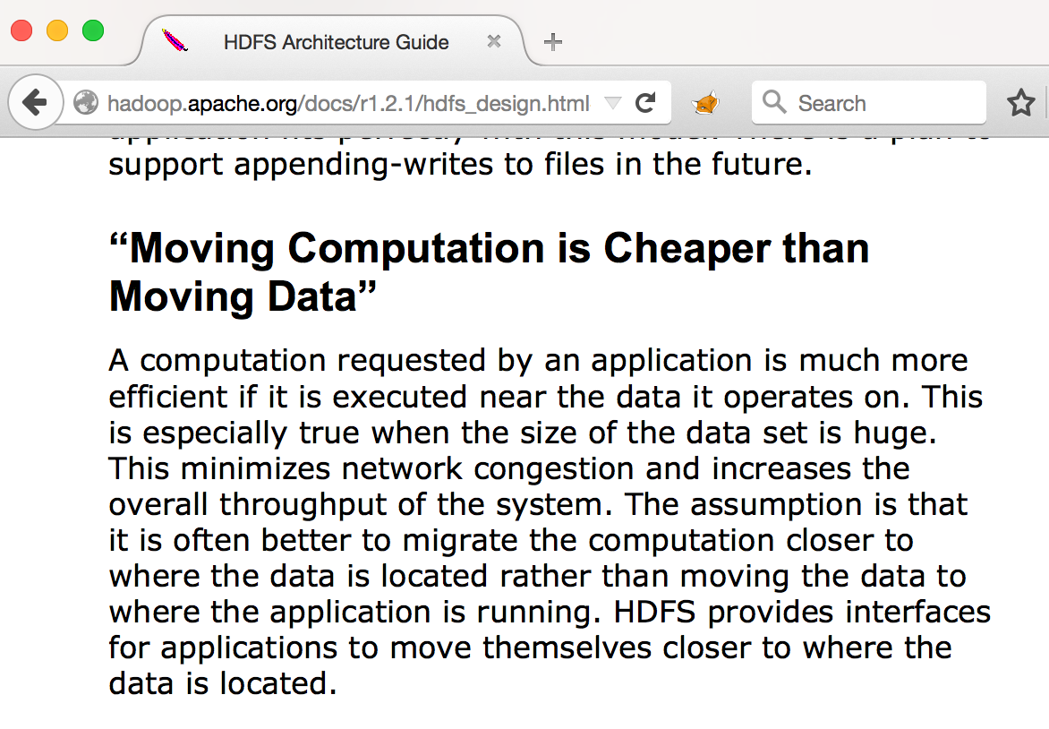
Store / Compute Separation

Slide 10
Store / Compute Separation
Moving computation is way more expensive than moving data
  Computation requires permissions
  Computation produces dependencies
  Computation requires compatibility
Data storage makes hardware stateful… and precious!
  Cannot swap out one cluster for another
  Cannot tailor HW type for job profile – CPU bound, memory bound etc.
  Must keep HW up 24/7
  Loss of HW implies loss of data
Moving data is actually cheap
  S3 / EMR pairing works really well
  Permissions are much simpler to set up

Slide 11
Delay Materialization
Applying transformations to data prior to writing
  Aggregation
  Removing fields
  Removing records (filtering)
Scenario: business logic requirements change
  New aggregation is required (weekly instead of monthly)
  New field is required (and we’ve already thrown it away)
  Different filtering is required
Result: BACKFILL
  Original data may or may not be available
  Schema is modified
  Customers are asked to migrate

Slide 12
Delay Materialization
To the extent possible, transformations to data should be made on READ
Caching can be used to avoid repeated computations
  Transparent to the calling application
  Original data is preserved, so all computations can be repeated
Logic should be shared as code or service, not as data

Slide 13
Delay Materialization - examples
Data source contains sensitive information – REMOVE
Data source is disaggregated, but your customer needs weekly aggregation – KEEP
Data source has inconsistent province names – Ontario, Ont., ON, etc. - ???
  Save raw source and modified dataset – but what about streaming?
  Will anyone ever want to undo this?

Slide 14
Delay Materialization – sharing code
Library: but does everyone use Spark?
Binary: but does everyone has compatible environment?
SQL registry: but are SQL dialects really compatible? And does everyone know how to apply SQL?
Service: but can you throttle / schedule big data jobs under strict SLA?
Call-back service: but is everyone’s HW compatible?
Spin-up/Spin-down service (“bring your own account”): performance
Record-by-record SOA: performance, high frequency service

Slide 15
Metadata is… big data
We need to process many thousands of Parquet files at once
Default behaviour wants to open each file
That’s 4 fstat / seek operations!
Parquet’s solution: directory manifest
  But… datasets are not directories!
  S3 hashing
PAR1
MANIFEST
LEN
PAR1

Slide 16
Big metadata, take 1: file per split
Count the files
If too many, avoid reading manifest on master node: task.side.metadata = true
Also avoid getting file size (hacked Parquet code)
One file per Hadoop Split / RDD partition
This doesn’t work very well
  How many is too many? Depends on cluster size
  For some cluster sizes, you either have too few partitions or too lengthy processing on master
  No control over partition size

Slide 17
Big metadata, take 2: use Spark tools
Use Spark to compute RDD parts by distributing file access
Parallelize a list of paths, send to each node (rdd.map())
Node gets file size, sends back (rdd.collect())
Split files into partitions on Master
…this is better
Still using task-side metadata, so partitions are not aligned to pages

Slide 18
Test at Correct Scale
System tested at TB scale will not perform the same at PB scale
Example: Parquet Integer Overflow
  Nested schema: MAP containing ARRAYs
  > 2 billion elements in column
  Integer overflow
  PARQUET-511

Slide 19
Conclusions
Do not wrap spark
Define a dataset as logical entity
Maintain store / compute separation
Metadata can be Big Data
Do not modify data on WRITE (if you can)
Test at Correct Scale

