Slide 1

Toronto Apache Spark (TAS)
Spark as a Service
by Sansom Lee
27/1/2016 (TAS)

Slide 2
Introduction
Sansom Lee
Ideating and Experimenting @ LoyaltyOne
27/1/2016 (TAS)

Slide 3
Background – Spark Jobserver
Developed by the good folks at Ooyala
Sits above Spark clusters
Streamline Spark job management through simple REST interfaces
Ability to pre-load “Job Context” enables reuse of RDDs for other jobs
Such reuse enables fast analytics (queries)
27/1/2016 (TAS)

Slide 4
Demo - Setup
AWS EMR, 3 x r3 instances
Job server sits at master node for simplicity sake
Follow this link for a no-brainer EMR setup:
https://github.com/spark-jobserver/spark-jobserver/blob/master/doc/EMR.md
27/1/2016 (TAS)

Slide 5
Demo - Use Case
Loading Cycle App data from Bike Share Toronto Hackathon (2G)
Create two classes - CacheService , AnalyticService
Pre-Load RDD using CacheService job
- Cache
Query RDD using AnalyticService job
- Count
- Latitude and Longitude range
27/1/2016 (TAS)

Slide 6
Demo – Job Management
Load the application jar
Create a Job context
27/1/2016 (TAS)

Slide 7
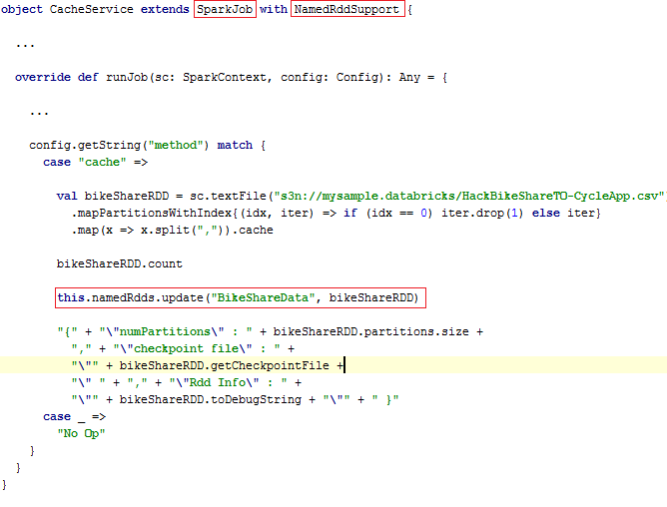
Demo – Cache RDD
Run our demo job CacheService to cache Bike Share data in RDD
27/1/2016 (TAS)

Slide 8
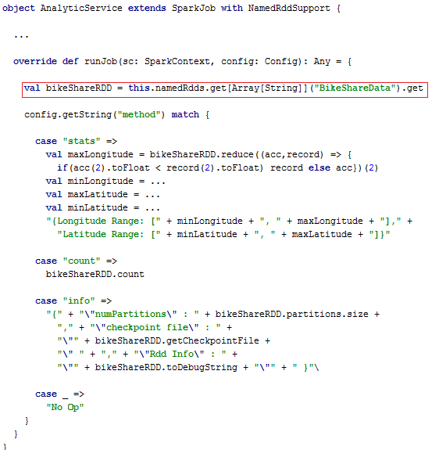
Demo – Fast Query
Query with another job AnalyticService by using the shared RDD
27/1/2016 (TAS)

Slide 9
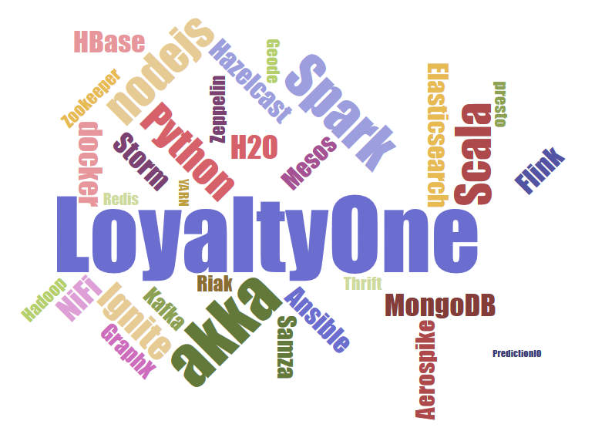
Thanks!
My Contact Info:
slee@loyalty.com

