Slide 1
REDUX
By Mykhailo Torskyi

Slide 2
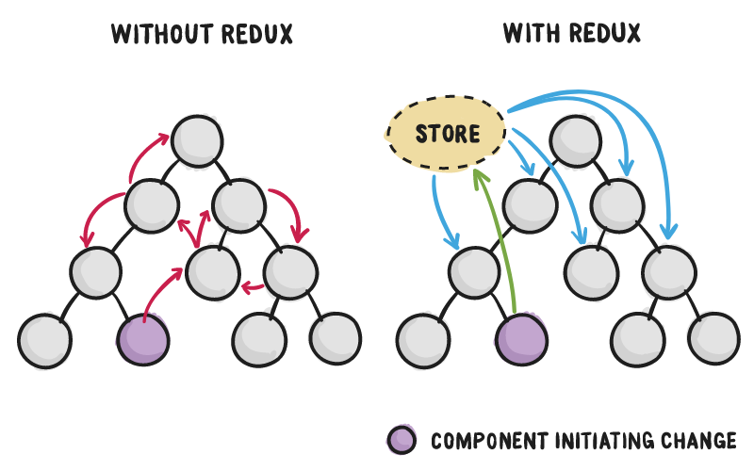
STORE

Slide 3
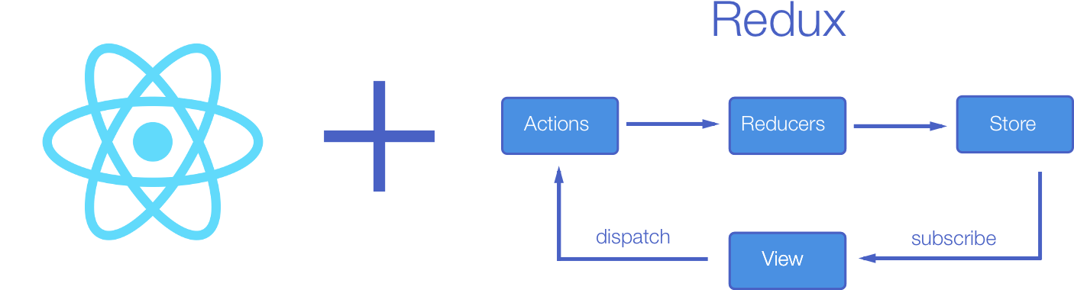

Slide 4
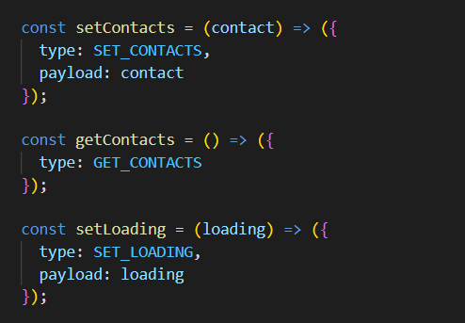
ACTIONS
Actions are payloads of information that send data from your application to your store. They are the only source of information for the store. You send them to the store using store.dispatch()

Slide 5
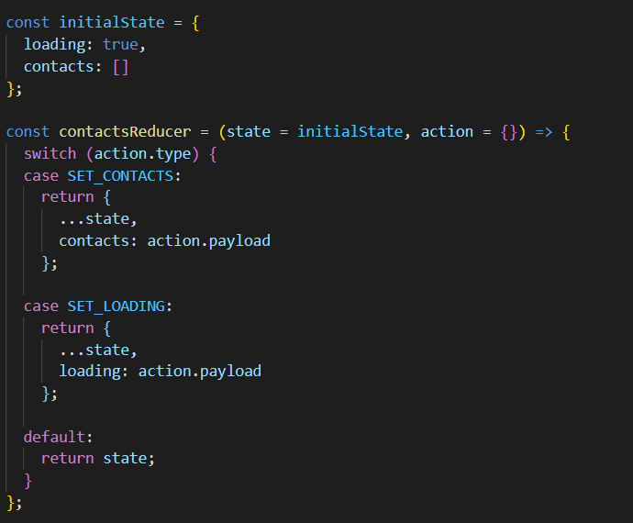
REDUCER
A reducer is a function that determines changes to an application’s state. It uses the action it receives to determine this change. We have tools, like Redux, that help manage an application’s state changes in a single store so that they behave consistently.

Slide 6
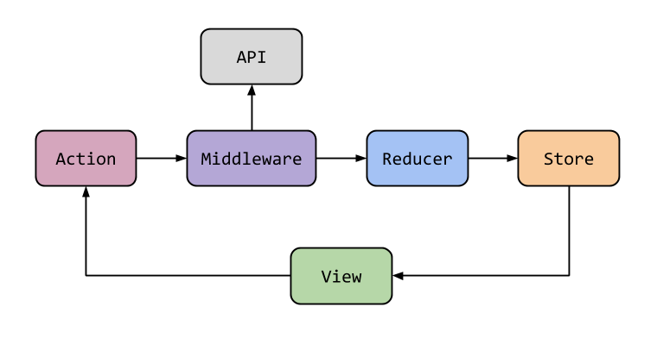
MIDDLEWARE
Middleware provides a third-party extension point between dispatching an action, and the moment it reaches the reducer. People use Redux middleware for logging, crash reporting, talking to an asynchronous API, routing, and more.

Slide 7


