Slide 1
Assessment 3
Lauren Keenan
Made using 360-Degree Feedback Framework

Slide 2
Student 1
Preferences:
Studious, eager to teach
Wants to break things down to really understand
Motivators:
Learning/building
Skill-sharing
Strengths:
Driven
Consistent & reliable
Versatile
Limitations:
Get caught on over-explaining
Communication confusing

Slide 3
Student 2
Preferences:
Clarity
Wants to contribute feasibly
Motivators:
Wants to contribute meaningfully
Wants to learn, by doing and by observing
Strengths:
Open attitude, grounded
Consistent & reliable
Honest & consistent communication
Limitations:
Confidence
Experience

Slide 4
Student 3
Preferences:
Studious, theoretical
Prefers smaller teams
Motivators:
Learning
Solution-oriented
High-degree
Strengths:
Intelligent
Driven if interested
Great valuable input
Limitations:
Communicating blockers
Reliability

Slide 5
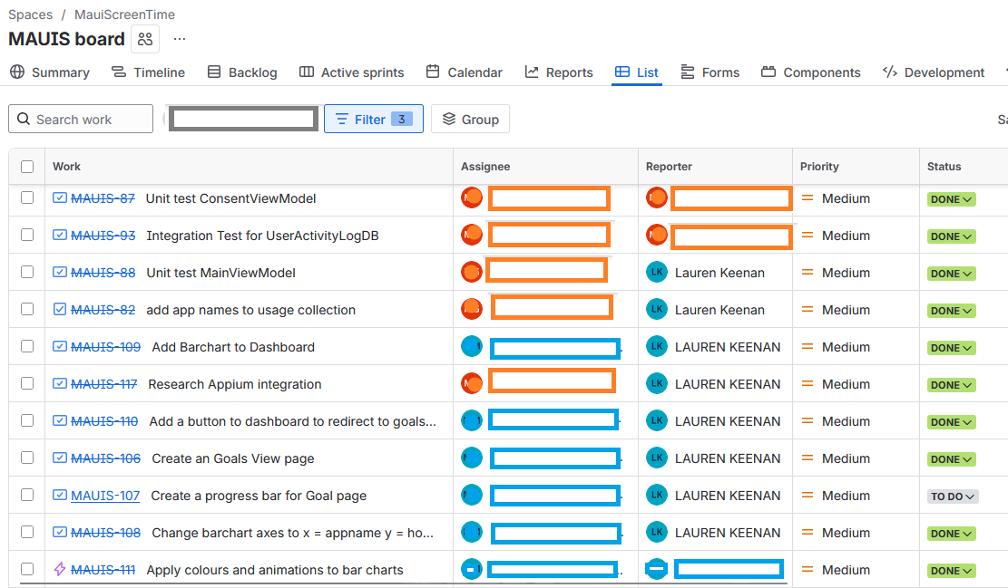
Why it’s useful for teamwork
Understand teammates, how they fit together
How to work concurrently to maximise progress

Slide 6
How to motivate
Understand preferences, motivations, strengths
Identify opportunities and present them
Encouraging ownership

Slide 7
