Slide 1
MauiScreenTime
Lauren Keenan

Slide 2
Release #1 (end Nov 25)
CI/CD and dev environment set up
GDPR policy in place
Consent system
Store Data Locally
Research CO2 sinks, bank of cool nature facts
Permissions from user
Track screen time data
Design documentation & Agile ceremonies

Slide 3
Release Plan
Release #1 (end Nov 25)
CI/CD and dev environment set up
GDPR policy in place (Lauren)
Research CO2 sinks, bank of cool nature facts
Permissions from user
Track screen time data
Release #2 (end Jan 26)
Store Data locally
Display data
Calculate CO2eq
Nature facts DB
Compare to natural event
Release #3 (end Mar 26)
Compare data with previous week total
Calculate the CO2eq difference
Tree goal logic
Leader boards, personal bests, all users, trees planted
Release #4 (end May 26)
User testing
Focus groups, how long to measure for
Fully automated tested
Produced and released

Slide 4
Introduction
A digital wellbeing app that converts user minutes spent on media/social media apps into CO2eq to compare with natural world events and incentivise healthier online habits by planting 1 Tree per 0.5Kg/1Kg of CO2eq saved by the user. Initiative to help inform consumers and reconnect users with the natural world.
“CO₂-eq is a metric measure used to compare the emissions from various greenhouse gases on the basis of their global-warming potential”
https://ec.europa.eu/eurostat/statistics-explained/index.php?title=Glossary:Carbon_dioxide_equivalent

Slide 5
Main Deliverables
Safe and performant background screen time tracking (GDPR)
Local data storage
Timers to restrict app usage? (exists in other apps, maybe focus on usps?)
Compare user activity with previous weeks
CO2eq calculations based on social carbon calculator comparethemarket.com.au/
Compare CO2eq to natural events
Tree planting goals (0.5Kg saved/ 1Kg saved = 1 Tree planted)
Leader boards
Clean intuitive user Interface

Slide 6
Skills Needed
Legal
Creating GDPR policy
User controls over data
Lawful processing
Can processed data be kept for longer?
Research
Create a bank of carbon sink events (milestones)
Develop a more accurate and reusable formula
Bank of offsets, alternatives
Design (HCI)
Initial Design
Landing page, Permissions, Splash Screen
Refactoring known designs
Different “Leagues”/Scoreboards: Personal bests, All users, Most Trees planted
Development
Using documentation and diagrams to build the software
Potentially different teams between front and backend

Slide 7
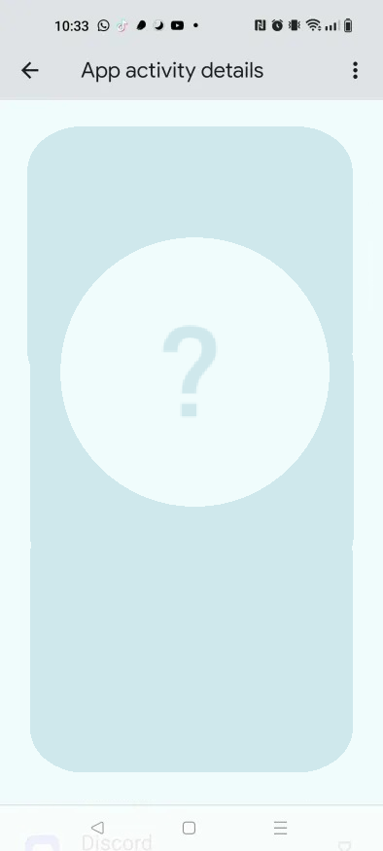
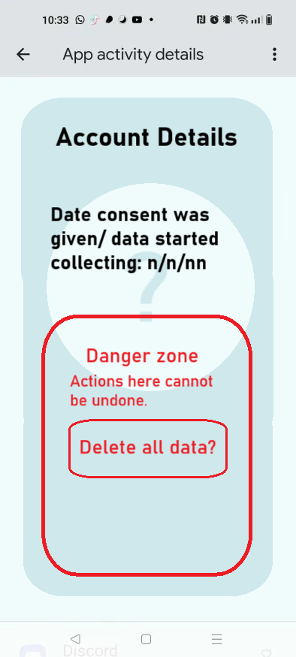
Intro page
Splash screen
User erases Data
With app deletion instead?
Permissions
Explanation of App how it works? 1 sentence?
Explanation of estimates
Data sources
Loads up data in the background
unsafe?
too many
openings to DB

Slide 8
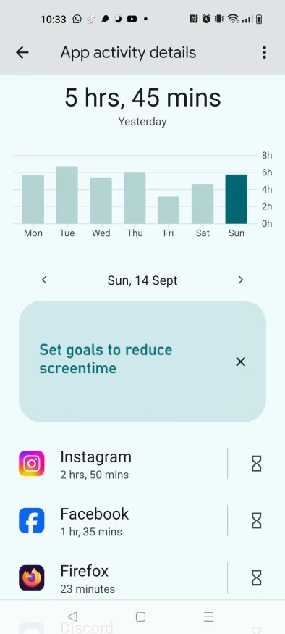
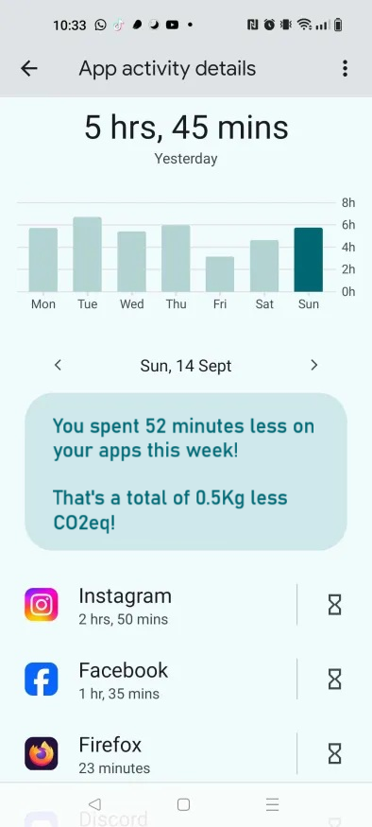
Phone tracks screen time
Comparisons
Achievement Visuals
Permissions
Tracking
Display
Stores data
Compares:
Weeks
CO2eq
Events (calculable)
Overall screen time per day
apps listed with their specific screen time, co2eq

Slide 9
Recap
Dev - Permissions, basic App tracking
UX/UI - Designing the landing pages, basic main page
Legal - GDPR policy
Thanks

