Slide 1
Bisemester Test 1
26th September, Thursday, 15:30 – 16:45, covers Lecture 1 to Lecture 6.
Report 15 mins before for admin procedures.
T1 – T4 report to LT22
T5 – T8 report to LT25
Only 1 retake of bisemester test for those who submit an official letter to UG office.
No other retakes: will get 0 if miss retake.

Slide 2

Auctions
HE3001, Microeconomics 3 Nanyang Technological University

Slide 3
Introduction
An auction is a process which involves the taking of bids, and a subsequent allocation of goods.
The study of auctions is more generally related to mechanism design.
Mechanism design: What kind of structure to implement to achieve particular outcomes?
HE2001: social decision mechanisms like the Borda-count which decide on a social choice.
Last week: incentives which decide on a (conditional) payment distribution.
They are particularly applicable in settings where there is incomplete information about something we want to base our allocations on.
E.g. for social choice: no information on people’s preferences..

Slide 4
Introduction
Why use auctions?
Resources are scarce, and we want to allocate resources to the “right” place.
What is considered the “right” place can depend on various factors, for which there is incomplete and asymmetric information.
Auctions can help us with doing this resource allocation, by helping us (indirectly) discover such information through proper incentives.
Private Sector: Ebay, Stock Markets, Real Estate Sales … Public Sector: Government sales of resources, Network Bandwidth, Radio Spectrum allocation…
Notes:
Auctions are not only conducted on single items, but sets of items and can have multiple bids.

Slide 5
Structure of Auctions
Auctions have a simple structure:
Bidders who want some good and have preferences over it.
An auctioneer who is trying to allocate the good.
Bidders submit bids and based on the rules of the auction,
An allocation of the good is decided.
Payments each bidder must make are determined.

Slide 6
Rules of Auctions
Auctions can be defined by three kind of rules:
Rules for bidding E.g who can bid, what kinds of bids can be made, whether bids expire, can be withdrawn, or replaced etc.
Rules for what information is revealed E.g. are bids revealed, when are they revealed etc.
Rules for clearing When does the auction stop, who is allocated the good(s), who pays what etc.
In this lecture, we will examine some simple auctions..

Slide 7
Auctions and Game Theory
Auctions are an example of a game of incomplete information.
Bids are the strategies of bidders.
Bidders have different types (e.g. preferences) which determine their payoffs.
There are beliefs about what types are present.
We can solve for the Bayesian Nash Equilibria of such games.
Strategies are best responses to beliefs and others’ strategies.
These will be the likely outcome of auctions.
We will be focusing less on the exact specification of such equilibria, and more on the intuition, though it is useful to keep in mind our game theory concepts.
Notes:
Auctions are not only conducted on single items, but sets of items and can have multiple bids.

Slide 8
Examples of Auctions (Different Rules)

Slide 9
English Auction (ascending price auction)
Bids start at a reserve price.
Bids are (sequential) public announcements.
A new bid exceeds the previous bid by a fixed increment.
Bid price rises until there are no further bids;
The highest bid wins and the winner pays his bid.
A reserve price is a seller-specified bid level below which no sale is made.
If set to zero, we say there is no reserve price.
Notes:
There are possible variations of the increment of bids, but we focus on the simplest scenario.

Slide 10
Dutch Auction (descending price auction)
Auctioneer (publicly) announces a high bid
He then gradually lowers the bid;
First buyer to accept wins and pays that price.
Lowering of bids ends at a reserve price (if any).

Slide 11
Sealed-bid first-price auction
Bids are private information.
Bids are made simultaneously by everyone participating.
The highest bid wins and the winner pays his bid.
If there is a reserve price, bids must be at least this value. (Can treat the reserve price as a separate bid by the auctioneer)

Slide 12
Sealed-bid second-price auction
Bids are private information.
Bids are made simultaneously by everyone participating.
The highest bidder wins, and the winner pays the second-highest bid.
If there is a reserve price, bids must be at least this value. (Can treat the reserve price as a separate bid by the auctioneer)
Notes:
This is essentially Ebay.

Slide 13

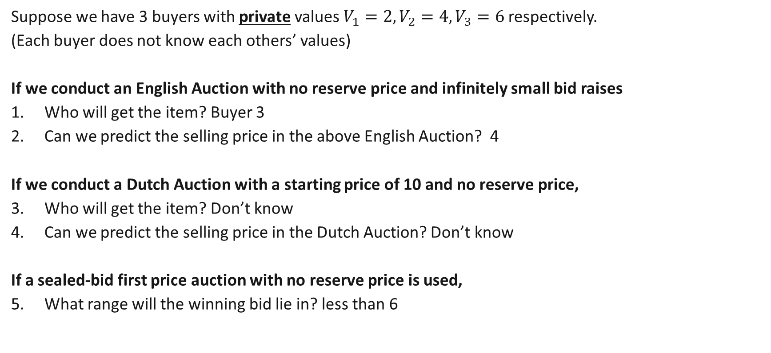
Review Questions 1
Suppose we have 3 buyers with private values $V_{1}=2, V_{2}=4, V_{3}=6$respectively.
(Each buyer does not know each others’ values)
If we conduct an English Auction with no reserve price and infinitely small bid raises
Who will get the item? Buyer 3
Can we predict the selling price in the above English Auction? 4
If we conduct a Dutch Auction with a starting price of 10 and no reserve price,
Who will get the item? Don’t know
Can we predict the selling price in the Dutch Auction? Don’t know
If a sealed-bid first price auction with no reserve price is used,
What range will the winning bid lie in? less than 6

Slide 14
Examples of Auctions (Different Types of Goods)

Slide 15
Economists’ Classification of Auctions
Private-value auctions:
Every potential buyer knows her own valuation of the item for sale.
Individual valuations are (usually) assumed to be independent of each other.
E.g. a bottle of vintage wine for own consumption.
Common-value auctions:
Item for sale has the same value to every potential buyer.
Potential buyers differ in their own estimates of this common value.
E.g. rights to oil drilling.
Depending on the type of item, can have different outcomes.
We will mostly be considering private-value auctions which are more familiar.
Notes:
An example of PB auctions is the sale of collectables with artistic value.
An example of CV auctions is the sale of an oil field.

Slide 16
Auction Design

Slide 17

Auction Design
For simplicity, let us consider a single item to auction off, with $n$ bidders with private values: $v_{1},v_{2},…v_{n}$.
What kind of auction should we use?
Some possible criteria:
Pareto efficiency
Profit maximisation of the seller
Notes:
Zero value means that will always prefer selling off the item.

Slide 18
Properties of an Auction
Efficiency
An outcome of an auction is efficient if the item is allocated to the buyer with the highest valuation of the item.
Profit Maximising
An outcome of an auction is profit maximizing (from the perspective of the seller) if it maximises the seller’s expected revenue given his/her beliefs about the distribution of buyers’ valuations. (Assume only sunk costs)
Let us now consider the previous examples of auctions and their properties..

Slide 19
Pareto Efficiency of Auctions

Slide 20
Auctions and Efficiency
An English auction with no reserve price is always efficient.
If a buyer with a low valuation were about to buy, the highest valuation buyer would bid higher.
An English auction with a reserve price can be inefficient.
In the case where the reserve price is set above the highest buyer valuation (unknown to the seller), then the good will not be allocated and there are no gains to trade.
(Also holds for any auction with a reserve price)

Slide 21
Auctions and Efficiency
A Dutch auction with no reserve price can be inefficient.
No buyer knows other buyers’ valuations, so the highest-valuation buyer may delay too long and lose to another bidder.
A Sealed-bid first-price auction with no reserve price can be inefficient.
No buyer knows other buyers’ valuations, so the highest valuation buyer may bid too low and lose to another bidder.
Generally, if one’s bidding strategies depend on beliefs about other’s valuations, there is the possibility for inefficiency due to errors in beliefs. (Less of a problem in the long run with learning)

Slide 22
Auctions and Efficiency
A sealed-bid second-price auction is however efficient
This occurs even though no buyer knows the other buyers’ valuations!
Why? Because bids do not depend on one’s beliefs!
It is a dominant strategy to state one’s true valuation.
Let us consider a simple two bidder example…

Slide 23
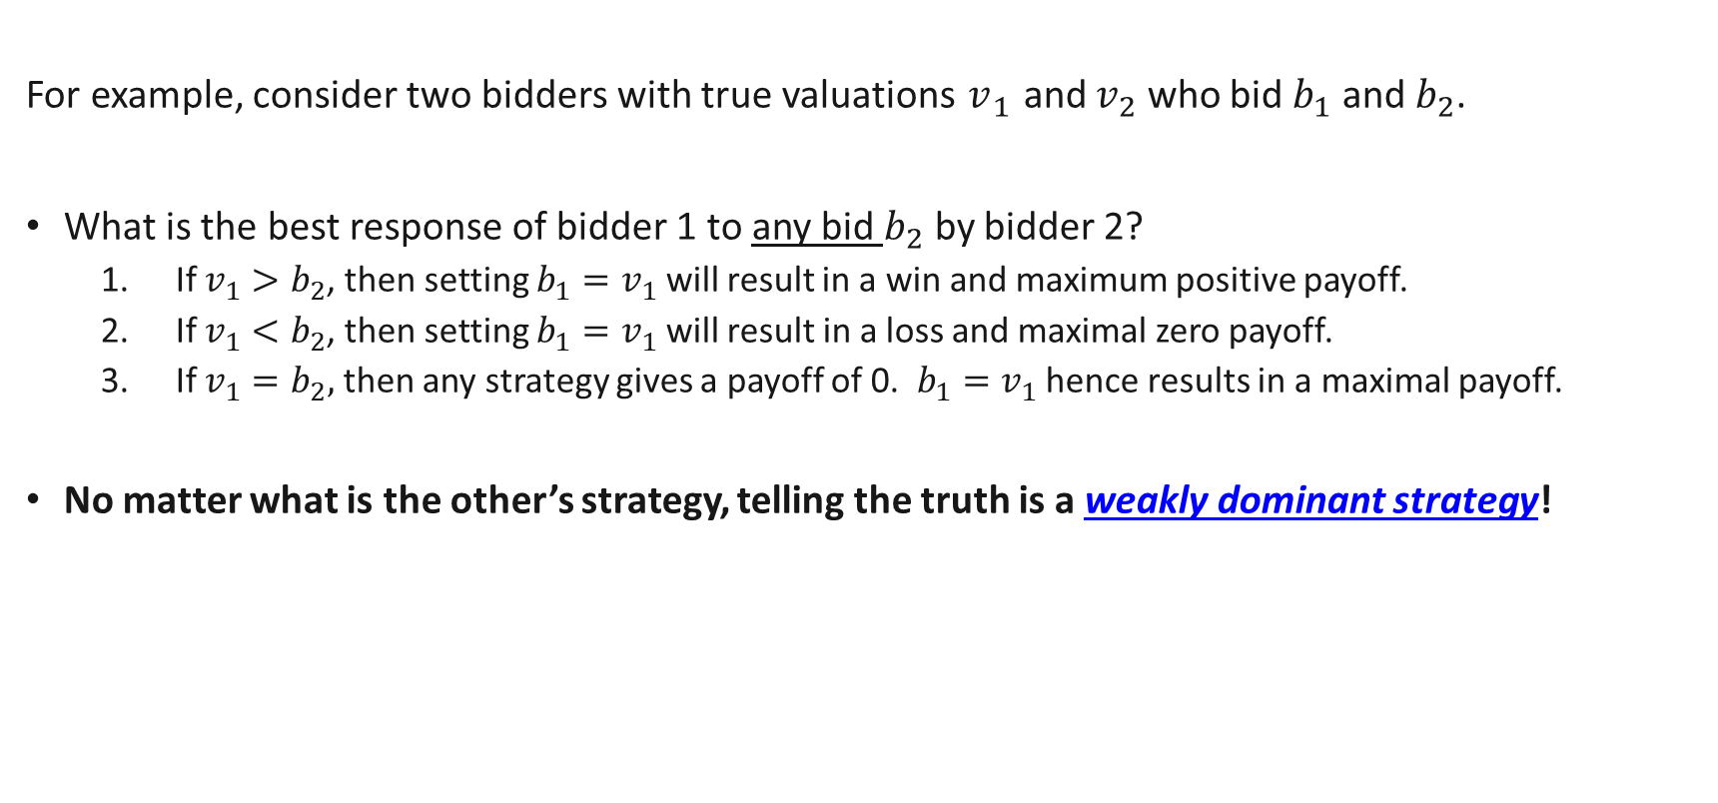
Truth Telling in Second Price Auction
For example, consider two bidders with true valuations $v_{1}$ and $v_{2}$ who bid $b_{1}$ and $b_{2}$.
What is the best response of bidder 1 to any bid $b_{2}$ by bidder 2?
If $v_{1}>b_{2}$, then setting $b_{1}=v_{1}$ will result in a win and maximum positive payoff.
If $v_{1}<b_{2}$, then setting $b_{1}=v_{1}$will result in a loss and maximal zero payoff.
If $v_{1}=b_{2},$ then any strategy gives a payoff of 0. $b_{1}=v_{1}$ hence results in a maximal payoff.
No matter what is the other’s strategy, telling the truth is a weakly dominant strategy!
Notes:
There are probabilities here due to different types.

Slide 24
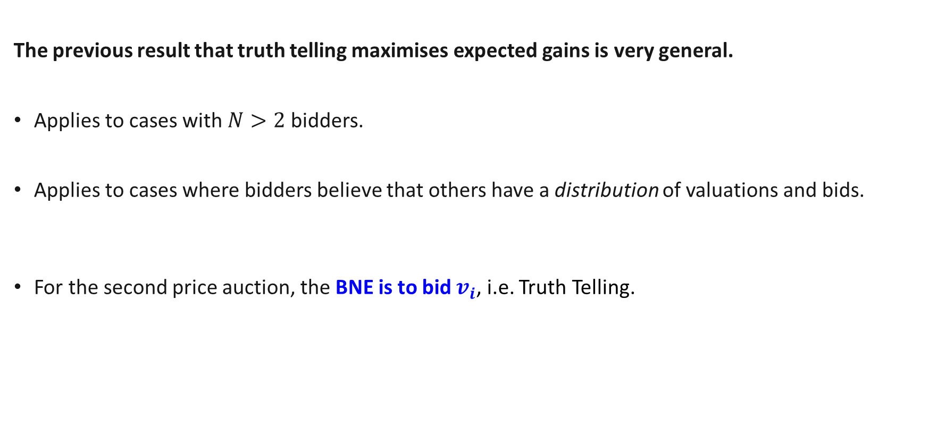
Truth Telling in Second Price Auction
The previous result that truth telling maximises expected gains is very general.
Applies to cases with $N>2$ bidders.
Applies to cases where bidders believe that others have a distribution of valuations and bids.
For the second price auction, the BNE is to bid $v_{i}$, i.e. Truth Telling.
Notes:
There are probabilities here due to different types.

Slide 25
Comments
Some of these auctions are very similar in terms of efficiency. This is because they are somewhat similar strategically.
English Auction and Second Price Auction (w/o reserve price)
In English auction, will not raise bid beyond valuation. Bidders will drop out once bids exceed on valuation. Bidder with highest valuation wins and pays approximately the second highest bidder’s amount.
Dutch Auction and First Price Auction
In Dutch auction, no one will accept if price is higher than valuation. A bidder will accept if price is lower than own valuation, but (minimally) higher than the beliefs about the next highest valuators bid.

Slide 26
Maximising Revenue using Auctions

Slide 27

The Independent Private Value model
In general, the seller’s expected revenue of an auction design depends on what are the likelihoods of each kind of buyer (from the seller’s perspective).
In auction theory, a common model is the independent private value (IPV) model.
It is assumed that buyers’ valuations are independently drawn from a common probability distribution, here: uniform distribution $[0,1]$
This is common knowledge amongst everyone (ignores possible mistakes in beliefs).
A somewhat surprising result is the “Revenue Equivalence Theorem”: as long as the rules satisfy certain criteria, revenue will stay the same!

Slide 28

Revenue Equivalence: 1st & 2nd Price Auction
Previously for the second price auction, the BNE is to bid their true valuation $v_{i}$.
For the first price auction, the BNE is to bid $\frac{N−1}{N}v_{i}$.
Lower than true valuation because can sacrifice a bit of probability of winning for lower price paid. (If bid true valuation, always get 0!)
Becomes close to the true value as $N$ increases.
What is the expected revenue given these strategies?
Notes:
When N increases, more likely that will have someone in between one’s bid and valuation.

Slide 29
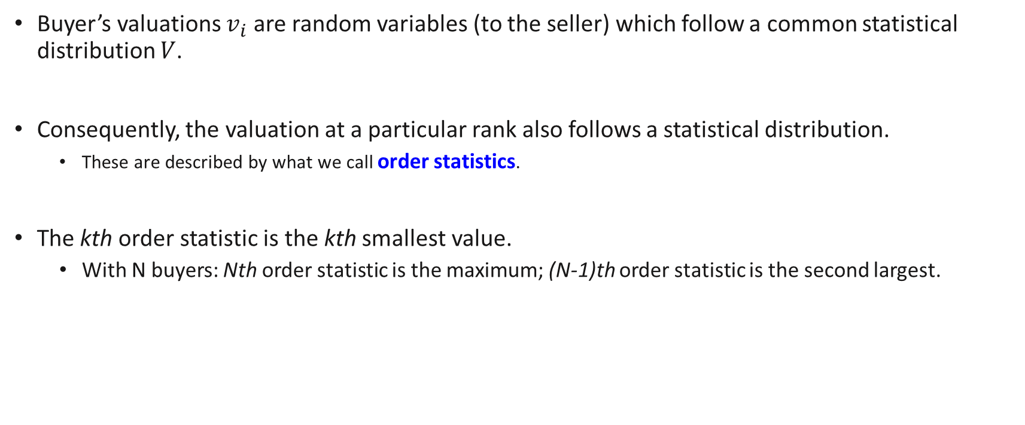
Aside: Order Statistics
Buyer’s valuations $v_{i}$ are random variables (to the seller) which follow a common statistical distribution $V$.
Consequently, the valuation at a particular rank also follows a statistical distribution.
These are described by what we call order statistics.
The kth order statistic is the kth smallest value.
With N buyers: Nth order statistic is the maximum; (N-1)th order statistic is the second largest.
Notes:
F(x) for the first order statistic is the probability that the highest value is less or equal to x.

Slide 30
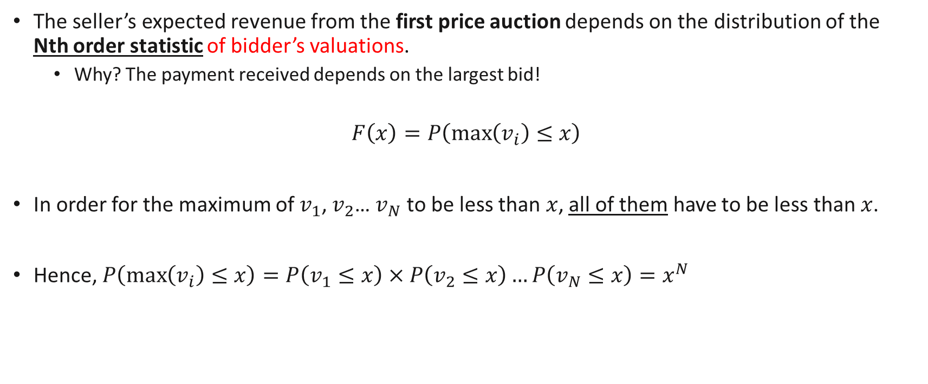
Revenue Equivalence: 1st & 2nd Price Auction
The seller’s expected revenue from the first price auction depends on the distribution of the Nth order statistic of bidder’s valuations.
Why? The payment received depends on the largest bid!
$$F\left(x\right)=P\left(\max\left(v_{i}\right)≤x\right)$$
In order for the maximum of $v_{1}$, $v_{2}$… $v_{N}$ to be less than $x$, all of them have to be less than $x$.
Hence, $P\left(\max\left(v_{i}\right)≤x\right)=P\left(v_{1}≤x\right)×P\left(v_{2}≤x\right)…P\left(v_{N}≤x\right)=x^{N}$

Slide 31
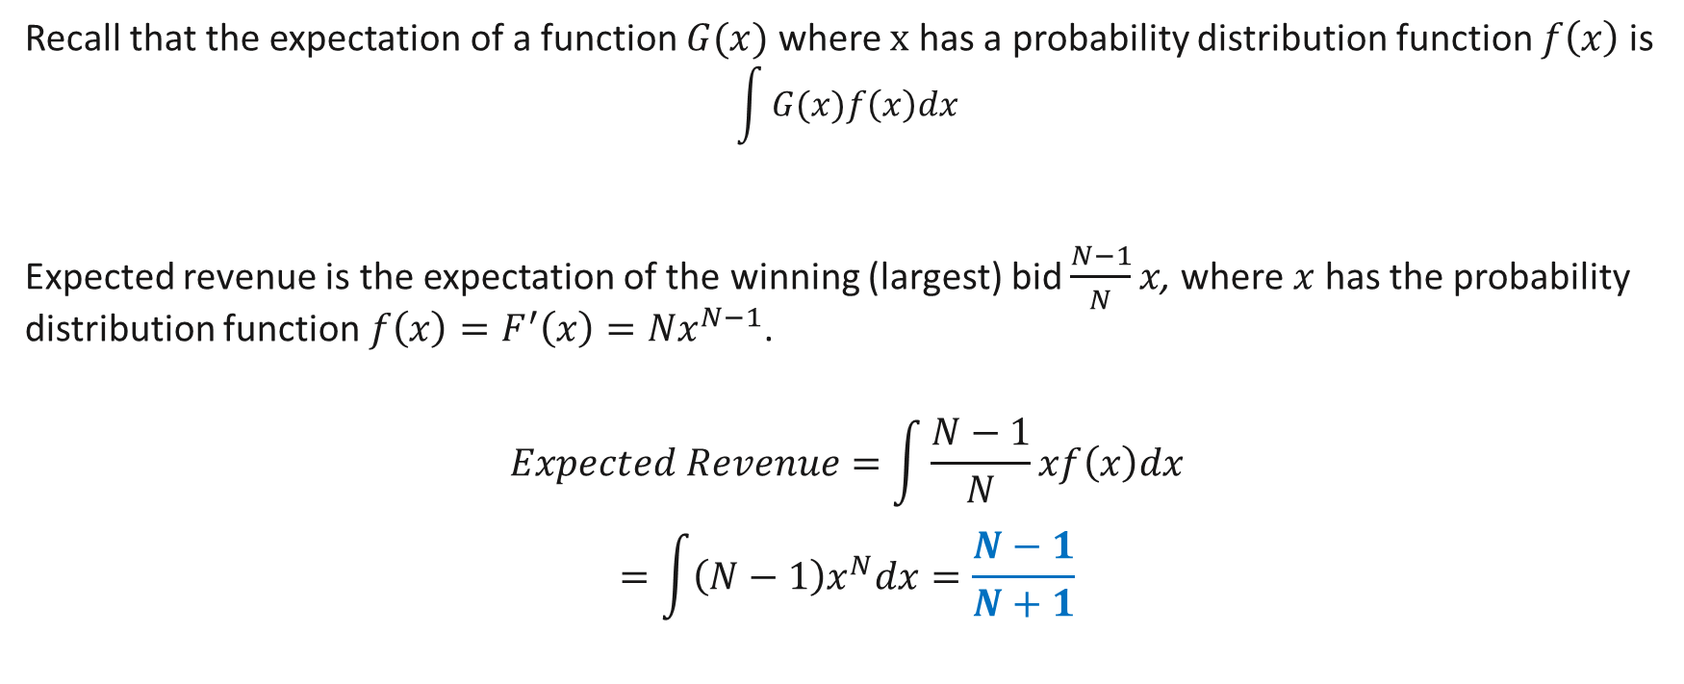
Revenue Equivalence: 1st & 2nd Price Auction
Recall that the expectation of a function $G(x)$ where $x$ has a probability distribution function $f\left(x\right)$is
$$\int{G(x)f\left(x\right)dx}$$
Expected revenue is the expectation of the winning (largest) bid $\frac{N−1}{N}x$, where $x$ has the probability distribution function$f\left(x\right)=F^{′}\left(x\right)=Nx^{N−1}$.
$$Expected Revenue=\int{\frac{N−1}{N}xf\left(x\right)dx}$$
$$=\int{\left(N−1\right)x^{N}dx=\frac{N−1}{N+1}}$$

Slide 32
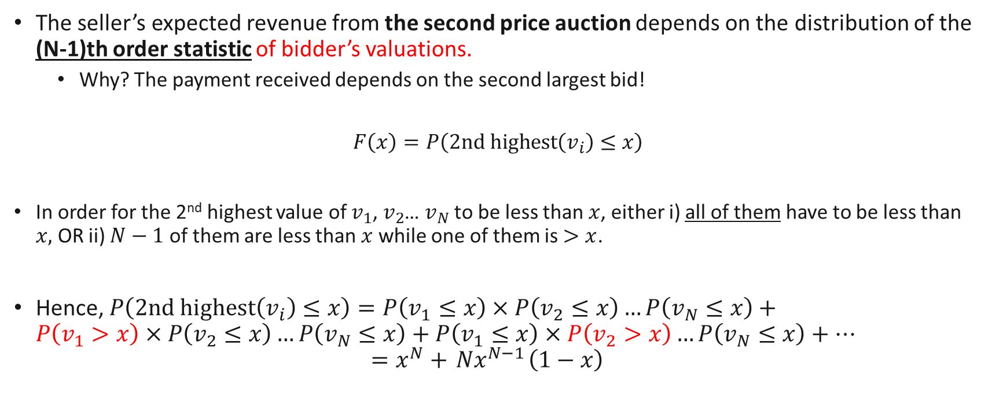
Revenue Equivalence: 1st & 2nd Price Auction
The seller’s expected revenue from the second price auction depends on the distribution of the (N-1)th order statistic of bidder’s valuations.
Why? The payment received depends on the second largest bid!
$$F\left(x\right)=P\left(2nd highest\left(v_{i}\right)≤x\right)$$
In order for the 2nd highest value of $v_{1}$, $v_{2}$… $v_{N}$ to be less than $x$, either i) all of them have to be less than $x,$ OR ii) $N−1$ of them are less than $x$ while one of them is $>x$.
Hence, $P\left(2nd highest\left(v_{i}\right)≤x\right)=P\left(v_{1}≤x\right)×P\left(v_{2}≤x\right)…P\left(v_{N}≤x\right)+$ $P\left(v_{1}>x\right)×P\left(v_{2}≤x\right)…P\left(v_{N}≤x\right)+$ $P\left(v_{1}≤x\right)×P\left(v_{2}>x\right)…P\left(v_{N}≤x\right)+…$ $=x^{N}+{ Nx}^{N−1}\left(1−x\right)$
N cases

Slide 33
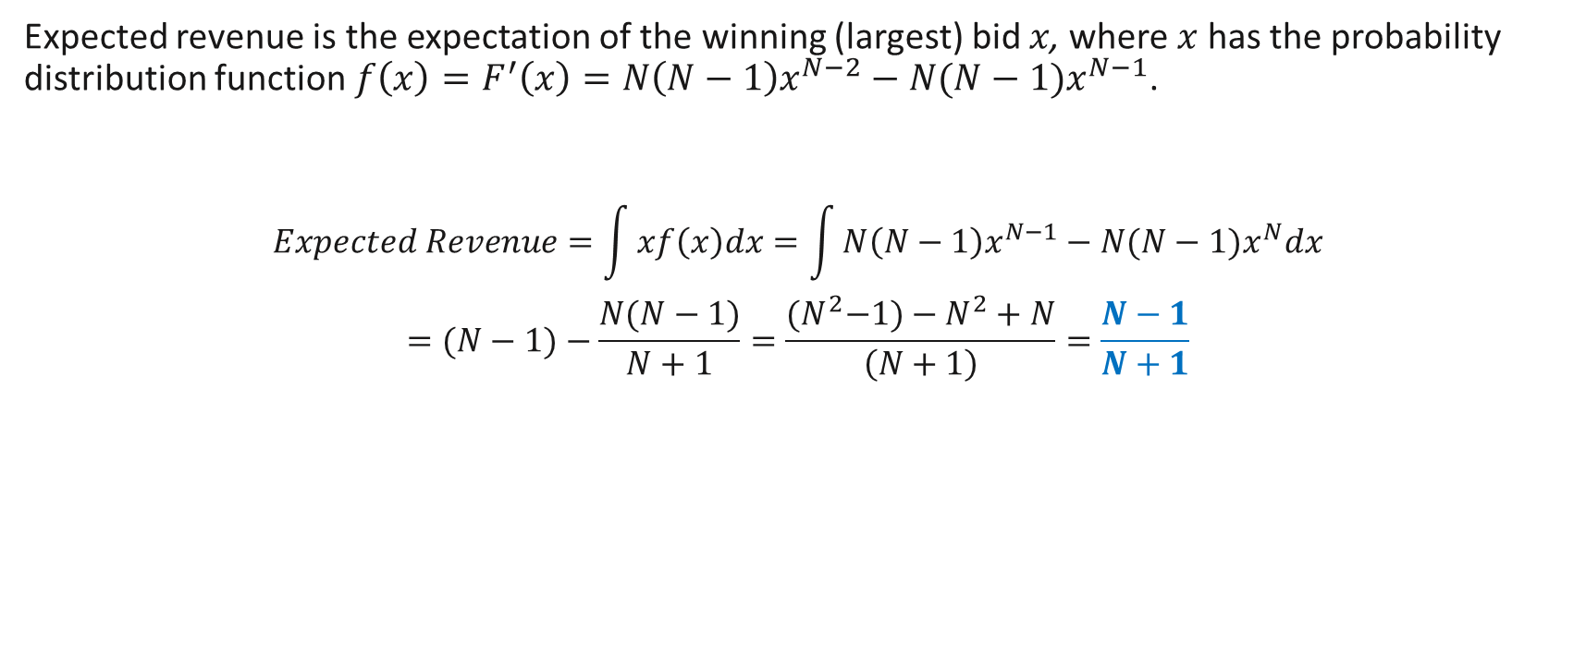
Revenue Equivalence: 1st & 2nd Price Auction
Expected revenue is the expectation of the winning (largest) bid $x$, where $x$ has the probability distribution function$f\left(x\right)=F^{′}\left(x\right)=N\left(N−1\right)x^{N−2}−N(N−1)x^{N−1}$.
$$Expected Revenue=\int{xf\left(x\right)dx}=\int{N\left(N−1\right)x^{N−1}−N(N−1)x^{N}dx}$$
$$=(N−1)−\frac{N(N−1)}{N+1}=\frac{{(N}^{2}−1)−N^{2}+N}{\left(N+1\right)}=\frac{N−1}{N+1}$$

Slide 34
Revenue Equivalence: 1st & 2nd Price Auction
Thus, under the IPV assumptions, the expected revenue that can be obtained from the 1st and 2nd Price Auction is the same.
In fact, revenue equivalence holds for any standard auction where (in the BNE):
The expected utility of a bidder with the lowest possible valuation 0 is 0.
The bidder with the highest valuation wins.
Notes:
One implication of this is that amongst these equivalent auctions, the ease of understanding the rules might be the determining factor for which is chosen.
For example, we often see the 1st price auction used in consumer auction markets like ebay.

Slide 35
Improving revenue using reserve prices
If the rules satisfy these conditions, revenue will be the same…
We need to change the allocation rules somehow in order to improve revenue! One way to do so is using a reserve price.
Here, we give a simple example: Suppose there are 2 buyers. The seller believes each buyer’s valuation is $20 with chance 1/2 and $50 with chance 1/2.
Based on that premise, there is a 1/4 chance that each of the following combinations of buyer valuations is present: ($20, $20), ($20, $50), ($50, $20), and ($50, $50).

Slide 36
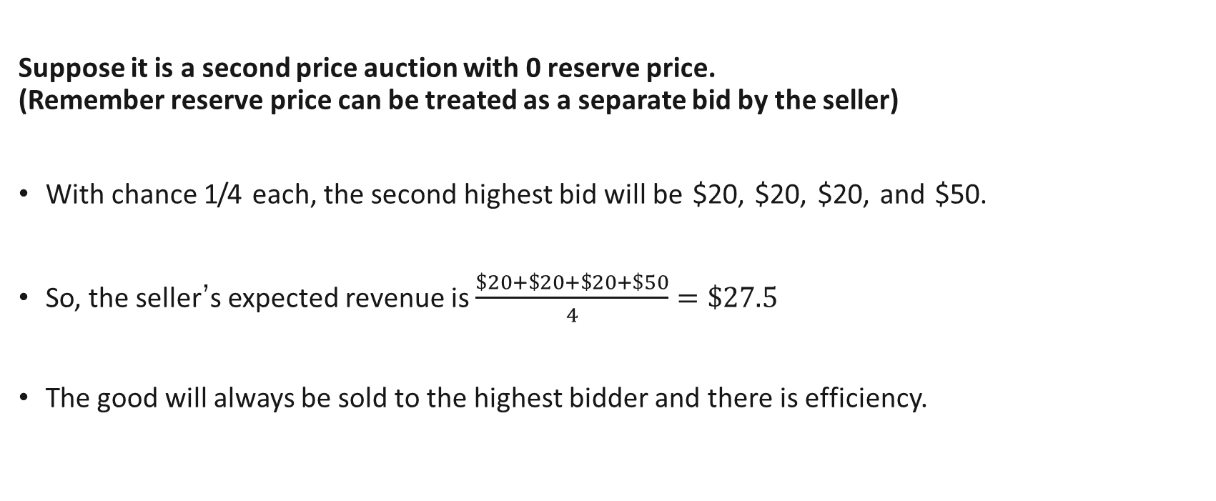
Example: no reserve price
Suppose it is a second price auction with 0 reserve price. (Remember reserve price can be treated as a separate bid by the seller)
With chance 1/4 each, the second highest bid will be $20, $20, $20, and $50.
So, the seller’s expected revenue is $\frac{\$20+\$20+\$20+\$50}{4}=\$27.5$
The good will always be sold to the highest bidder and there is efficiency.
Notes:
If higher valuation moves first, then sequence will be: 1, 2, 3, 4,….
H,L, H, L….

Slide 37
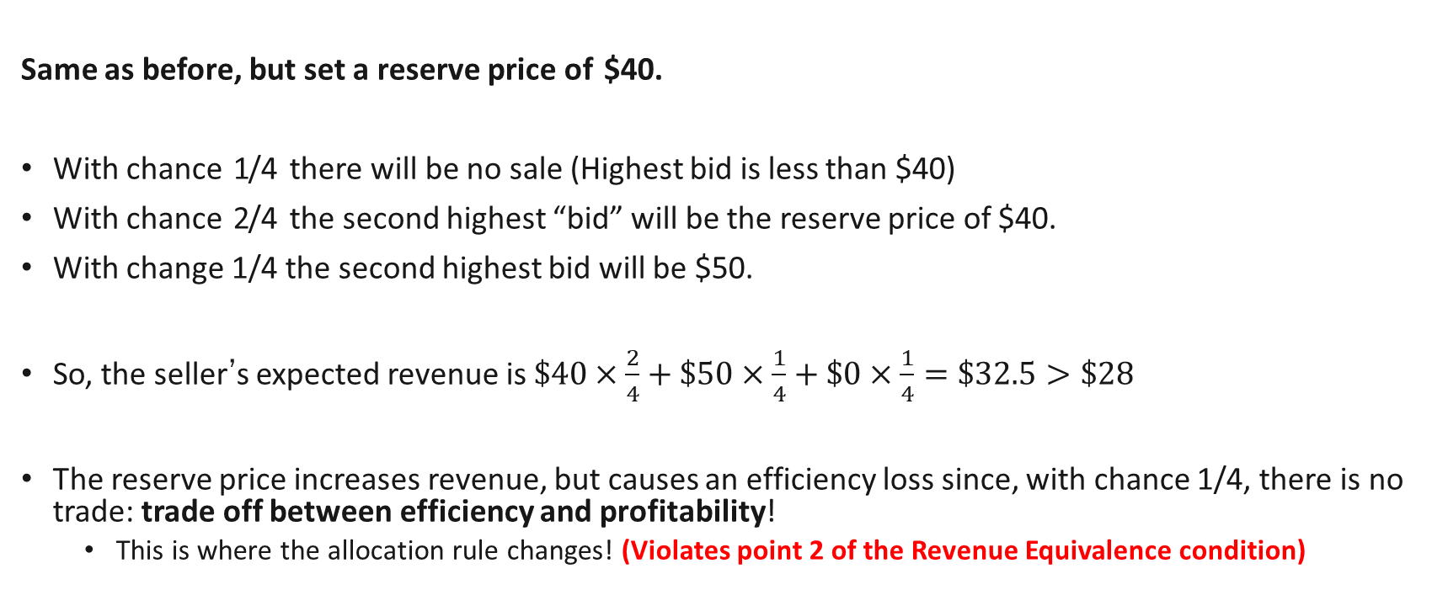
Example: Reserve price
Same as before, but set a reserve price of $40.
With chance 1/4 there will be no sale (Highest bid is less than $40)
With chance 2/4 the second highest “bid” will be the reserve price of $40.
With change 1/4 the second highest bid will be $50.
So, the seller’s expected revenue is $\$40×\frac{2}{4}+\$50×\frac{1}{4}+\$0×\frac{1}{4}=\$32.5>\$28$
The reserve price increases revenue, but causes an efficiency loss since, with chance 1/4, there is no trade: trade off between efficiency and profitability!
This is where the allocation rule changes! (Violates point 2 of the Revenue Equivalence condition)

Slide 38
Review Questions 2
Consider a second price auction with 2 bidders. There are 2 types of buyers with values $10 and $20 which each occur with probability 0.5.
If there is no reserve price, what is the expected revenue of the seller? 12.5
If there is a reserve price of 5, what is the expected revenue of the seller? 12.5
If there is a reserve price of 20, what is the expected revenue of the seller? 15

Slide 39
Common Value Auctions

Slide 40
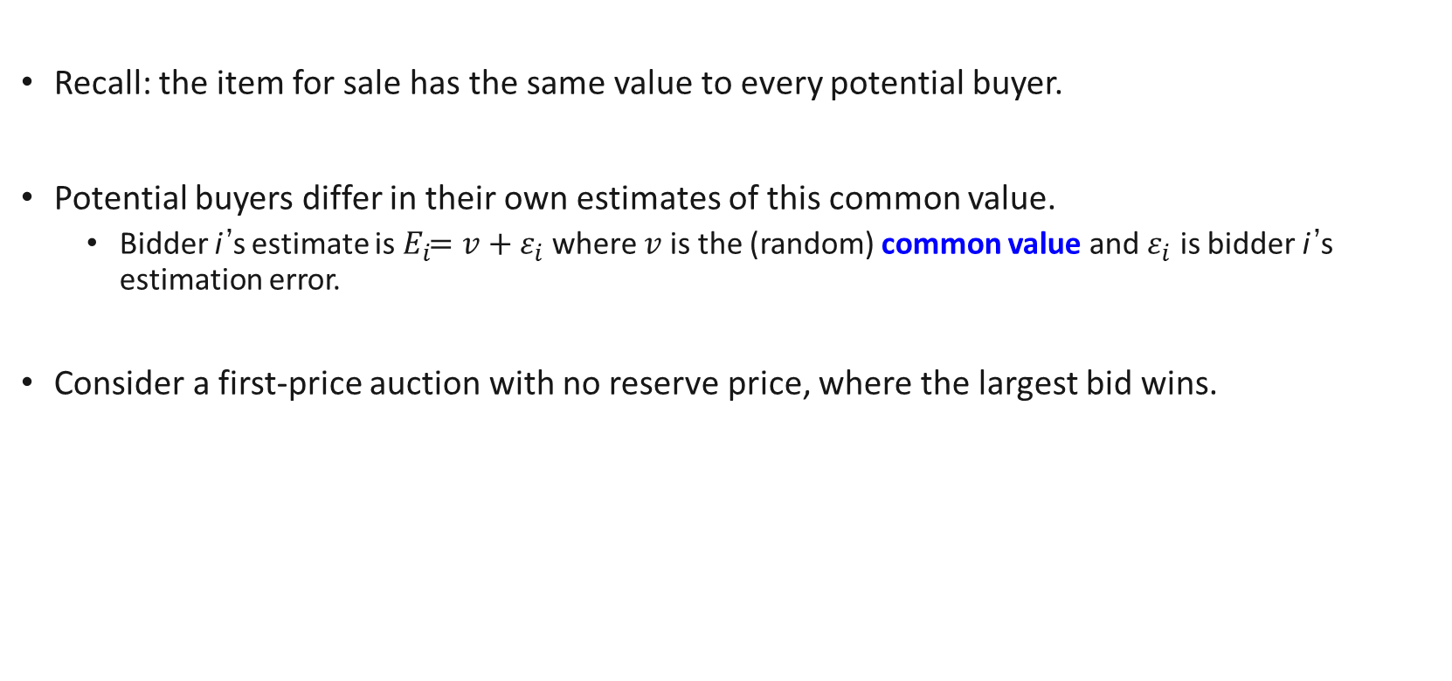
Modelling Common-Value Auctions
Recall: the item for sale has the same value to every potential buyer.
Potential buyers differ in their own estimates of this common value.
Bidder i’s estimate is${ E}_{i}=v+ε_{i}$ where $v$ is the (random) common value and $ε_{i}$ is bidder i’s estimation error.
Consider a first-price auction with no reserve price, where the largest bid wins.

Slide 41
Modelling Common-Value Auctions
If every bid is truthful, the winner is the bidder with the largest estimation error.
So, a truthful winner on average pays more than the true value—the winner’s curse. Hence, should account for this…
In the BNE of a common value auction, strategy is to:
Bid less than their estimate,
Bid decreases with number of buyers N Why? As N increases, winning means that I must be very optimistic.
Notice that this differs from the BNE in the IPV first price auction.

Slide 42
Key Learning Outcomes
Structures of auctions and evaluating them.
BNE of the first and second price auctions with independent private values.
Showing revenue equivalence.
General criteria for revenue equivalence in IPV auctions.
Independent private value (IPV) auctions vs common value (CV) auctions:

Slide 43
References
Varian Chapter 18
If interested, do take a look at the chapter for other auction forms.
Related articles
https://news.stanford.edu/2020/11/19/bid-picture-nobel-prize-winners-explain-auction-theory-collaboration/

