Slide 1
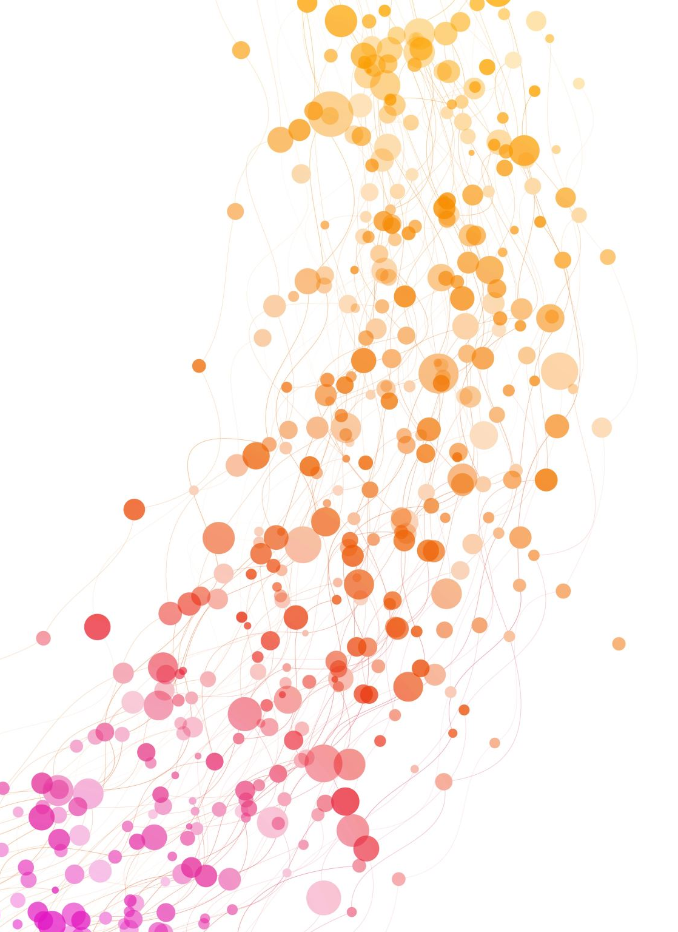
Externalities
HE3001, Microeconomics 3 Nanyang Technological University

Slide 2
Introduction
In HE2001, we have seen that the market can work quite well:
Perfect competition can lead to a pareto efficient allocation (FWT)
Under the right initial redistribution, can maximise fairness or some desired SWF (SWT)
One major reason why markets may not work so well as predicted is the presence of externalities.
What exactly are externalities?

Slide 3


Externalities
Vaccination choices
Behaviour during the Blackpink concert.

Slide 4
Externalities
An externality is a cost or benefit imposed upon third parties by actions taken by an entity.
An externally imposed benefit is a positive externality.
An externally imposed cost is a negative externality.
Notes:
This should be a familiar topic from their introductory courses.

Slide 5
Some standard examples of Externalities
Negative Externalities
Air pollution, Water pollution, Loud parties next door, Traffic congestion, Second-hand cigarette smoke, Increased insurance premiums due to alcohol or tobacco consumption.
Positive Externalities
A well-maintained property next door, Improved driving habits, A scientific advance, Vaccinations, Hygienic practices..
Can you think of any others?
Notes:
Asking students to add to this list is appropriate.

Slide 6
Externalities & Efficiency
Externalities typically cause inefficiency. Either:
Too much scarce resources are allocated activities with negative externalities
Too little resources are allocated to activities which cause positive externalities.
Why? Because the involved parties do not (completely) take into account how their actions affect others.
We illustrate this next in a simple model using a supply/demand framework.

Slide 7
A Simple Model of Externalities

Slide 8

Private Costs and Benefits
Consumers of goods gain personal utility when consuming $−$ i.e. consumption has private benefits.
Marginal private benefits are approximated by the demand curve.
Producers of goods incur costs when producing $−$ i.e production has private costs.
Marginal private costs are approximated by the supply curve.
In HE2001, we assumed that there are no other costs or benefits besides these private ones, hence the sum of CS and PS approximates social welfare.
But this is no longer the case when there are externalities!
Notes:
Remember demand curve and reservation price curve, supply curve and MC curve?

Slide 9

Social Costs and Benefits
When there are externalities in production, marginal social costs $≠$ marginal private costs (supply curve).
Social Costs = Private Costs + (Net) External Costs
The net external cost is positive (negative) for negative (positive) externalities.
When there are externalities in consumption, marginal social benefits $≠$ marginal private benefits (demand curve).
Social Benefits= Private Benefits + (Net) External Benefits
The net external benefit is negative (positive) for negative (positive) externalities.

Slide 10
Externalities with Perfect Competition
In our Supply/Demand framework, this leads to deadweight welfare loss.
P
MSC
P
MC
MC
DW loss
DW loss
MSB
MSB
MB
Q
Q
Negative production externalities
(over production)
Positive consumption externalities (under consumption)
Notes:
Deadweight welfare loss is the loss in total consumer and producer surplus.

Slide 11
Deriving the areas..

Slide 12
Solving the externality problem..
Recall that the root of the issue is that private interests do not align with social interests.
To realign them, one can use additional charges or payments (Arthur Cecil Pigou).
Pigouvian taxes or subsidies help solve the problem by closing the gap between private costs and social costs
Consumers/Producers will now account for the proper costs and benefits of their own actions.
Causing the creator of an externality to bear the full external cost or to enjoy the full external benefit is called internalizing the externality.

Slide 13
Pigouvian Taxes/Subsidies
Optimal tax (subsidy) is the marginal external cost (benefit) at the optimal level!
Do you remember how to draw the shifts of curves with subsidies/taxes?
P
MSC
P
MC
MC
Optimal per unit tax on production
Optimal per unit subsidy on consumption
MSB
MSB
MB
Q
Q
Negative production externalities
Positive consumption externalities
Notes:
To get the optimal tax, we draw down the optimal amount and get the gap between the MSC or MC or the MSB and MB at that quantity.
Notice the issues with such a policy: we would need to know exactly the actual MSC to derive the optimal quantities and thus taxes.
Note that a per-unit tax/subsidy on the opposite party will lead to the same outcome: indirectly forces the main party to take into account costs/benefits.

Slide 14
Deriving the areas..

Slide 15

Review Question 1
P
MC
Suppose that marginal external benefits on consumption are not constant as in earlier illustrations. What is the optimum subsidy for consumption in the market?
(a)
(b) Answer is b
(a)
(b)
MSB
MB
Q

Slide 16
Remarks
To reach the socially efficient outcome, need to shift demand and supply curves to appropriate positions.
In real-life: carbon taxes, alcohol tax, ERP, child subsidies.
However, not always feasible due to information constraints…
Setting the wrong levels of taxes/subsidies can lead to distortions…
Any alternatives?
Notes:
Note that you can always choose to Pigouvian subsidies or taxes to the other party to solve the problem.

Slide 17
Externalities and Property Rights

Slide 18
A simple example…
Alice’s vehicle repair shop and Teddy’s tea house are adjacent to each other.
Both of them are risk neutral.
Alice’s profit schedule and most preferred option is as follows:
Alice’s o/p | Marginal Profit | Alice’s profit
0 | - | 0
1 | 90 | 90
2 | 60 | 150
3 | 10 | 160
4 | -50 | 110
Notes:
Given the problems with doing so, are there any alternatives, here we illustrate one way of doing so.
Alice’s preferred option is 3 as it maximises her profit.

Slide 19
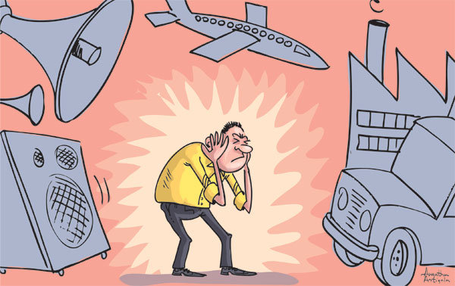
A simple example…
Suppose the noise from the vehicle repair ship hurts Teddy’s tea house business. The more cars the auto body shop works on, the more noise it generates, which hurts Teddy’s profit.
Teddy’s profit schedule and most preferred option is as follows:
Alice’s o/p | Marginal Damage | Teddy’s profit
0 | - | 230
1 | 20 | 210
2 | 40 | 170
3 | 70 | 100
4 | 100 | 0

Slide 20
A simple example…
What is the socially optimal/efficient output level?
Utilitarian perspective (sum of utility)
Alice’s o/p | Alice’s profit | Teddy’s profit | Total profit
0 | 0 | 230 | 230
1 | 90 | 210 | 300
2 | 150 | 170 | 320
3 | 160 | 100 | 260
4 | 110 | 0 | 110

Slide 21
A simple example…
What actually happens in this situation?
Alice chooses an output of 3 while the social optimal level is an output of 2. This is not an efficient outcome!
Why? Because she does not take into account how noise from her shop affects Teddy’s tea house.

Slide 22
Externalities and Property Rights
Coase (1960): Maybe the main problem here is not the externality per se, but some missing markets… What if noise pollution was tradeable?
This is meaningful only if property rights are well defined
Holders of property rights have the exclusive privilege to own and use it.
Any trading agreement reached is hence enforceable.

Slide 23
Externalities and Property Rights
Suppose now, Alice and Teddy can bargain on the vehicle repair shop’s output level. Consider the following 3 scenarios:
No property rights.
Teddy owns the property right to (not) pollute.
Alice owns the property right to pollute.

Slide 24
No Property Rights
Suppose the property right is not defined and/or the court does not enforce it.
Then there is nothing to bargain about.
Regardless of any informal “agreement”, Alice keeps producing any level she wants, knowing that there won’t be any (legal) consequence.
They won’t pay anything to each other, knowing that any informal agreement would be violated anyways.
Outcome: Alice works 3 cars, and the total profit is 260.

Slide 25
Teddy has the Property Right.
Now suppose that the court grants Teddy the property right (not) to have noise pollution. If he wishes, he can force Alice to work his initially preferred option of 0 cars.
But this is not ideal as he can do better by selling Alice the right to pollute a certain amount:
Consider an agreement where Alice works 2 cars. Teddy is willing to do so for at least 230-170=60. Alice is willing to pay at most 150-0=150.
They can agree on this at some price between 60 and 150.
Any agreement which does not maximise their total profits will be pareto dominated by one which maximises total profits.
Final agreement: Alice allowed to produce 2 cars for some price between 60 and 150.

Slide 26
Alice has the Property Right.
Now suppose that the court grants Alice the property right to create noise pollution. This means that she can work on her initially preferred option of 3 cars.
But this is not ideal as she can do better by selling Teddy part of the property rights.
Consider an agreement where Alice reduces output to 2 cars. Alice is willing to do so for at least 160-150=10. Teddy is willing to pay at most 170-100=70.
They can agree on this at some price between 10 and 70.
Final agreement: Alice agrees to produce only 2 cars for some price between 10 and 70.

Slide 27
The Coase Theorem
Notice that in each case, the final agreement arrived at, is the socially optimal outcome.
This demonstrates the results of the Coase Theorem.
Insight: most externality problems are due to an inadequate specification of property rights and, consequently, an absence of markets in which trade can be used to internalize external costs or benefits.
Coase Theorem
If property rights are clearly defined and protected, there are no transactions costs (such as haggling costs/information asymmetry), and preferences are quasi-linear (no wealth effects), then the same socially optimal outcome results, regardless of who is assigned the property right initially.

Slide 28
Remarks
Property rights creates a market for trading noise pollution rights: restores complete markets.
By the FWT, when we have complete markets, the competitive allocation is pareto efficient.
Property rights rely on the free market and require less knowledge on the actual extent of external, but:
Defining property rights can be difficult and costly: How can one define the rights to be healthy/COVID free?
Bargaining can be difficult if many parties are involved: Amongst others, who benefits the most from my vaccination?
When externalities are “global”, hard to enforce: Can one country have jurisdiction on the vaccination policies of other countries?
Notes:
Quasilinear means utility of the form $u\left(x\right)+y$

Slide 29
Remarks
The theorem mentions quasi-linearity.. What are its implications?
From HE2001, recall that with quasi-linearity, pareto efficient allocations (with transfers) must be utilitarian (and socially optimal). If there is a unique utilitarian allocation of goods (besides money), then no matter who we assign property rights to, we must arrive at this.
What if preferences are not quasi-linear?
Pareto efficient allocations (with transfers) may not be utilitarian. I.e., depending on who we assign property rights to, a different pareto efficient allocation may be attained.
Example later!
Notes:
Quasilinear means utility of the form $u\left(x\right)+y$

Slide 30
Review Question 2
Consider a similar scenario as before, but with different values as below. Suppose Teddy is assigned property rights.
Alice’s o/p | Alice’s profit | Teddy’s profit | Total profit
0 | 0 | 230 | 230
1 | 130 | 210 | 340
2 | 160 | 160 | 320
3 | 140 | 120 | 260
4 | 110 | 0 | 110
Which of this will be the outcome? a) Alice produces 1 car. b) Alice produces 2 cars. c) Alice produces 3 cars.
Answer is a
Which of these are possible prices at which they can negotiate an agreement? a) 65 b) 140 c) 100 d) 30 e) 160
Answer is a, c and d
20<p<130

Slide 31
Externalities in the Edgeworth Box

Slide 32
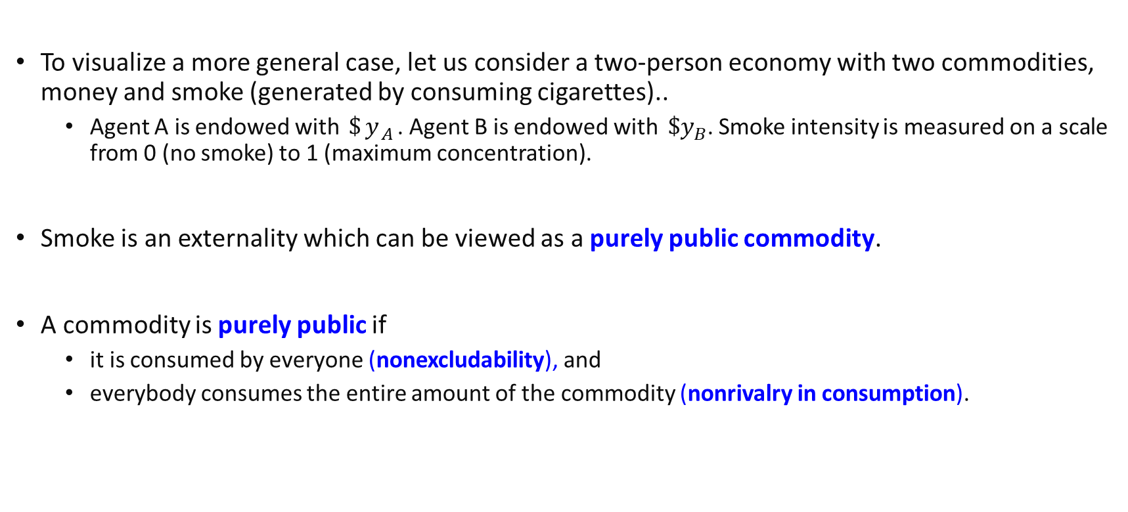
Revisiting the Edgeworth box
To visualize a more general case, let us consider a two-person economy with two commodities, money and smoke (generated by consuming cigarettes)..
Agent A is endowed with $\$y_{A}$. Agent B is endowed with $\$y_{B}$. Smoke intensity is measured on a scale from 0 (no smoke) to 1 (maximum concentration).
Smoke is an externality which can be viewed as a purely public commodity.
A commodity is purely public if
it is consumed by everyone (nonexcludability), and
everybody consumes the entire amount of the commodity (nonrivalry in consumption).

Slide 33
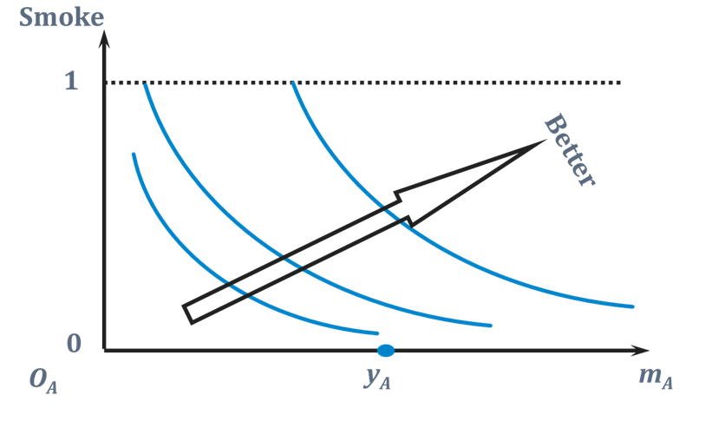
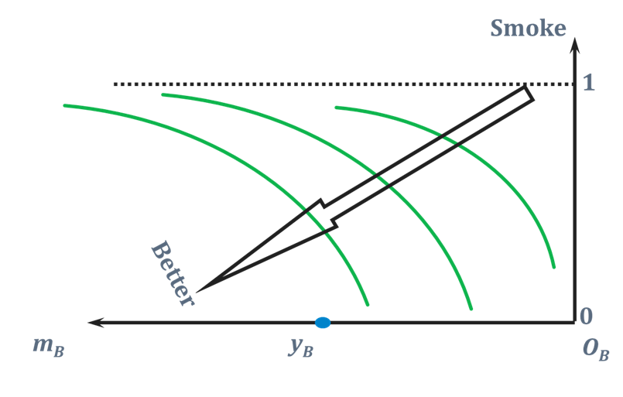
Revisiting Edgeworth box
Person A enjoys cigarettes (and hence smoke) and money, while Person B enjoys money, but dislikes smoke.
Common y-axis because smoke is like a public commodity.

Slide 34
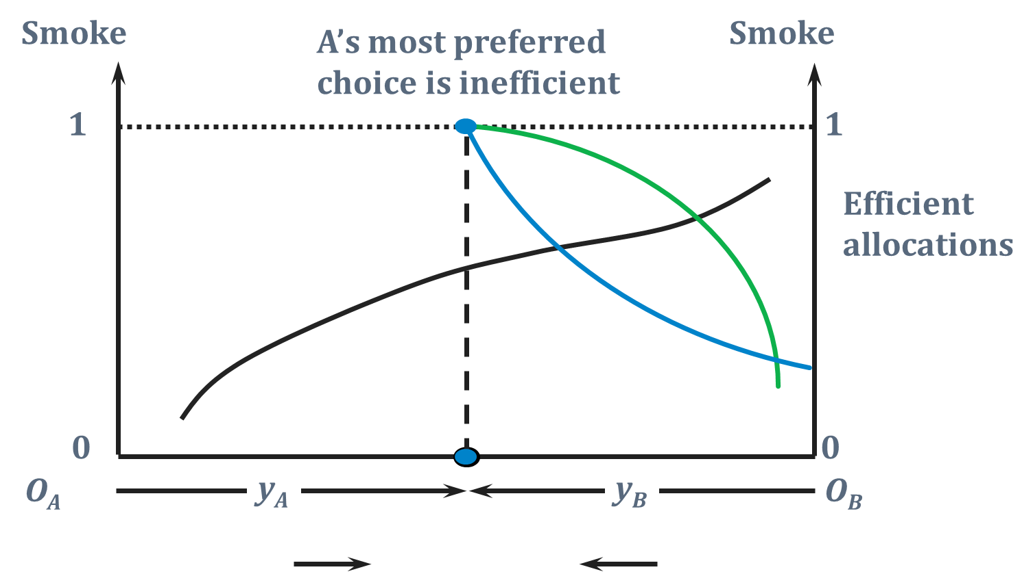
No Property Rights
A’s preferred choice is smoke = 1 , which will override B’s preferred choice of smoke = 0.
(Purely public good)
Smoke is non tradeable and (common) amount is free to be chosen by either of them, budget line is vertical.
m_{A}
m_{B}
Notes:
Vertical price line is like a 0 price for smoke.
y=Ps S + m
S=-y/Ps +m/Ps

Slide 35
Inefficiency & Negative Externalities
So, if A and B cannot trade money for changes in smoke intensity, then the outcome is inefficient.
There is too much smoke (A’s most preferred choice) because B can’t control A’s actions.
Neither agent A nor agent B owns the air in their room. What happens if this property right is created and is assigned to one of them?

Slide 36
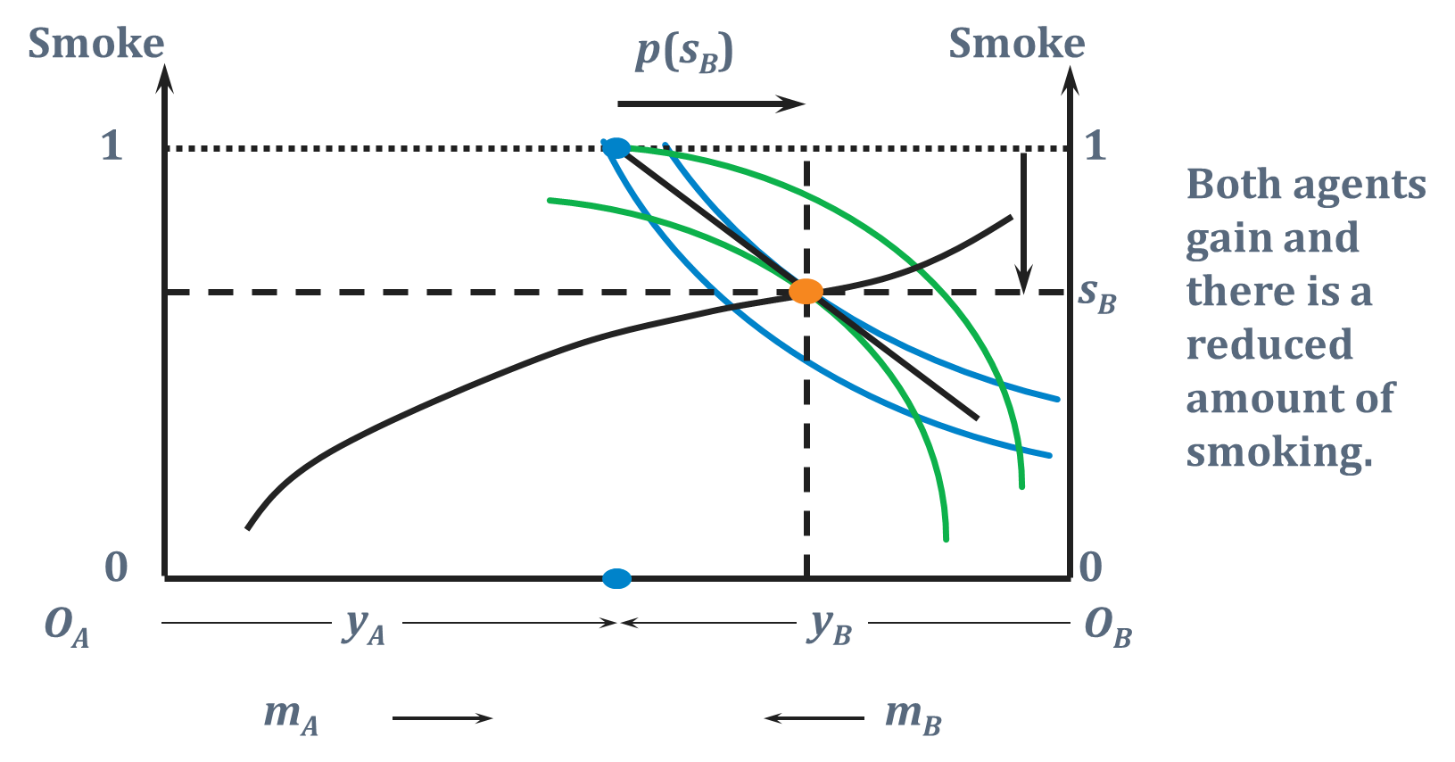
Property Rights to Person A
Default “endowment” is Smoke=1 because person A likes smoke.
Competitive Equilibrium
Since smoke is now tradeable at some positive price, budget line is now downward sloping.

Slide 37
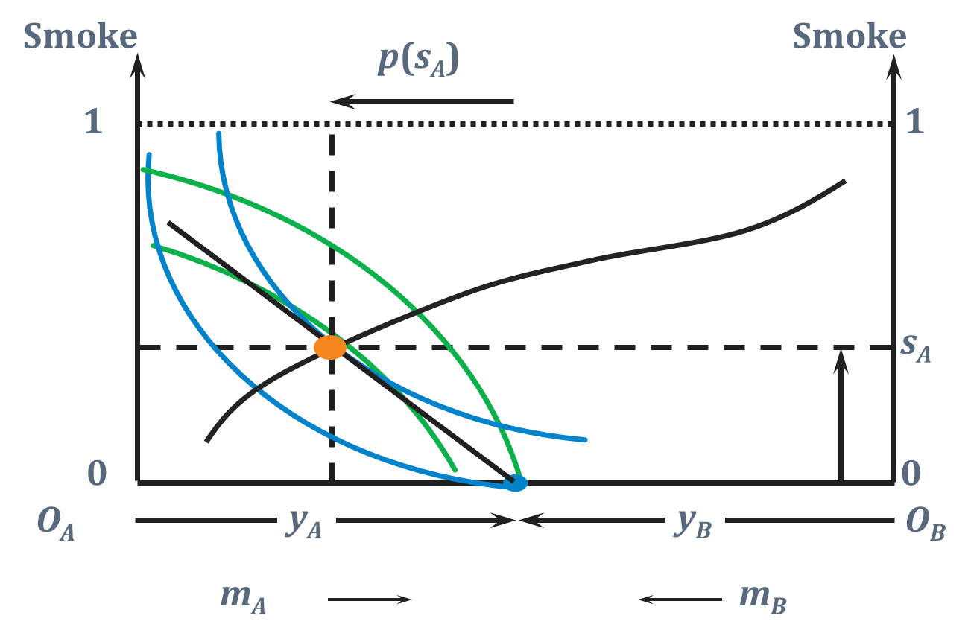
Property Rights to Person B
Since smoke is now tradeable at some positive price, budget line is now downward sloping.
Competitive Equilibrium
Default “endowment” is Smoke=0 because person B dislikes smoke.

Slide 38
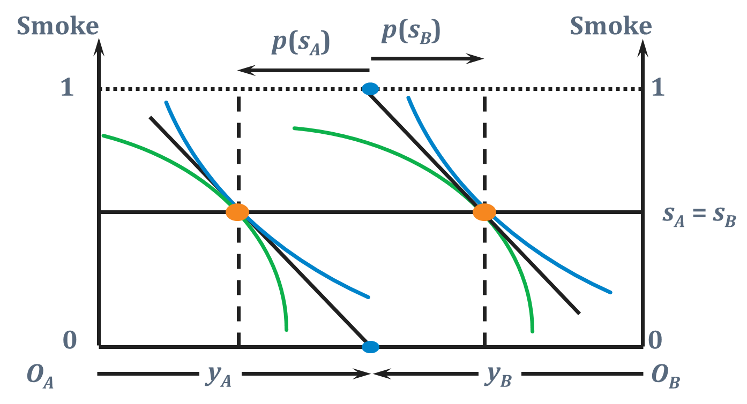


Externalities & Property Rights
Notice that in the past 2 slides, the amount of smoking that occurs in equilibrium depends upon which agent is assigned the property right.
This happens because preferences are not quasi-linear.
If preferences are quasi-linear: $U\left(m,s\right)=m+f(s)$
MRS is constant with 𝑠 as 𝑚 changes when preferences are quasi linear in money.. The same amount of smoking results no matter who is assigned the property right $→$ i.e. the allocation of the (non-monetary) good is unique. (see slide 27/28)
Notes:
Indifference curve is
M+f(s)=C
f(s)=C-M
S=f-1(C-M) -> If C increases, for same value of S, just need to raise M by same amount.

Slide 39
Merger and Internalisation

Slide 40
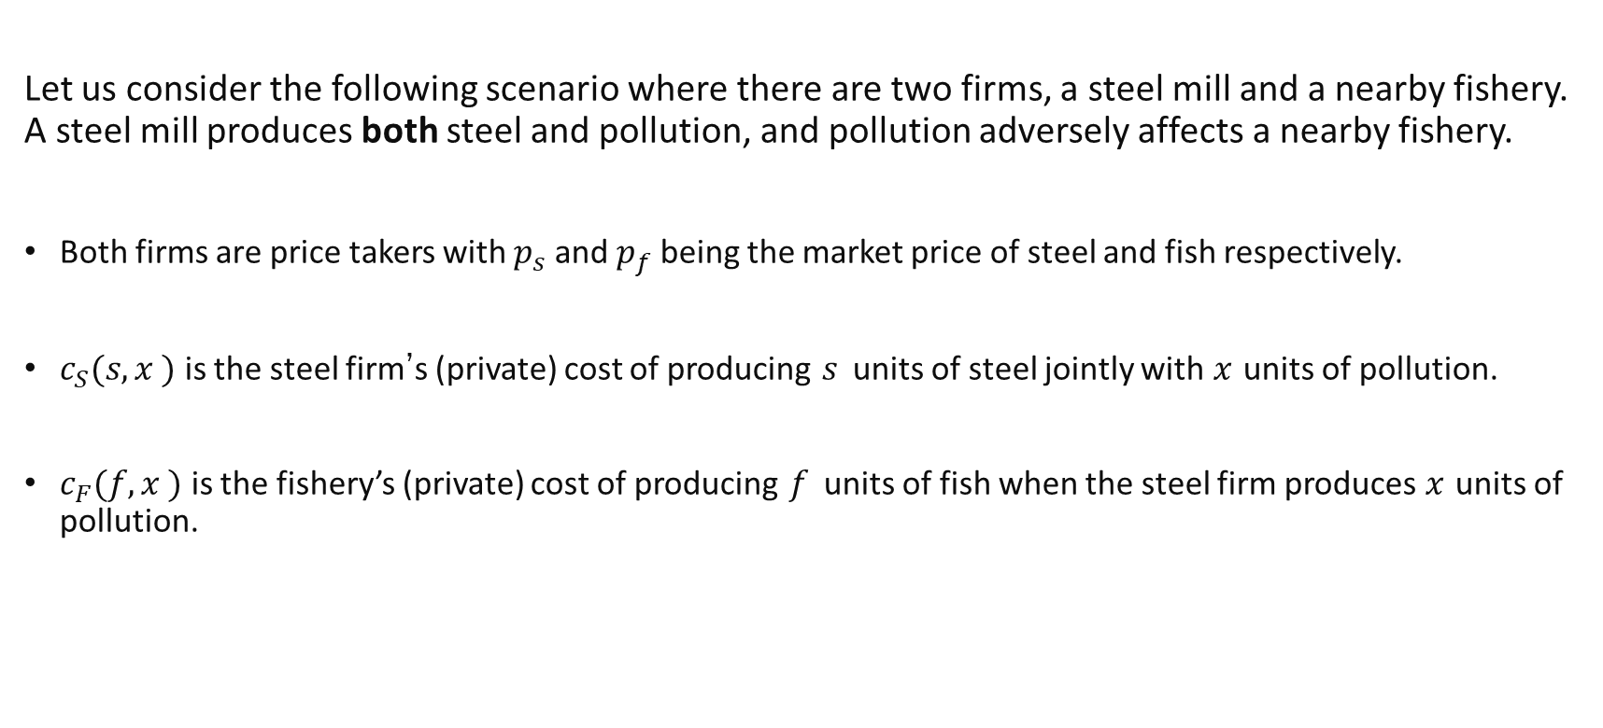
An example of externalities in production
Let us consider the following scenario where there are two firms, a steel mill and a nearby fishery. A steel mill produces both steel and pollution, and pollution adversely affects a nearby fishery.
Both firms are price takers with $p_{s}$ and $p_{f}$ being the market price of steel and fish respectively.
$c_{S}(s,x )$ is the steel firm’s (private) cost of producing $s$ units of steel jointly with $x$ units of pollution.
$c_{F}(f,x )$ is the fishery’s (private) cost of producing $f$ units of fish when the steel firm produces $x$ units of pollution.
Notes:
Production externalities occur when the “third party” is a firm whose production function is affected by the market transaction.

Slide 41

The Steel Firm
The steel firm chooses $s$ and $x$ to maximises profits:
$$π_{s}\left(s,x\right)=p_{s}s−c_{s}(s,x)$$
The first order conditions give:
$p_{s}=\frac{∂c_{s}}{∂s}$
$−\frac{∂c_{s}}{∂x}=0$
Suppose $c_{s}\left(s,x\right)=s^{2}+{\left(x−4\right)}^{2}$ and that $p_{s}=12$
$s=6$
$x=4$

Slide 42
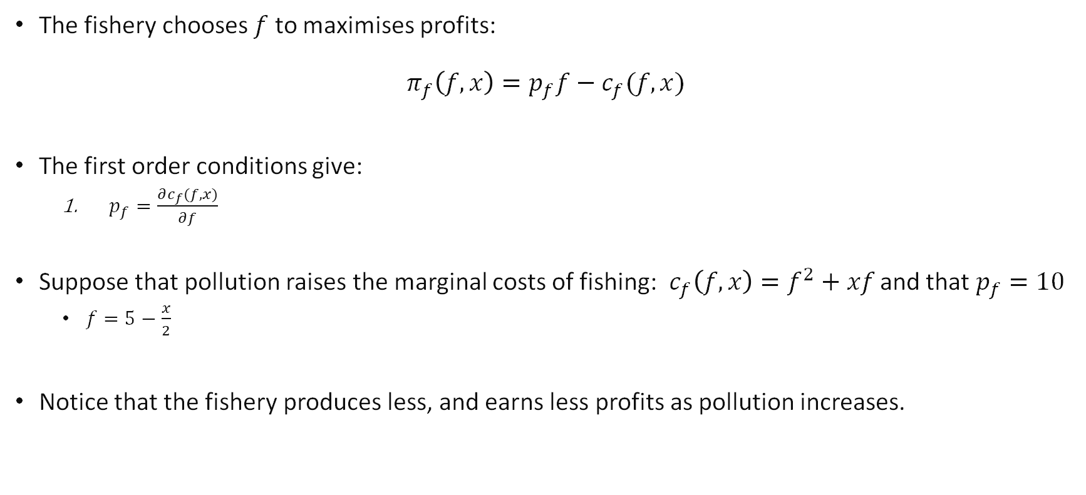
The Fishery
The fishery chooses $f$ to maximises profits:
$$π_{f}\left(f,x\right)=p_{f}f−c_{f}(f,x)$$
The first order conditions give:
$p_{f}=\frac{∂c_{f}(f,x)}{∂f}$
Suppose that pollution raises the marginal costs of fishing: $c_{f}\left(f,x\right)=f^{2}+xf$ and that $p_{f}=10$
$f=5−\frac{x}{2}$
Notice that the fishery produces less, and earns less profits as pollution increases.

Slide 43
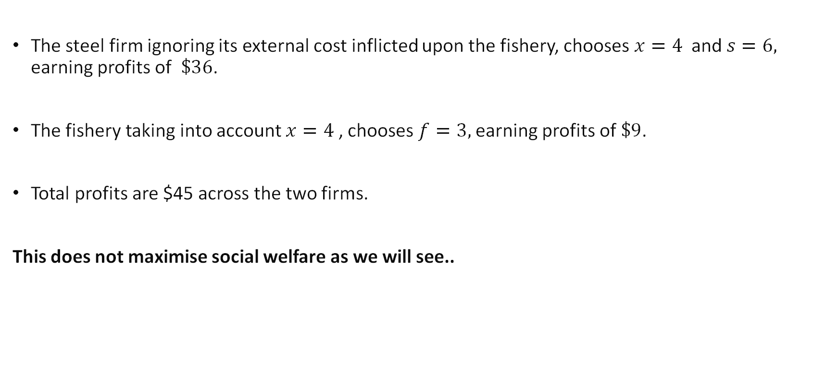
Equilibrium
The steel firm ignoring its external cost inflicted upon the fishery, chooses $x=4$ and $s=6,$ earning profits of $\$36$.
The fishery taking into account $x=4$, chooses $f=3,$ earning profits of $\$9$.
Total profits are $45 across the two firms.
This does not maximise social welfare as we will see..
Notes:
This is also the NE of the simultaneous game.

Slide 44
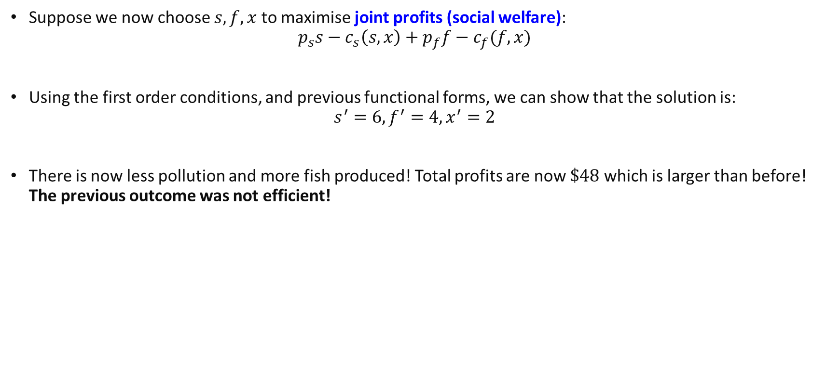
New Equilibrium with Merger
Suppose we now choose $s,f,x$ to maximise joint profits (social welfare):
$$p_{s}s−c_{s}\left(s,x\right)+p_{f}f−c_{f}(f,x)$$
Using the first order conditions, and previous functional forms, we can show that the solution is: $s^{′}=6,f^{′}=4,x^{′}=2$
There is now less pollution and more fish produced! Total profits are now $\$48$ which is larger than before! The previous outcome was not efficient!

Slide 45
Remarks
Maximising joint profits is the same as saying that the two firms are one entity
By merging the 2 firms, we can improve outcomes because the merger causes the steel firm to internalizes its externality.
However, mergers can have similar coordination issues.
Before merging, coming to an agreement on a share of joint profits can be hard.. (Especially, with an increasing number of stakeholders)
Notes:
Quasilinear means utility of the form $u\left(x\right)+y$

Slide 46
Key Learning Outcomes
The issue of externalities can be viewed two ways
It is a lack of proper incentives
It is a lack of proper markets
There are different ways of tackling this problem
Taxes and subsidies which create the appropriate incentives.
Creation of property rights which allows of trading of externalities. (Coase theorem)
Merger (if possible) is also another way to create appropriate incentives.
Each of these solutions has their own potential problems.

Slide 47
Readings
Varian Chapter 35
Related articles
Coasean economics in Irvine, California
Costs of property rights
Lobsterman versus Whalers
Carbon Pricing

