Slide 1
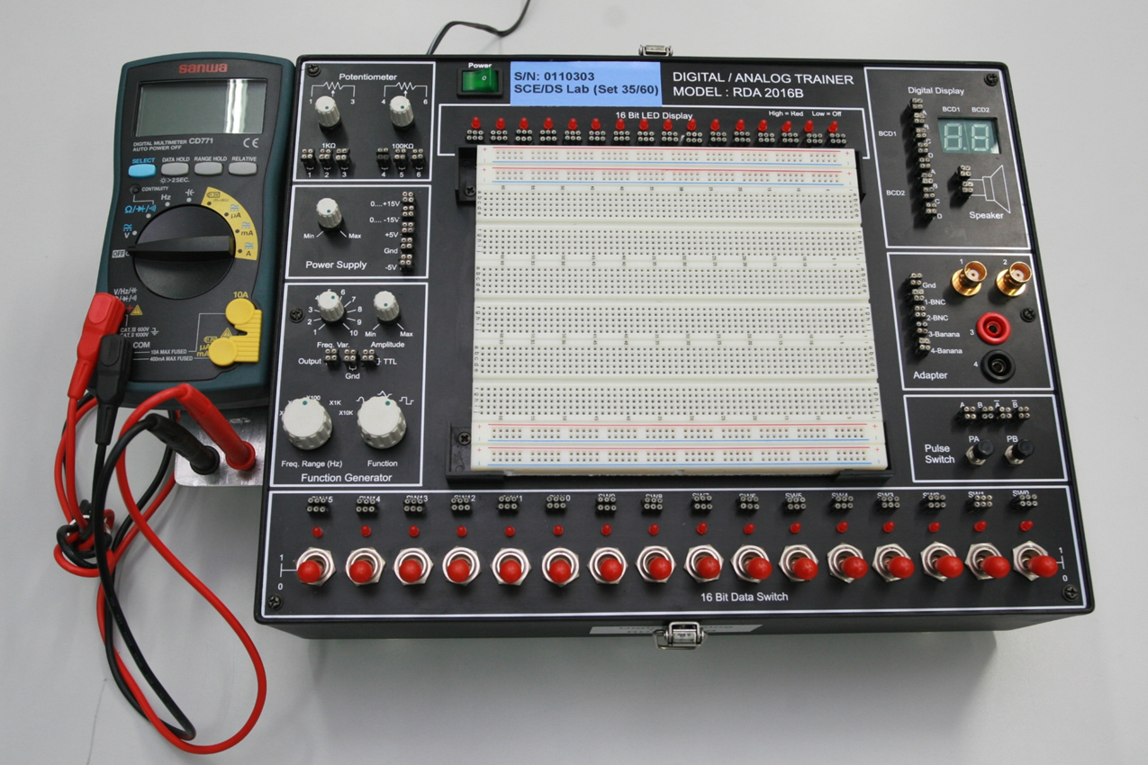
Introduction on Digital\Analog (DA) Trainer Set
16 bit LED Display
Power “on/off” Switch
1kohm and 100kohm potentiometer
The Digital Display
General introduction on the DA trainer set
The Power Supply
The Breadboard
Adapter
The Function Generator
Pulse switch
16 bit Data Swtich

Slide 2
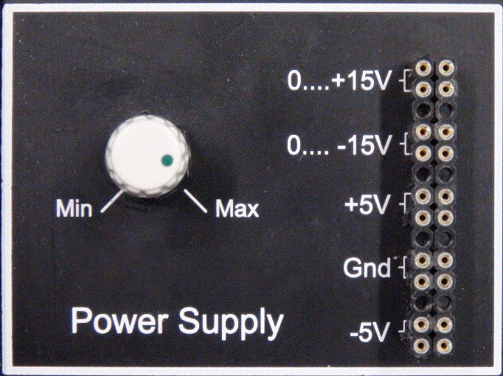
Introduction on the Power Supply
The Power Supply provides a
(i) Fixed : +5V and -5V
(ii) Variable Voltages : 0 to +15V
and 0 to -15V.
(iii) Ground point
Turn knob C to vary the voltage from 0 to ±15V.
C
C
Four turn-pins are internally connected
Four turn-pins are internally connected

Slide 3
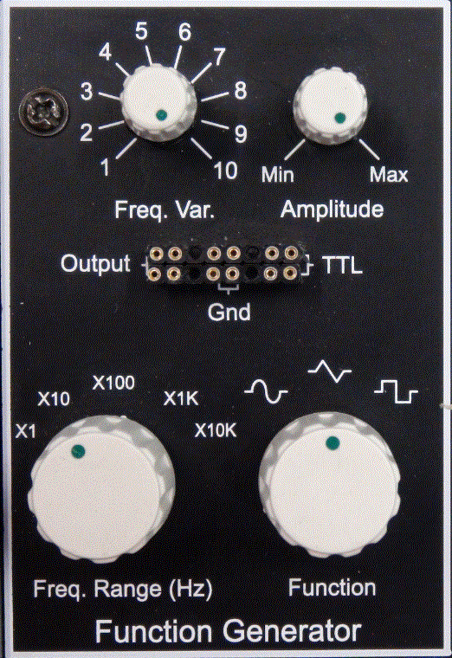
Introduction on the Function Generator
The Output waveform is determined by adjusting the Function knob D and the amplitude can be increase and decrease by adjusting the Amplitude knob G.
The TTL and Output frequency can be
adjusted by setting the Freq.Range
knob E and adjusting the Freq. Var.
(fine) knob F.
The Function Generator provides
(i) Fixed TTL : +2.8V to +5V
(ii) Ground point and
(iii) Output waveform
F
F
G
G
Four turn-pins are internally connected
Four turn-pins are internally connected
E
E
D
D
Frequency Range
X1 : 1Hz ~ 10Hz
X10 : 10Hz ~ 100Hz
X100 : 100Hz ~ 1Khz
X1K : 1Khz ~ 10Khz
X10K : 10Khz ~ 100Khz

Slide 4
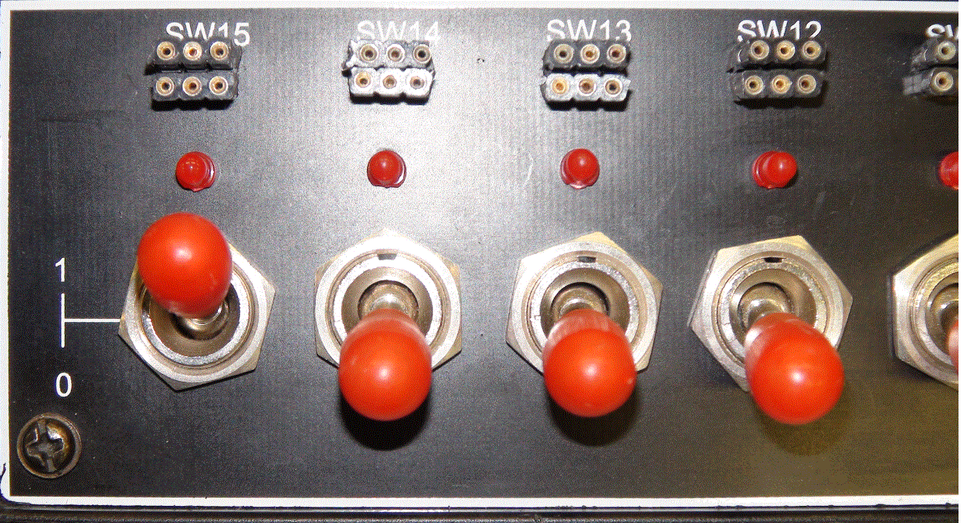
Introduction on the 16 Bit Data Switch
2. When the switch is set to 1
position , the output is at HI LEVEL
and the LED will turn on.
There are 16 set of Data/Toggle Switches. When the switch is set to 0
position , the output is at LO LEVEL
and the LED will turn off.
LED turn ON
LED turn OFF

Slide 5
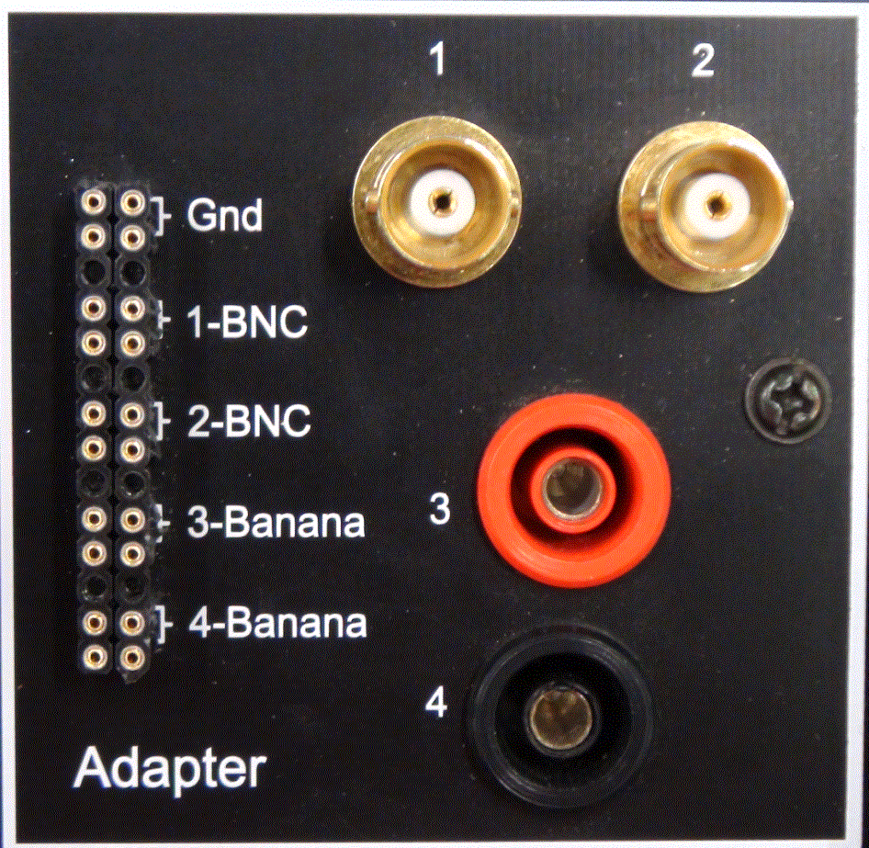
Introduction on the Adapter
BNC cable connected to CH1 of oscilloscope
BNC cable connected to CH2 of oscilloscope
The Adapter provides :-
(i) Ground point
1-BNC , connected to CH1 of the
oscilloscope.
2-BNC , connected to CH2 of the
oscilloscope.
Signal input from TTL/IC chip
Signal input from IC chip

Slide 6
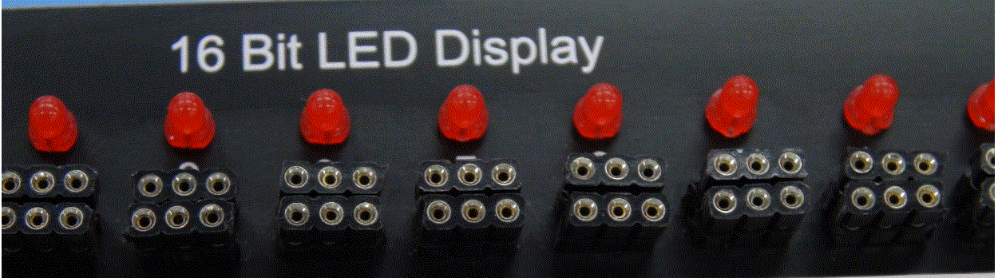
Introduction on the 16 Bit LED Display
LED off = LO LEVEL
LED on = HI LEVEL
Six turn-pins are internally connected
The are 16 Bit LED Display.
When at HI LEVEL the LED will turn on.
It will turn off when at LO LEVEL.

