Slide 1
Scaling the Divide: Work-life Balance and Recreation
By: Issac Goh

Slide 2
Table of contents
01
02
03
04
05
Observations, Analysis and Question
Source 1
Source 2
Synthesis
Argument and Conclusion

Slide 3
01
Observations, Analysis and Question

Slide 4
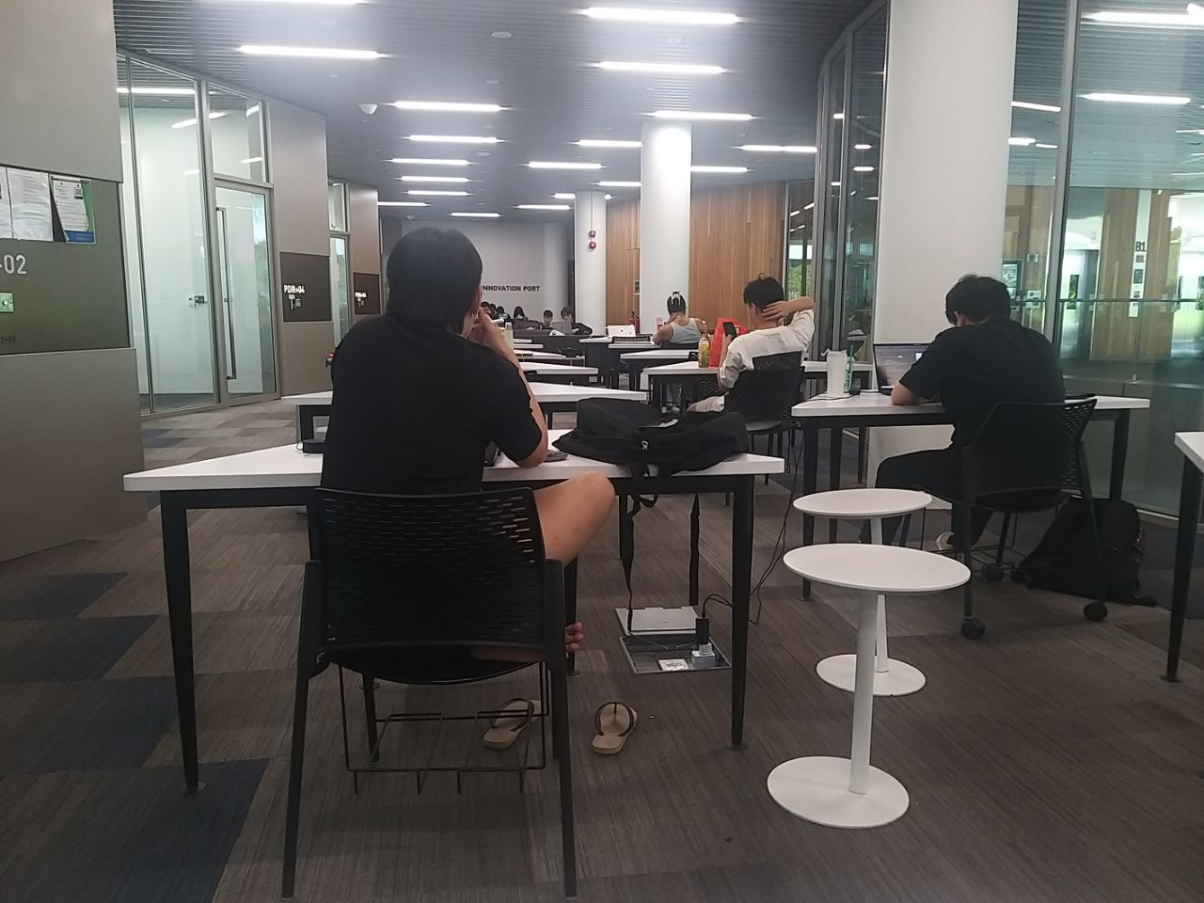
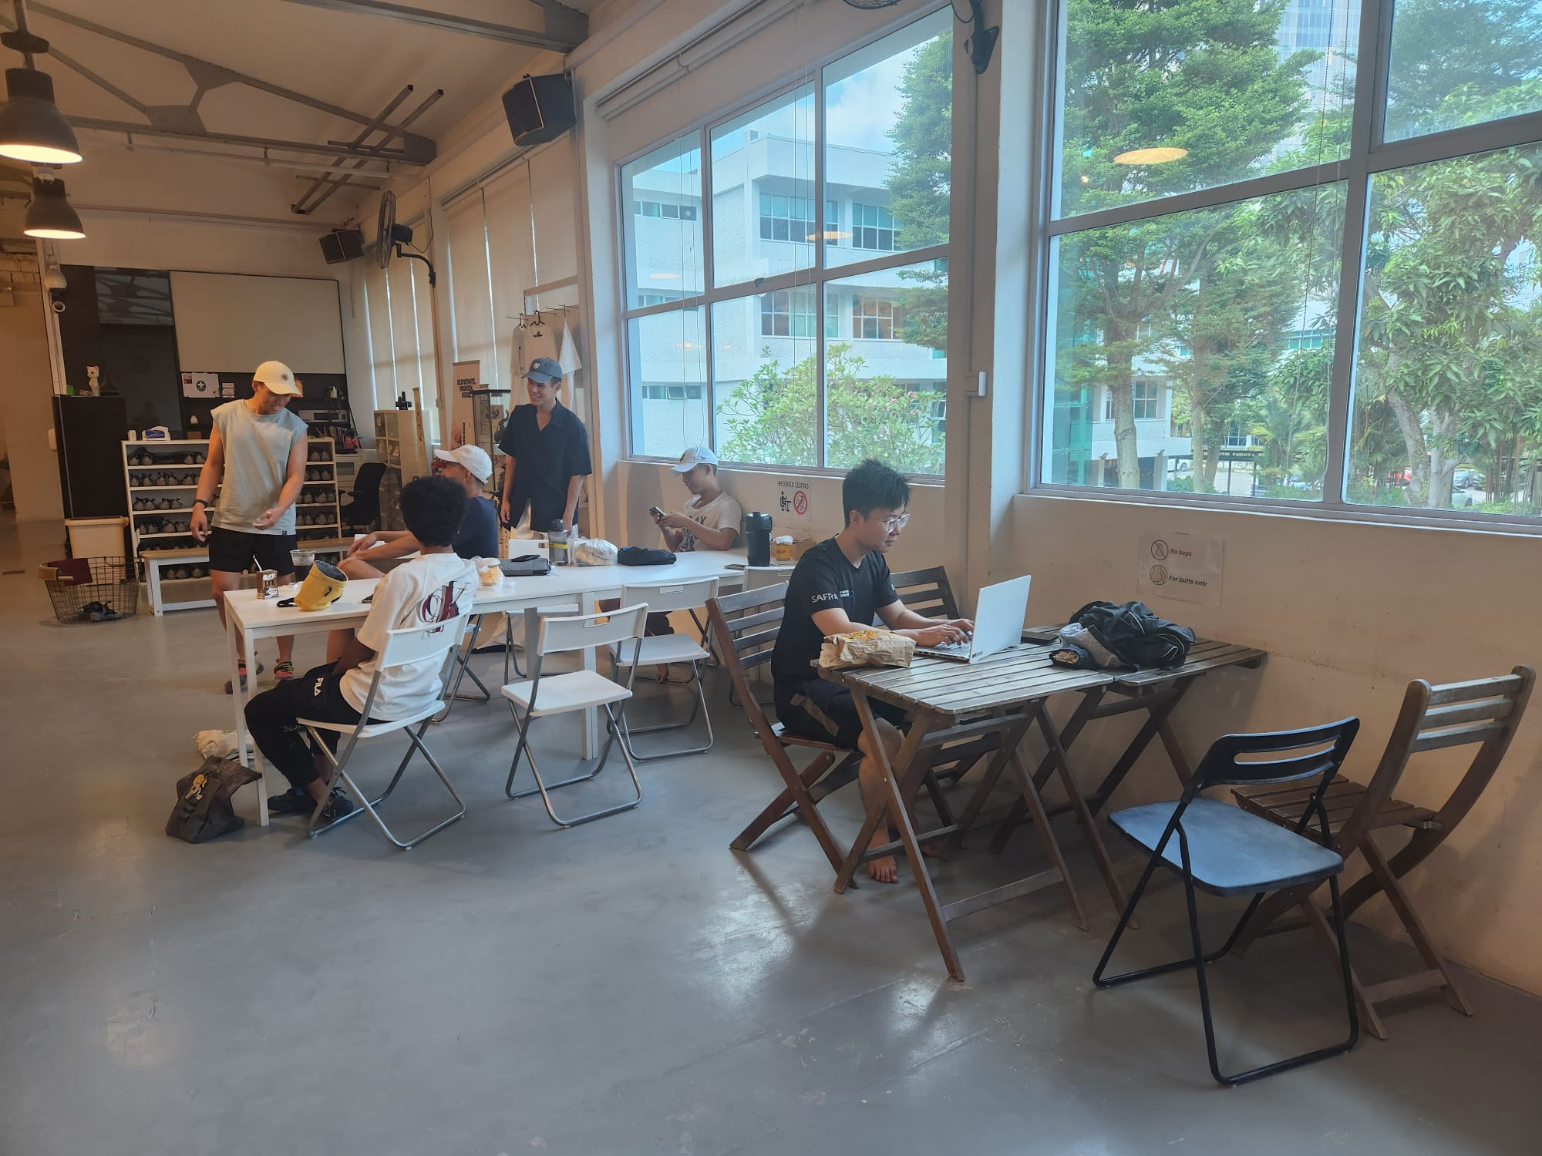
Present
Future

Slide 5
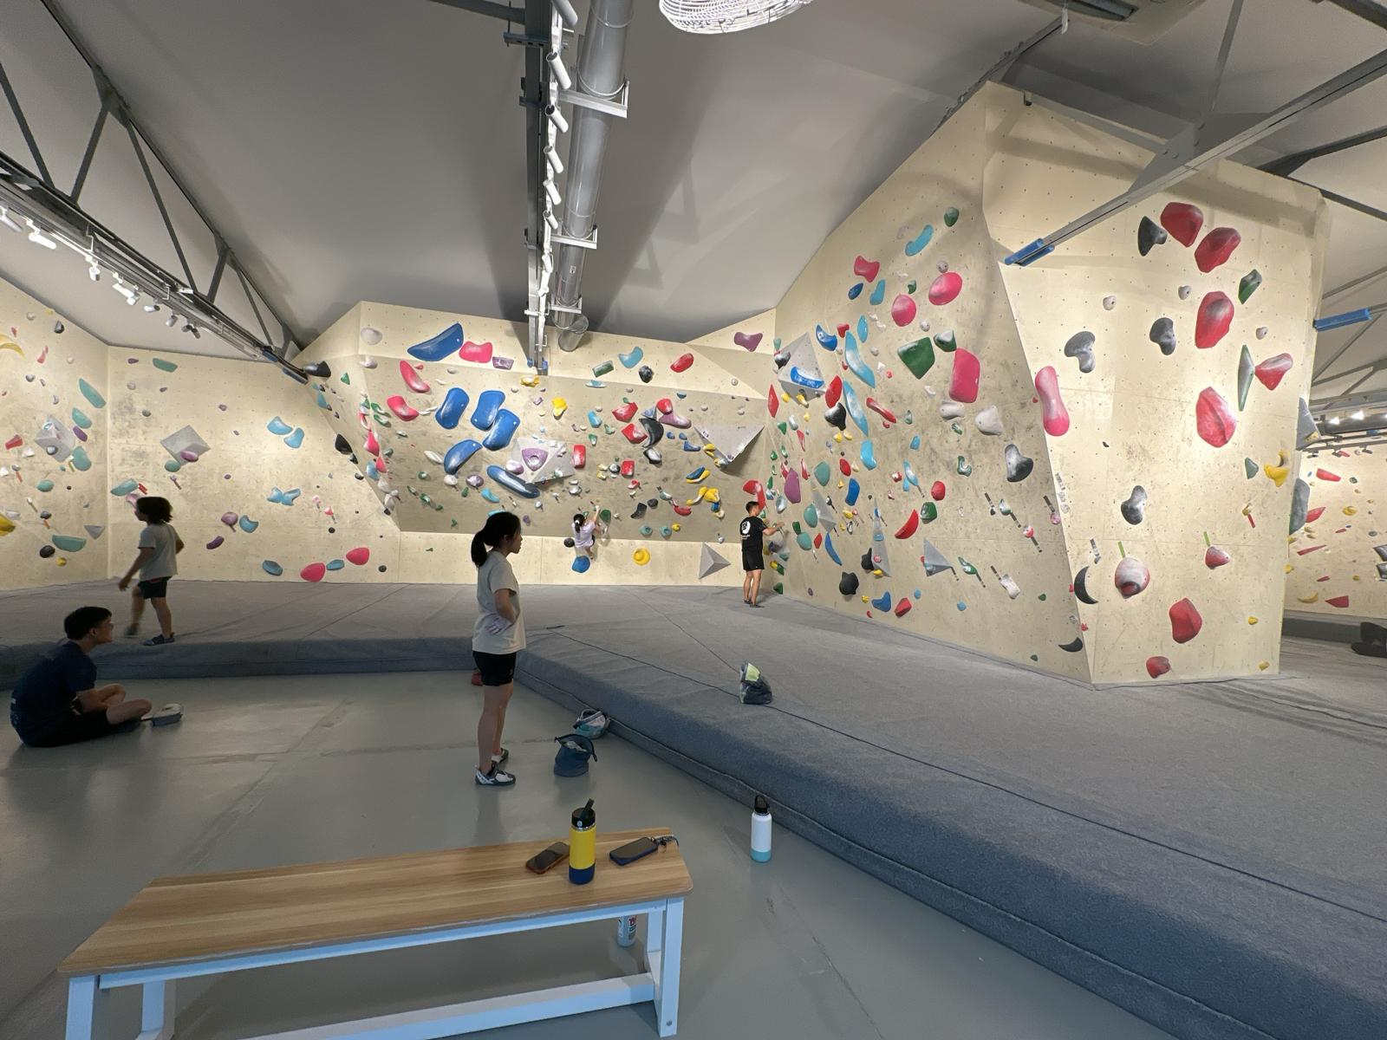
Observations

Slide 6
Why do many Singaporeans continue to work during leisure time?

Slide 7
02
Source 1

Slide 8
Source 1: Wee (2016) - “Work-in-Life…”
Organisational control through technological tools.
Normative Control
Methods companies use to ensure workers are aligned with their goals
“creates a virtual office” (Wee, 2016, p.17)
Obscure the distinction between work and leisure time
Enforcement of behavioural norms through social expectations and cultural values
Offering work after hours
Instill a sense of responsibility in employees

Slide 9
Source 1: Wee (2016)
Evaluation:
Misuse of digital technology
Personal work ethic may prompt voluntarily working during leisure time
Misrepresentation of other organisational control tools beyond communication technologies

Slide 10
03
Source 2

Slide 11
Source 2: Lim et al (2006) “Recommendations on work-life…”
Predominant asian culture
Local environmental influences
“influenced more strongly by Confucian dynamism”(Lim et al., 2006, p.15).
Prioritise tenacity and adherence to pecking order
Excessive adherence leads to poor work-life balance
Capitalistic world influence people to pursue materialistic wealth
High cost of living leads to its citizens to work excessively.

Slide 12
Source 2: Lim et al (2006)
Evaluation:
Interplay between Asian culture and Singapore’s environmental influences
This behaviour more common in traditional workplace settings
Shifts in working attitudes towards valuing work-life balance, due to new flexible work arrangements.

Slide 13
04
Synthesis

Slide 14
Synthesis
Lim et al (2006)
Wee (2016)
Environmental influence and Asian culture forms the foundation for Singaporeans to grow up in
Digital tools and normative control reinforces employees’ attitude

Slide 15
05
Argument and Conclusion

Slide 16
Argument & Conclusion
Pandemic
Post-Pandemic
Future
Adopt new remote-work technologies.
Liberated from in- person micromanagement
No pressure of seeing others not clocking off.
Reverted back to traditional behaviours - decrease in productivity Basu (2024)
Younger generation employers still adopt remote-working
Do not lack Technology
Change in employer’s mindset

Slide 17
Thank You!

Slide 18
References
Basu, S. (2024, March 22). More bosses want employees back in the office. Like, now. The Economic Times.https://economictimes.indiatimes.com/jobs/hr-policies-trends/more-bosses-want-employees-back-in-the-office-like-now/articleshow/108717540.cms
Lim, Zhixun., Lim, L. Fei., & Tan, S. X. Xian. (2006). Recommendations on work-life balance in Singapore.
Singapore, New York top ‘world’s costliest city’ survey. (2022, December 4). The Straits Times. https://www.straitstimes.com/world/singapore-new-york-top-world-s-costliest-city-survey
Wee, Y. W. (2016). “Work-in-Life” : reconsidering work-life balance in Singapore.

