Slide 1
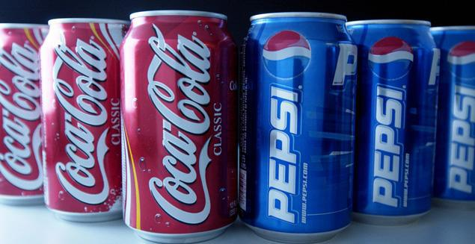

Microeconomics I Topic 12: Oligopoly
Assistant Professor He Tai-Sen
ts.he@ntu.edu.sg

Slide 2
Outline
Assumptions of Oligopoly
Choosing Quantity
Stackelberg Model
Cournot Model
Choosing Price
Bertrand Model
Price competition with Differentiated Products

Slide 3
Assumptions of Oligopoly
Assumptions of oligopoly:
Buyers: many buyers (price-takers)
Sellers: two or a few sellers
Product homogeneity: firms sell a homogeneous good in Stackelberg/Cournot/Bertrand models
Which of the following are good examples of oligopoly?
Coke, Pepsi
Watsons, Guardian, Unity
OCBC, DBS, …
NTU, NUS, SMU
Notes:
4

Slide 4
Stackelberg Model
Stackelberg model: oligopoly model in which one firm sets its output before the other firm does.
The other firm will make observations first before responding to the initial firm’s move.
Assumptions
Market demand: P=30-Q where Q is total output: Q=Q₁+Q₂
Firms produce a homogeneous good
Firm 1 sets its output first and then Firm 2, after observing Firm 1’s output, makes its output decision.
Both firms have zero marginal cost: MC=0
Notes:
4

Slide 5
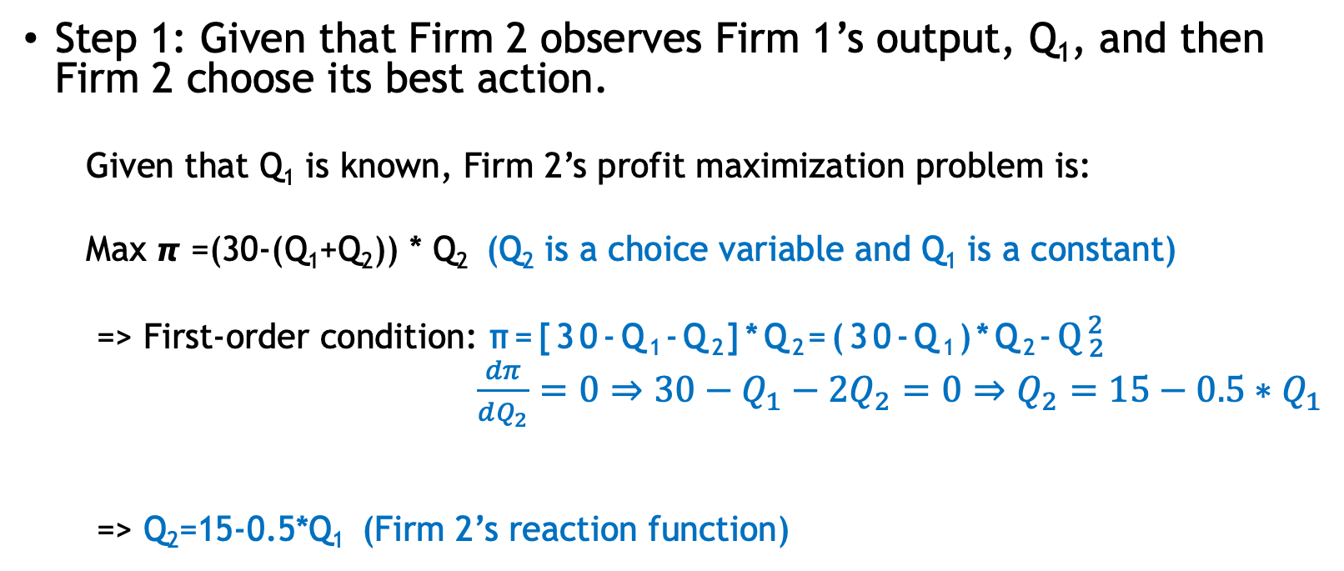
Stackelberg Model
Step 1: Given that Firm 2 observes Firm 1’s output, Q₁, and then Firm 2 choose its best action.
Given that Q₁ is known, Firm 2’s profit maximization problem is:
Max 𝞹 =(30-(Q₁+Q₂)) * Q₂ (Q₂ is a choice variable and Q₁ is a constant)
=> First-order condition: π=[30-Q₁-Q₂]*Q₂=(30-Q₁)*Q₂-$Q_{2}^{2}$
$\frac{dπ}{dQ_{2}}=0⇒30−Q_{1}−2Q_{2}=0⇒Q_{2}=15−0.5{∗Q}_{1}$
=> Q₂=15-0.5*Q₁ (Firm 2’s reaction function)
Notes:
4

Slide 6
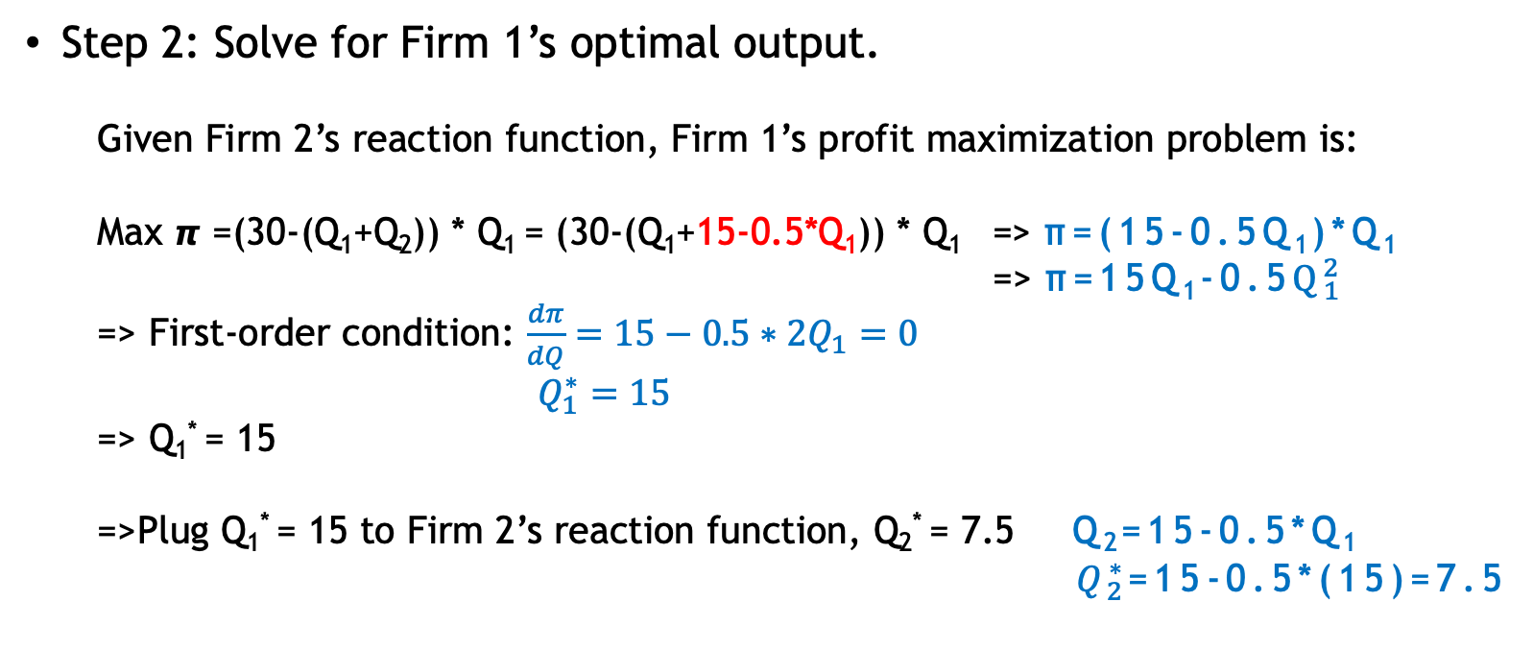
Stackelberg Model
Step 2: Solve for Firm 1’s optimal output.
Given Firm 2’s reaction function, Firm 1’s profit maximization problem is:
Max 𝞹 =(30-(Q₁+Q₂)) * Q₁ = (30-(Q₁+15-0.5*Q₁)) * Q₁ => π=(15-0.5Q₁)*Q₁
=> π=15Q₁-0.5$Q_{1}^{2}$
=> First-order condition: $\frac{dπ}{dQ}=15−0.5∗2Q_{1}=0$
$Q_{1}^{∗}=15$
=> Q₁* = 15
=>Plug Q₁* = 15 to Firm 2’s reaction function, Q₂* = 7.5 Q₂=15-0.5*Q₁
$Q_{2}^{∗}$=15-0.5*(15)=7.5
Notes:
4

Slide 7
Stackelberg Model
The equilibrium in Stackelberg model is a subgame perfect equilibrium.
Notes:
4

Slide 8
Cournot Model
Cournot model: oligopoly model in which firms produce a homogeneous good, each firm treats the output of its competitors as fixed, and all firms decide simultaneously how much to produce.
Notes:
4

Slide 9
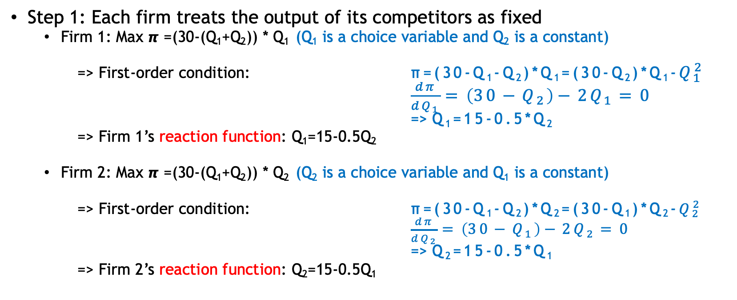
Cournot Model
Step 1: Each firm treats the output of its competitors as fixed
Firm 1: Max 𝞹 =(30-(Q₁+Q₂)) * Q₁ (Q₁ is a choice variable and Q₂ is a constant)
=> First-order condition: π=(30-Q₁-Q₂)*Q₁=(30-Q₂)*Q₁-$Q_{1}^{2}$
$\frac{dπ}{dQ_{1}}=\left(30−Q_{2}\right)−2Q_{1}=0$
=> Q₁=15-0.5*Q₂
=> Firm 1’s reaction function: Q₁=15-0.5Q₂
Firm 2: Max 𝞹 =(30-(Q₁+Q₂)) * Q₂ (Q₂ is a choice variable and Q₁ is a constant)
=> First-order condition: π=(30-Q₁-Q₂)*Q₂=(30-Q₁)*Q₂-$Q_{2}^{2}$
$\frac{dπ}{dQ_{2}}=\left(30−Q_{1}\right)−2Q_{2}=0$
=> Q₂=15-0.5*Q₁
=> Firm 2’s reaction function: Q₂=15-0.5Q₁
Notes:
4

Slide 10


Cournot Model
Step 2: Cournot equilibrium
Using both conditions derived in Step 1
=> Q₁=15-0.5Q₂
Q₂=15-0.5Q₁
=> Q₁* = Q₂* = 10
Q₁
Firm 2’s reaction curve
15
Cournot equilibrium
$$Q_{1}^{∗}$$
Firm 1’s reaction curve
Cournot equilibrium: the equilibrium in the Cournot model in which each firm correctly assumes how much its competitor will produce and sets its own
$$Q_{2}^{∗}$$
15
Q₂
Notes:
4

Slide 11



Cournot Model
Cournot equilibrium is a Nash equilibrium
Q₁
Firm 2’s reaction curve: Q₂=15-0.5Q₁
$$Q_{1}^{C}$$
≠ N.E
$$Q_{1}^{D}$$
Cournot equilibrium = N.E
Firm 1’s reaction curve: Q₁=15-0.5Q₂
$$Q_{2}^{C}$$
Q₂
Notes:
4

