Slide 1
Lab 5 Tasks
Advanced Workshop
Spring 2026

Slide 2
Main Tasks
Teacher review feedback from last week on SRS partial document.
Teacher explains solution for last week’s tasks.
Students
Update SRS partial documents according to feedback.
Create state transition diagrams and user interfaces for all use cases.
Create a basic scenario for each import use case.
That would help you to create the transition diagram.

Slide 3
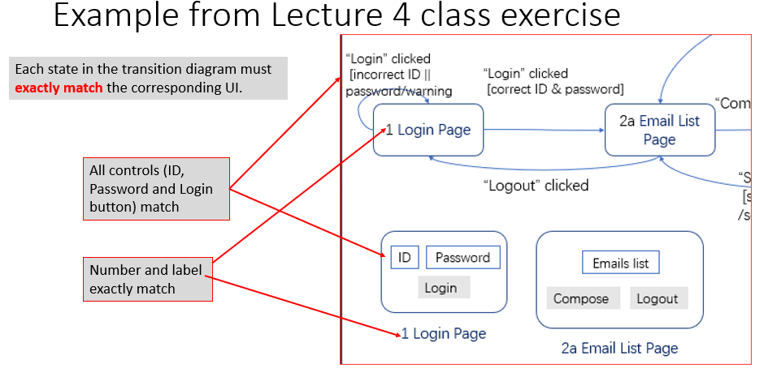
Task1: Feedback from Last Week
(A) Transition diagram and UI must exactly match:
Each state in the transition diagram must have a corresponding UI.
Each state in the transition diagram must have a number and label that exactly match the number and label in the corresponding UI.

Slide 4
Task1: Feedback from Last Week
Every event and condition in a transition diagram state must have a corresponding control in the UI diagram.
If a transition diagram state has the event “Click Button 1”, the corresponding UI must have a Button 1.
A UI diagram should not have any button, control object or other unnecessary junk not used in the transition diagram.

Slide 5
Task1: Feedback from Last Week
(B) Transition diagrams:
The same number in a state cannot be reused in another state.
Cannot have “2. Search Student Info” and “2. Search Mentor Info”.
Improper actions
“Go to Edit page” is not a proper action, because the arrow in the transition diagram is already pointing to Edit page.
Warning boxes and other controls with only one button are not states; they should be actions.
Every state after login has a “Home” button for users to return to their respective home pages.
Only need to have the state “1. Login” in the login transition diagram. In other transition diagrams, you can start with the home page(s) and put “Assume the user has logged in” as a requirement in 3.x.3.

Slide 6
Task1: Feedback from Last Week
(C) UIs and UI file
Must put all UIs in a UI file separate from the SRS document.
Should have one complete set of UIs for all transition diagrams.
The UIs in the UI file should not be organized by transition diagrams.
Should not have one set of UIs for one transition diagram, and another set of UIs for another transition diagram.
A UI cannot appear more than once in the UI file.

Slide 7
Task1: Feedback from Last Week
The UIs in the UI file should be organized by the numbers in the label.
Organize the number in the UIs something like this:
UIs for Login and Home Pages begin with 1.
E.g. 1 Login, 1A Home Mentor, 1B Home Student, 1C Home Faculty Consultant, etc.
UIs for Search, Edit and Export pages begin with 2.
E.g. 2A1 Search Stud Info Page, 2A2 Edit Stud Info Page, 2B Search Mentor Page, etc.
These are pages for the highest priority goal-oriented use cases.
UIs for Utilities begin with 3.
E.g. 3A Sent Message Page, 3B Make Appointment Page, etc.
These are the support pages for those beginning with 2.
UIs for Admin and Maintenances begin with 4.
In the UI file, list the UI diagrams by their numbers.
For any state in the transition diagram, we can easily find the corresponding UI in the UI file by looking up its number.

Slide 8
Task1: Feedback from Last Week
(D) Scenario
User action and systems response must alternate.

Slide 9
Task1: Feedback from Last Week
(E) Miscellaneous Remarks
In the cover, write down the contribution by each member: Full, Fair, Little or None.
Font sizes should not be too small
Font size in the transition diagram and UIs should be comparable to the size of the regular text in your document.
The numbers and labels for a state and UI should be a little bigger, and the text for the event/condition/action can be a little smaller.

Slide 10
Task1: Feedback from Last Week
(F) Specific Common Errors
In some transition diagrams such as Search Student’s Info / Edit Interview Record, must consider the actor in the condition.
Otherwise, you allow the coordinator to edit the interview record.

Slide 11
Task2: Solution to last week’s tasks
OK to put Search Students’ Info (left hand side of next slide) in 3.1.2.
No points deducted if you did that.
But the combine transitions of 3.1 Search Student’s Info and 3.2 Edit Interview Record contains the same states as 3.1.2.
Only need to add the controls for 2B. Student Info at the far right of next slide in order to combine 3.1 with 3.2.

Slide 12
Transition Diagram: Search Students’ Info + Edit Interview Record
"Edit" clicked /
"Save“, and "Cancel" enabled **
"Search" clicked
[ID valid, coordinator or faculty consultants]
/ show student info*
"Save" clicked /
save modified record
1A. Home Page
mentors
"Search" clicked
[ID valid, mentor]
/ "Save“, and "Cancel" disabled in 2B.
"Search students’ info" clicked
1C. Home Page coordinator
2A. Search Students' Info Page
2B. Student Info Page
"Back" clicked
1D. Home Page faculty consultants
"Search" clicked [no ID or invalid ID]
/ warning
"Cancel" clicked /
restore previous record
Note: Every state after login has a “Home” button for users to return to their respective home pages. * Show student info is 2B. Student Info Page without Edit, Save and Cancel. i.e. it’s a message box.
** User can add, modify or delete record, followed by Save or Cancel.

Slide 13
Transition Diagram: Search Mentors’ Info
"Search" clicked
[(name or email) valid or group ID selected]
/ show mentor name, email and select the group ID in group ID list
"Search" clicked
[(name and email) invalid and group ID not selected]
/ warning
1C. Home Page coordinator
"Search mentors’ info" clicked
/ set up search range
2C. Search mentors’ info Page
“Show members” clicked
[group id not selected]
/warning
1D. Home Page faculty consultants
select a student in group member list /
show student's record
“Show members” clicked
[group id selected]
/show mentor name, email and group member list
Note: Every state after login has a “Home” button for users to return to their respective home pages.

Slide 14
UI
Search students’ info
Search students’ info
Search students’ info
Search mentors’ info
Search mentors’ info
Other mentor use cases
Other coordinator use cases
Other faculty consultants use cases
1A. Home Page mentors
1C. Home Page coordinator
1D. Home Page faculty consultants
display other info here
display records here, if exists
Student ID:
Search
Back
Edit
2A. Search Students' Info Page
Cancel
Save
2B. Student Info Page
Note: Every state after login has a “Home” Button for users to return to their respective home pages

Slide 15
UI (continue)
mentor name:
Show members
mentor email:
group id:
Group ID List
Search
Back
display group member list here, if any
display students' record here, if any
2C. Search mentors’ info Page

Slide 16
Task4: New tasks this week
Students update the SRS according to the feedback.
Create the state transition, and UI diagrams for all use cases.
You should change the numbering for the transition diagrams; section 3.1 is for Login, section 3.2 for Search Student Info, etc.
List the important (goal-oriented) use cases first, then the support and maintenance use cases later.
For better readability, put related use cases into the same transition diagram.
Create the basic scenarios for all important use cases.
That helps you to figure out the transition diagram.

Slide 17
Submission
Each group (company) submits the partial SRS and UI file (two documents, ONE copy) into iSpace and GitHub .
Deadline: noon, Saturday 28 March 2026.
Don’t submit too close to the deadline!
On the cover of the SRS next to the student names, leaders (with the support of most of the team) indicate how much each member contributed: Full, Fair, Little or None.

