Slide 1
Lab 7 Tasks Architectural Design
Advanced Workshop
Spring 2026

Slide 2
Tasks
Teacher
Gives feedback on the class and sequence diagrams,
Gives an updated long project description,
Gives a solution for the class diagram,
Explains the architecture design template.
Students
Update the class and sequence diagrams,
Prepare the architecture design document.
4/15/2026
2

Slide 3
Task 1A: Class Diagram Feedback
Completeness:
Most groups did well, but the following were missing in some groups.
Missing classes: Faculty, Department and Major.
Missing associations:
Each faculty has some faculty consultants,
Each department has a coordinator,
Each major has several MCP groups.

Slide 4
Task 1A: Class Diagram Feedback
Consistency:
Operation in a class should operate on the attributes in this class, not the operation as a user.
E.g., setFacultyConsultants, setSupportingStaff are not operations of the Admin class.
That would violate the OO rule “tell the other guy”.
See next page, a slide from Lecture 6

Slide 5
Operations in a Class
Operations in a class must be the operation working on the attributes of this class.
Operation in a class is not an operation of object of this class to other class in the application usage.
User
Name
Document
Content
Example 1
If a user can edit the document, to which class Edit() belong to? User or Document?
Example 2
User
Name
Line
Point1, point2
If a user can draw a line, to which class should Draw() belong to? User or Line?

Slide 6
Task 1A: Class Diagram Feedback
Redundancy:
When a user role does an operation on an object, it does not mean this role class has an association with the class of that object.
E.g., handle, setup, manage, edit, reply are not associations in most cases.
See next page, a slide from Lecture 6.

Slide 7
Association between Classes
Association between classes is created because two participating classes have information dependency, not because the object represented by the class has some operation on another system
Not every verb is an association. Only when two classes have some static (state) relationship, there is an association.
User
Name
Edit?
Document
Content
If a user can edit the document, is edit an association?
If the edit work in the document needs to be tracked according to user’s information, then edit is an association
If the edit work in the document will not record any user information, the association is not needed.

Slide 8
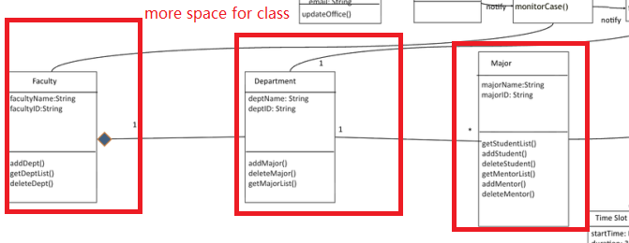
Task 1A: Class Diagram Feedback
Notation
Some crossing lines can be avoided,
Fonts too small, too much line spacing,
Inheritance symbol is a triangle, not an arrow.
This arrow should not be used as inheritance symbol.

Slide 9
Task 1B: Update to the project long description
Version 1.2 is now in iSpace.
The changes are highlighted in the updated version.
One small change section 2.1.
One small change in Appendix B.
Task 1C: a Solution to Class Diagram
Please use the class diagram in the next slide in all future labs.
Other solutions are possible, but for constancy in grading, we want all teams to use the same class diagram.

Slide 10
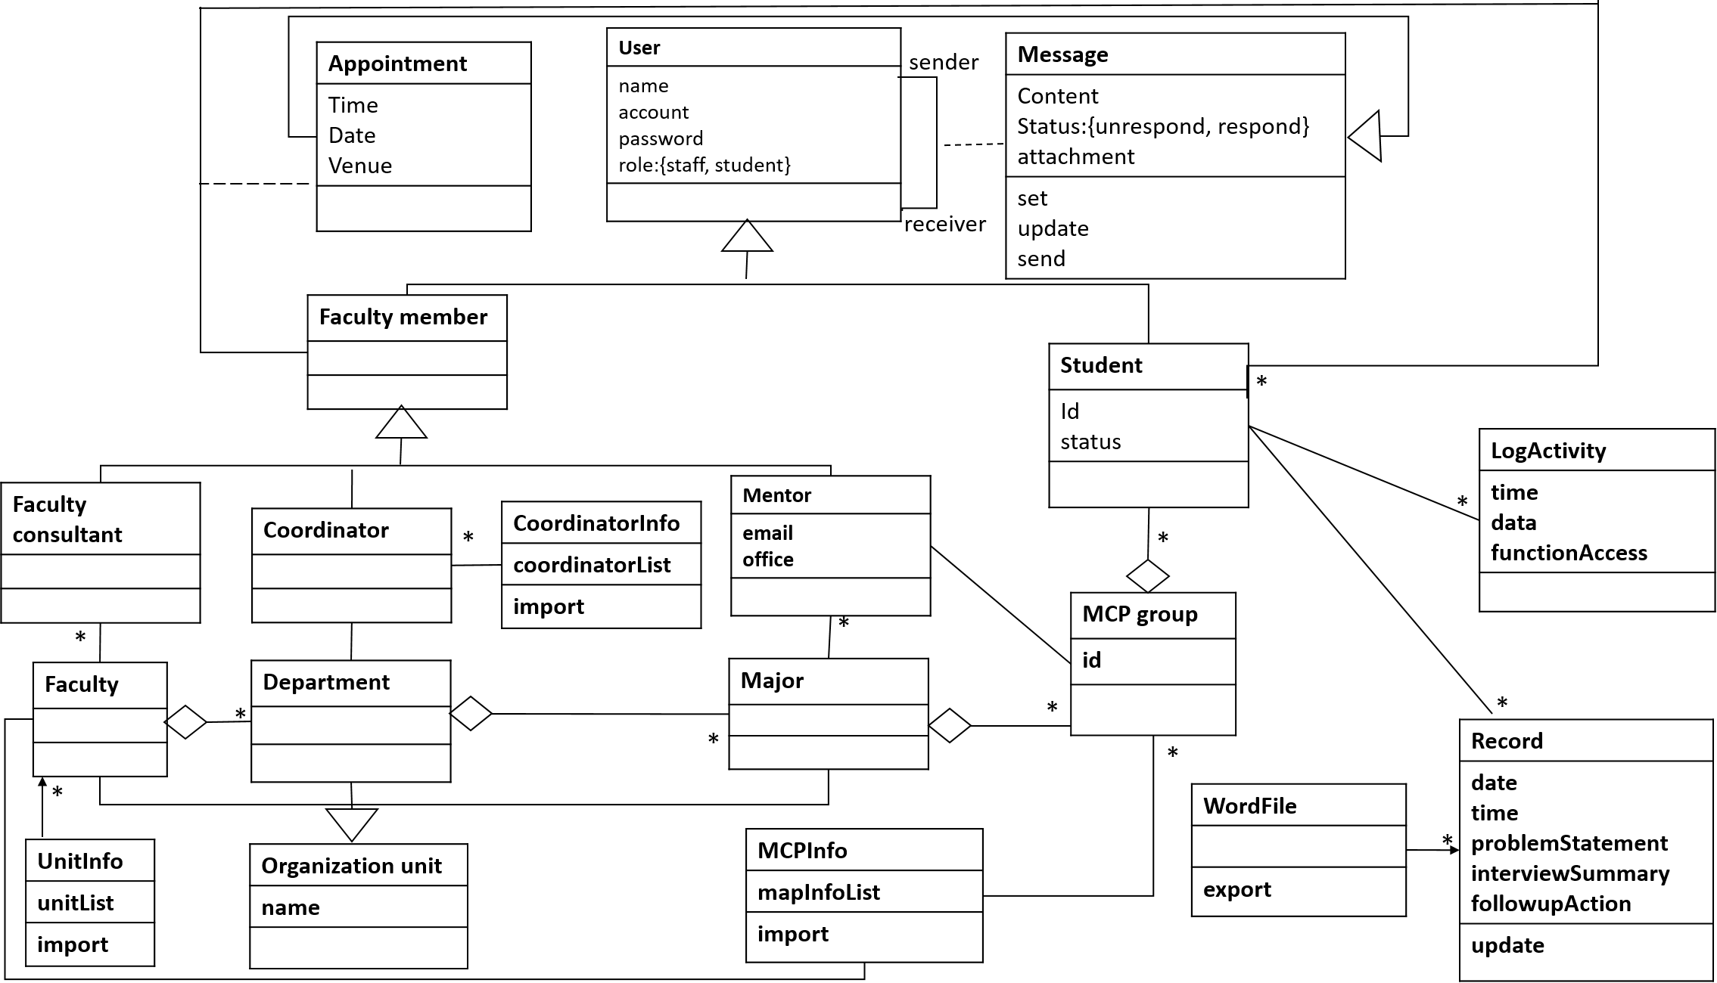
Sample Solution

Slide 11
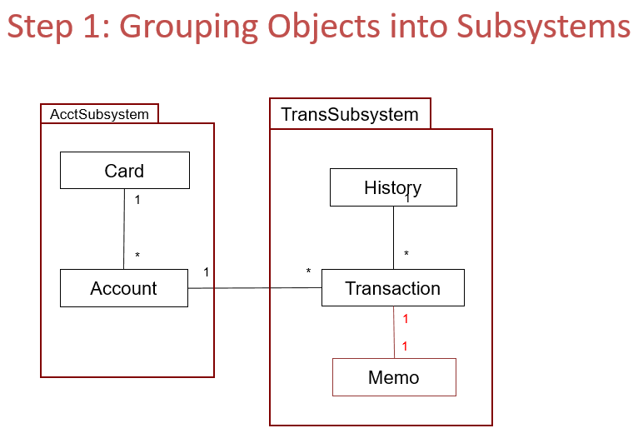
Task 1D: Architecture Design Template
Teacher explains the architecture design template. The template is available on iSpace.
Remember to update the table of content after finishing the document.
Main points
Section 2.3: Whole architecture: refer to this slide in Lecture 10.
4/15/2026
11
Notes:
1. Project introduction I simply shows the students first simple version of the project description which is on iSpace already
2. Interview skills introduce very common interview skills used in industry like email, phone, face to face, question list
3. The purpose to explain SRS is for students to further understand, before start a software development, what should be known. Students shall ask the questions so they can fill in the SRS document. So question list version 2 should be more complete and organized.
4. Students should not ask the questions in the following areas. These are not issues in “Software Requirements”
Cost
– Delivery schedules
– Reporting procedures
– Software development methods
– Quality assurance
– Validation and verification criteria
– Acceptance procedures.
5. So far, we will not tell students the development language that will be used. The decision on language should be put as late as possible.
6. We will behave in the role of customer or client who knows very little about computers. Students should ask in a way that such clients are able to understand. Therefore, they should avoid the use of jargon.
7. In the SRS template, there is an explanation about each section. More attentions should be paid here:
1)Section 1.1 is not the purpose of this project, it is the purpose of this document.
2)References are not software engineering books. It is about the documents in a company which is related to this system and can help understand this system.
3)Software interface exists only when a software system is a subsystem or a module of a whole system. 4)Hardware exists when embedded software is developed.

Slide 12
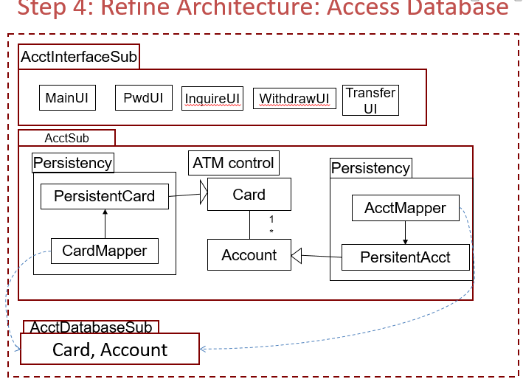
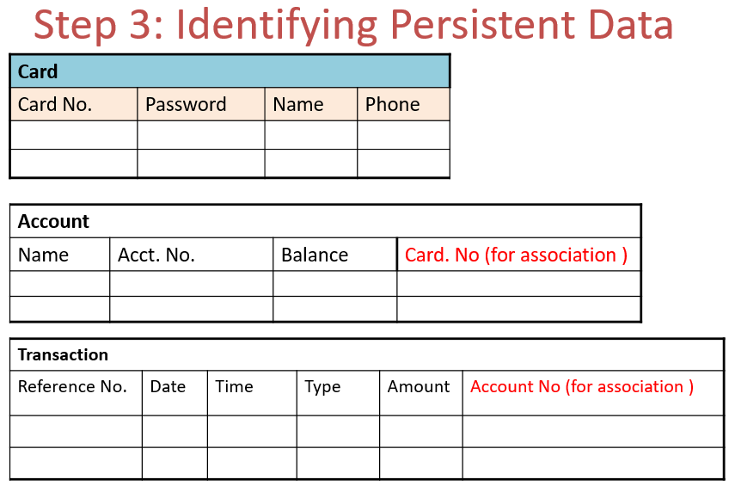
Task 1D: Architecture Design Template
Main points (continue)
Each subsection describes one subsystem, i.e. 3.1 for one subsystem, 3.2 for another subsystem, etc.
Section 3.#, 3.#.1 and 3.#.2: Refer to these slides in Lecture 10
4/15/2026
12
Notes:
1. Project introduction I simply shows the students first simple version of the project description which is on iSpace already
2. Interview skills introduce very common interview skills used in industry like email, phone, face to face, question list
3. The purpose to explain SRS is for students to further understand, before start a software development, what should be known. Students shall ask the questions so they can fill in the SRS document. So question list version 2 should be more complete and organized.
4. Students should not ask the questions in the following areas. These are not issues in “Software Requirements”
Cost
– Delivery schedules
– Reporting procedures
– Software development methods
– Quality assurance
– Validation and verification criteria
– Acceptance procedures.
5. So far, we will not tell students the development language that will be used. The decision on language should be put as late as possible.
6. We will behave in the role of customer or client who knows very little about computers. Students should ask in a way that such clients are able to understand. Therefore, they should avoid the use of jargon.
7. In the SRS template, there is an explanation about each section. More attentions should be paid here:
1)Section 1.1 is not the purpose of this project, it is the purpose of this document.
2)References are not software engineering books. It is about the documents in a company which is related to this system and can help understand this system.
3)Software interface exists only when a software system is a subsystem or a module of a whole system. 4)Hardware exists when embedded software is developed.

Slide 13
Task 2 for Students
Task 2A: Update the class diagram in SRS
Students update the class diagram according to the feedback.
Please use the class diagram we gave in an earlier slide.
Task 2B: Finish the Architecture Design Document
Students finish the Architecture Design Document according to the template.
Do not make the text too long.
E.g. sections 1.1 and 2.2 should have a maximum of 3 to 5 sentences each, and don’t make the sentences too long.
4/15/2026
13
Notes:
1. Project introduction I simply shows the students first simple version of the project description which is on iSpace already
2. Interview skills introduce very common interview skills used in industry like email, phone, face to face, question list
3. The purpose to explain SRS is for students to further understand, before start a software development, what should be known. Students shall ask the questions so they can fill in the SRS document. So question list version 2 should be more complete and organized.
4. Students should not ask the questions in the following areas. These are not issues in “Software Requirements”
Cost
– Delivery schedules
– Reporting procedures
– Software development methods
– Quality assurance
– Validation and verification criteria
– Acceptance procedures.
5. So far, we will not tell students the development language that will be used. The decision on language should be put as late as possible.
6. We will behave in the role of customer or client who knows very little about computers. Students should ask in a way that such clients are able to understand. Therefore, they should avoid the use of jargon.
7. In the SRS template, there is an explanation about each section. More attentions should be paid here:
1)Section 1.1 is not the purpose of this project, it is the purpose of this document.
2)References are not software engineering books. It is about the documents in a company which is related to this system and can help understand this system.
3)Software interface exists only when a software system is a subsystem or a module of a whole system. 4)Hardware exists when embedded software is developed.

Slide 14
Submission
Each team (company) submits the following documents (ONE copy each) to iSpace and GitLab:
The updated SRS
The architecture design document
On the cover of the documents next to the student names, leaders (with the support of most of the team) indicate how much each member contributed: Full, Fair, Little or None.
4/15/2026
14
Notes:
1. Project introduction I simply shows the students first simple version of the project description which is on iSpace already
2. Interview skills introduce very common interview skills used in industry like email, phone, face to face, question list
3. The purpose to explain SRS is for students to further understand, before start a software development, what should be known. Students shall ask the questions so they can fill in the SRS document. So question list version 2 should be more complete and organized.
4. Students should not ask the questions in the following areas. These are not issues in “Software Requirements”
Cost
– Delivery schedules
– Reporting procedures
– Software development methods
– Quality assurance
– Validation and verification criteria
– Acceptance procedures.
5. So far, we will not tell students the development language that will be used. The decision on language should be put as late as possible.
6. We will behave in the role of customer or client who knows very little about computers. Students should ask in a way that such clients are able to understand. Therefore, they should avoid the use of jargon.
7. In the SRS template, there is an explanation about each section. More attentions should be paid here:
1)Section 1.1 is not the purpose of this project, it is the purpose of this document.
2)References are not software engineering books. It is about the documents in a company which is related to this system and can help understand this system.
3)Software interface exists only when a software system is a subsystem or a module of a whole system. 4)Hardware exists when embedded software is developed.

Slide 15
Submission
Note: two grades will be given:
Text (workshop rubric)
Architecture design (SE rubric: models)
Deadline*: Sat 18 Apr, 11:59 pm
* Usually, we give a few more minutes of grace period, in case of any network or unusual problems. But please respect the deadline; the length of the grace period is NOT guaranteed.
4/15/2026
15
Notes:
1. Project introduction I simply shows the students first simple version of the project description which is on iSpace already
2. Interview skills introduce very common interview skills used in industry like email, phone, face to face, question list
3. The purpose to explain SRS is for students to further understand, before start a software development, what should be known. Students shall ask the questions so they can fill in the SRS document. So question list version 2 should be more complete and organized.
4. Students should not ask the questions in the following areas. These are not issues in “Software Requirements”
Cost
– Delivery schedules
– Reporting procedures
– Software development methods
– Quality assurance
– Validation and verification criteria
– Acceptance procedures.
5. So far, we will not tell students the development language that will be used. The decision on language should be put as late as possible.
6. We will behave in the role of customer or client who knows very little about computers. Students should ask in a way that such clients are able to understand. Therefore, they should avoid the use of jargon.
7. In the SRS template, there is an explanation about each section. More attentions should be paid here:
1)Section 1.1 is not the purpose of this project, it is the purpose of this document.
2)References are not software engineering books. It is about the documents in a company which is related to this system and can help understand this system.
3)Software interface exists only when a software system is a subsystem or a module of a whole system. 4)Hardware exists when embedded software is developed.

