Slide 1
Efficient Food Development
Capstone 3
By Tim Osburg

Slide 2
Problem Statement
Excessive nitrogen poses a hazard to both wildlife and humans with the introduction of large algae blooms and increased secondary bacteria and toxins. According to the United States Environmental Protection Agency (EPA) “Nutrient pollution is one of the America’s most widespread, costly and challenging environmental problems, and is caused by excess nitrogen and phosphorus in the air and water.” As a result, using materials that knowingly introduce hazardous elements should be accomplished efficiently.

Slide 3
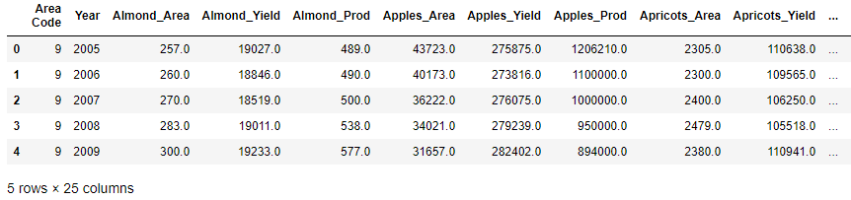
FAOSTAT data collection

Slide 4
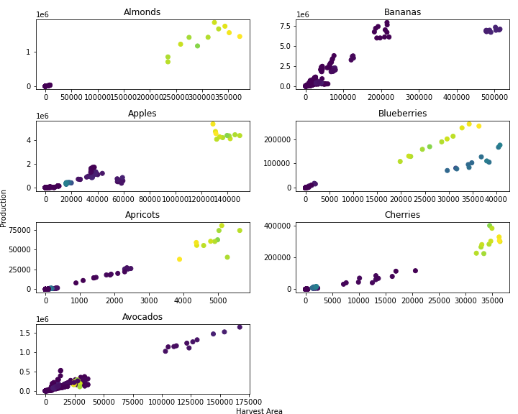
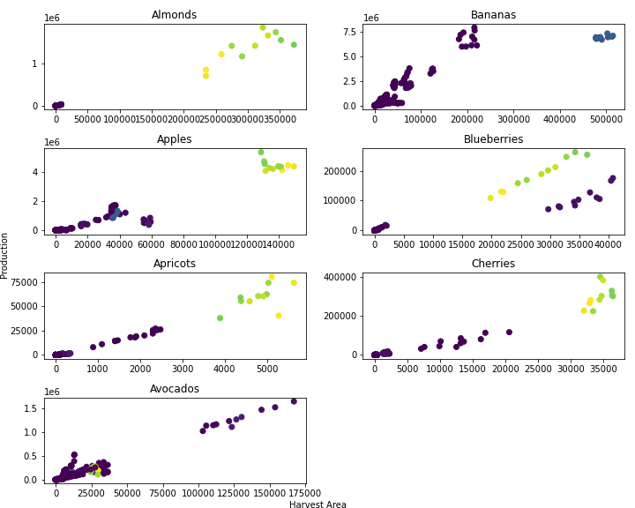
Harvest area vs Production
Nitrogen Production
Phosphate Production

Slide 5
Analysis
Initial high values in mean squared error indicate poor fit to individual values. However, this could be attributed to the scale of values.
High coefficient of determination indicates that the data does fit a linear regression.

Slide 6
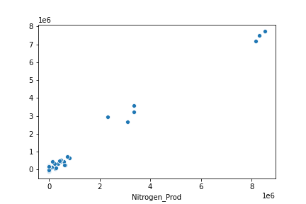
Linear regression modeling

Slide 7
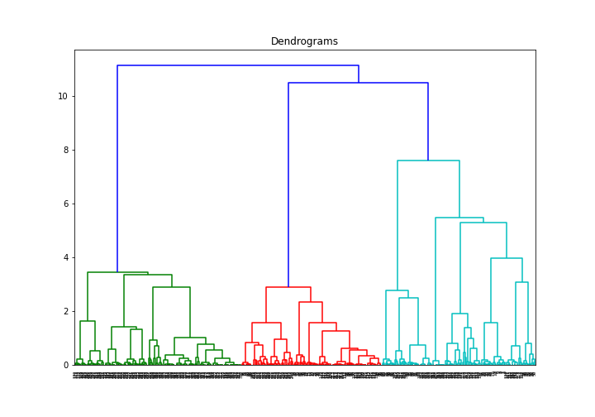
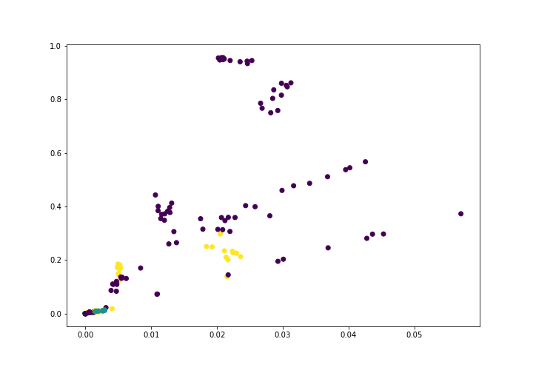
Hierarchal modeling
Apples Area vs Production

Slide 8
Future Work
Improve data organization for modeling
Explore additional modelling methodologies
Clarify data with flagged values

