Slide 1
Wildfire Modeling
Capstone 2
By Tim Osburg

Slide 2
Problem Statement
Is it possible to provide some prediction to wildfires allowing for the timely response and correct allocation of resources decreasing the total lives lost and property distruction.

Slide 3
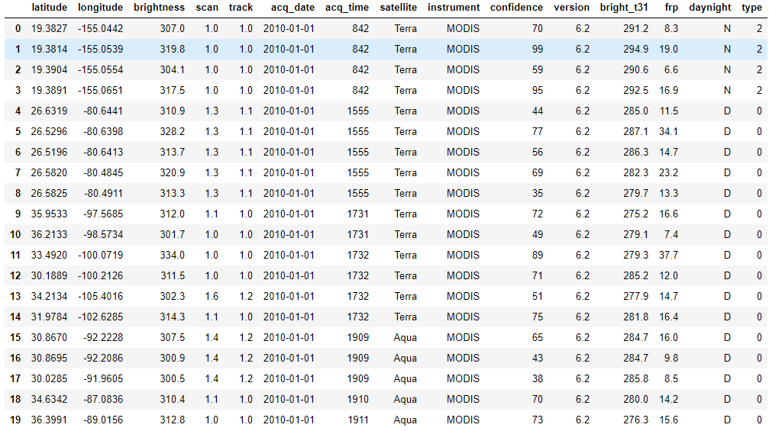
FIRMS collected dataset

Slide 4
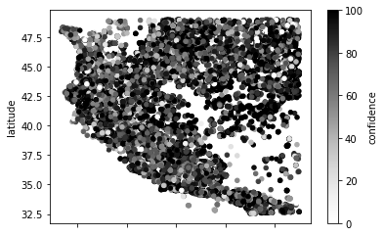
Limiting dataset to a western block

Slide 5
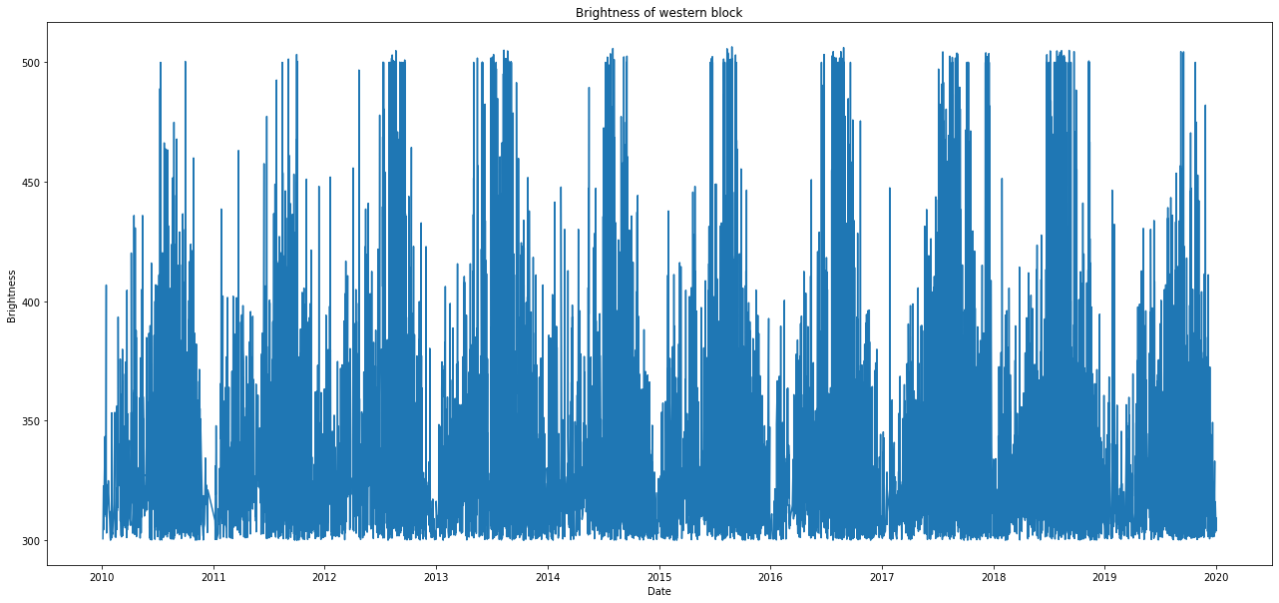
Brightness time series of western block

Slide 6
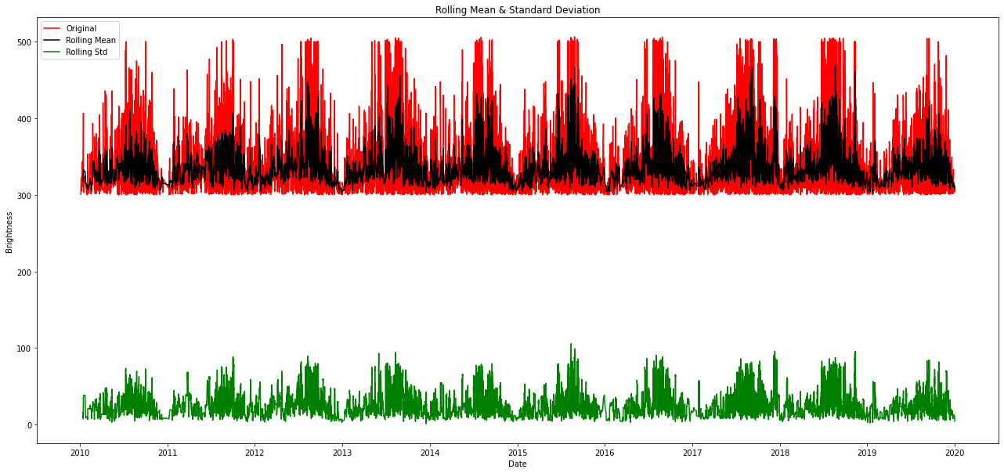
Checking for stationarity

Slide 7
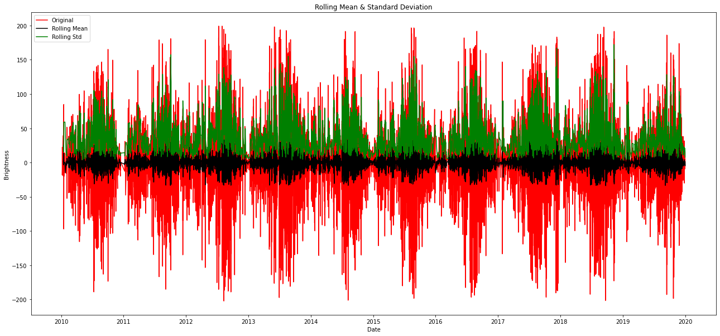
Solving for stationarity through differencing

Slide 8
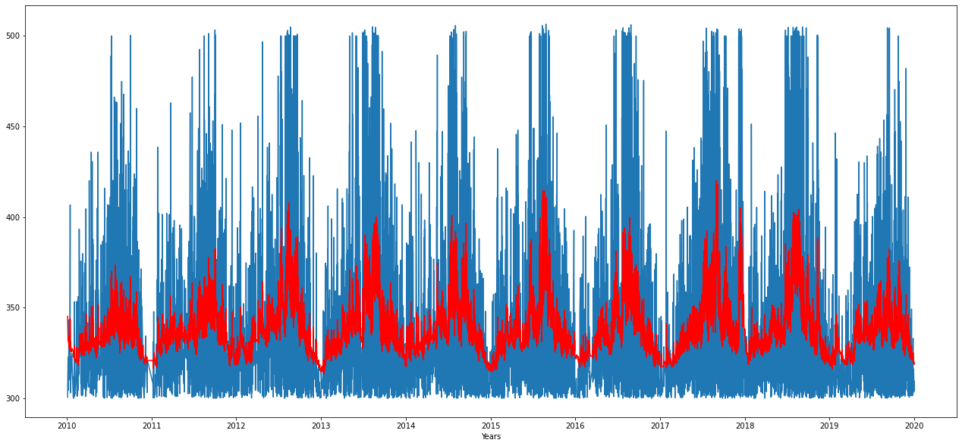
Initial modeling

Slide 9
Initial Results
Model does not accurately represent maximum values
Further testing variables and combination of variables for examination

Slide 10
Future work
Improve modelling
Parameter refinement
Selection of individual fires
Improved geographic selection

