Slide 1
Business Model Canvas

Slide 2
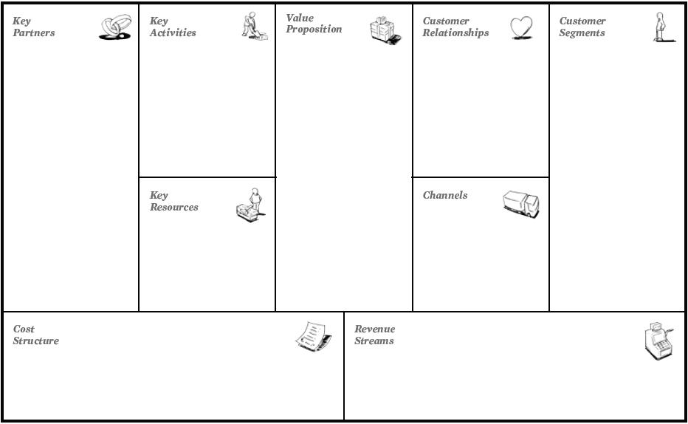
Bus
Shops inside metro
Parking lot companies
Airport (in some cases)
Investors(Government, City Council, etc)
Public transport service
Promote sustainable mobility for users in some area
Fast
Cheap
Low waiting time
Easy access
Automated/nonautomated
Impersonal/ personal
(depending of the station you can have differente combinations)
Workers/Students
Occasional users
Turists
Urban Network of stations
Customer-Oriented
Stations
App
Digital Media
Maintenance of a Network
Infrastructure Security
Employees payroll
Tickets
Publicity

Slide 3
Our Solution

Slide 4

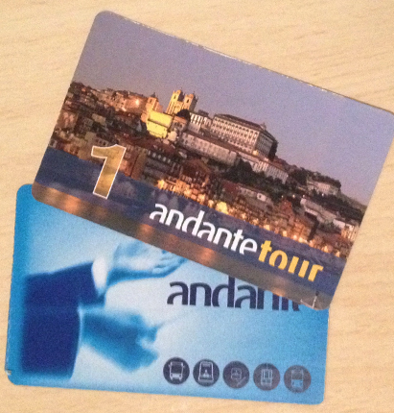
Use sensors on tickets that can be validated through sensors on doors

Slide 5
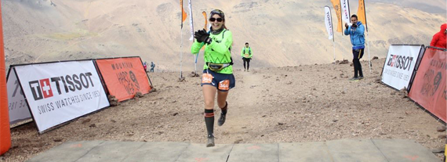

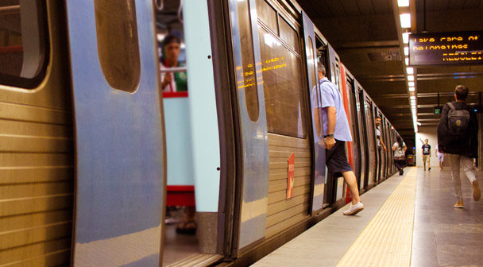
Sensor used in ticket should be similiar to the one used in races

Slide 6
If someone didn’t pay their ticket the system raises a warning alarm and the person can purchase the ticket inside the train.
For those who pay, they will get a discount after some validations.

Slide 7
Business Model Canvas (After our solution)

Slide 8
Bus
Shops inside metro
Parking lot companies
Airport (in some cases)
Investors(Government, City Council, etc)
Public transport service
Promote sustainable mobility for users in some area
Fast
Cheap
Low waiting time
Easy access
Automated/nonautomated
Impersonal/ personal
(depending of the station you can have differente combinations)
Workers/Students
Occasional users
Turists
Urban Network of stations
Customer-Oriented
Stations
App
Digital Media
Maintenance of a Network
Infrastructure Security
Employees payroll
Tickets
Publicity

