Slide 1
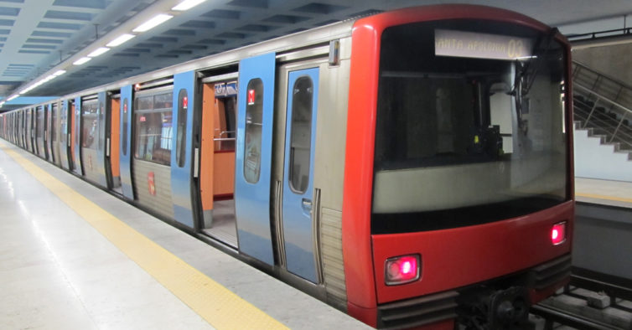
User Research Results

Slide 2
We did an online survey to help us understand some fundamental questions:
What users do
What users need
What users want
What users expect
What users think

Slide 3
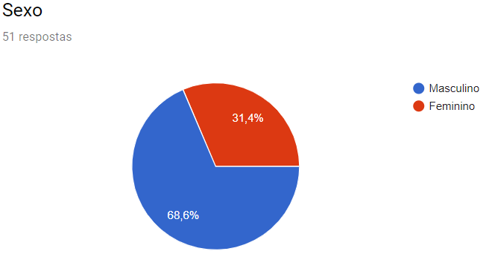
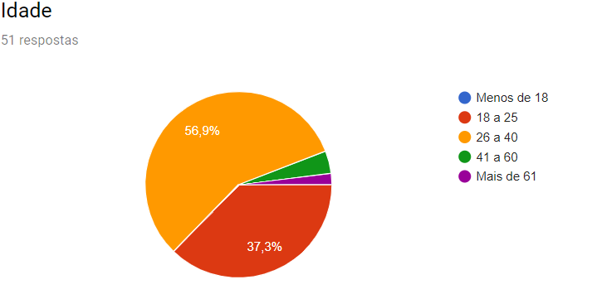

Slide 4
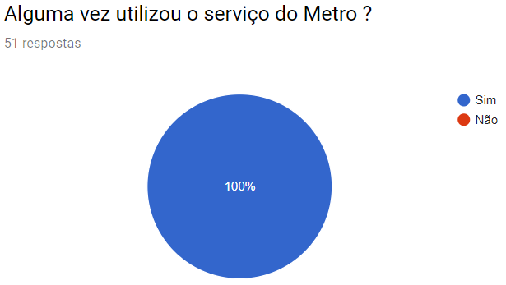
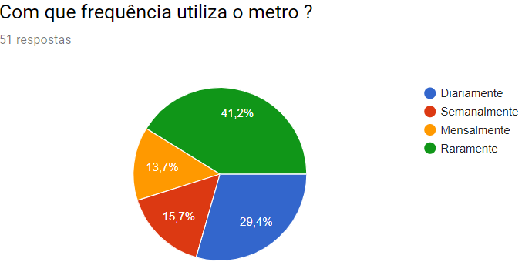

Slide 5
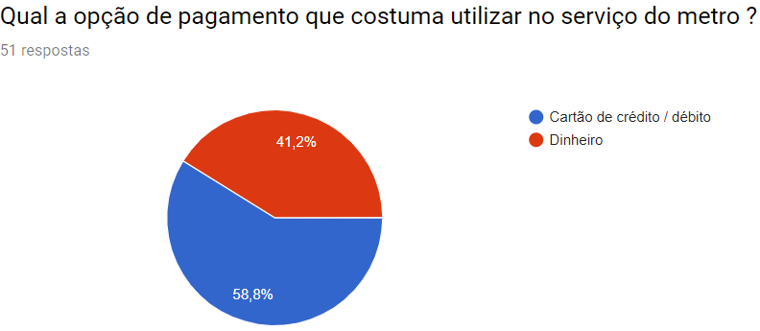
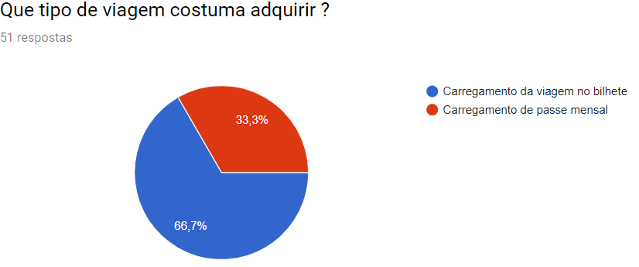

Slide 6
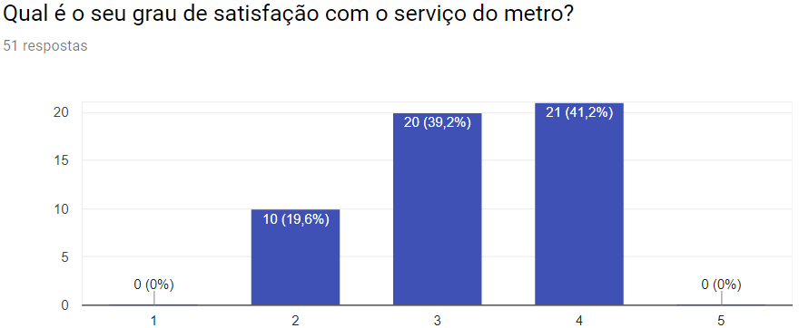

Slide 7
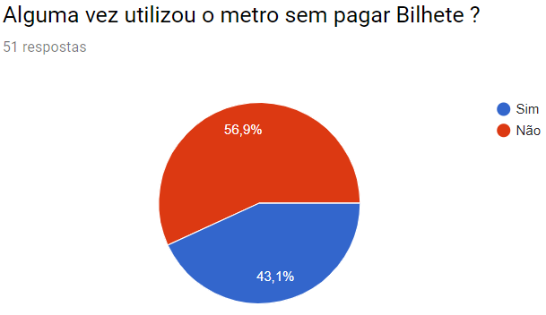
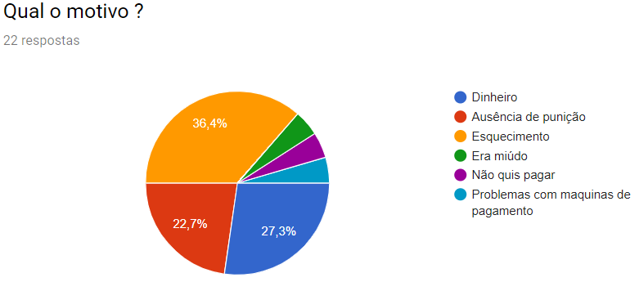

Slide 8
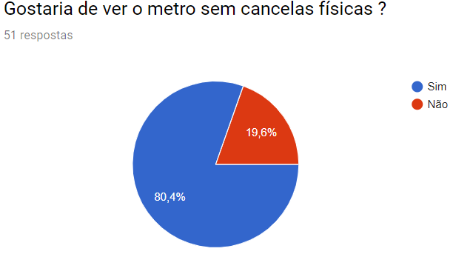
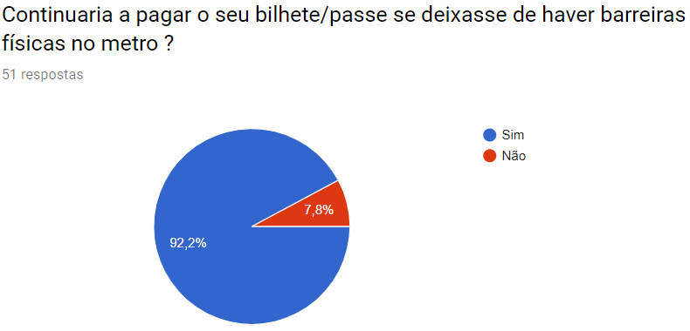

Slide 9
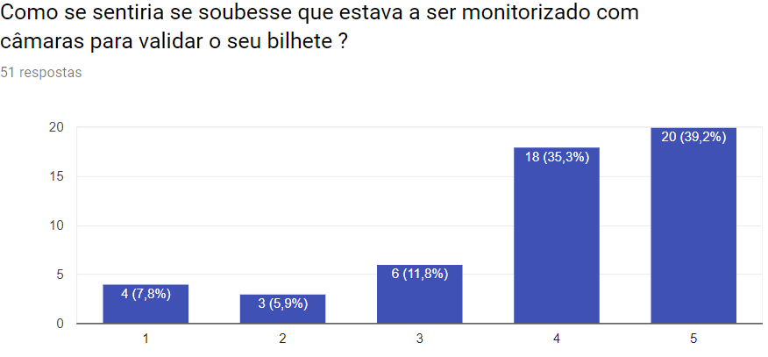
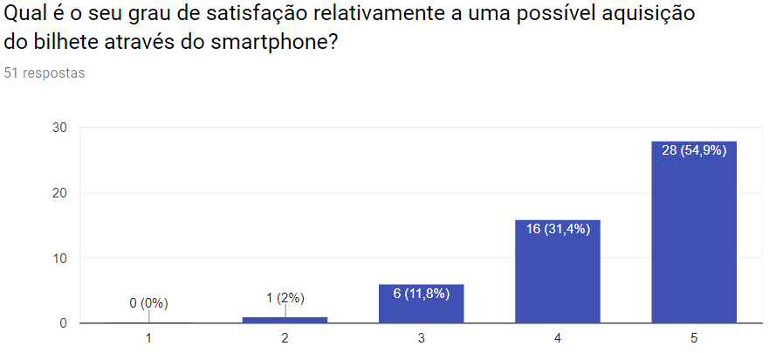

Slide 10
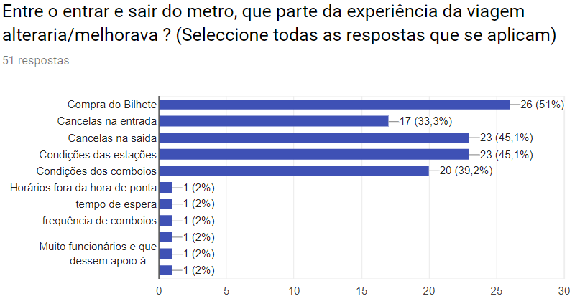
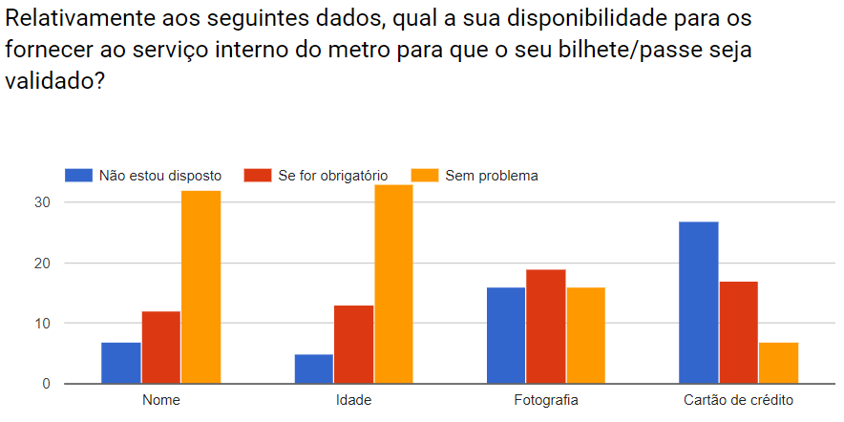

Slide 11
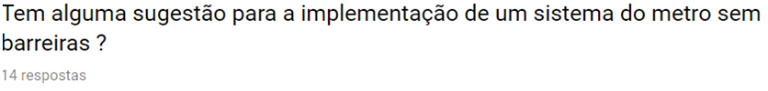

Slide 12
Sensores nas estações, como nas lojas de roupa.
Não aprovo porque o metro tem muitas gaps em termos de segurança e qualidade de serviços
Demora na compra de bilhetes, compra por smartphone seria ótimo.
Aplicação com bar code
Tags rfid ativas
Barreiras, mas com bilhete virtual (QR Code); pulseira (ou algo do género) com sensor tipo via verde com câmaras a registarem quem passa sem pulseira válida
Sistema de check point duplo para validar quem entra e sequencialmente quem adquiriu bilhete. Compra de viagens ou passe virtual através de app que permita fazer gestão de conta e histórico de viagens e com a possibilidade de gerar QR Code que seria utilizado no 2o checkpoint para validar título de viagem
Numa primeira fase seria mais viável eliminar apenas a barreira de saída.

Slide 13
Field Observation

Slide 14
Quick & Dirty
How people use the tickets' machines;
Passing the barriers;
~2 hours
2 days (week and weekend; lunch time and middle of the day)
2 different metro stations

Slide 15
Quick & Dirty – tickets' machines
~100 people observed (~1h)
Who What | < 30 years old | Middle age | > 60 years old | Tourist
Took too long (>1m30s) | 7 | 3 | 2+ | 14
Asked for help | 4 | 2 | 1 | 2
Changed machine | 0 | 1 | 2 | 8

Slide 16
Quick & Dirty – Barriers
~1h
(1)
Pushing doors
Jumping over doors
Passing after someone else
(2)
Had to insist
Had to change barrier
Who What | < 30 years old | Middle age | > 60 years old
Without paying (1) | 27 | 6 | 4
With difficulties (2) | 10 | 5 | 1

Slide 17
Quick & Dirty – Other
People with travel bags, baby trolleys or other big packages with difficulties passing the normal barriers;
Barriers with enough space not working or not visible;
People with mobility difficulties using the normal accesses:
Lack of step-free access?
Lack of knowledge of where is the access?

Slide 18
Field Observation – Conclusions
Most of the people observed are < 30 years old;
Interaction with the tickets' machines seem to cause some difficulties, mainly to those that appear to be tourists;
Those who apparently don't pay are < 30 years old;

