Slide 1
Information Visualization Visualization Sketch
G14-A
81633 – João Henriques
83497 – Leonor Llansol
83541 – Pedro Esteves

Slide 2
Overview
01

Slide 3
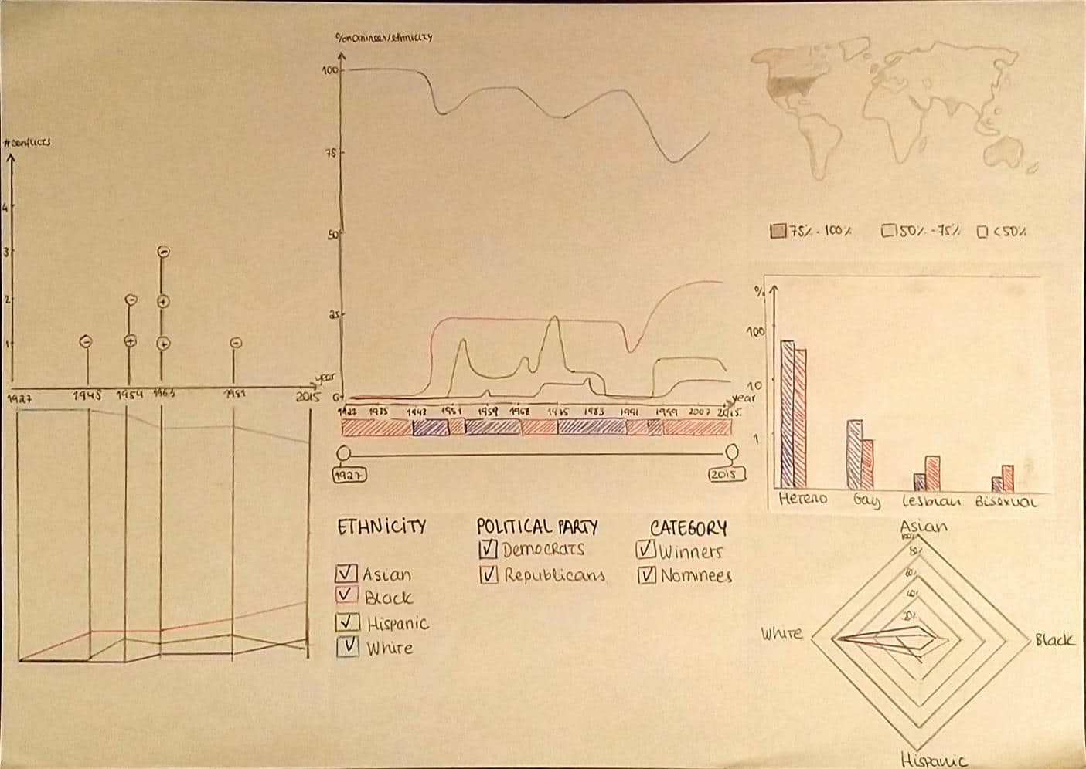
Overview

Slide 4
Visual encoding
02

Slide 5
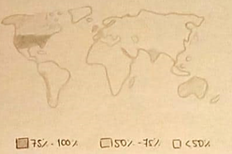
Choropleth map
Answers | Item | Type | Mark | Channel
Q2 | Percentage of Winners | Ratio | Area | Color
Q2 | Birthplace | Nominal | Area | Position

Slide 6
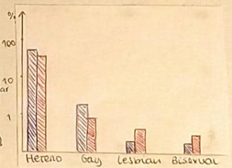
Grouped bars
Answers | Item | Type | Mark | Channel
Q1 | Sexual Orientation Type | Nominal | Area (bar) | Position x
Q1 | Sexual Orientation Percentage | Ratio | Area (bar) | Position y
Q1 | Party in Power | Nominal | Area (bar) | Color

Slide 7
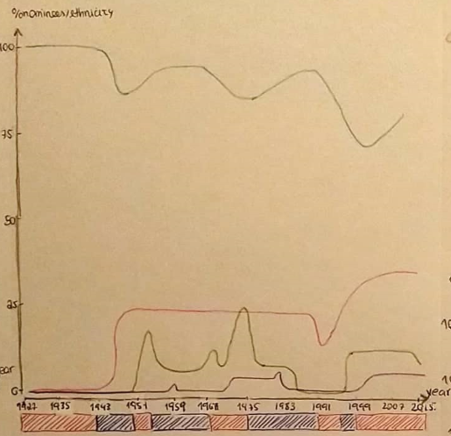
Line chart
Answers | Item | Type | Mark | Channel
Q3 | Year | Sequencial | Line | Position x
Q3/Q4 | Percentage of winners/nomines | Ratio | Line | Position y
Q3 | Ethnicity | Nominal | Line | Color

Slide 8
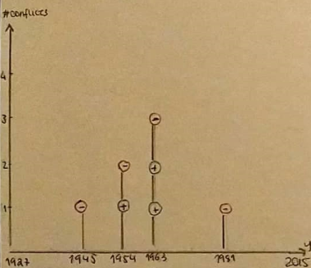
Lollipop
Answers | Item | Type | Mark | Channel
Q5 | Number of racial conflicts | Continuous | Point | Position x
Q5 | year | Sequencial | Point | Position y
Q5 | Sentiment | Nominal | Point | Color

Slide 9
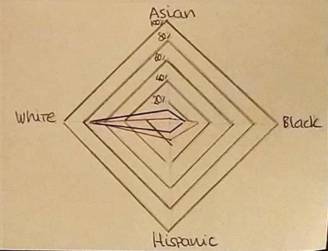
Star plot
Answers | Item | Type | Mark | Channel
Q3/Q4 | Ethnicity | Nominal | Line | Position
Q3/Q4 | Percentage of winners/nomines | Racial | Line | Position
Q4 | Party in power | Nominal | Line | Color

Slide 10
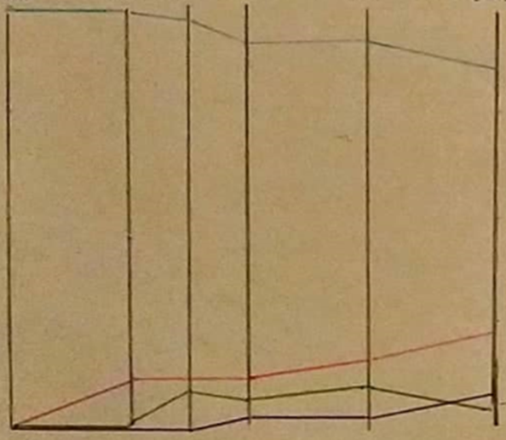
Slopegraph
Answers | Item | Type | Mark | Channel
Q3/Q5 | Ethnicity | Nominal | Line | Color
Q3/Q5 | Year | Sequencial | Line | Position x
Q3/Q5 | Percentage of winners/nomines | Racial | Line | Position y

Slide 11
Answering the Questions
03

Slide 12
Question 1
Q: How does the political party in power influence the sexual orientation of nominees?

Slide 13
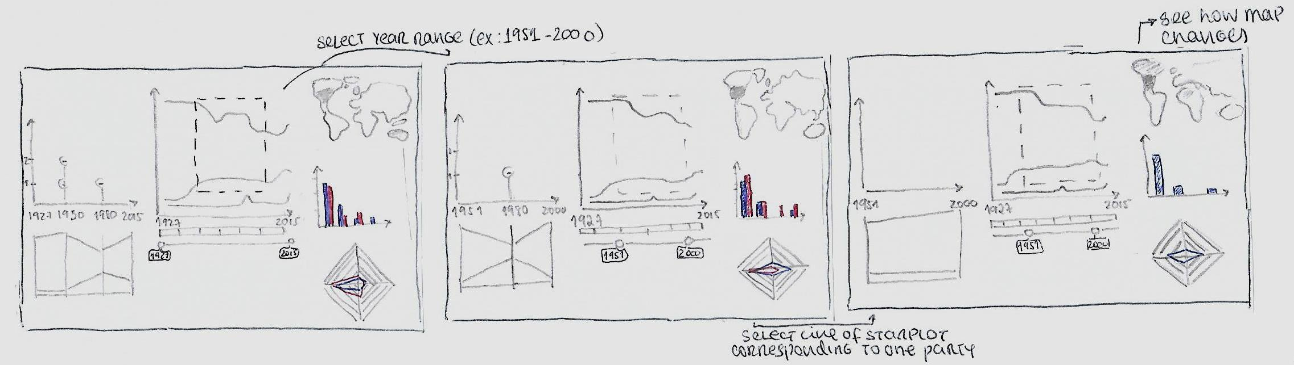
Question 2
Q: How does the political party in power influence the birthplace of Oscars winners?

Slide 14

Question 3
Q: How does the ethnicity of the Oscars winners and nominees change over time?

Slide 15
Question 4
Q: How does the ethnicity of the Oscars winners and nominees change with the party in power?

Slide 16
Question 5
Q:How does the ethnicity of the Oscars winners and nominees change with racial conflicts?

