Slide 1

Fit of Magist as an LSP for Eniac
Magist delivers - but are they delivering the right thing?

Slide 2
Agenda
Meeting Objectives
Magist & Eniac – Strategic Fit
Conclusion & Next Steps

Slide 3
Agenda
Meeting Objectives
Magist & Eniac – Strategic Fit
Conclusion & Next Steps

Slide 4



Shared understanding of situation and open question
Strategy and potential are clear - a logistic service provider (LSP) decision is still required
Eniac’s objective:
Expand business by selling mainly high-end tech products to a broader customer base
Brazilian market as enabler:
Total revenue of consumer electronics via e-commerce expected to exceed €15B by 2030 ¹⁾
Required decision:
Is Magist the right LSP to leverage given potential by meeting (local) requirements?
¹⁾ Sources: Statista, eCommerce Institut Köln.

Slide 5
Agenda
Meeting Objectives
Magist & Eniac – Strategic Fit
Conclusion & Next Steps
Notes:
We all know that Magist is the right choice from a monetary perspective
We also know that it is not all about the money, as the delivered service also needs to meet our requirements
Therefore, lets now talk about strategic fit

Slide 6
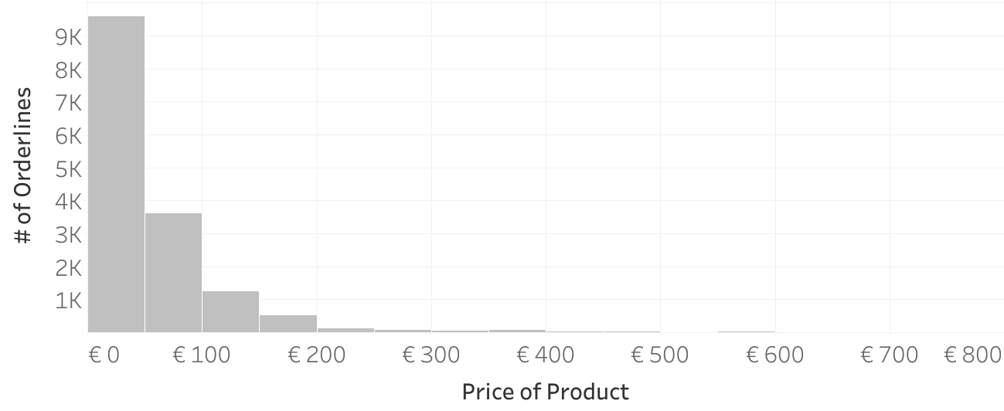
Products sold via Magist not matching Eniac’s scope
Risk of failing to meet key requirements for high-end tech sales, shipping and returns
Pricing-structure of Magist’s tech-related products ¹⁾:
Ø Only 1 orderline per day of high-end tech
products
over 2 years at Magist ²⁾
Ø price of Eniac’s products: € 540
¹⁾ Tech-products categories: computers, audio, computers_accessories, telephony, electronics, tablets_printing_image, pc_gamer; Prices adjusted to compensate approx. 50% higher price level in BR to EU [1], [2], [3].
²⁾ Average value; Pricing-threshold for definition of high-end products: €200 resulting in approx. 750 orderlines in 2 years covered by received dataset.
Notes:
Product fit: products sold by magist are not matching eniacs scope
Risk of not meeting processual requirements that come with logistics of high-end tech products
How do we come to that conclusion?
Pricing structure of Magists order line in tech categories - with adjusted prices to account for higher pricing level in Brazil compared to EU
Average price of Eniacs products
If we define high-end tech as a tech product with a price of more than 200 EUR, only one orderline per day

Slide 7

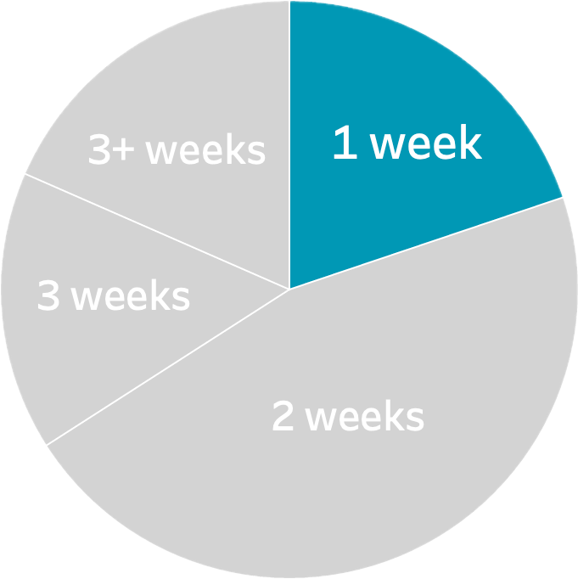
Slow delivery: 80% of high-tech orders in capitals
Magist’s service levels can not compete with benchmark in top 5 capitals as key markets ¹⁾
Share of e2e order delivery of Magist’s high-end tech-products within…
Fortaleza
Magist’s revenue distribution in high-end tech-products by cities
Industry benchmark: 1-week delivery ²⁾ for high-end tech in Brazilian capitals only met in 20 % vs.
target of 95+ % ³⁾
Brasilia
Salvador
Rio de Janeiro
São Paulo
¹⁾ Selected top 5 capitals / major cities with highest population: 1. São Paulo 2. Rio de Janeiro 3. Brasilia 4. Fortaleza 5. Salvador.
²⁾ Sources: Amazon 2 (EX) - 4 (STD) workdays, Mercadolivre 2 (EX) - 3 (STD) workdays, Kabum 2 (EX) - 5 (STD) workdays [top online shops in BR]; TNT 2+ workdays (EX), FedEx 5-6 workdays (STD) [major carriers].
³⁾ Source: Amazon Supply Chain.
Notes:
Looking at the delivery performance: cannot compete with benchmark looking at major cities
Why do we look at major cities?
1. Because there is the revenue - As we can already see by the distribution of revenue in high-end tech products of magist
2. This also offers us the chance for a valid benchmarking of delivery times
We see that even in the major cities with good infrastructure, only 20 % of orders are delivered within one week
This is the benchmark looking at major competitors in eCommerce such as Amazon, Mercadolivre, Kabum + LSPs such as FedEx and TNT
Should be met in at least 95% of the cases

Slide 8
Agenda
Meeting Objectives
Magist & Eniac – Strategic Fit
Conclusion & Next Steps
Notes:
So, when we come back to our question from the beginning? What does that tell us?

Slide 9
Recommendation: Don’t sign & tender required service
For an informed decision on the LSP selection, Eniac should consider a strategic approach
Recommended decision:
No signing of a 3 year contract with Magist due to lack of product & service fit
+
Additional finding:
No aligned requirements available to measure the fit of an LSP against or include in SLA ¹⁾
!
Recommended next steps:
1. Align relevant requirements and metrics in categories: Must-, Should-, Could-, Won’t-Have
2. Create RFI and RFQ documents ²⁾, tailored specifically to those requirements
3. Conduct a proper tender process ³⁾, including Magist as well as major competitors such as Novatrade Brasil, DHL Fulfillment, FedEx/TNT, UPS, Yusen Logistics etc.
4. Compare service offered in quotations and select best fitting LSP
Alternative (not recommended): Shorter (1-year) contract with defined SLAs incl. KPIs (target delivery times etc.) to allow exit if requirements aren’t met
¹⁾ SLA - Service Level Agreement. Usually part of a contract that specifies the expected service quality, performance metrics, and responsibilities. ²⁾ RFI - Request for Information; RFQ - Request for Quotation.
³⁾ Typically consisting of the following steps: 1. Creation of LSP longlist 2. RFI 3. Shortlisting 4. RFQ 5. Assessment 6. Negotiations 7. Awarding.
Notes:
We would answer the question if eniac should sign a 3 year contract with no as the risk of neither the product nor the performance fit is given
Additionally, we found that there are no aligned business requirements at Eniac, regarding what exactly to expect from an LSP and also include in SLAs for example
Therefore, we suggest the following next steps:
Aligning business requirements (e.g., target service levels)
Document those requirements in RFI and RFQ
Conduct a proper tender process - Transparency of what is possible
Compare offered service as we then also can benchmark magist properly + selection of LSP
If that is not possible due to the timeline:
Alternative that is not recommended: sign shorter contract and define SLAs incl. KPIs to allow an early exit if quality is not met
So now we open the round for discussion, so please provide your input, remarks and ask questions

