Slide 1
Practical Project – Endangered Animals
Toseef mehdi

Slide 2
Introduction
The creation of an application with full CRUD functionality and a stored database.
User interaction through front-end.
Code fully integrated into a version control system (Github) using Main/Dev/Feature model
Documentation:
Jira board with epics, tasks and user stories
ERDs & UML showing the database relationships
Risk assessment including a matrix
MoSCoW document

Slide 3
Technologies Used
Eclipse (Java)
MySql
H2 Console
Postman
Visual Studio Code (JavaScript)
Maven
Junit
GitHub
Jira
Bootstrap

Slide 4
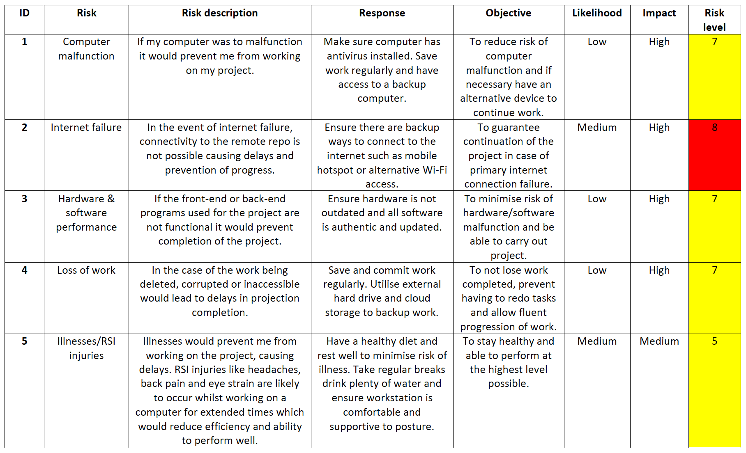
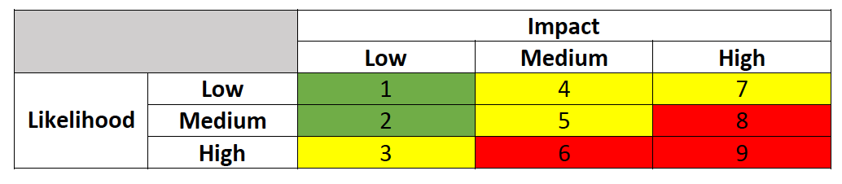
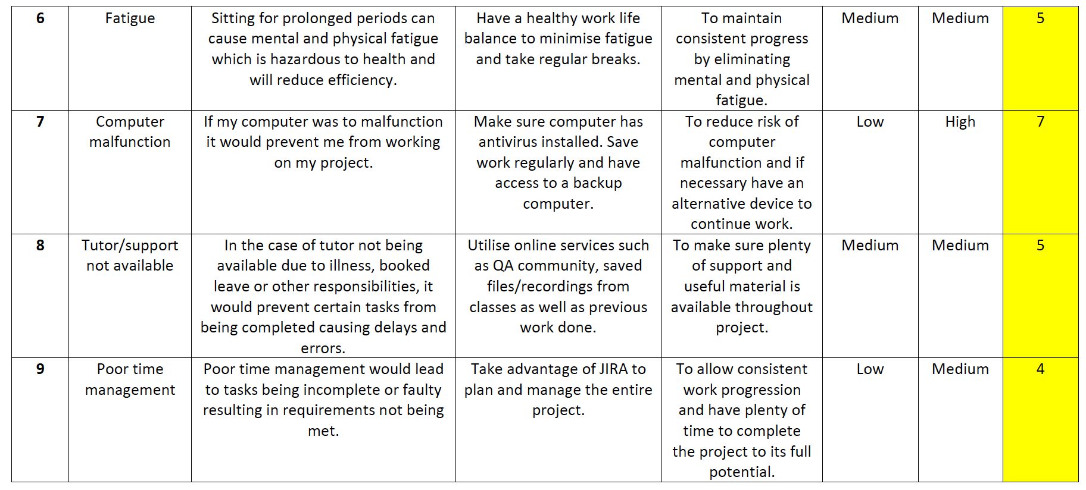
Risk Assessment

Slide 5
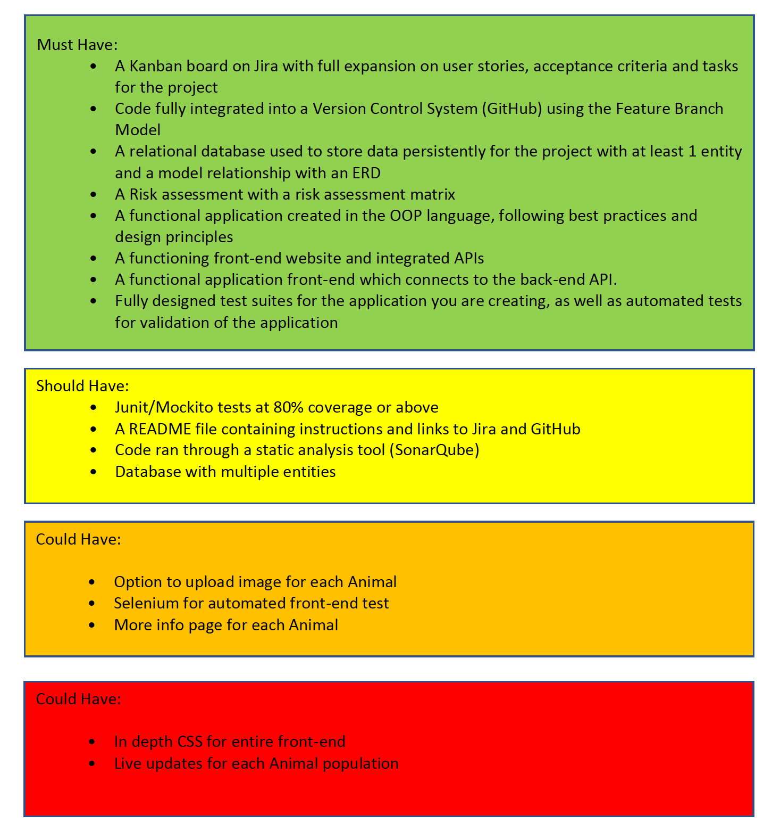
MoSCoW Document

Slide 6
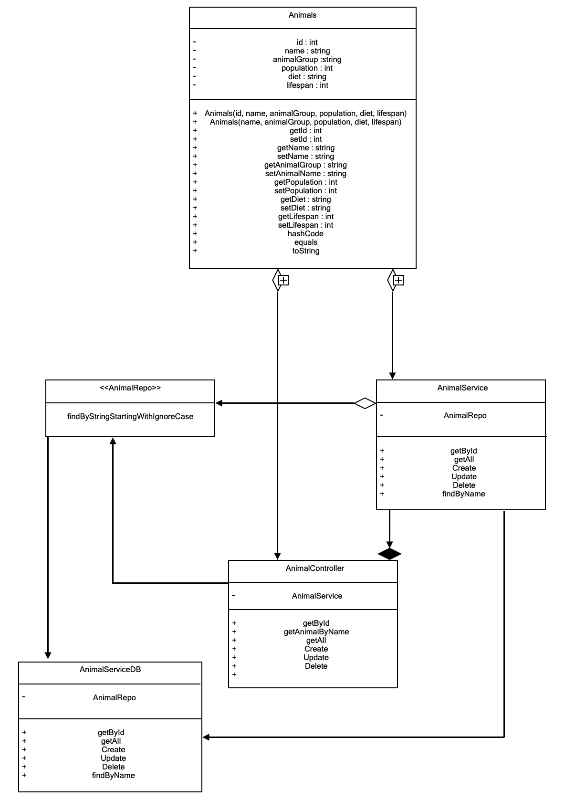
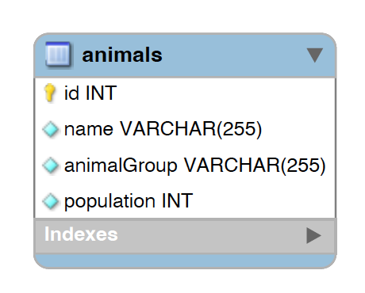
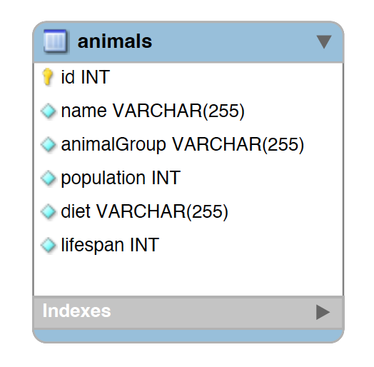
ERD & UML

Slide 7
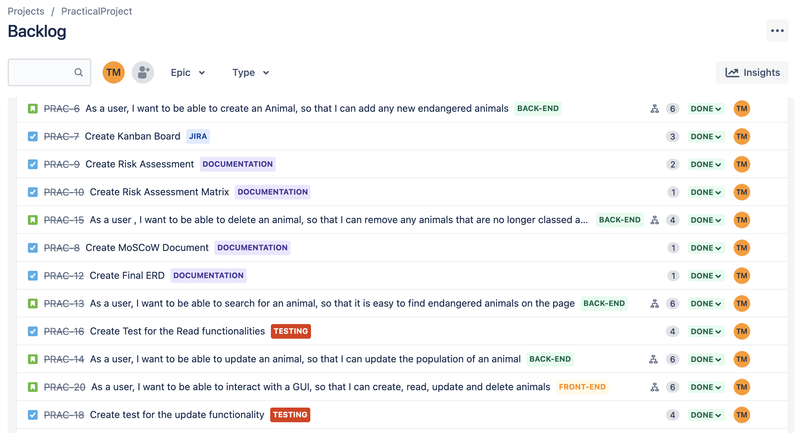
Stories and Tasks with Epics Applied

Slide 8
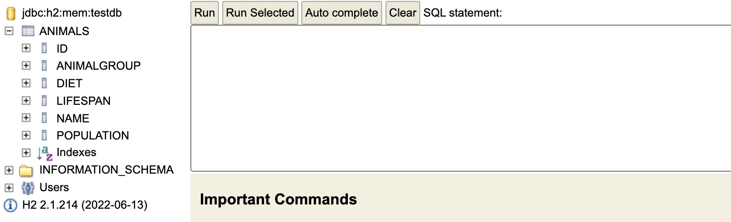
H2 Console

Slide 9
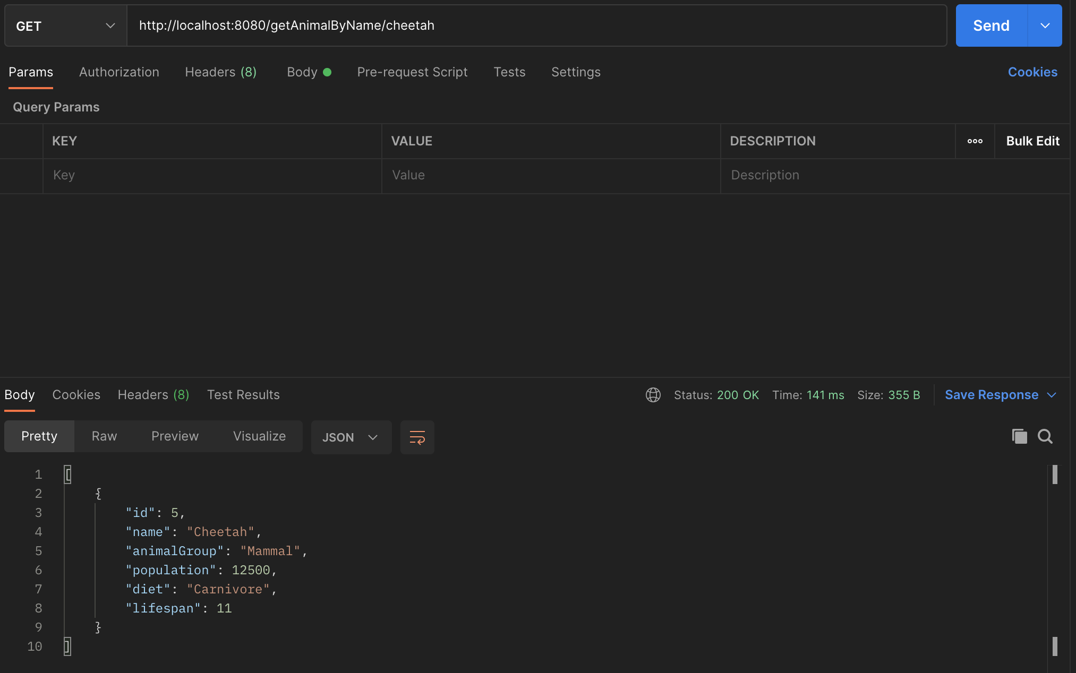
Postman

Slide 10
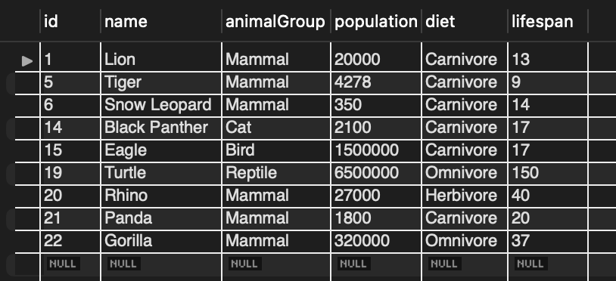
MySQL database

Slide 11
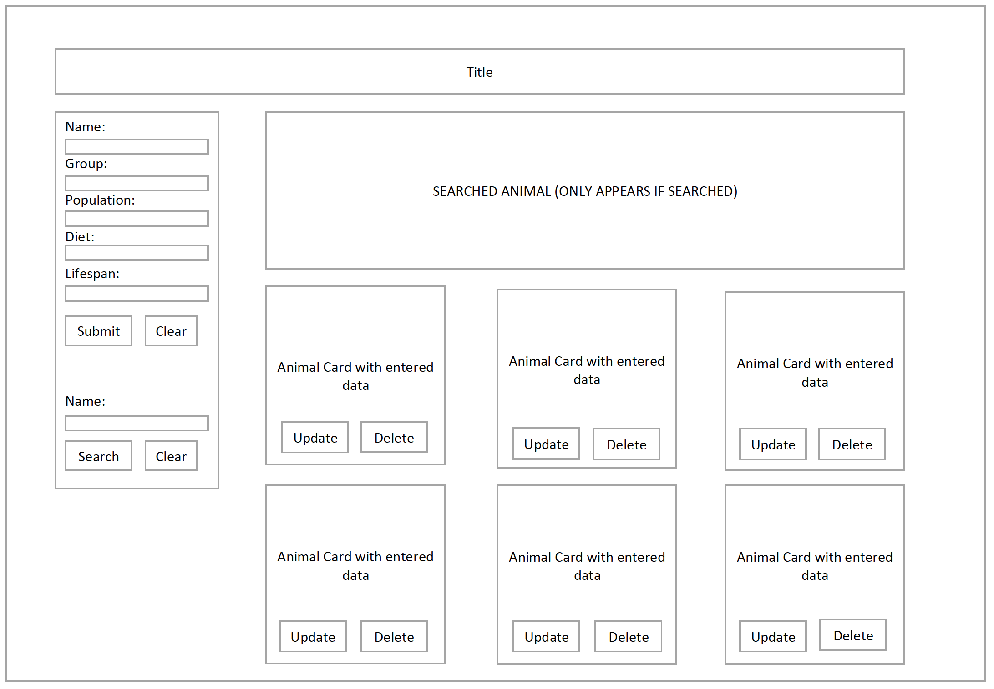
WireFrame

Slide 12
DEMO TIME

Slide 13
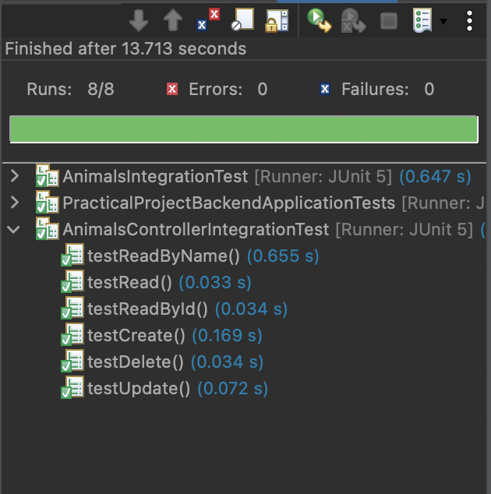
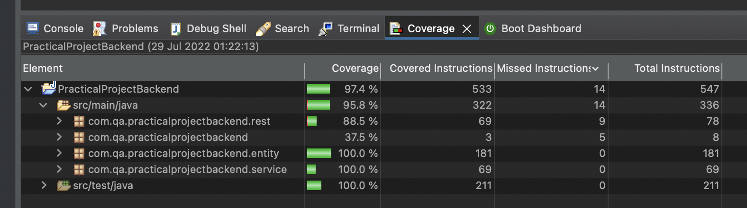
Testing

Slide 14
Project reflection
I was able to complete:
CRUD via GUI
Testing for all CRUD functionality
ERD & UML
Fully functional front-end with styling
Test coverage above 95%
Unable to achieve:
Multiple entities
Mockito
Selenium front end testing
Sonarqube analysis of project

Slide 15
Conclusion
Overall, this project was a success as all tests passed and my application front-end is aesthetically pleasing
I was also able to improve on my weaknesses from the last project by:
Test coverage above 95%
Able to utilize GitHub from the very beginning of the project.
To improve the project I would include more tests and Sonarqube analysis.

