Slide 1
雨場切割SOP
20200701

Slide 2
雨場切割SOP
讀取各時段檔案
統整各時段資料
雨場切割
(降雨開始時間：雨量大於4 mm)
(降雨結束時間：雨量小於4 mm，且持續 6 hr以上)
製圖
輸出

Slide 3
匯入模組
import pandas as pd
import numpy as np
import os
import os.path
import plotly #主要製圖工具
import plotly.graph_objects as go
from plotly.subplots import make_subplots
import datetime

Slide 4
讀取檔案路徑
file_list = []
def getfilename(filepath):
# root 為檔案路徑位置
# dirs 為list，為該文件夾中所有目錄名字
# files 為list，為該文件夾中所有文件
for root,dirs,files in os.walk(filepath):
for filepath in files:
file_list.append(os.path.join( root,filepath))
return file_list
#得到檔案夾中所有雨量資料
getfilename( r“D:\NTNU_SUMMER\rain4\rain4” )

Slide 5
資料統整
result = pd.DataFrame()
result_rain = []
for file in range(len file_list)):
filepath = file_list[file]
df1 = pd.read_csv(filepath)
df1 = df1.drop(columns = 'HQT') #拿掉每日雨量
df = np.split(df1,[1,4],axis = 1) #切開DataFrame，然後分開存
df_no = df[0]
df_date = df[1]
df_date.columns = ['year','month','day'] #轉成datetime格式
df_date = pd.to_datetime(df_date)
df_rain = df[2]

Slide 6
資料統整
#資料轉成array，然後轉成一維
test = df_rain.values.ravel()
L = []
L_rain = [0]
r_start = 0
r_end = 0
L_end = 0
L_max = 0
L_sum = 0

Slide 7
雨場切割
#判斷剩餘的list還有沒有大於4的數值
while any(x > 4 for x in test):
#找到第一個大於4的位置，往後全部存成一個新的list
for i in range(len(test)):
if test[i] >= 4:
first = i
break
LL = test[first: ]
#若取到最後一筆資料，避免進入無限迴圈
if sum(LL) <= sum(L):
break
L = []

Slide 8
for j in range(len(LL)):
if LL[j] >= 4:
L.append(LL[j])
if L_max < LL[j]:
L_max = LL[j]
else:
ii = LL[ j + 1: j + 6]
#判斷是否連續6筆資料都小於門檻值
if all(jj < 4 for jj in ii):
L_end = L_end + first + j
test = test[(first + j) : ]
break
else:
#如果取到最到一筆資料，結束有Bug
L.append(LL[j])
if L_sum < sum(L):
L_sum = sum(L)
L_rain = L
r_end = L_end - 1
r_start = L_end - len(L_rain)

Slide 9
d = {‘index’: file,'ID':filepath[27: -4],
‘站號’: df_no.values[0],
‘S_date’: df_date[0],
‘E_date’: df_date[len(df_date)-1],
‘降雨延時’: len(L_rain),
‘最大降雨量’: L_max,
‘總降雨量’: L_sum,
‘S_rain’: r_start,
‘E_rain’: r_end}
df_test = pd.DataFrame(data = d)
result = pd.concat([result,df_test], axis = 0)
result_rain.append(L_rain)

Slide 10
輸出統整檔
#同一個list存進單格
df_L_rain = pd.DataFrame(np.array([result_rain]))
#行列互換
df_L_rain = df_L_rain.T
df_L_rain = df_L_rain.reset_index()
rain_all = pd.merge(result, df_L_rain, on = 'index')
rain_all.columns = ['index','事件ID','測站站號','起始日期','結束日期','降雨延時','最大降雨量','總降雨量','降雨延時開始','降雨延時結束','rain_detail']
rain_all = rain_all.set_index('index')
#輸出檔案(xls檔)
rain_all.to_excel(r"D:\NTNU_SUMMER\rain4\降雨延時_統計.xls")

Slide 11
根據陣列畫出統計圖
for i in range(len(rain_all.rain_detail)):
j = rain_all.降雨延時[i]
#排除不符合降雨延時定義的資料
if j > 1:
#取出降雨事件始末時間
start = datetime.datetime.strptime(str(rain_all.起始日期[i]), "%Y-%m-%d %H:%M:%S")
end = datetime.datetime.strptime(str(rain_all.結束日期[i]), "%Y-%m-%d %H:%M:%S")
#分別抓出從start到end的每一時間段(天)
date_generated = [start + datetime.timedelta(days = x) for x in range(0, (end-start).days)]
date_generated.append(end + datetime.timedelta())

Slide 12
根據陣列畫出統計圖
#存取事件始末時間的Year,Month,Day
date_all = []
for date in date_generated:
qq = (date.strftime("%Y-%m-%d"))
date_all.append(str(qq))
#用降雨延時開始的時間計算是在該事件的第幾天
kk = int(rain_all.降雨延時開始[i])/24
kk = int(kk)
ttl = range(120)
#X軸Y軸長度
rain_width = ttl[rain_all.降雨延時開始[i]:(rain_all.降雨延時結束[i]+1)]
rain_height = rain_all.rain_detail[i]
#累積雨量
rain_total = []
total = 0
for k in range(len(rain_width)):
q = rain_height[k]
total += q
rain_total.append(total)

Slide 13
根據陣列畫出統計圖
fig = make_subplots(specs=[[{"secondary_y“ :True}]])
#新增降雨強度
fig.add_trace(
go.Bar(y = rain_height, name="降雨強度"),
secondary_y=False
)
fig.update_yaxes(secondary_y = False,
title = “降雨強度(mm//hr)”,
titlefont = dict(family="Microsoft JhengHei",size=14,color="black")
)

Slide 14
根據陣列畫出統計圖
#新增累積降雨量
fig.add_trace(
go.Scatter(y=rain_total, name="累積降雨量"),
secondary_y= True
)
fig.update_yaxes(ticks = 'outside',
showgrid = False,
secondary_y=True,
title = '累積雨量(mm)',
titlefont=dict(family="Microsoft JhengHei",size=14,color="black")
)

Slide 15
根據陣列畫出統計圖
fig.update_layout(
#設定輸出的圖的標題
title=go.layout.Title(
text = "降雨延時自 {0}:{1}點 開始".format(date_all[kk],ttl[rain_all.降雨延時開始[i]]),
xref = "paper",
x=0,
font = dict(
family = "Microsoft JhengHei",
size = 12,
color = "black")
),

Slide 16
根據陣列畫出統計圖
#設定輸出的圖的圖例
legend = go.layout.Legend(
x = 0,
y = 1,
traceorder = "normal",
font = dict(family = “sans-serif”, size = 12, color = “black”),
bgcolor = "rgba(0,0,0,0)",
bordercolor = "rgba(0,0,0,0)",
),
#設定X軸顯示的資訊
xaxis = go.layout.XAxis(title = '降雨延時(hr)',titlefont = dict(family="Microsoft JhengHei",size = 14,color = "black")))

Slide 17
輸出檔案至路徑
#輸出圖檔為jpeg檔
fig.write_image("D:/NTNU_SUMMER/result/{}.jpeg".format(rain_all.事件ID[i]))

Slide 18
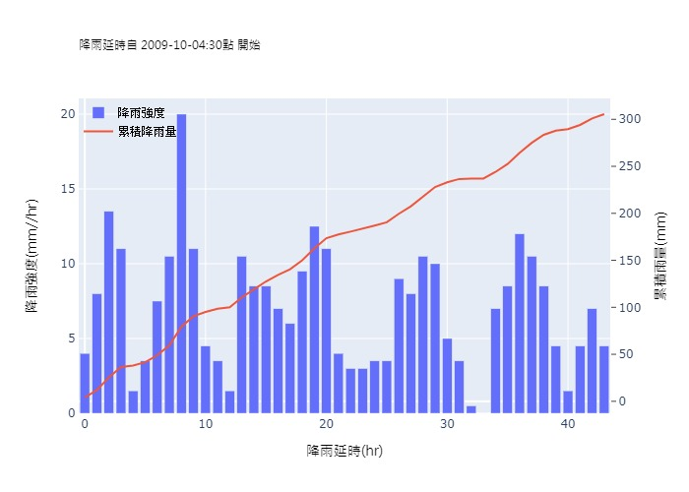
成果範例

Slide 19
可能會遇到的問題及解決方案
錯誤訊息：
ValueError:
The orca executable is required to export figures as static images,but it could not be found on the system path.
解決方案：將orca降級至1.2.1版
conda remove plotly plotly-orca
conda install -c plotly plotly-orca==1.2.1

