Slide 1
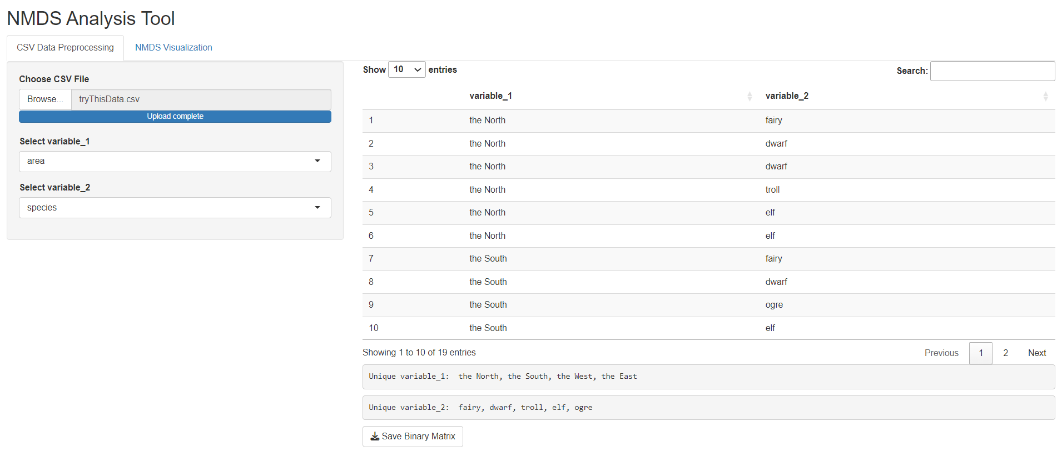
1. Choose the CSV file
2. Choose two variables
3. Check the file content
4. Download the binary file

Slide 2
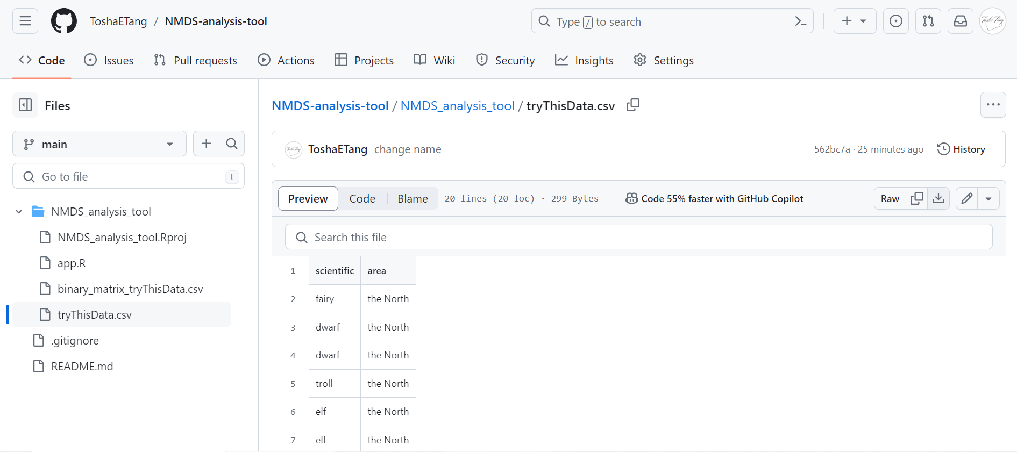
Download This File

Slide 3
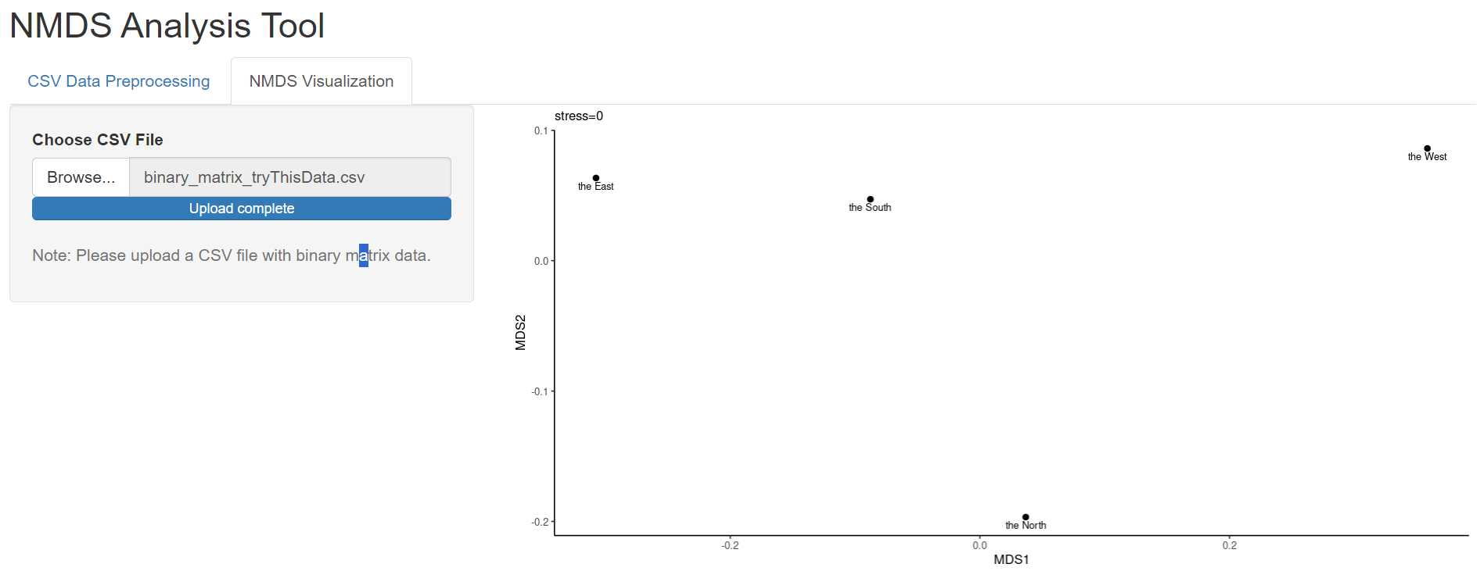
2. Check the NMDS result
1. Choose the CSV file

