Slide 1

Project Presentation
(For Topic Finalization)
An Autonomous AI Agent Capable of Creating, Testing and Integrating Its Own Tools
Group ID:05
Group Members:
Apurva Patil
Toshal Zambare
Sarthak Nalawade

Slide 2
Abstract
Most existing AI agents depend on predefined tools and APIs to interact with external systems. When an agent encounters an unsupported API, database, or external service, developers generally need to manually develop and integrate a new tool, which limits the autonomy and scalability of AI agents. This project proposes a Self-Forging AI Agent capable of dynamically creating, testing, repairing, and integrating its own tools at runtime with minimal human intervention. The framework uses a coding-capable Large Language Model (LLM) as its central intelligence. When an unsupported capability is required, the agent generates the necessary tool implementation, executes and validates it within a secure Docker sandbox, automatically attempts to repair detected errors, and registers the validated capability as a reusable tool through the Model Context Protocol (MCP). The newly created tool can subsequently be reused for future tasks, enabling the agent to progressively expand its functional capabilities. The proposed approach aims to reduce manual tool-development effort and improve the adaptability, scalability, and autonomy of AI agents operating across changing software environments.

Slide 3
Introduction
Modern AI agents powered by Large Language Models can reason about user requests and interact with external systems through tools, APIs, databases, and software services. However, these agents usually operate using a predefined collection of tools created by developers. If a required capability is unavailable, the agent may be unable to complete the task without additional human development and integration. A Self-Forging AI Agent extends the conventional tool-using paradigm by allowing an agent to dynamically construct new tools according to task requirements. Instead of only selecting an existing tool, the proposed system identifies missing capabilities, determines the required interface, generates executable code, validates it in an isolated environment, repairs failures, and registers successful implementations for future reuse. This creates a continuous cycle of reasoning, tool creation, verification, execution, and reuse, moving AI agents toward more adaptive and self-expanding systems.

Slide 4
Problem Statement
Current AI agent systems largely depend on fixed and predefined tool libraries to interact with APIs, databases, and external services. When an unsupported system or new capability is encountered, developers must manually design and integrate the required tools, increasing development effort and limiting agent adaptability. Although LLMs can dynamically generate code, such code may contain syntax, logical, interface, or runtime errors, making one-shot tool generation unreliable. Furthermore, dynamically generated tools must be safely tested and validated before execution, while many existing approaches create temporary task-specific scripts rather than persistent and reusable capabilities.
Therefore, there is a need for a self-forging AI agent that can autonomously identify missing capabilities, generate the required tools, securely test and repair them, and permanently integrate validated tools for reuse in future tasks with minimal human intervention.

Slide 5
Objectives
To identify whether the current tool library can satisfy a user's request.
To detect missing capabilities automatically.
To use an LLM to determine the functionality required from a new tool.
To dynamically generate executable Python tools.
To automatically construct appropriate tool interfaces and schemas.
To execute generated tools inside an isolated Docker sandbox.
To automatically detect syntax, runtime, and functional errors.
To implement a self-repair feedback loop for failed tools.
To validate generated tools using automated test cases.
To register successfully validated tools using MCP.
To maintain a persistent Tool Registry for future reuse.
To enable the agent's capabilities to expand progressively over time.

Slide 6
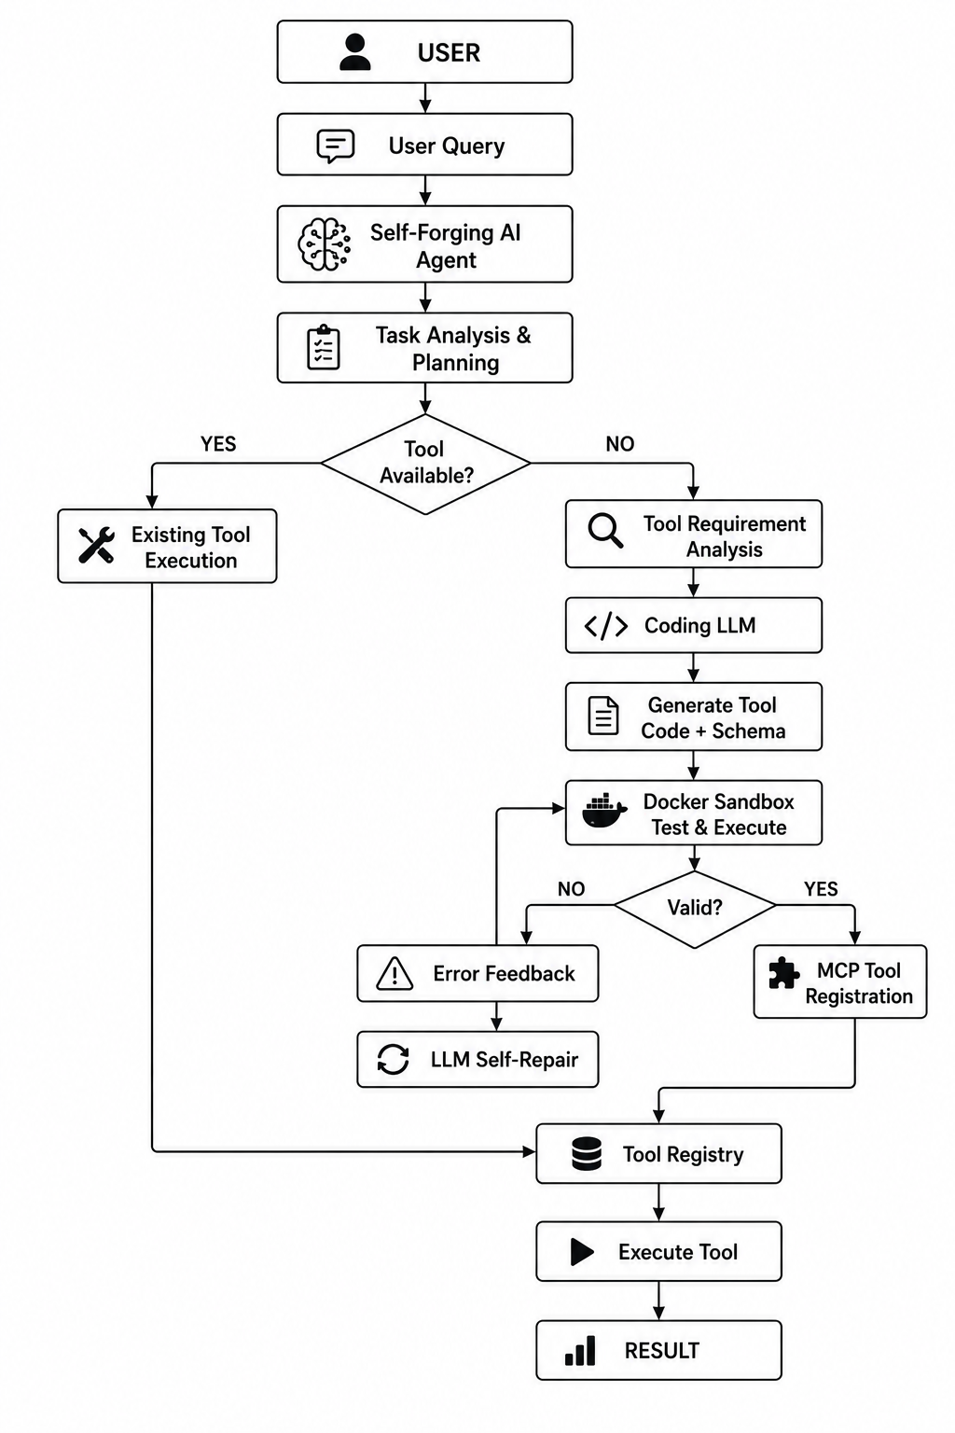
System Architecture

Slide 7
Requirements
Hardware | Software
Laptop/Desktop | Python
Ram 16GB | LangChain / LangGraph
Multi-core CPU | LLM APIs or Open-Source LLMs
GPU | SQLite / PostgreSQL , Git & GitHub

Slide 8
Expected Outcome
An AI agent capable of recognizing when a required tool is unavailable.
Automatic generation of new tool interfaces and executable code.
Secure testing of dynamically generated tools.
Automated detection and repair of tool failures.
MCP-based registration of validated tools.
Persistent storage and reuse of previously created capabilities.
Reduced dependence on manually developed integrations.
Improved adaptability to new APIs, databases, and software environments.
Creation of a continuously expanding tool ecosystem.
A practical prototype demonstrating self-expanding AI capabilities.

Slide 9
References:
[1] B. Xia et al., "Tool-Genesis: A Task-Driven Tool Creation Benchmark for Self-Evolving Language Agent," arXiv:2603.05578, 2026.
This paper introduces Tool-Genesis, a benchmark for evaluating language agents that can autonomously create, improve, and reuse software tools.
[2] T. Cai et al., "Large Language Models as Tool Makers," 2023.
The authors demonstrate that Large Language Models can generate executable software tools directly from natural language instructions.
[3] T. Schick et al., "Toolformer: Language Models Can Teach Themselves to Use Tools," 2023.
Toolformer enables language models to learn how to use external tools through self-supervised learning without requiring manual annotations.
[4] Y. Qin et al., "ToolLLM: Facilitating Large Language Models to Master 16000+ Real-World APIs," 2023.
ToolLLM provides a framework that allows language models to interact with more than 16,000 real-world APIs using intelligent retrieval.
[5] S. Yao et al., "ReAct: Synergizing Reasoning and Acting in Language Models," 2023.
ReAct combines logical reasoning with action execution, enabling language models to think before interacting with external tools or environments.

