Slide 1



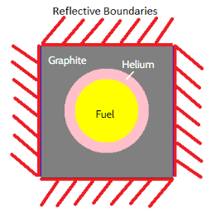
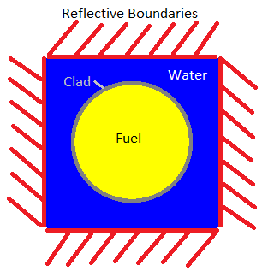
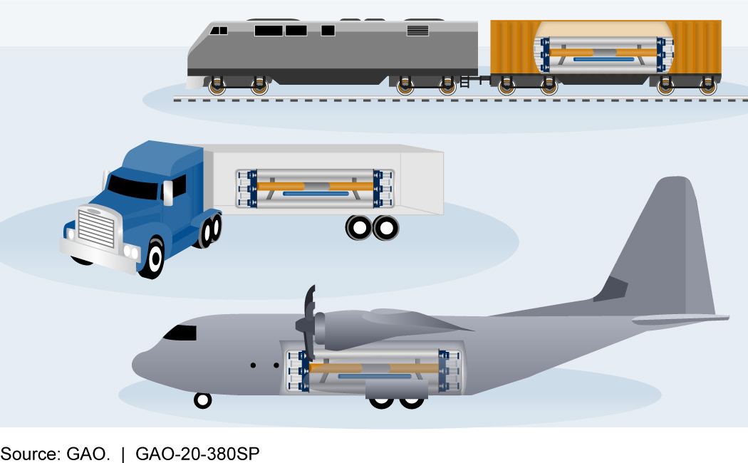
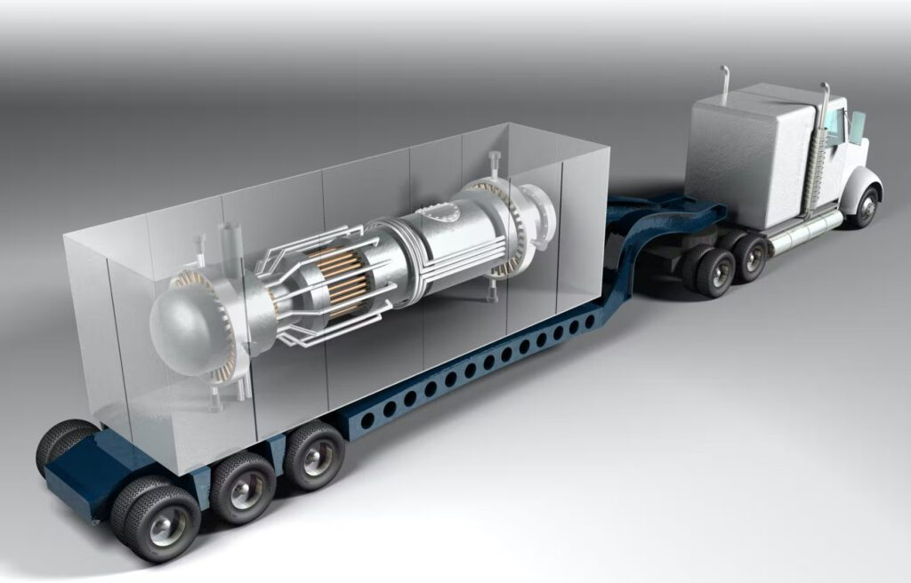
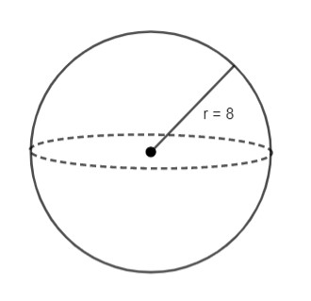


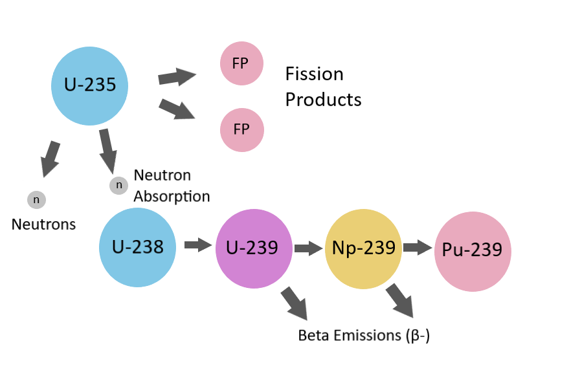
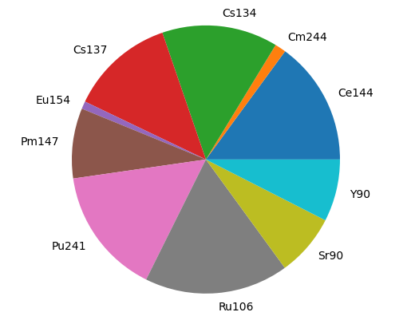

Capstone Poster Tips
Analysis of Proliferation Resistance of Nuclear Fuels for Microreactors
Midshipman 1/C Hitoshi J. Cullinan
CAPT Stu Blair, Department of Mechanical & Nuclear Engineering
Abstract
Methodology
Results
Conclusions
With the growing interest in microreactors for remote power applications, additional risks exist. As current events in Ukraine have demonstrated, it is imperative to ensure that nuclear fuel used in these reactors would not be a major proliferation risk in the event an ill-intended group were to take control of the reactor or fuel. By evaluating core concepts for proliferation resistance, prospective microreactor fuels can be compared for proliferation risk.
Models Used
Spent fuel from the Project Pele core concept has some benefits and drawbacks compared to standard commercial PWR LEU spent fuel.
Negatives: The Project Pele concept has a lower BCM compared to the PWR LEU concept.
Positives: The Project Pele concept requires a much greater net weight. The processing required would also be more complex.
“OpenMC is a community-developed Monte Carlo neutron and photon transport simulation code.”
Identify
Identify core concept of interest
Model basis used for Project Pele reactor
Fuel: HALEU TRISO compact with a 30% packing factor
Moderator: Graphite
Power Density: 20.0 W/gHM
Cycle Length: 4.5 years at full power followed by 2 years at 0 W/gHM for cooldown period
Background
Model basis used for LEU PWR
Fuel: LEU UO₂
Moderator: Light Water
Power Density: 30.5 W/gHM
Cycle Length: 4.5 years at full power followed by 2 years at 0 W/gHM for cooldown period
Future Work
Model
Build core model with OpenMC
Generally nuclear fuel is a poor candidate for nuclear weapons; however, with access to a microreactor, the fuel could be irradiated in such a way to become useful in a nuclear explosive device. Project Pele is a current DoD effort to build a portable microreactor. The core concept should be evaluated for its material attractiveness for use in nuclear weapons in order to ensure global safety.
Deplete
An analysis of the heat content can be conducted in order to determine the energy associated with each burned fuel and thermal energy mitigation required for handling
Using this methodology, future work can be done to analyze other microreactor core concepts in order to compare them.
Run depletion calculation of fuel using the model
Bare Critical Mass (BCM)
Project Pele in various modes of transport
Extract
Separate the isotopes of interest from depleted fuel
BCM Results from Irradiated Fuel
Pu Material | %Pu-239 | BCM (kg)
Irradiated Project Pele Fuel | 83.03% | 11.228
Irradiated LEU PWR Fuel | 48.56% | 14.380
BCM
References
Calculate radius of a bare critical sphere of extracted material
Project Pele on semi truck
DoE materials used to compare spent fuel BCMs to US plutonium grades.
Department of Defense, “DoD to Build Project Pele Mobile Microreactor and Perform Demonstration at Idaho National Laboratory,” (2022).
Eva Lisowski, “Evaluation of Material Attractiveness to Non-state Actors of Various Nuclear Materials in Thorium Fuel Cycles,” Massachusetts Institute of Technology, (2020).
Hitoshi Cullinan, “Proliferation_Research,” Github Repository, (2023). https://github.com/Toshi-23/Proliferation_Research
Paul K. Romano, Nicholas E. Horelik, Bryan R. Herman, Adam G. Nelson, Benoit Forget, and Kord Smith, “OpenMC: A State-of-the-Art Monte Carlo Code for Research and Development,” Ann. Nucl. Energy, 82, 90–97 (2015).
Factors identified for analysis of material attractiveness.
Bare Critical Mass (BCM)
Heat Content
Net Weight
Dose Rate
Processing Time and Complexity
Acquisition time
Net Weight
Calculate spent fuel needed to create one BCM
BCM Results for DoE Characterized Materials
Pu Material | %Pu-239 | BCM (kg)
Weapons Grade | 93.52% | 10.470
Fuel Grade | 86.15% | 11.126
Power Grade | 62.51% | 12.841
Dose Rate
Calculate dose rate of net weight using OpenMC
Net Weight
What is Depletion?
Depletion occurs when the nuclear fuel in a reactor fissions and transmutes to other elements, changing the atomic composition of the fuel.
Below is a diagram depicting a fission reaction in U-235.
Fuel burnup calculation results
Net Weight of spent fuel needed for one BCM
Project Pele Net Weight | LEU PWR Net Weight
5447 kg | 1223 kg
?
Isotopic composition of all Pu isotopes for radius search
Follow this link to see full project code implementation on my Github repository.
Dose Rate
Critical mass of bare Pu sphere
Bare sphere with variable radius to find criticality
Activity from fuel used to calculate a photon dose rate at 1m from source.
Estimated using OpenMC based on composition and net weight for spent fuel
OpenMC has an Application Programing Interface (API) for use in Python. Code is written in python and then converted to XML files by the API and run by OpenMC. The results are able to be manipulated using python tools such as numpy, matplotlib, and other python libraries.
Acknowledgements
Activity (Bq) of major isotopes present in irradiated LEU PWR fuel.
The Advance Research Computing Support for the use of Calypso.
CAPT Stu Blair for his patience, dedication, and encouragement in my pursuit of knowledge.
Project Pele irradiated fuel dose rate | LEU PWR irradiated fuel dose rate
0.7 rem/hr | 20.7 rem/hr

