Slide 1
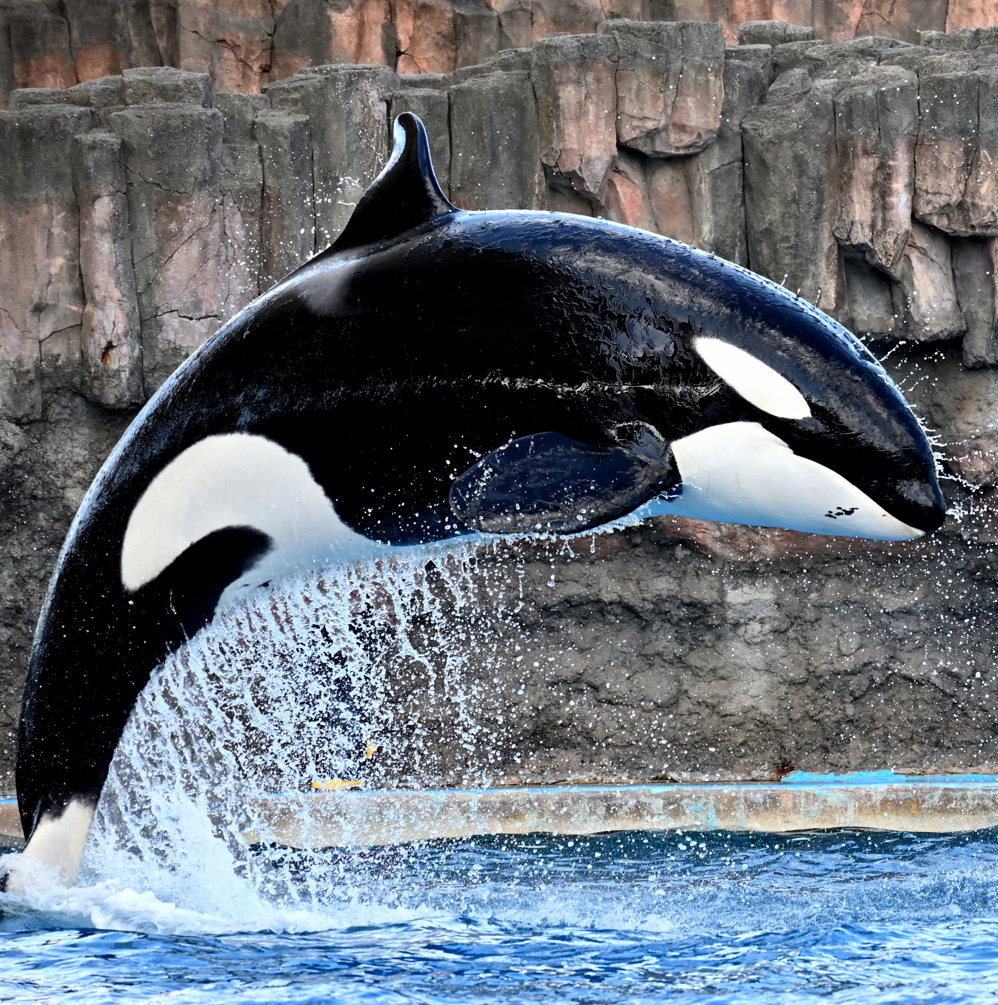
JANUARY 2026

