Slide 1

AI DEPLOYMENT & AUTOMATION
IILM UNIVERSITY
GREATER NOIDA
Industry-oriented learning in production AI, deployment, automation and MLOps
SUMMER
INTERNSHIP
STUDENT NAME
ENROLLMENT NUMBER
TOSHI PANDEY
2410030422
2026 • 8 WEEKS
PROGRAM & SEMESTER
SECTION
B.Tech CSE • 5th Semester
3CSE3
AICTE – EduSkills Virtual Internship Program
ORGANIZATION
INTERNSHIP DOMAIN
EduSkills Foundation
AI Deployment & Automation
Internship period: June 2026 – August 2026
Presented to the School of Computer Science and Engineering

Slide 2
Internship Overview
What the AICTE – EduSkills program covered
Program
Domain
Outcome
8-week virtual internship with week-wise learning, assessments, project documentation and a final assessment test.
AI Deployment & Automation — from model serving and containers to cloud, agents, observability and RAG.
Successful completion of the internship requirements and award of the internship credential.
Core idea
Production AI is more than a model: it is a lifecycle of APIs, containers, CI/CD, cloud runtime, security, monitoring, optimization and continuous improvement.
FastAPI
Docker
CI/CD
Cloud AI
Agents
Kubernetes
RAG
Source: Official EduSkills Internship Offer Letter and Course/Internship Certificate.

Slide 3
Organization & Program Context
EduSkills Foundation
Application & Selection
Offer letter / verification
AICTE – EduSkills Virtual Internship
The internship was designed as a structured, industry-oriented learning journey with practical exposure, assessments and project-based learning.
8-Week Learning
Week-wise technical modules
Assignments & Assessments
Progress tracked through the program
Final Assessment
Final-week assessment test
JUNE 2026 – AUGUST 2026
Credential
Completion certificate after requirements
Source: Offer letter states the program was an 8-week AICTE – EduSkills Virtual Internship and specifies the internship duration as June 2026–August 2026.

Slide 4
Objectives of the Internship
1
Understand the AI deployment lifecycle
2
Build production-oriented API skills
From development and validation to serving and operations.
Use FastAPI to expose model or AI functionality.
3
Automate delivery
4
Explore cloud AI
Apply Docker, MLOps and CI/CD concepts.
Study managed AI deployment platforms and serving patterns.
5
Develop agentic workflows
6
Operate AI responsibly
Use LangChain, LlamaIndex and LangGraph concepts.
Cover security, privacy, observability, drift and optimization.
Derived from the official 8-week learning structure and the competencies listed on the completion certificate.

Slide 5
8-Week Learning Roadmap
The official weekly module structure
01
AI Deployment Foundations
02
Containerization & CI/CD
FastAPI model serving • production readiness
Docker • MLOps • pipeline automation
03
Cloud AI & GenAI Serving
04
AI Agents & Automation
SageMaker • Vertex AI • Azure ML • vLLM
LangChain • LlamaIndex • LangGraph
05
AI Integration & Security
06
Kubernetes & Observability
Streamlit • Gradio • privacy • bias
Pods • Deployments • Services • Prometheus • Grafana
07
Optimization, Drift & RAG
08
Applied AI & Capstone
Cost • tuning • Evidently AI • advanced RAG
RAG app • business automation • end-to-end AI
Source: Week-wise structure reproduced from the official EduSkills internship offer letter.

Slide 6
AI Deployment Lifecycle
From code and model artifacts to a monitored service
1
2
3
4
5
6
7
Develop
Serve
Package
Automate
Deploy
Observe
Improve
Model / app
FastAPI
Docker
CI/CD
Cloud / K8s
Metrics / logs
Tune / retrain
Why automation matters
Why observability matters
Why optimization matters
Repeatable builds, fewer manual errors, faster releases and consistent environments.
Health checks, metrics and logs help detect failures and understand runtime behaviour.
AI systems evolve through tuning, cost management, drift detection and retraining.
Architecture shown as a synthesized representation of the concepts covered across the official internship modules.

Slide 7
FastAPI Model Serving
Week 1 • turning AI logic into an application service
FastAPI Service
AI Model
Response
Client
• API endpoint
• Input validation
• Async operations
• Model integration
Inference / prediction / generation
JSON / result / output
Request
Key learning
An AI model becomes useful to other systems when it can be consumed reliably through an application interface.
Source: Week 1 official module — AI Deployment Foundations & FastAPI Model Serving.

Slide 8
Docker + CI/CD for MLOps
Week 2 • reproducible packaging and automated delivery
SOURCE
BUILD
TEST
PUBLISH
DEPLOY
Git / code
Dockerfile → Image
Validation / tests
Container registry
Runtime / service
Docker
CI/CD
Containers package application code and dependencies into a portable runtime, helping reduce environment inconsistency.
Automated pipelines validate changes, build artifacts and support repeatable delivery of AI applications.
REPEATABLE
PORTABLE
AUTOMATED
CONSISTENT
Source: Week 2 official module — Containerization & CI/CD for MLOps.

Slide 9
Cloud AI Deployment & Generative AI
Week 3 • scalable serving and LLM considerations
Amazon SageMaker
Google Vertex AI
Azure Machine Learning
Managed AI/ML deployment
Managed AI/ML deployment
Managed AI/ML deployment
Generative AI serving considerations
1
LLM resource requirements
2
Latency & throughput
3
vLLM serving
4
Model quantization
Key takeaway
Cloud deployment choices and efficient serving techniques become critical when AI workloads grow in size or complexity.
Source: Week 3 official module — Cloud AI Deployment & Generative AI Serving.

Slide 10
AI Agents & Automation Workflows
Week 4 • moving from answers to actions
INPUT
AGENT
TOOLS
ORCHESTRATE
ACTION
User / event
Reason + plan
APIs / systems
LangGraph
Business outcome
LangChain
LlamaIndex
LangGraph
Framework concepts for building AI agents and tool-using workflows.
Connect models and agents with external data and knowledge sources.
Structured orchestration for multi-step agent workflows.
Business automation lens
The internship connected agentic AI with hyper-automation — using models, tools and orchestration to support repeatable business processes.
Source: Week 4 official module — AI Agents & Automation Workflows.

Slide 11
AI Integration, Security & Compliance
Week 5 • connecting AI to users responsibly
Web / App Integration
Security
Responsible AI
Streamlit and Gradio-style interfaces can turn AI services into accessible application experiences.
Protect endpoints, credentials, model access and connected tools.
Consider privacy, compliance, threat handling and bias mitigation.
PRIVACY
ACCESS
SAFETY
BIAS
Data handling
Auth / control
Threat awareness
Mitigation
Source: Week 5 official module — AI Integration, Security & Compliance.

Slide 12
Kubernetes & Observability
Week 6 • running AI services in production environments
KUBERNETES CLUSTER
Prometheus
Metrics and monitoring data for deployed services.
POD
DEPLOYMENT
AI API
Replica set
Grafana
Dashboards and visualization for operational visibility.
SERVICE
POD
Traffic
Worker
Operational lesson
A production AI system must be observed, not only deployed.
Source: Week 6 official module — Kubernetes & Observability in Production AI.

Slide 13
Performance, Drift & Advanced RAG
Week 7 • keeping AI systems accurate, efficient and useful
PERFORMANCE
COST
DRIFT
RETRAIN
RAG
Tune model behaviour
Optimize cloud usage
Detect data changes
Refresh models
Retrieve relevant context
RAG architecture
User Query
Retrieval
Context
LLM
Response
Question
Vector search
Relevant chunks
Grounded generation
Useful answer
Evidently AI was covered for model drift detection; LlamaIndex and vector-database integrations were covered for advanced RAG.
Source: Week 7 official module — Performance Optimization, Drift & Advanced RAG.

Slide 14
Applied AI & Capstone Projects
Week 8 • bringing the learning together
Full-Stack RAG Application
AI Agent for Business Automation
End-to-End AI Solution
FastAPI backend + frontend
• Retrieval-augmented generation
• Knowledge-grounded responses
• End-to-end application flow
Agent + tools + orchestration
• Multi-step workflows
• Automation of business tasks
• Structured agent execution
From model development to operation
• API deployment
• Monitoring
• Scaling
End-to-end perspective
The capstone stage connected model development, API serving, deployment, automation, monitoring and scaling into a single production-oriented solution mindset.
E-commerce case study
Healthcare case study
FastAPI backend
AI agent automation
Source: Week 8 official module and competencies listed on the completion certificate.

Slide 15
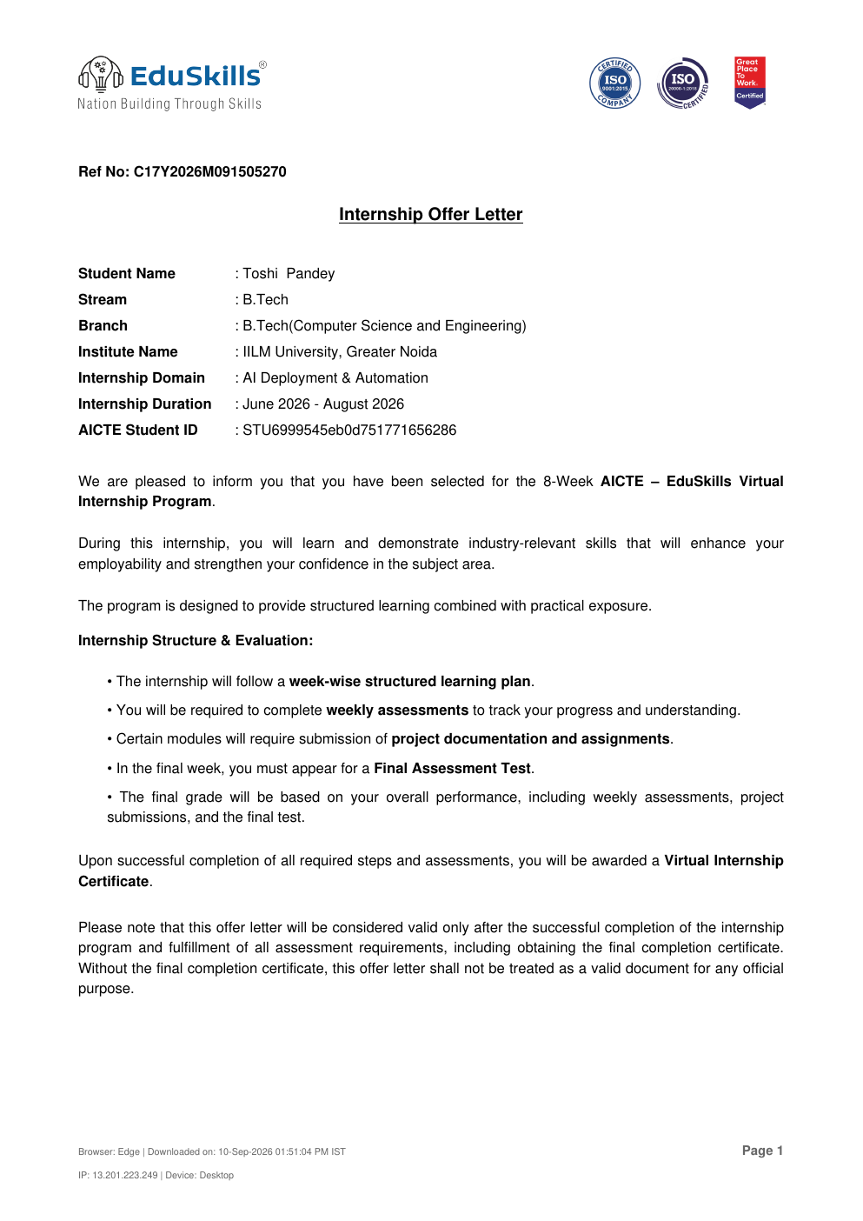
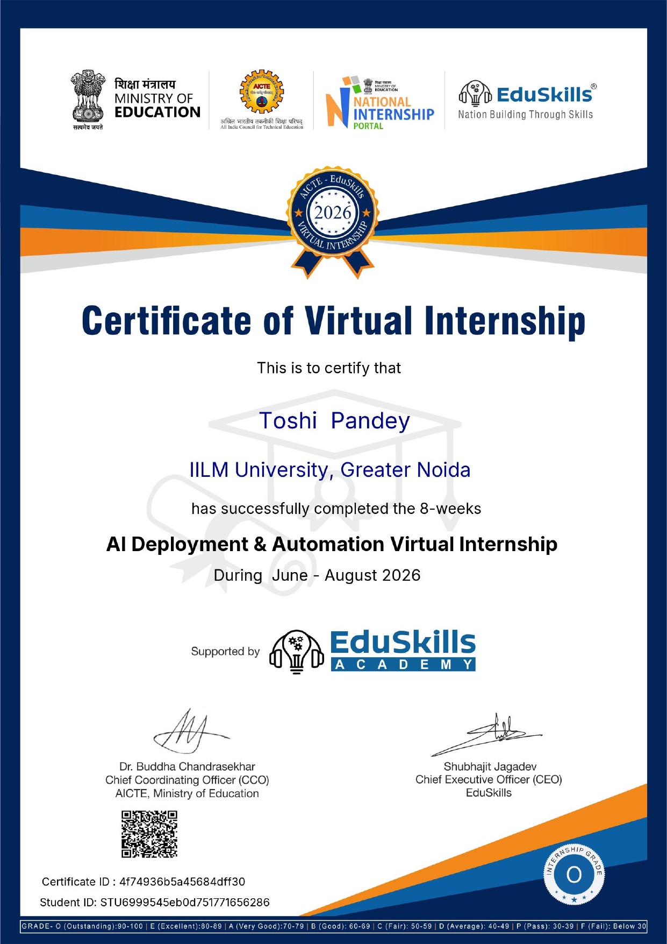
Official Internship Documents
Evidence of selection and successful completion
Offer Letter
Certificate of Completion
Offer letter: Ref. C17Y2026M091505270 • June–August 2026
Completion certificate: Issued 10 Sep 2026 • Certificate ID 2026-D1DDA7AB3A

