Slide 1

Sentiment Analysis of Hospital Feedback
Summer Internship Project 2022
for
Maharaja Surajmal Institute of Technology
Toshin Ghosh
CSE-3
14215002720
5th Sem

Slide 2
Contents
About company
Why this project?
What is sentiment analysis?
Software and dataset used
Result
Future scope
Other projects undertaken
Certificate

Slide 3

Quality Council of India
Quality Council of India (QCI) was established as a National body for Accreditation on recommendations of Expert Mission of EU after consultations in Inter-ministerial Task Force, Committee of Secretaries and Group of Ministers through a Cabinet decision in 1996.
QCI has been established to create a mechanism for independent third party assessment of products, services and processes. It plays a pivotal role at the national level in propagating, adoption and adherence to quality standards in all important spheres of activities including education, healthcare, environment protection, governance, social sectors, infrastructure sector and such other areas of organized activities that have significant bearing in improving the quality of life and wellbeing of the citizens of India.

Slide 4
Need for the Project
Assessment on various hospitals is done for their accreditation.
It is very important for these assessment to be fair and done in a proper manner.
This can be monitored through feedback on the assessments provided by the hospital staff.
However, since the feedback data is massive, it becomes a tedious task to find out the areas with bad assessment experience.
This is where this project comes to play

Slide 5
Objective
The main objective is to minimize the work required to find out the places where the assessments have been done poorly and the problems faced during the assessment process.

Slide 6
Procedure
The goal can be achieved through sentiment analysis.
By labelling the different feedback comments as positive, neutral and negative we divide the large data in groups.
Now, we can simply focus on the negative ones and understand the problems faced.

Slide 7

What is Sentiment Analysis?
Sentiment Analysis is a field of Natural Language Processing (NLP) that builds models that try to identify and classify attributes of the expression e.g.:
Polarity: if the speaker expresses a positive or negative opinion,
Subject: the thing that is being talked about,
Opinion holder: the person, or entity that expresses the opinion.

Slide 8
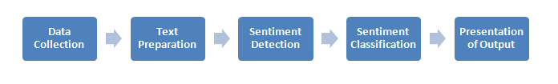
Process of Sentiment Analysis
There are 5 steps to analyse sentiment data and here’s the graphical representation of the methodology to do the same.

Slide 9
Software Used
The project was created solely on jupyter notebook using python language.
Python libraries used :
Pandas
NLTK
Numpy
re

Slide 10
Dataset Used
The actual data on which I worked on had information which I am not allowed to disclose.
Thus, I have used a different dataset for the project which only has the feedback, comments and serializing as rows.

Slide 11
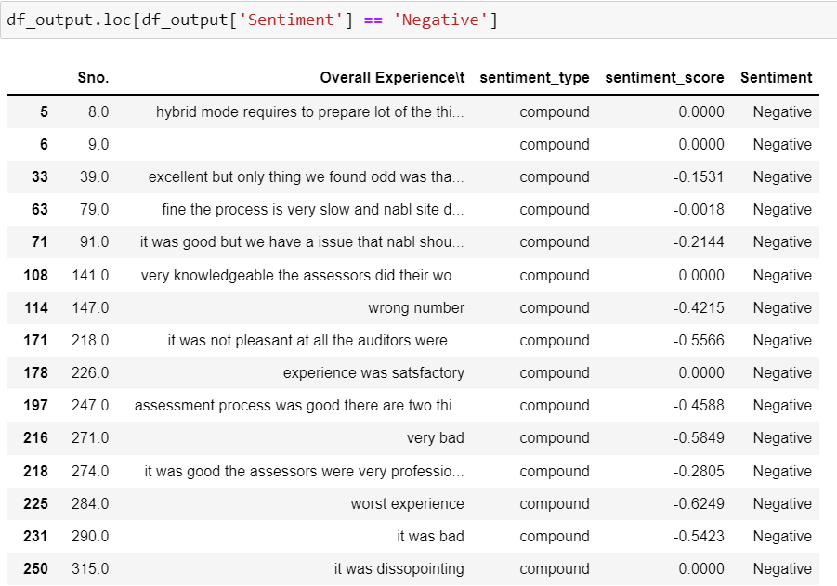
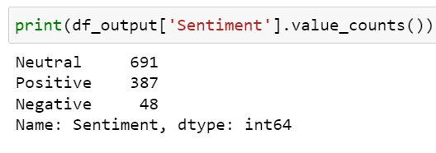
Result
From the code output snippet it can be seen that the sentiment analysis done is quite accurate

Slide 12
Future Scope
The sentiments acquired on given dataset can be used to train model which can further classify new statements as positive, neutral or negative.

Slide 13
Other Projects Created during Internship
An image classification model to differentiate between clean and unhygienic laboratories.
Exploratory Data Analysis on multiple datasets

Slide 14
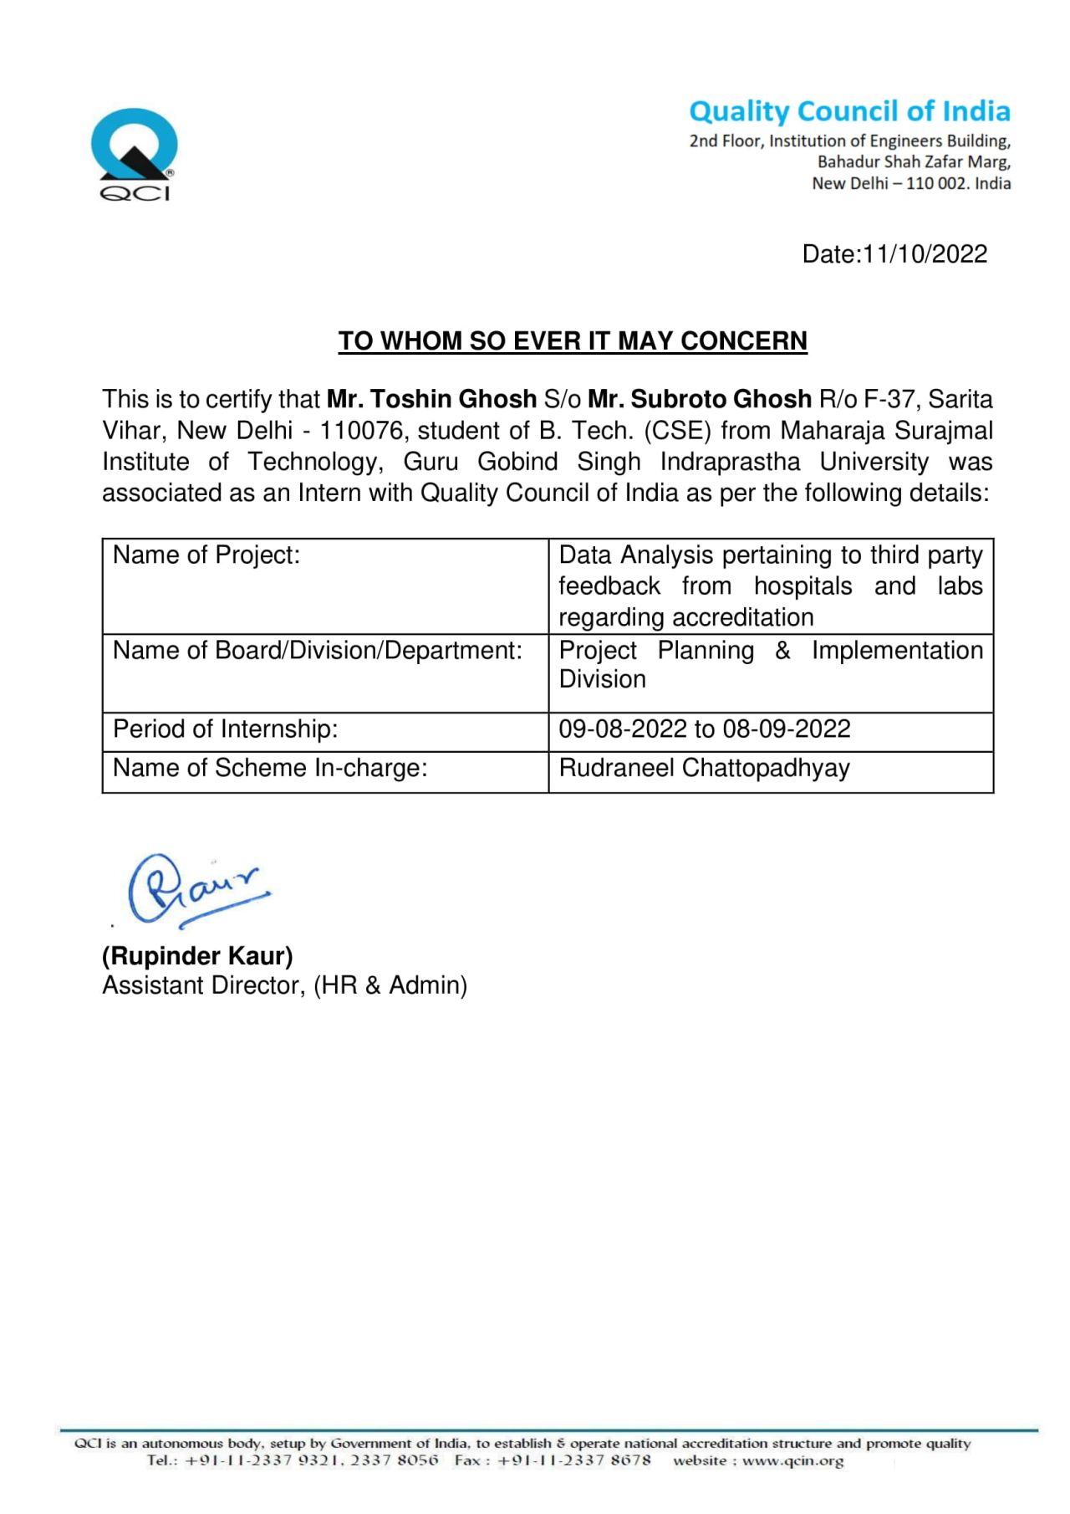
Certificate of Internship

Slide 15
THANK YOU

