Slide 1







MULTI-DB ADAPTER

Slide 2
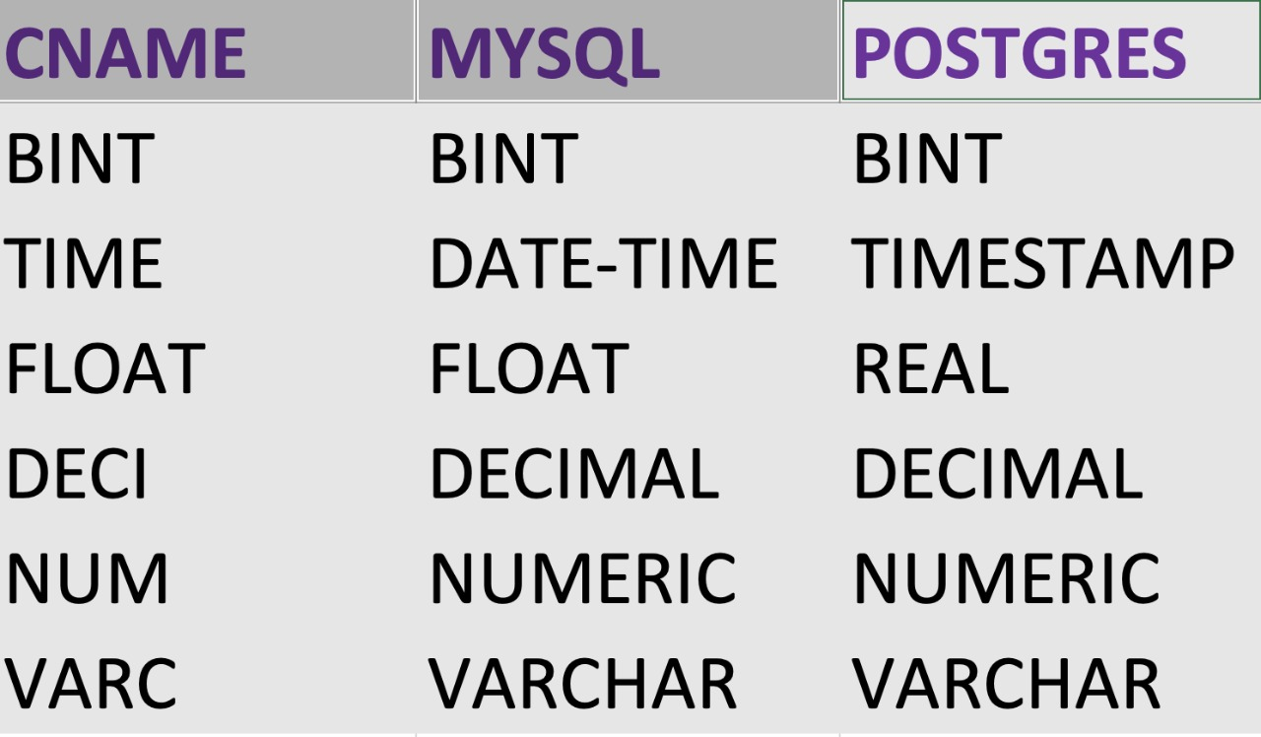
EXTRACTION OF DATATYPES
Defining common datatypes based on two different DataBases.

Slide 3
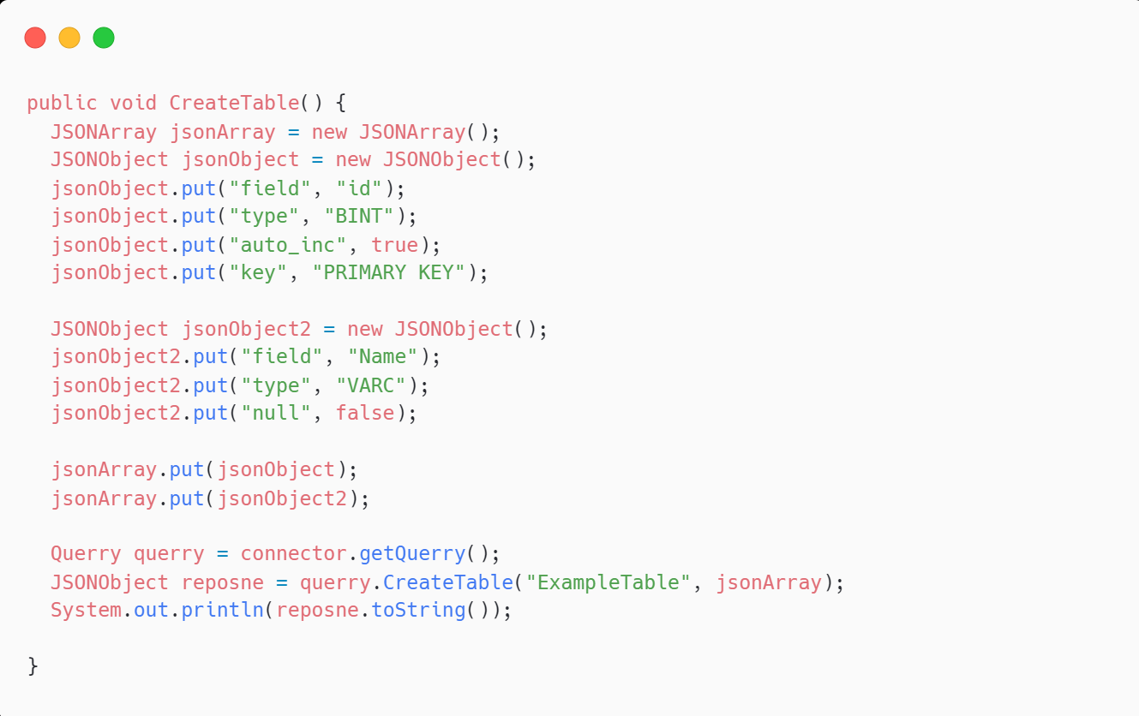
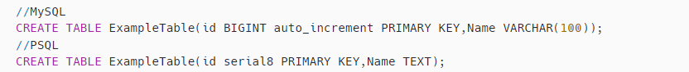
Query - Create Table

Slide 4
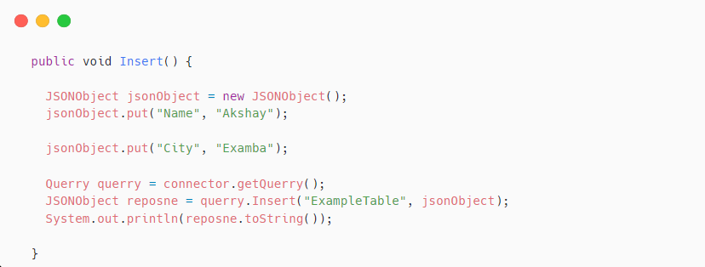
Query - Insert into Table

Slide 5
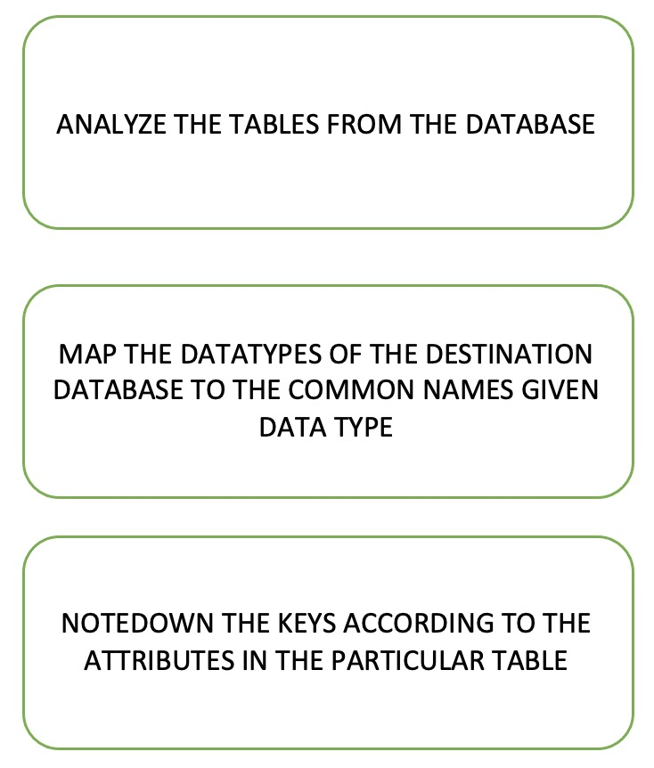
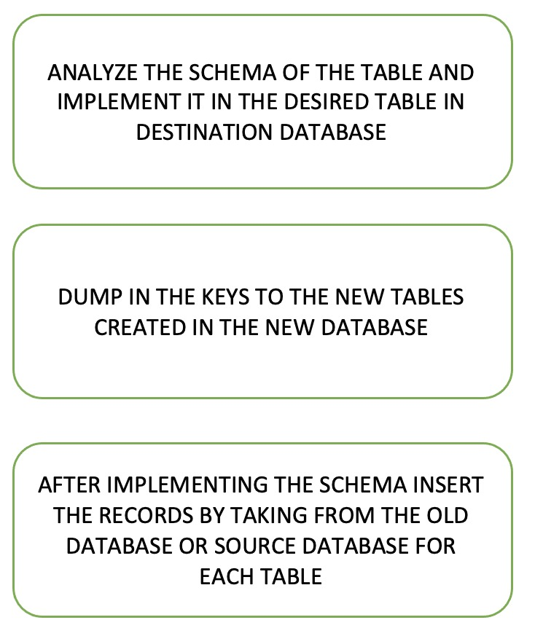
PROCESS OF DATA MIGRATION

