Slide 2
Oracle PL/SQL
iSQLplus: http://uadoem02.uad.ac.uk:5560/isqlplus.
TRIGGERS

Slide 3
What is a trigger?
A block of code that is attached to an event. When that event occurs the trigger code is fired.
A stored block with [Declare], Begin, End.
Associated with a database table or action
Fires automatically when certain DML action is carried out on the table
Before or after an event
Change may be INSERT, DELETE, UPDATE
Do we want to perform on multiple rows?
If not, then Statement level trigger fires once only
If so, then Row level trigger fires for each affected row

Slide 4
Trigger Uses
Auditing
Write information about (sensitive) data modifications to an audit table
May include old and new values, user, timestamp
E.g. new and old salary
Data Integrity
Implement checks on data against business rules
Can compare with live database values
NEW and OLD values can be compared
E.g. prices must not go down

Slide 5
Trigger Uses
Referential integrity
Allows implementation of a "cascade update"
E.g. if author ID (aID) is changed, appropriately change authID in foreign key
Derived data
Update any stored derived data when base data changes
E.g. if total number of employees is stored, add 1 if new employee added

Slide 6
Trigger Uses
Security
Logging of database access
E.g. date and time each user logs on
E.g. deny access at weekend
Maintaining synchronous replicates
In a distributed database
Generating statistics on table access

Slide 7
How Triggers Are Used
You can also use triggers to:
Automatically generate derived column values
Prevent invalid transactions
Enforce complex security authorizations
Enforce referential integrity across nodes in a distributed database
Enforce complex business rules
Provide transparent event logging
Provide auditing
Maintain synchronous table replicates
Gather statistics on table access
Modify table data when DML statements are issued against views
Publish information about database events, user events, and SQL statements to subscribing applications

Slide 8
Parts of Trigger
A triggering event or statement
A trigger restriction
A trigger action

Slide 9
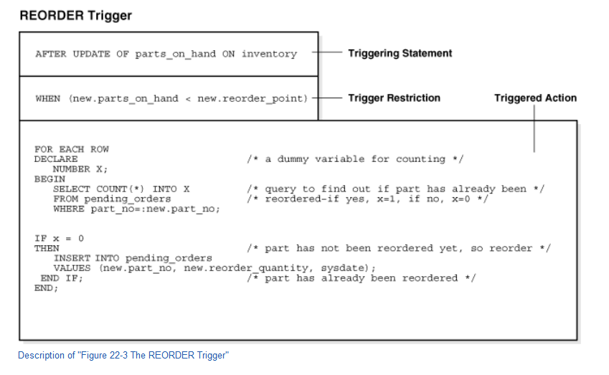

Slide 10
The Triggering Event or Statement
A triggering event or statement is the SQL statement, database event, or user event that causes a trigger to fire. A triggering event can be one or more of the following:
An INSERT, UPDATE, or DELETE statement on a specific table (or view, in some cases)
A CREATE, ALTER, or DROP statement on any schema object
A database startup or instance shutdown
A specific error message or any error message
A user logon or logoff

Slide 11
Triggering event or statement
e.g. UPDATE OF parts_on_hand ON inventory
This statement means that when the parts_on_hand column of a row in the inventory table is updated, fire the trigger.
When the triggering event is an UPDATE statement, you can include a column list to identify which columns must be updated to fire the trigger.
You cannot specify a column list for INSERT and DELETE statements, because they affect entire rows of information.

Slide 12
Trigger Restriction
A trigger restriction specifies a Boolean expression that must be true for the trigger to fire.
The trigger action is not run if the trigger restriction evaluates to false or unknown. In the example, the trigger restriction is:
new.parts_on_hand < new.reorder_point
Consequently, the trigger does not fire unless the number of available parts is less than a present reorder amount.

Slide 13
Trigger Action
A trigger action is the procedure (PL/SQL block, Java program) that contains the SQL statements and code to be run when the following events occur:
A triggering statement is issued.
The trigger restriction evaluates to true.
Like stored procedures, a trigger action can:
Contain SQL, PL/SQL, or Java statements
Define PL/SQL language constructs such as variables, constants, cursors, exceptions
Define Java language constructs
Call stored procedures
If the triggers are row triggers, the statements in a trigger action have access to column values of the row being processed by the trigger. Correlation names provide access to the old and new values for each column.

Slide 14
Types of Triggers
Row Triggers and Statement Triggers
BEFORE and AFTER Triggers

Slide 15
Row Triggers and Statement Triggers
When you define a trigger, you can specify the number of times the trigger action is to be run:
Once for every row affected by the triggering statement, such as a trigger fired by an UPDATE statement that updates many rows
Once for the triggering statement, no matter how many rows it affects

Slide 16
Row Triggers
A row trigger is fired each time the table is affected by the triggering statement.
For example, if an UPDATE statement updates multiple rows of a table, a row trigger is fired once for each row affected by the UPDATE statement.
If a triggering statement affects no rows, a row trigger is not run.
Row triggers are useful if the code in the trigger action depends on data provided by the triggering statement or rows that are affected.

Slide 17
Statement Triggers
A statement trigger is fired once on behalf of the triggering statement, regardless of the number of rows in the table that the triggering statement affects, even if no rows are affected.
For example, if a DELETE statement deletes several rows from a table, a statement-level DELETE trigger is fired only once.
Statement triggers are useful if the code in the trigger action does not depend on the data provided by the triggering statement or the rows affected. For example, use a statement trigger to:
Make a complex security check on the current time or user
Generate a single audit record

Slide 18
BEFORE and AFTER Triggers
When defining a trigger, you can specify the trigger timing—whether the trigger action is to be run before or after the triggering statement.
BEFORE and AFTER apply to both statement and row triggers.
BEFORE and AFTER triggers fired by DML statements can be defined only on tables, not on views.
However, triggers on the base tables of a view are fired if an INSERT, UPDATE, or DELETE statement is issued against the view.
BEFORE and AFTER triggers fired by DDL statements can be defined only on the database or a schema, not on particular tables.

Slide 19
BEFORE Triggers
BEFORE triggers run the trigger action before the triggering statement is run. This type of trigger is commonly used in the following situations:
When the trigger action determines whether the triggering statement should be allowed to complete. Using a BEFORE trigger for this purpose, you can eliminate unnecessary processing of the triggering statement and its eventual rollback in cases where an exception is raised in the trigger action.
To derive specific column values before completing a triggering INSERT or UPDATE statement.

Slide 20
AFTER Triggers
AFTER triggers run the trigger action after the triggering statement is run.

